Slide 1
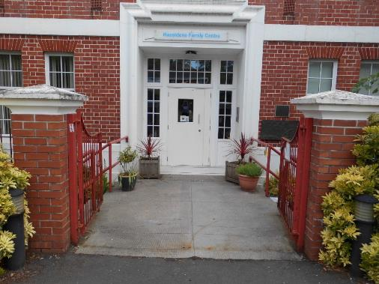
Staying Healthy at Hazeldene Family Centre
We are going to nursery. You will be excited to see your teachers, friends and play in the playrooms and the garden.
At Hazeldene there will be some things that are new and a bit different

Slide 2
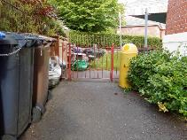
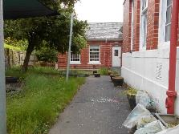
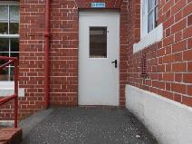
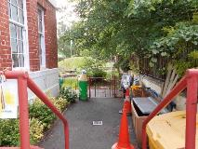
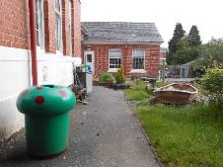
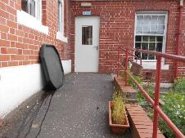
You may need to wait a little while and need to stand apart from each other
You can look for the hearts while you are waiting.
You can say bye to your mummy/adult at the gate and one of the teachers will take you to the playroom.
Rowan Room
Oak
Room

Slide 3
The first thing we do when we go in is wash our hands or use hand sanitiser.
This helps everyone stay safe and healthy

Slide 4
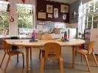
We will wash our hands more times in the day.
We will still wash after using the toilet and before and after we eat.
We will wash our hands after playing in the garden
We will wash our hands after playing with toys and after playing with something messy

Slide 5
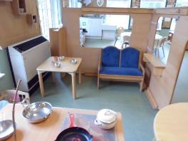
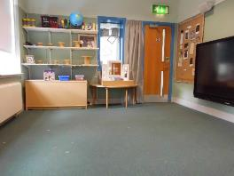
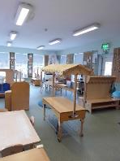
You will be playing in small groups.
We will not be moving between the playrooms and the opposite garden.
There are less things to play with in the playrooms but still plenty to do.
This helps the germs from spreading

Slide 6
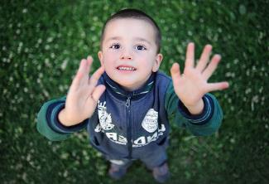
Hugging and touching our friends and teachers might spread germs.
We can do other things to show our friends and teachers how much we care about them. There are some ideas in the story below.
https://www.youtube.com/watch?v=2PnnFrPaRgY

Slide 7
I notice that my day has some new routines. This new way brings up lots of different feelings for me.
I might even feel different emotions too.
It’s ok for me to feel this way.

Slide 8
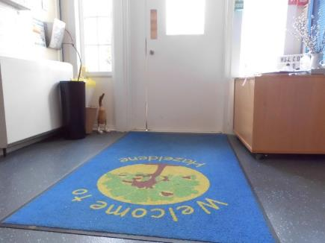
When it is time to go home I will go with a teacher to the front door to meet my family and tell them about the fun I had.

