Slide 1
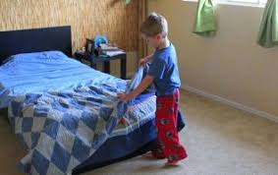
Challenge of the week
Let’s see if you can be a super helper!
This week we have set the challenge of “Making your own bed”
Help take off your old sheets from your bed, duvet and pillow.
Carry your bed sheets to your washing machine and the adult will carefully add the washing powder or capsule (talk to your child about why they should not touch these). Select the correct setting. Talk about what numbers and letters you can see, are there any letters from your name?
When your washing cycle is finished, help to carry out the washing to hang up. Maybe you could have a lower line to hang small items outside using pegs. (Encourage your child to clip the pegs on (this will help develop your child’s pincer grasp). Count how many pegs you had to use.
Once the washing is dry, you can then make your bed. Make sure to hold the corners of your duvet, stretch the bed sheet to reach the other end of your bed and slide your pillow into your pillow case.
Don’t forget to put your special teddy or blanket on top of your bed!

