Slide 1
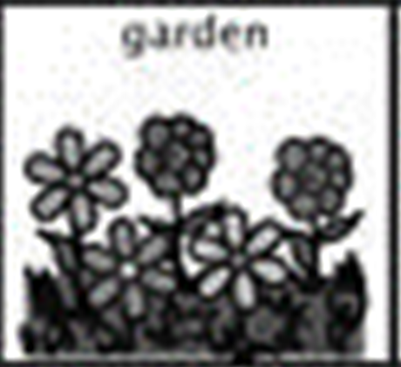
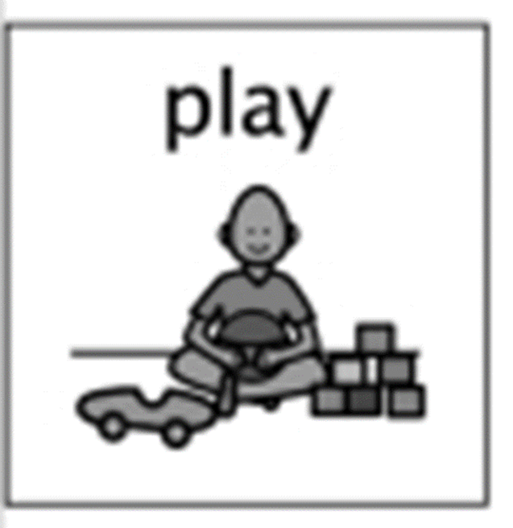
Exploring Patterns
Week beginning 25th May 2020 KBM

Slide 2
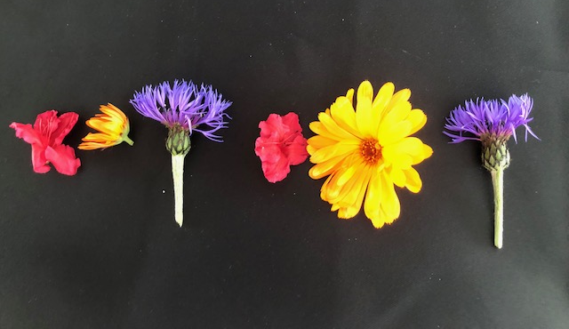
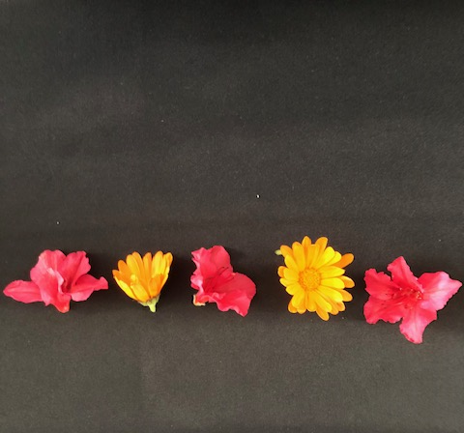
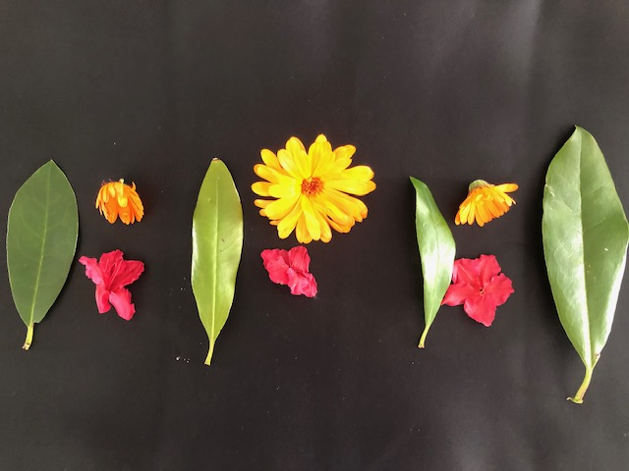
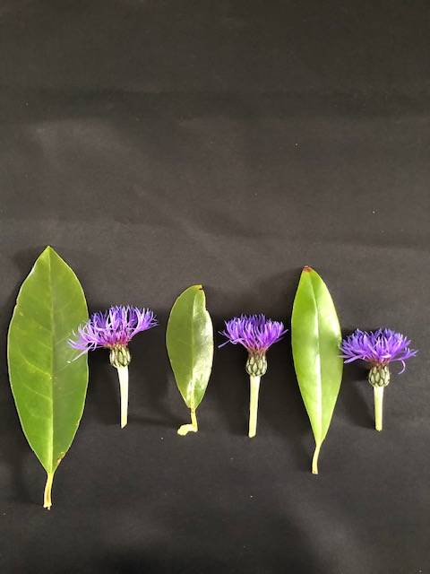
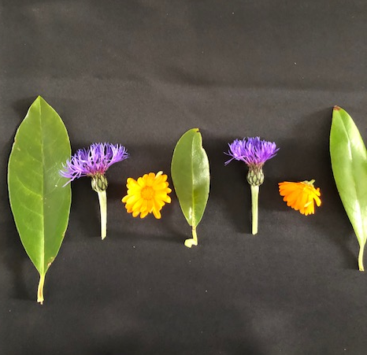
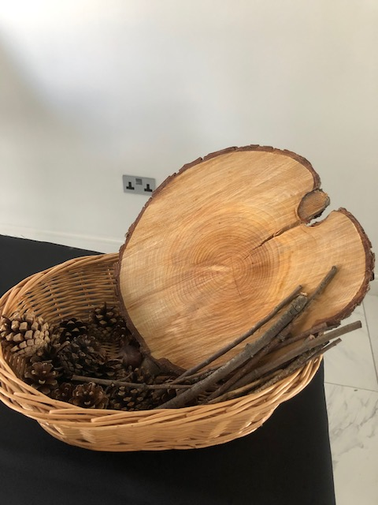
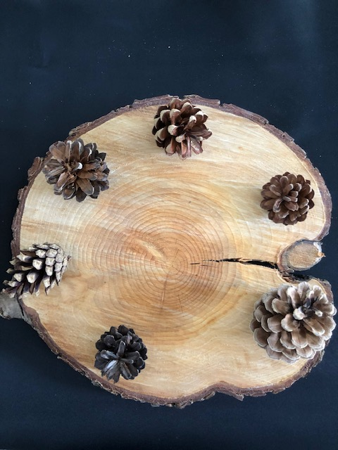
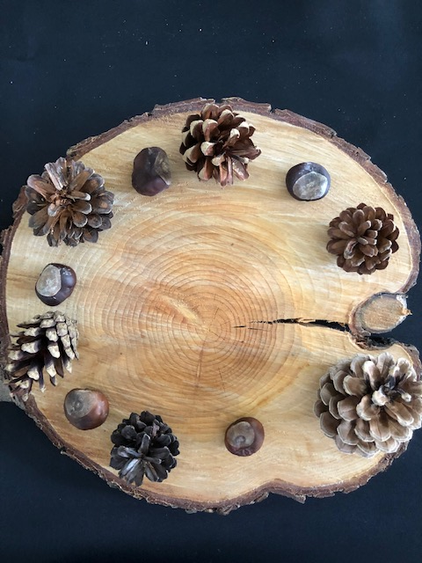
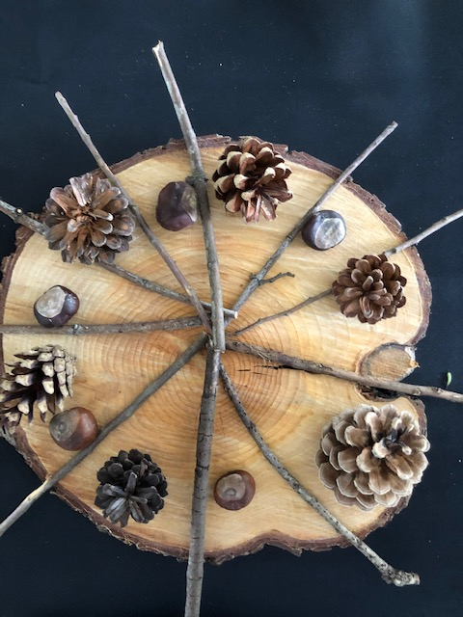
I have spotted and explored patterns in my own and wider environment and can copy and continue these and create my own patterns MTH0-13a
I collected some flowers, twigs and pinecones from the garden and decided to make some patterns. Can you predict which colour or item comes next ?
Find some things at home and try to make a pattern.
We would love to see your patterns! Please Tweet them to us @HazeldeneFamC
KBM

