Slide 1
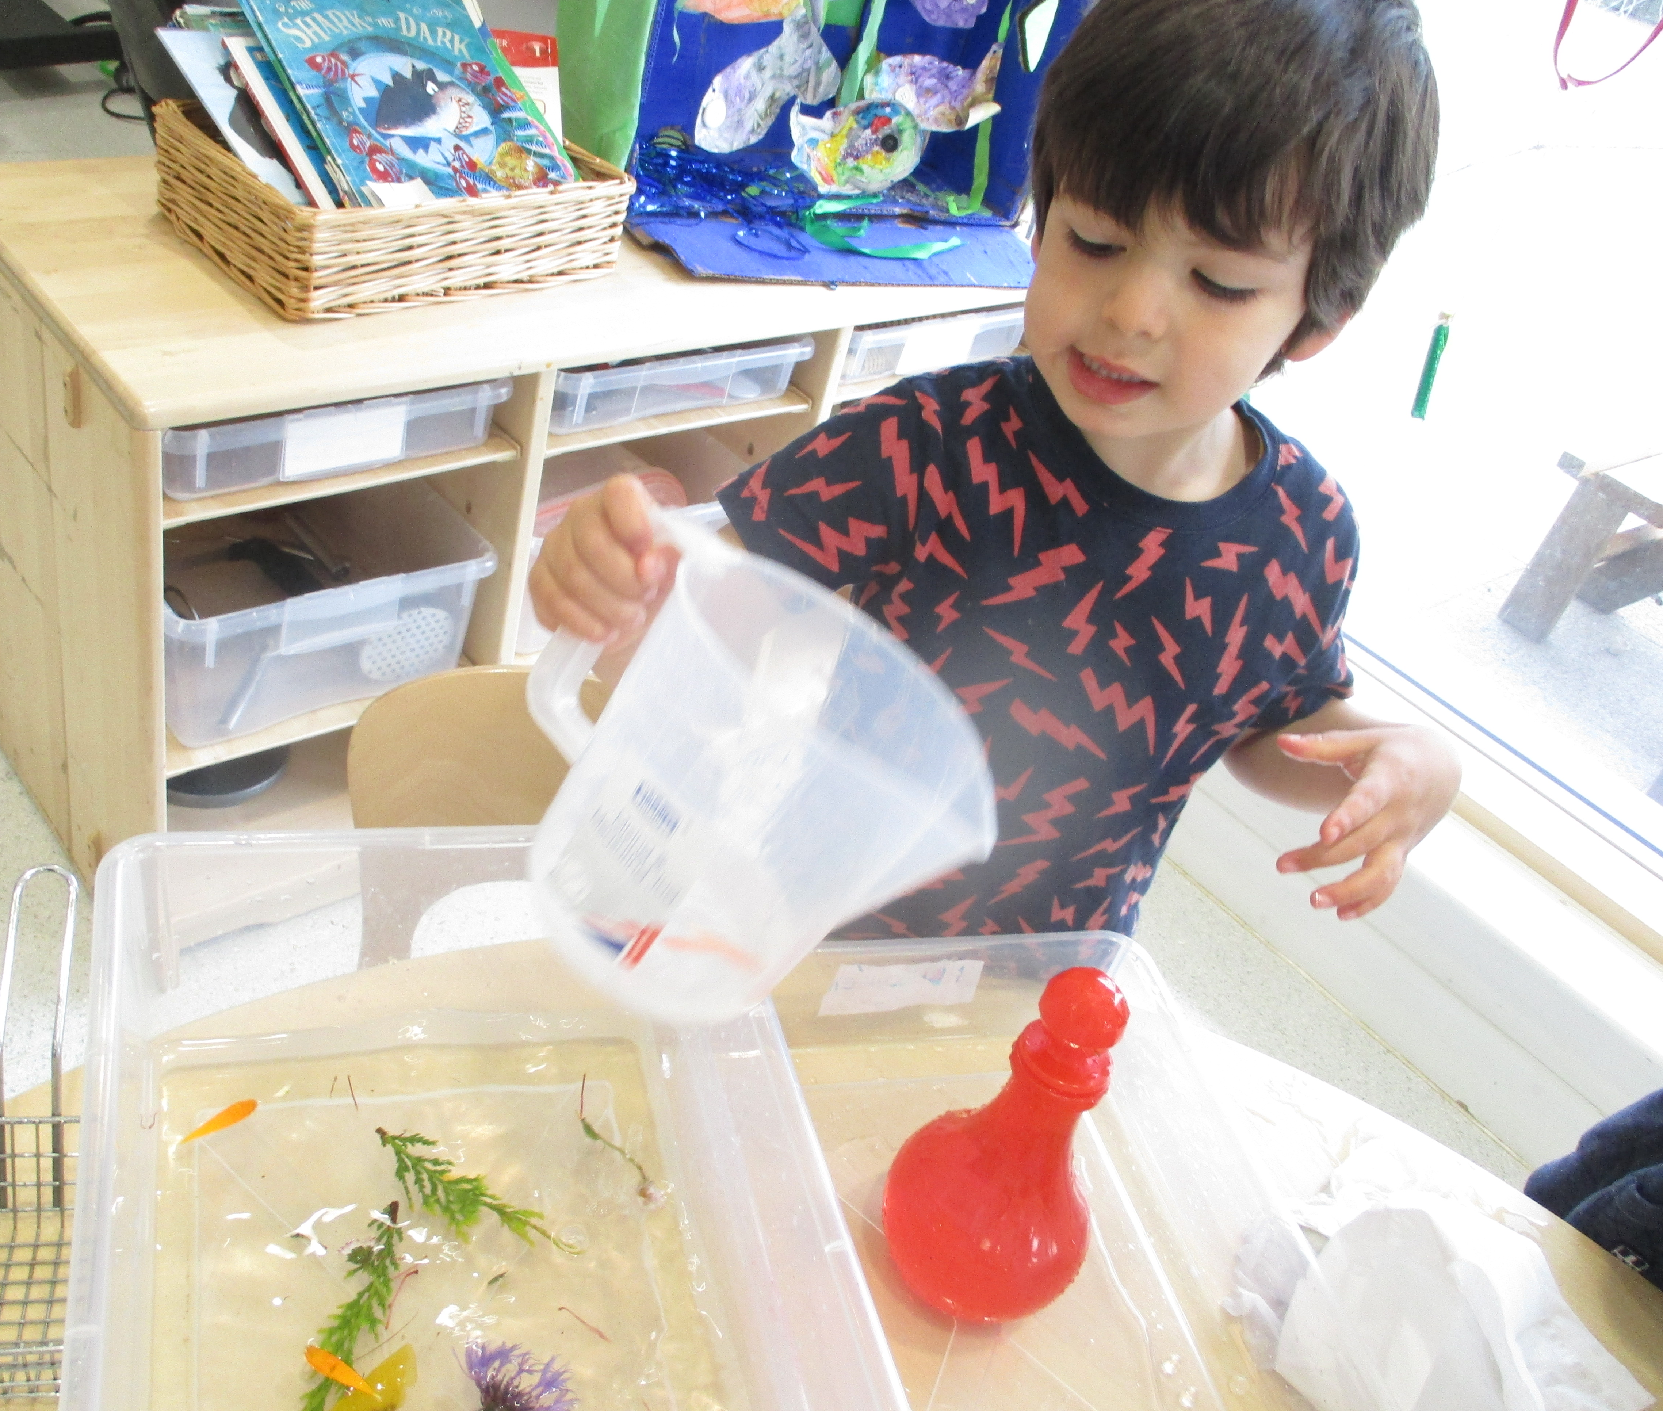
How to make an Ice Garden
Mrs. Bolton-McIlroy
WK beginning 18th May 2020 KBM

Slide 2
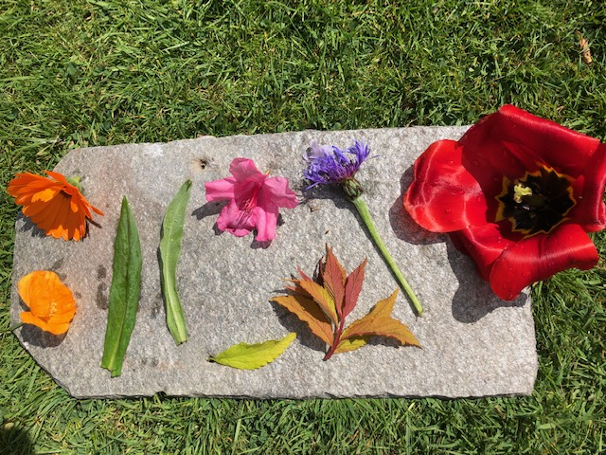
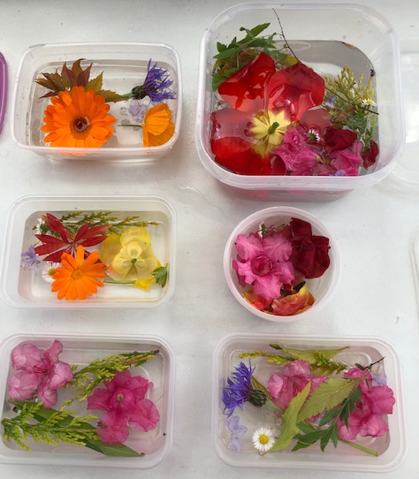
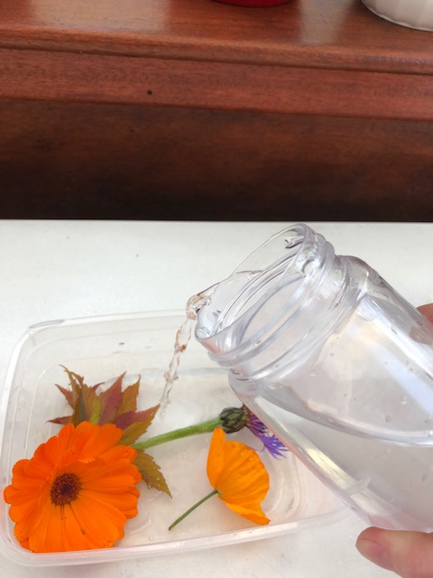
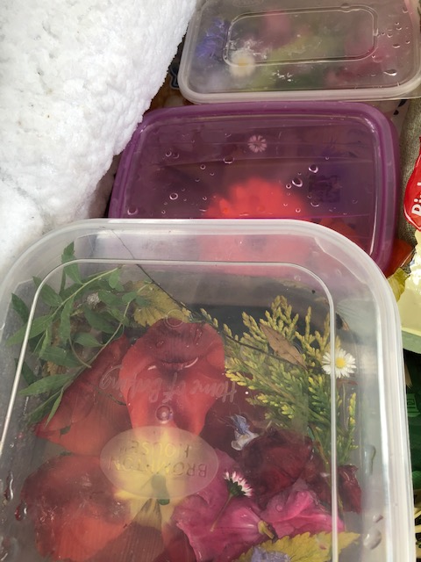
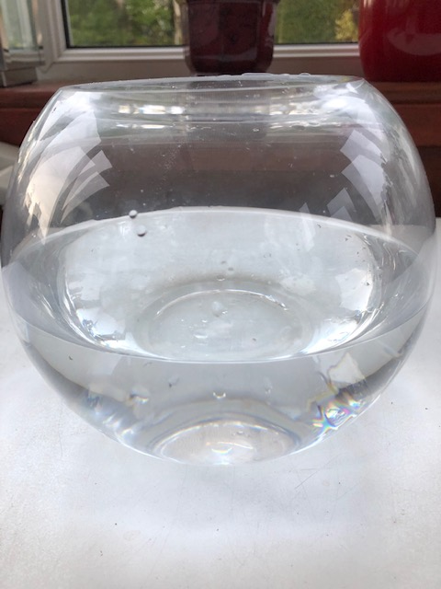
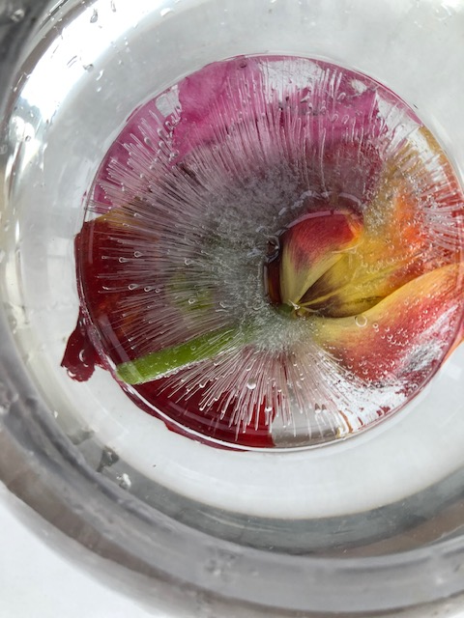
Ice Gardens
With the sunny weather now is a good time to explore flowers in the garden.
1. Gather a selection of flowers and leaves
2. Place into a selection of different sized containers
3. Add
water
6. Place frozen Ice garden into water and explore
4. Place into freezer for a few hours
5. Prepare a bowl or tub with water
As you gather talk about the different colours, shapes, sizes and flower parts. How many flower parts can you identify and name? Share your own creations with us. We would love to see them!

