Slide 1
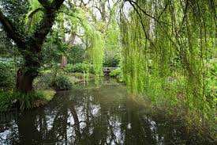
The Wonder of nature

Slide 2
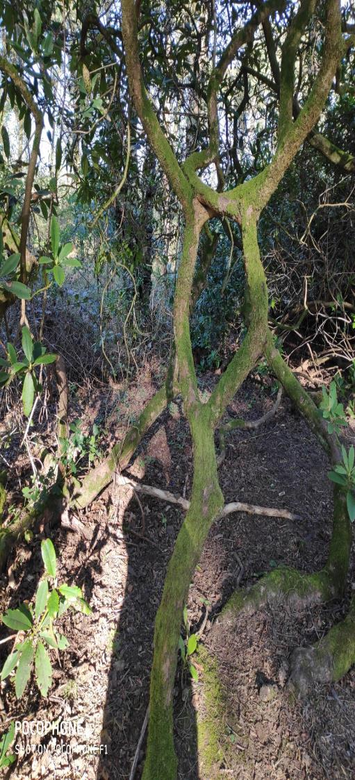
I thought it looked like a person, then I imagined a spyhole or even an alien. I also saw a shadow, whose shadow could it be ?
What can you see?
Children will explore, predict and hypothesise to develop an understanding of the interdependence between animals, land, people and plants.
Can you copy the tree's stance? Hold your balance and try different shapes. Can you try balancing on one leg?
HWB 0-21a

Slide 3
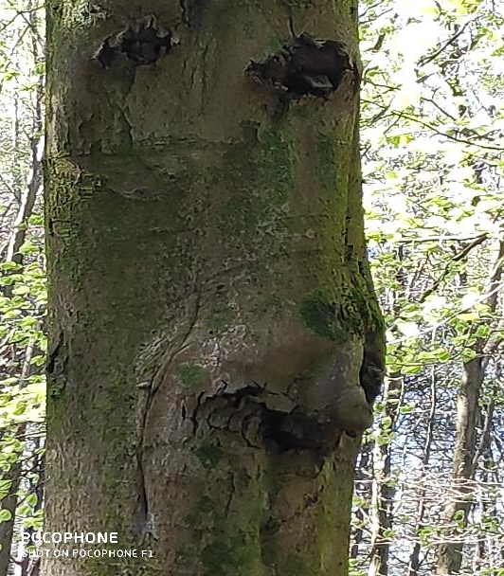
Look at the trees and discuss some of the emotions
Practise recognising these emotions using different facial expressions – with each other or in a mirror
Emotional Literacy
These trees look like they have faces. Do you think they are happy or sad?
Talk about emotions, feelings, happiness, joy, sadness, fear, anger, disgust, peacefulness.

Slide 4
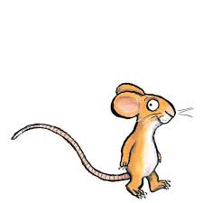
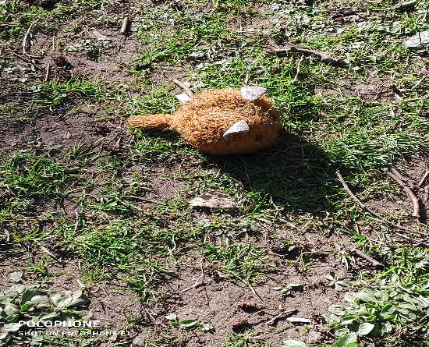
How did the mouse get into the forest ?
Ask your child if they would like to create their own story and you can scribe for them. Or choose a particular story to read with a mouse in it.
Helicopter stories – these allow your child to dictate their own story drawing connections and making sense of the world
Curricular Experience and Outcome
I enjoy exploring events and characters in stories and other texts and I use what I learn to invent my own, sharing these with others in imaginative ways.
LIT 0-09b / LIT 0-31a
You could draw a picture of the mouse or ask your child what they would like to draw.
Is it real, I wonder?

Slide 5
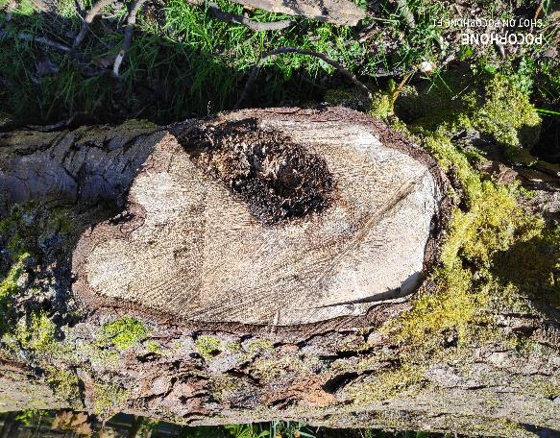
If you look at the photos at different angles what can you see?
I can see an eye !!
I can explore digital technologies and use what I learn to solve problems and share ideas and thoughts.
TCH 0-01a
Ask your child to take a photo of their favourite tree or any object that they see.

Slide 6
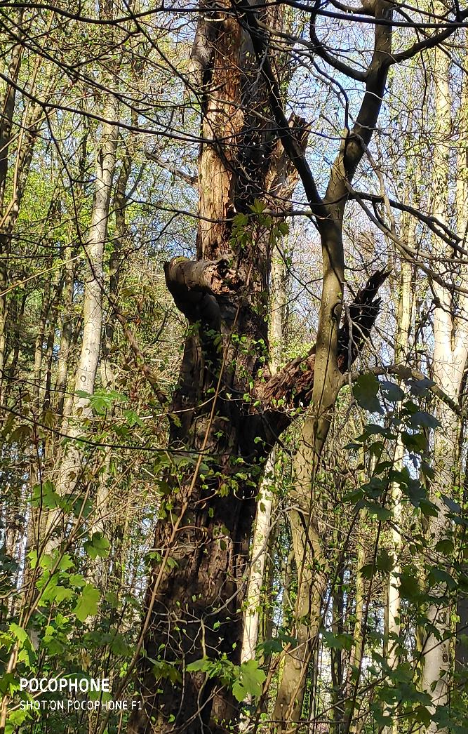
In this photo a tree the looks like it is hugging the other tree!
Why don’t you and your family draw each other, or draw all the special people in your life.
As I play and learn, I enjoy exploring interesting materials for writing and different ways of recording my experiences and feelings, ideas and information.
LIT 0-21b

Slide 7
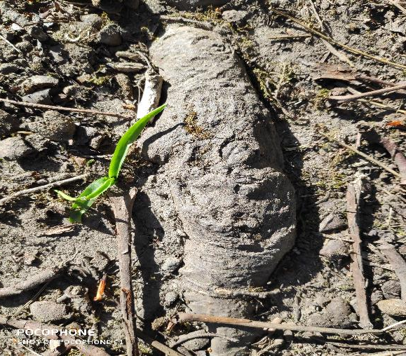
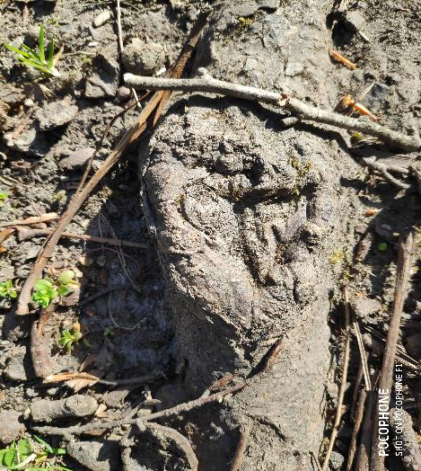
Can you see the markings in the roots of a tree what do you think they look like?
Spending time in nature has been shown to reduce stress
https://www.youtube.com/watch?v=1ZYbU82GVz4&t=3011s
Relaxation video
I saw a bird!
A face

Slide 8
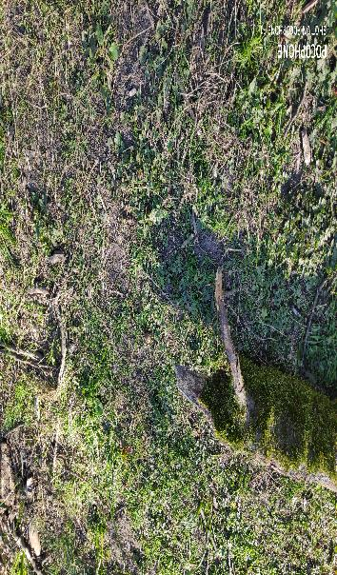
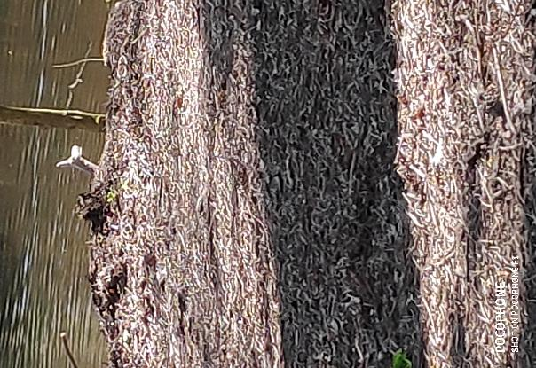
Can you see any branches or roots that look like animals?
A dog maybe
A penguin
I am developing a sense of size and amount by observing, exploring, using and communicating with others about things in the world around me.
MNU 0-01a
Now why don’t you see what types of animals or other toys you have in the house, group them and categorise them into farm, jungle, safari
Or subitise – estimate how many are in a group. See if you can do this without counting. Then estimate the amount in other groups and count them to see if you are right! Encourage vocabulary such as less than longer than, more then and the same.

Slide 9
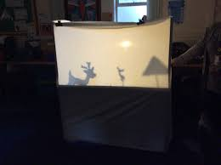
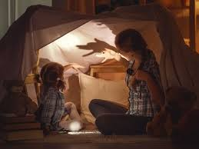
Shadows – what are they? Can you create a shadow.
Ask your child whether they think they have a shadow when in a dark room to try and establish that you need a light source and an object to block it to make a shadow. Ask them to reflect on shadows that they have seen.
A shadow
What do you see in this photo?
A mythical creature
It is a dark area or shape produced by a body coming between rays of light and a surface.
Why not make shadow puppets if you have a den in the house use torches and create your own hand puppets, or set up a sheet with torches behind it and let your child create their own stage!
A shadow
I can talk about science stories to develop my understanding of science and the world around me.
SCN 0-20a
A face

Slide 10
Something for the Parents
The Book You Wish Your Parents Had Read is an absorbing, clever and funny book written by psychotherapist Philippa Perry. It suggests what really matters and what behaviour is important to avoid. The vital dos and don'ts of parenting are included. Instead of creating the 'perfect' plan it offers a big-picture look that leads to good parent-child relationships. Full of sage and sane advice, this is the book that every parent will want to read and every child will wish their parents had.
All photos were taken at Pollok Country Park

Slide 11
All photos were taken from Pollok country side park.
If you are within walking distance of Rouken Glen, why not follow the steps in our Family Learning Walk? (You can download a copy from the Home Learning page on our website).

Slide 12
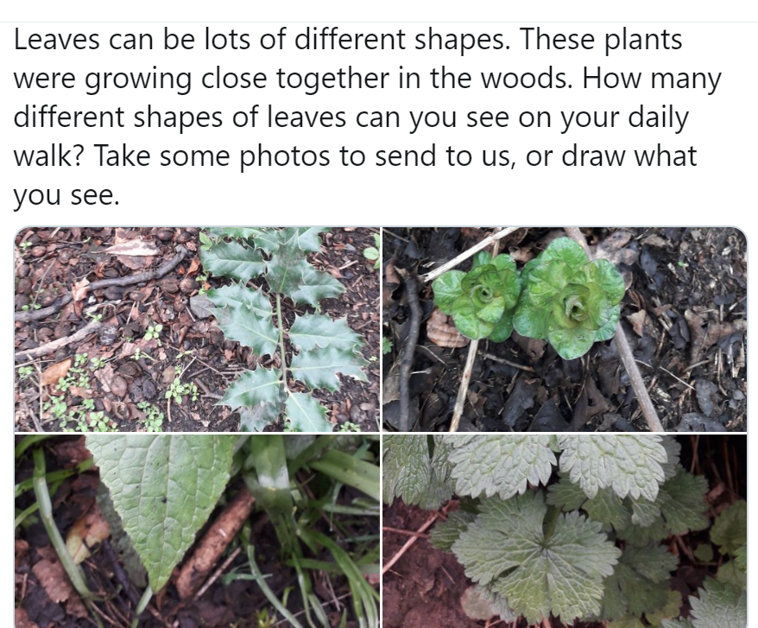
There are lots of ideas for learning with nature on our Twitter feed.
https://twitter.com/HazeldeneFamC/status/1255749108297596928

