Slide 1
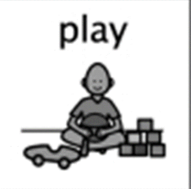
Numeracy, Literacy & Health and wellbeing
Hazeldene Family Centre
May 2020 EA

Slide 2
Numeracy: Data and analysis
Circle
Square
Triangle
Rectangle
Take a look around your home and see how many of these shapes you can find. Why not use a tally chart to keep a record of how many you have found. Take some photos or draw some of the shapes you find.
• Uses knowledge of colour, shape, size and other properties to match and sort items in a variety of different ways.
I can match objects, and sort using my own and others’ criteria, sharing my ideas with others.
MNU 0-20b
Talk about the difference between 2D shapes and 3D shapes, such as circle and sphere or square and cube. Encourage your child to count the number of sides and corners.

Slide 3
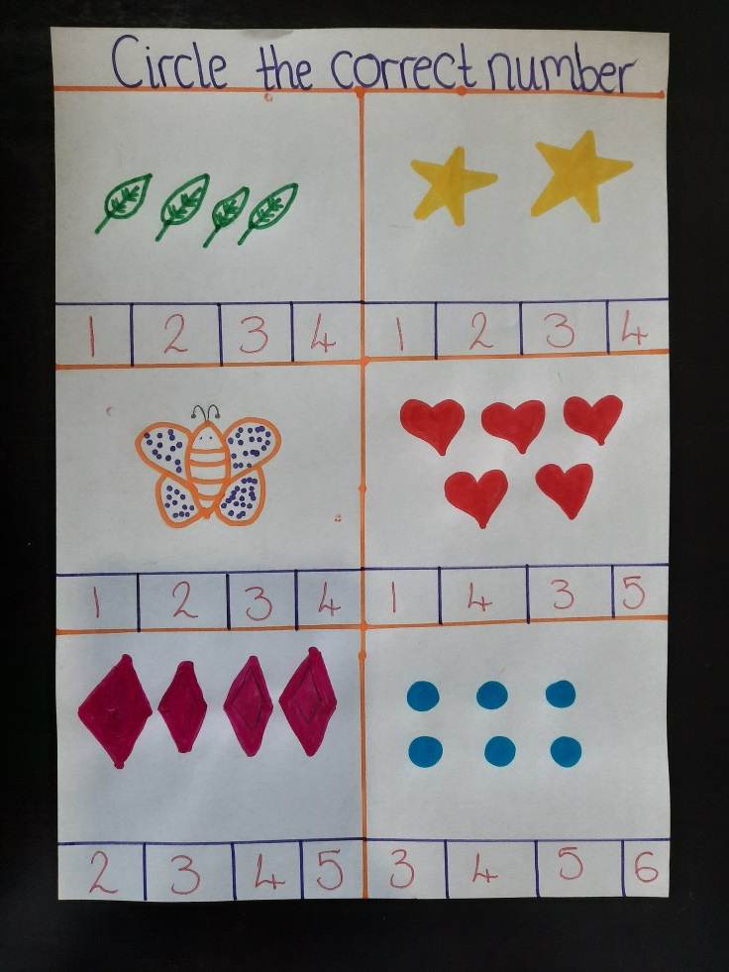
Numeracy: Number and number processes
I have explored numbers, understanding that they represent quantities, and I can use them to count, create sequences and describe order.
MNU 0-02a
• Identifies and recognises numbers from 0 to 20.
• Recalls the number sequence backwards from 20

Slide 4
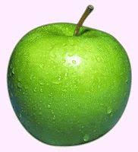
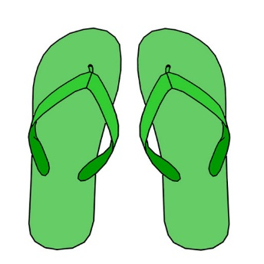
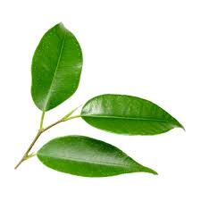
Can you find…..?
3 red things and 6 green things
10 things which will fit in a cup
6 things that are longer than a pencil?
2 things that are taller than the chair?
5 things that are wider than a cushion?
4 things with a pattern.
More ideas for a colour hunt:
https://theimaginationtree.com/were-going-on-colour-hunt/

Slide 5
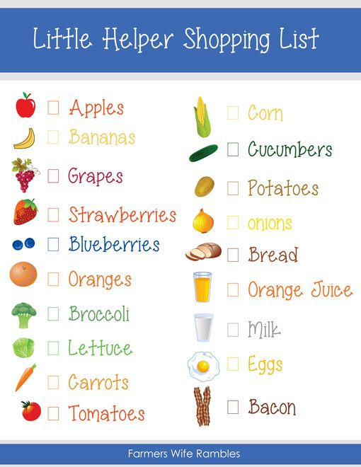
Writing: Organising and using information
Who is hungry? Why not take a look at the website below choose a delicious meal or healthy snack that you would like to make and become a chef!
Choose the meal/snack you wish to cook
Write or draw a shopping list of all the ingredients you need
Give your list to a grown up who can go to a shop safely, make sure to give them a shopping bag! Or maybe you could help your grown up to order the food online and wait for your food to be delivered
Follow the recipe and have fun learning how to be a chef!
Within real and imaginary situations, I share experiences and feelings, ideas and information in a way that communicates my message.
LIT 0-26a
https://www.bbcgoodfood.com/recipes/category/family-kids

Slide 6
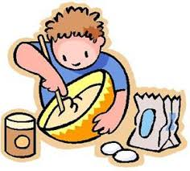
Mums and Dads - Did you know?
Baking develops lots of numeracy and maths skills:
Weighing ingredients. Measuring quantities.
Setting the temperature of the oven
Using a timer
Cutting into portions to share.
When baking, use mathematical language e.g.
More/less/ heaviest/lighter longer/shorter full/empty/enough thin/thickest

Slide 7
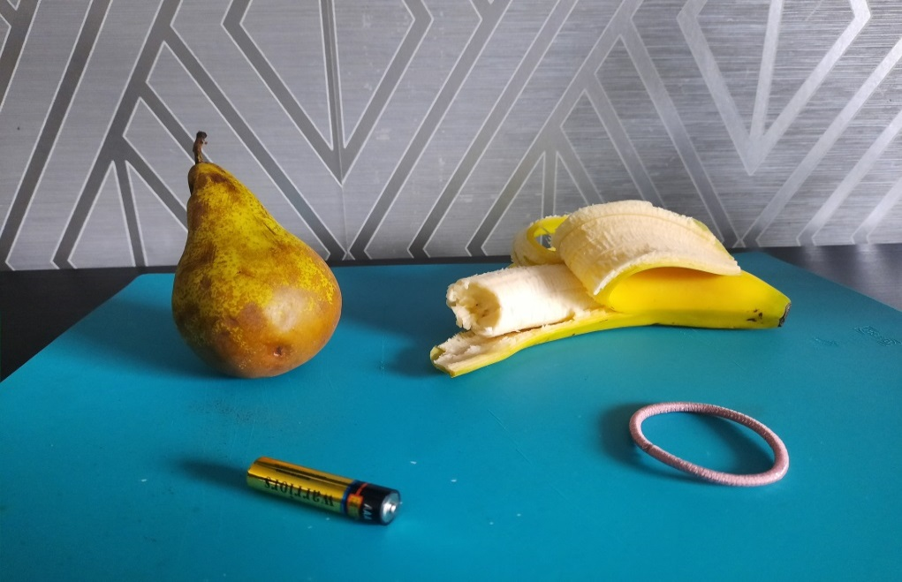
Literacy: Enjoyment and choice
Name each item out loud, can you hear a similar sound? Can you select the odd one out, which item sounds different from the others?
scissors, sock, star, toothbrush, spoon
battery, pear, banana, bobble,

Slide 8
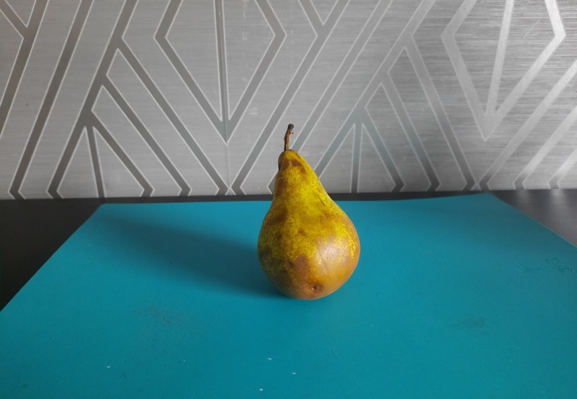
Did you guess the correct answer?
I enjoy exploring and playing with the patterns and sounds of language, and can use what I learn. LIT 0-01a / LIT 0-11a / LIT 0-20a
• Hears and says the different single sounds made by letters
t - toothbrush
p - pear
You can play lots of free online games to learn about letters and sounds at:
https://www.topmarks.co.uk/english-games/3-5-years/letters-and-sounds

Slide 9
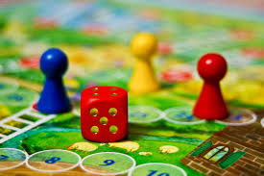
Literacy: Listening and talking
Why not have a family board night?
Get everyone together, each choose your favourite game and have some fun!
Board games are extremely beneficial to a child’s mental and social development. Board games develop many skills such as decision making, social interaction and critical thinking. These games can also develop on children's concentration, memory and personal qualities such as patience and determination. Dice games develop number recognition and counting on from a smaller number.
As I listen and talk in different situations, I am learning to take turns and am developing my awareness of when to talk and when to listen.
LIT 0-02a / ENG 0-03a
• Makes an attempt to take turns when listening and talking in a variety of contexts.
• Follows and gives simple instructions.
• Asks questions and responds relevantly to questions from others

Slide 10
please remember to share your photographs with us. we miss you all!
@HazeldeneFamC
schoolmail@hazeldene.e-renfrew.sch.uk

