Slide 1
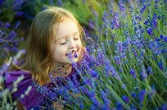
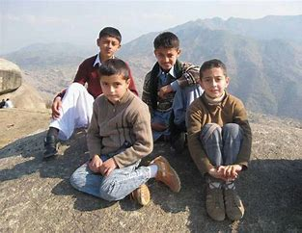
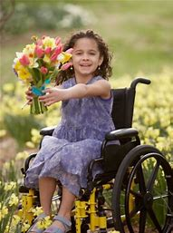
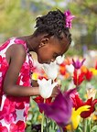
Spring Learning with Nature and having Fun!
Prepared by Charlotte Tennant

Slide 2
Outdoor Benefits
Children who play outdoors display more advanced motor skills including coordination, balance and agility.
In natural environments children’s play is more diverse; imagination and creative play develops language and collaboration.
Spending time in nature has been proved to reduce stress.
Wonder is an important motivator for lifelong learning.

Slide 3
The Creativity of Loose Parts
Investigate what items are in your garden to decorate a hollow tree, stumps or unusual shaped trees using stones or plastic bottle tops – Remember reduce, reuse, recycle.
“Creativity seems to emerge from multiple experiences, coupled with a well-supported development of personal resources, including a sense of freedom to venture beyond the known” (Malaguzzi, 1998, p. 76).

Slide 4
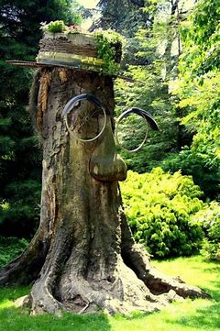
Trees can be people
You could make a hat using recycled materials and add moss, twigs and plant some herbs or flowers such as Perennials (please check that no bulbs or flowers are poisonous). In the photo old bike wheels are used for the eyes. You could use mud mixed with water instead for eyes and a nose. Care for Nature!
Everyone has different ways to share values and knowledge that they bring in the moment!

Slide 5
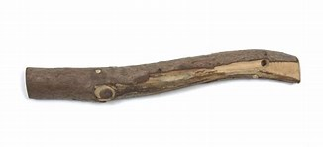
It’s not a Stick
This is a fun game to play. You hold a stick and say ”This is not a stick, it’s a ……….” and imagine it’s something else e.g. a comb, broomstick or a mobile etc. Mime the action for your child to guess. Remember don’t say what it is because it’s roleplay and the fun is in the guessing! Take turns to act it out and the other person guesses. Children love this game.

Slide 6
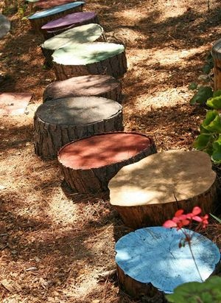
Log painting
Paint different log slices in various colours to create patterns or play a game to match the colours. Add numbers to identify numbers before/after/practise addition and subtraction. Use the logs to measure 2 metres so children are becoming aware of distance. Use chalks to draw/write on the logs let the rain wash it off. The following are curricular outcomes from The Curriculum for Excellence.
I have explored numbers, understanding that they represent quantities, and I can use them to count, create sequences and describe order.
(MNU 0-02a)
I use practical materials and can ‘count on and back’ to help me understand addition and subtraction, recording my ideas and solutions in different ways.
(MNU 0-03a )
I have experimented with everyday items as units of measure to investigate and compare sizes and amounts in my environment, sharing my findings with others.
(MNU 0-11a)
I have spotted and explored patterns in my own and the wider environment and can copy and continue these and create my own patterns.
(MTH 0-13a)

Slide 7
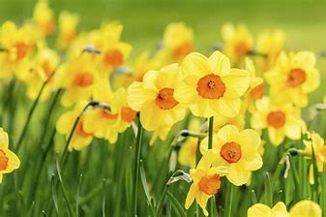
April Songs and Poems
Your child might enjoy listening to some songs and poems about Spring.
There are some beautiful ones to reflect on. If you click on this word nature it will take you to a website with lots of examples.

Slide 8
Garden Yoga for Children
Stand on one leg and then bend the other knee; place the sole of your foot onto your inner thigh. Sway from side to side like a tree in the breeze and now do the other side – For more ideas go to https://www.bing.com/images/search?q=garden+yoga+for+children+poster&qpvt=garden+yoga+for+children+poster&form=IGRE&first=1&cw=1117&ch=452 to practise the frog, seed, butterfly and flower.
Pretend to be a tree.

Slide 9
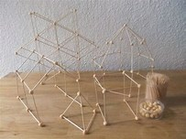
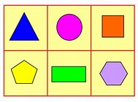
Stick and Pea learning experience inspired by Friedrich Froebel
Please supervise! If you get some blunt ended cocktail sticks and add some soaked dried peas, Blu tack, mini marshmallows or corks you can be an engineer. Just imagine what you could make! Maybe some 2d and 3d shapes. You be the creator!
I enjoy investigating objects and shapes and can sort, describe and be creative with them.
(MTH 0-16a).

Slide 10
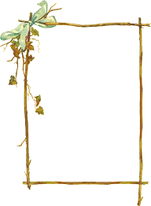
Decor?
Take photos of plants and flowers outdoors and discuss colours, shades and tones that match your furniture inside. Use paint colour sample cards to see if you can find items that match the shades, Look at reflections in puddles and look for mirrors in the house.
Create a stick frame by tying four pieces of wood together with wool or twine. Add a drawing or a photo maybe of your findings. You could also put your outside treasures in a tub (a talking tub) and discuss what you have found. These ideas have been taken from a Claire Warden’s book – Learning with Nature: Embedding Outdoor Practice.

Slide 11
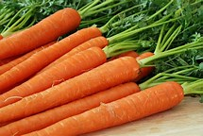
How to grow Carrots
1. Rake the soil until it's quite fine.
2. Make a small drill in the soil – you can use a trowel.
3. Sow the seeds 1cm deep in rows 15cm–30cm apart and place under a horticultural fleece or mesh. Carrot seeds are so small, to help sow them mix them with a small amount of sand and sprinkle them into the drill so that you can see them in the (row) and they are even.
4. You can thin them when the plants grow 5–7cm apart.
5. Cover your carrot crop with fleece or mesh so you do not attract carrot root fly.
6. Cover your seeds and seedlings with the fleece or mesh to protect them against cold weather.
7. Then harvest from June onwards.

Slide 12
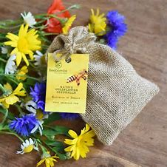
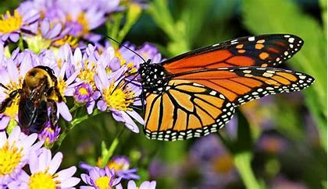
Wildflower Bomb
Roll some soil and wildflower seeds into a ball making sure it’s not too dry or too wet, so it can mould into a ball. Then throw it into a spot within the garden where you want the wildflowers to grow and wait to see the bees and butterflies in harmony once more. The one in the photo has been placed into a hessian bag.

Slide 13
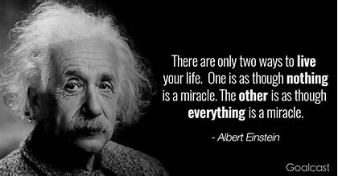
Explorify – for the whole family
This website is excellent – you can join for free https://explorify.wellcome.ac.uk/activities it is aimed for 9-11 year olds, https://explorify.wellcome.ac.uk/en/activities/zoom-in-zoom-out/brown-and-hairy this one is particularly fun you zoom in and out to guess whether it is a human or an animal. It’s great fun!
“Keep encouraging one another and building one another up”

