Slide 1


Please click on the speaker and you can watch it as a slideshow click right twice to get to the next page

Slide 2

Hello Everyone

Slide 3

Click on the speaker

Slide 4


Slide 5


Slide 6

Hope your still having fun

Slide 7


Slide 8
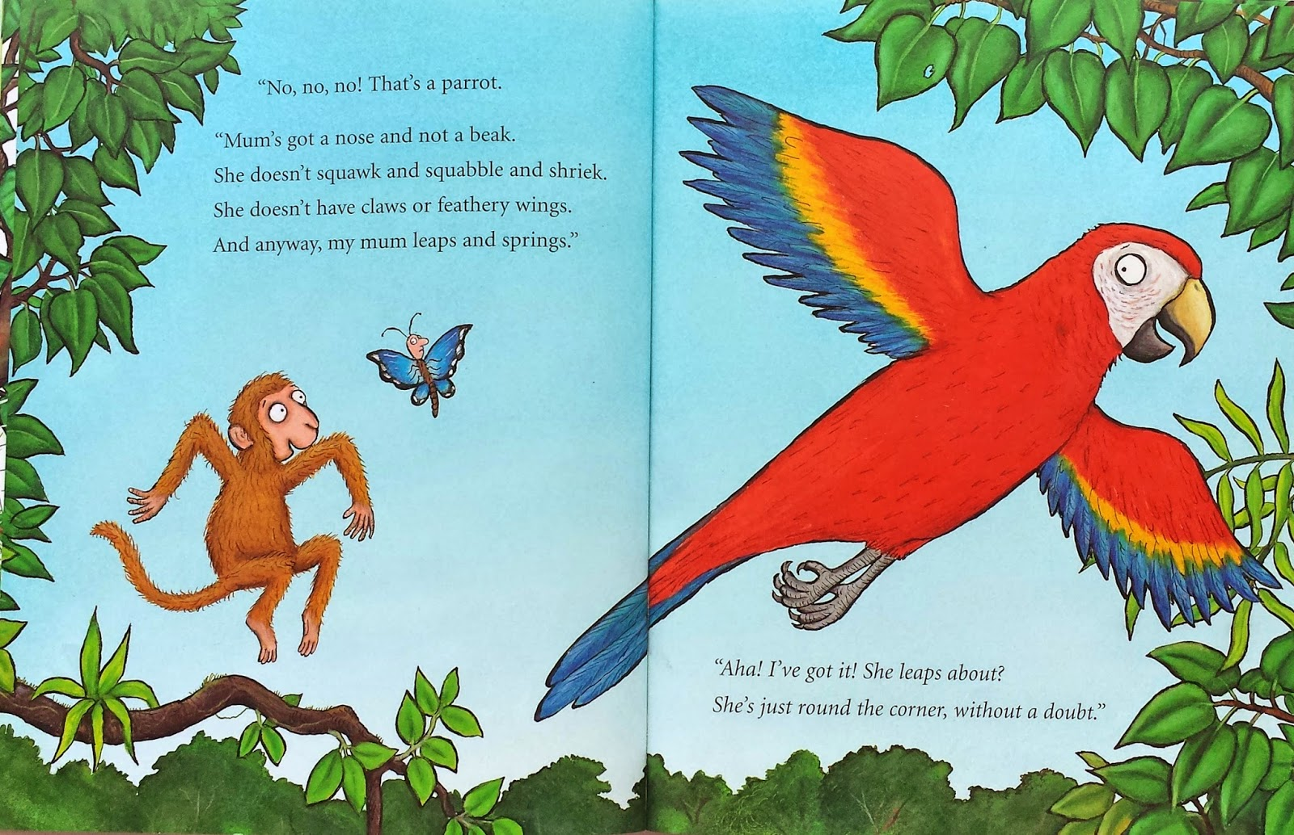

Slide 9


Slide 10


Slide 11


Slide 12


Slide 13


Slide 14


