Slide 1

S5 Curricular Choice Evening
Thursday 15th January 26

Slide 2
Speakers
Introduction –Kate Sinclair (HT)
Options Process – Allison MacKinnon (DHT)
Vocational and UCAS – Bethany Williams (PT Pupil Support)

Slide 3
Kate Sinclair
Head Teacher

Slide 4
S5 Year Group
Every year group is unique
Mrs MacKinnon loves her year group
Focus on meeting individual needs
Values
Individual progress
Upcoming months important – attendance/timekeeping/hard work

Slide 5
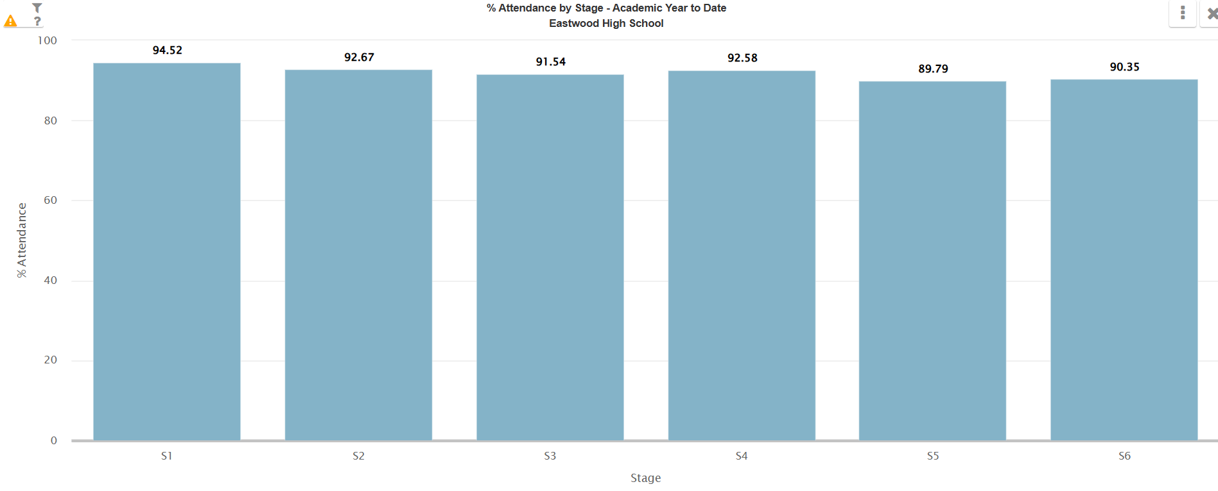
attendance

Slide 6
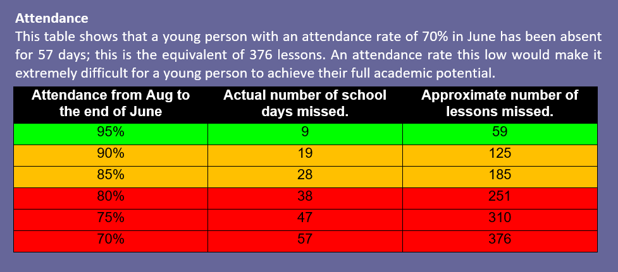

Slide 7
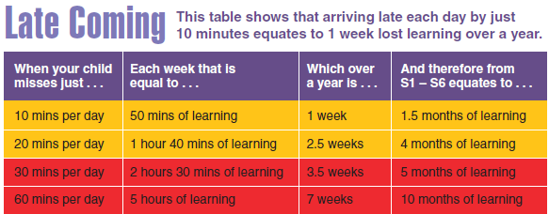

Slide 8
Transition point
Decision to make – S6/life after school
S5 exams – not taken place yet
“crash” Highers
Advanced Highers
4 subjects – full time education
Go around departments/ask questions
Issues identified

Slide 9

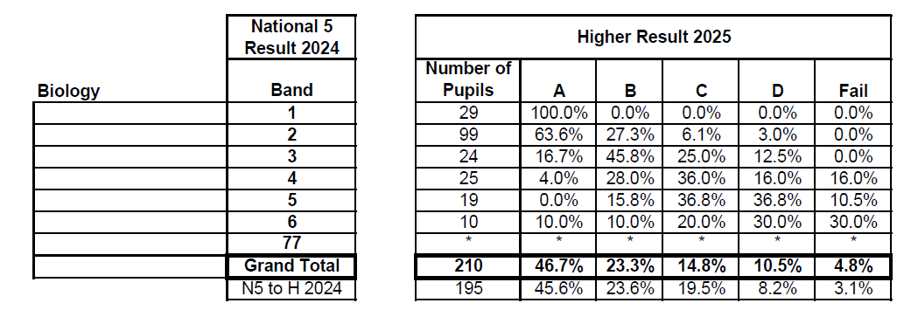
Progression statistics ERC (sciences)

Slide 10
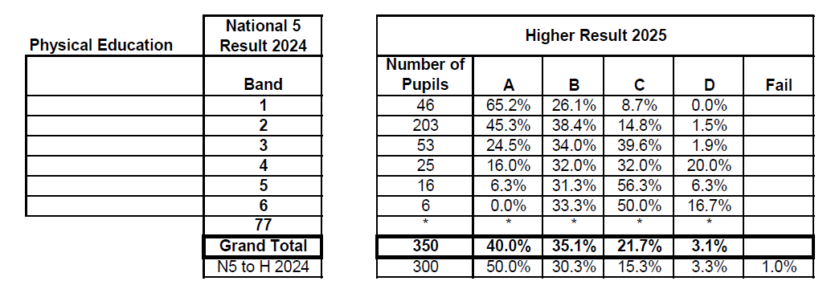
Progression statistics ERC (PE)

Slide 11
Allison mackinnon
Depute Head Teacher (S5)

Slide 12

The purpose of tonight
To give you an understanding of the curricular choice process
To offer parents advice on supporting their child through the process
To offer advice on making the right decisions
To give information about the curriculum and the wider supports on offer
To give you the opportunity to visit and speak to staff from all areas of the school
To give you the opportunity to speak to Pastoral Care Teachers (in the Pastoral Base on the Ground Floor) & Skills Development Scotland (in café bar.)

Slide 13

Choice at end of S5
Stay on at school for S6 or until the end of the year
Commitment, hard work and attendance needed
Build on success from S4 and S5
Look at recent tracking reports and upcoming prelim results/written reports
Leave - Further or Higher education, Modern Apprenticeship or employment
Need to look at entry requirements for the courses/apprenticeships you are interested in

Slide 14
supports
Pastoral Care – they know you best
Class Teachers and Principal Teachers
Senior Leadership Team
Careers Advisors

Slide 15


Karen Rees
Claire McCanney
Careers Advisers
Notes:
Introduce self and session S4 options and routes and pathways beyond school

Slide 16


My World of Work
What’s out there?
How to find the right information
Notes:
Getting the right information.......
Throughout today we have mentioned sources of information and help.
Highlight MyWoW is a great starting point for pupils and give some examples of use for information

Slide 17
S5 into S6 Options Process
Pupils will choose 4 subjects, one of which can be vocational
Exception for pupils studying 3 Advanced Highers only
Best to consider AH if going to achieve an A or B at Higher and if required for future employment or university
Subjects on offer will be at SCQF Levels 5, 6 & 7
S6 pupils can ‘crash’ Highers but this involves extra commitment
Choices should be realistic, ensure progression and challenge

Slide 18
Options Key Dates
Thurs 15th January
Curricular Choice Evening
Presentation and options booklet uploaded to school website
W/b 16th February
Departmental presentations to pupils on course progression (H/AH)
S5 Options and Vocational assembly
Research forms issued
Options forms issued to parents
S5 reports issued
W/b 2nd March
S5 Curricular Choice interviews with PCT
Pastoral use prelim grades, tracking data, reports, research forms, dept recommendations and ERC conversion data to support discussions
Friday 6th March
Options deadline
Tuesday 2nd June
Welcome to S6!

Slide 19
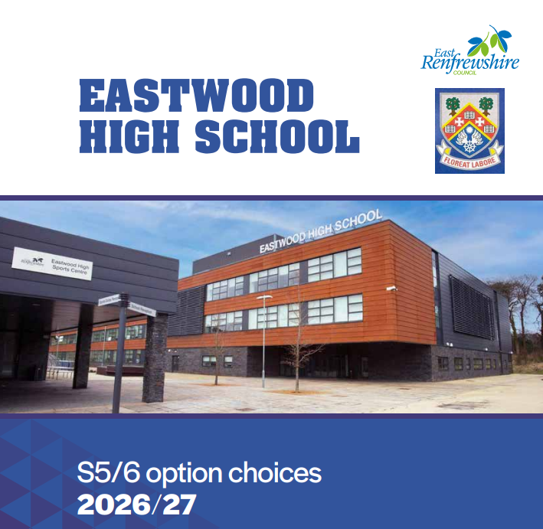

Slide 20
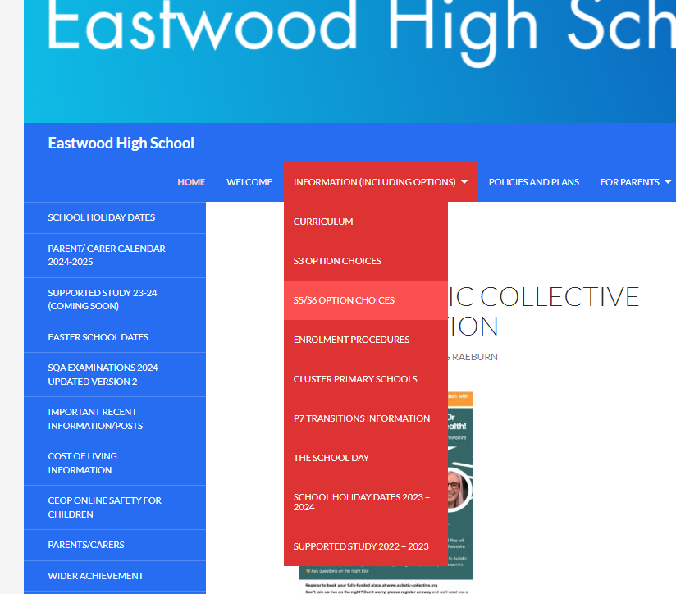
Options booklet

Slide 21


Slide 22
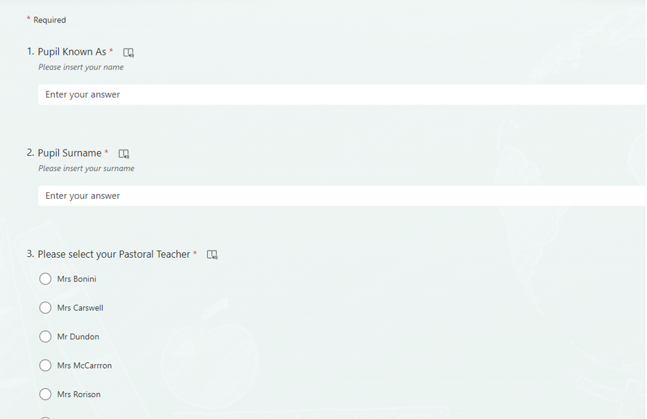

Slide 23
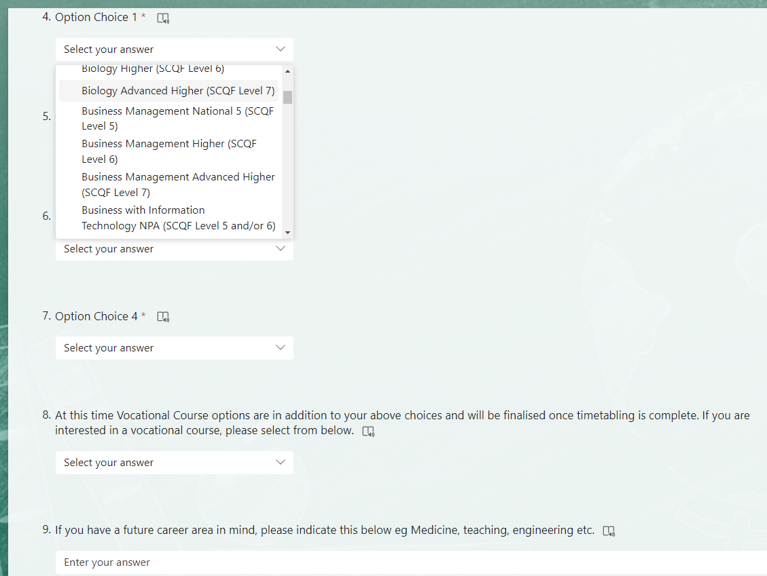

Slide 24
current column structure
Note: Subjects will not be delivered if the uptake is too low
A | B | C | D | E
Biology H Business Management H Chemistry AH/H Comms & Lit L6 Comp Games L6 English AH/H/N5 PE AH/H Physics AH/H RMPS H | Biology AH French H Geography AH/H History AH/H Maths Apps H/N5 Maths AH/H Media N5 Modern Languages for Life and Work (Italian) Level 5 Modern Studies H PE H Photography H Practical Cookery N5 Spanish H | Administration H Biology H/N5 Business Management H Chemistry AH/H Computing H Design & Man H French AH Graphic Communication H Health Sector N5 Practical Cookery N5 Mathematics AH/H Maths Apps H Music Technology H Physics H | Art AH/H Bakery NPA Biology AH Business Man AH Business & IT L5 Design & Man AH Drama H English H Fashion H Geography H HFT H/AH Music AH/H Musical Theatre L6 Politics H Practical Woodwork N5 Vocational Courses | Animation NPA Art H Biology H Business Man H Chemistry H Computing AH/H Creative Thinking L5 Drama H Geography H Graph Comm AH History H Modern Studies H PE H Practical Cookery N5 Physics H Spanish AH/H Sports Leadership L6 Travel and Tourism N5

Slide 25
Wider Opportunities
S6 gives pupils the opportunity to build skills that employers, colleges and universities are looking for & to give something back to the school
All pupils will choose a Powering Futures, Volunteering, Leadership or Mental Health award as an additional option
Expectation that pupils will take on leadership within the school and use their own experience to help support others and improve outcomes for all

Slide 26
Payment of £30 per week to the young person Household income below £24,421 for one child Household income below £26,884 for more than one dependent child Young people between ages of 16 & 19 Paid fortnightly, issued one week later Not payable during holidays Need to re-apply each year attendance based
Education Maintenance Allowance

Slide 27
Bethany Williams
Principal Teacher of Pupil Support

Slide 28
Vocational Programme

Slide 29
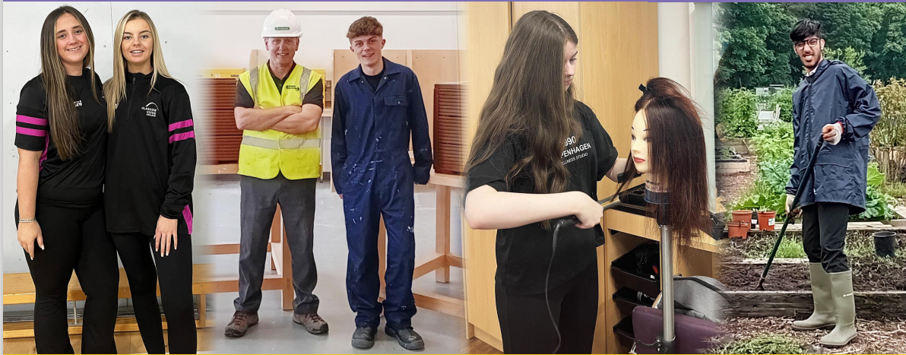
Programme Details
Opportunity to gain relevant qualifications and practical experience
Most courses run from August to May
Progress reports provided
Attendance/attitude/performance monitored
Courses do not run on school holidays or in-service days

Slide 30
Benefits of Vocational Courses
Relevant for career/work
Practical work
New environment/opportunity to try college
Treated as an adult
Qualifications – National 4, National 5, National Progression Awards, Higher, National Certificate & University Level 1 and 2

Slide 31


Programme Details
2 half days
Tuesday and Thursday afternoons
Friday morning
Periods 1 and 2
2.5 days per week
Monday, Tuesday and Wednesday afternoons, Thursday all day
Transport provided or free travel card

Slide 32
Courses are available in the following areas:
Aviation and Travel
Business and Finance
Care, Health, Life Science and Social Care
Construction and Engineering
Creative and Digital Industries and Music
Events Management
Fashion and Design
Hair and Beauty
Horticulture, Hospitality and Landscaping
Humanities and Social Sciences
Sport
Vehicle Systems

Slide 33



Applying for a course
Speak to Principal Teacher of Pupil Support and parent/guardian
Complete application forms – one with parents and one in school with Pupil Support teacher at options interview
Places are not guaranteed as only a small number of places are available to each school. You MUST choose four school subjects during the options process and indicate if you are interested in applying for a vocational college course.

Slide 34
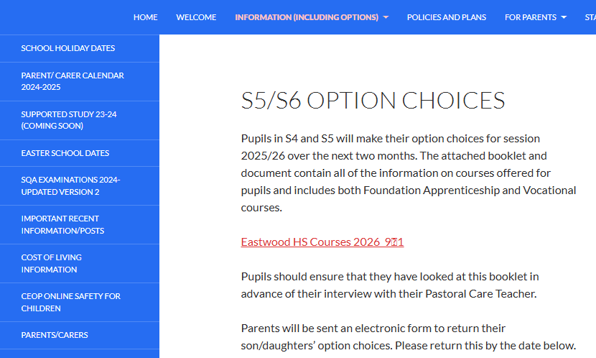
The Vocational Programme is combined within the
school’s options booklet
and can be viewed on the school website.
1
2

Slide 35
UCAS

Slide 36
Applying to university through UCAS

Slide 37
WHAT IS UCAS?
UCAS, the Universities and Colleges Admissions Service, is an independent charity, and the UK's shared admissions service for higher education.
Every person who wishes to apply to a UK university must do so through UCAS.
Pupils can make 5 choices for £28.50 (currently)

Slide 38
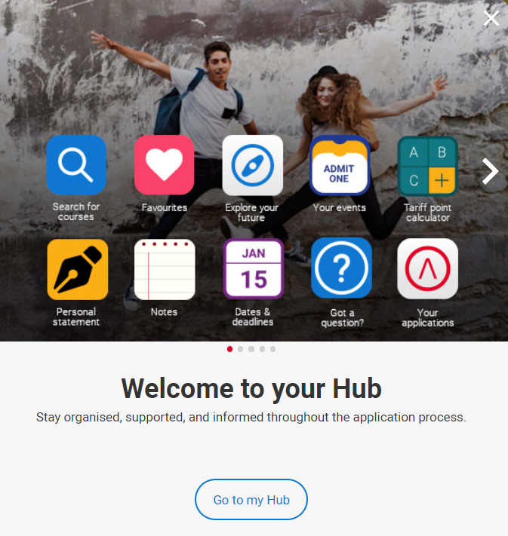
Start research early
Pupils will start the process in June and will register with the UCAS Hub to:
explore careers, subjects, places, and apprenticeships and find information for over 35,000 courses.
There are many tools for pupils to use in the hub, as well as the online application.

Slide 39
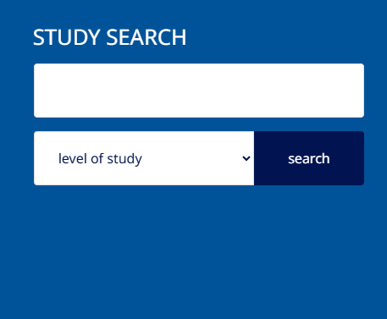
RESEARCH
In June, PSHE classes go through lessons focussing on:
Choosing courses and viewing entry requirements
Choosing universities and looking at teaching methodologies
Looking at location and contributing factors such as halls of residence, sports facilities, clubs

Slide 40

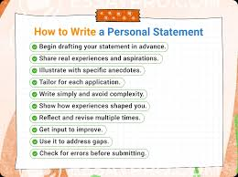





The personal statement
The only section pupils have full control over
The only chance to market oneself as an individual
The same statement is used for all choices
There is no spelling or grammar check
No formatting allowed
Similarity detection service: every personal statement is run through software to check for plagiarism and AI input

Slide 41

Start early - June
The personal statement questions:
Question 1: Why do you want to study this course or subject?
Question 2: How have your qualifications and studies helped you to prepare for this course or subject?
Question 3: What else have you done to prepare outside of education, and why are these experiences useful?
When reading your personal statement, admissions tutors are looking for evidence that you’re passionate and knowledgeable about the subject area you’re looking to study further and have the relevant skills, experiences, and potential to be a great student.

Slide 42
EHS TIMELINES
June – All pupils will create an account on the UCAS hub in PSHE.
June – Parents are invited to attend a workshop information evening on the UCAS process
June - Pupils applying for medicine, veterinary medicine, dentistry or Oxbridge (early applicants) must start working on their application and personal statement. Medicine and dentistry applicants should start working on their UCAT as this needs to be completed before end of September.
August – All pupils (who wish to apply) will start their application.
September weekend – Early applicants should submit draft to their Pastoral Care teacher and ensure all their information has been completed on their online application.
October – early applications must be sent before 14th October – no exceptions.
October break – draft of Personal Statement for pupils submitted to PCT.
November – those who are ready can start to submit their application.
December – ALL applications should be sent before Christmas break.

Slide 43
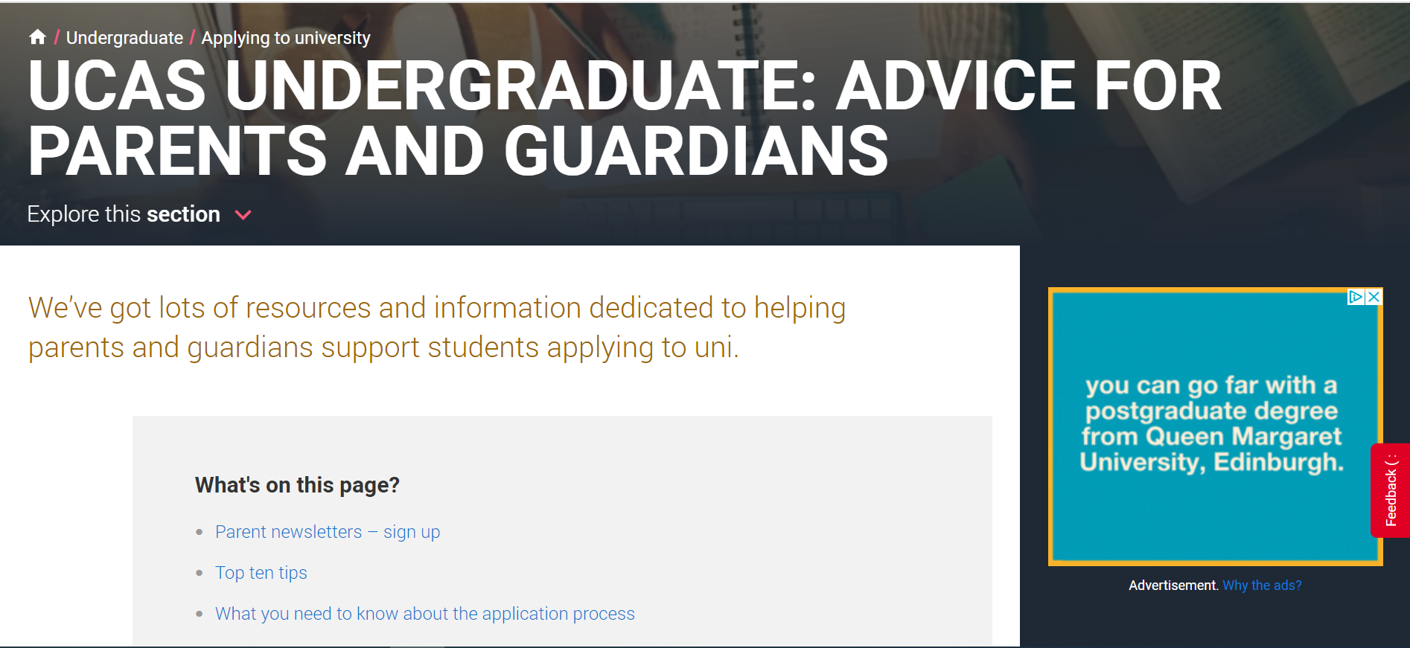
Tools to help …

Slide 44
Thank You
The school Pupil Support Team will answer your enquiries if you wish to phone/email the school.
S5/S6 Option Choices | Eastwood High School (glowscotland.org.uk)

