Slide 1

S4 Curricular Choice Evening
Thursday 15th January 2026

Slide 2

Kate Sinclair
Head Teacher

Slide 3

S4 Year Group
Very proud of S4 progress/development
Curriculum
Opportunities

Slide 4
What to think about…
Transition point – vast majority stay on for S5
Choosing from 8/9/10 subjects
What subjects to take? What levels and how many?
Progression statistics

Slide 5
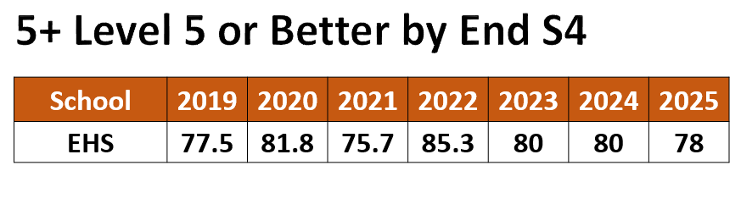
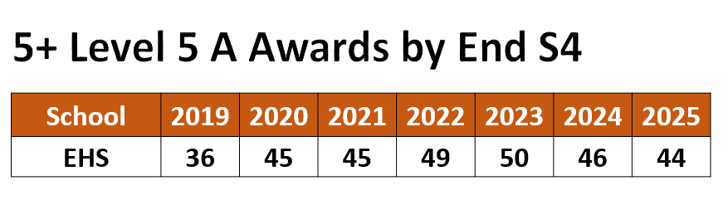
Number of Highers?

Slide 6
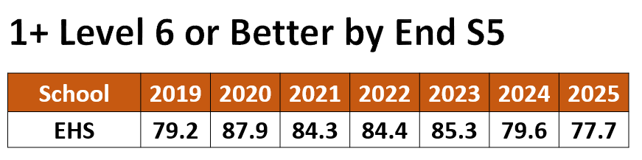
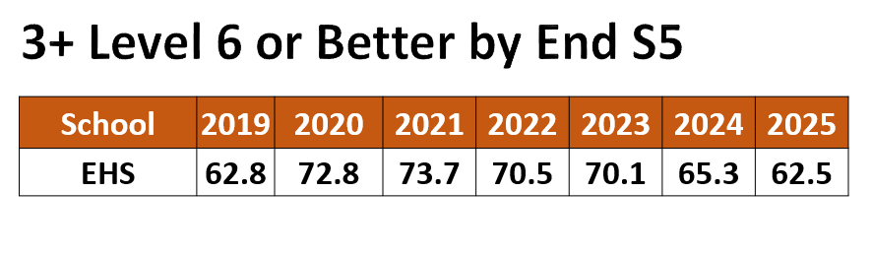
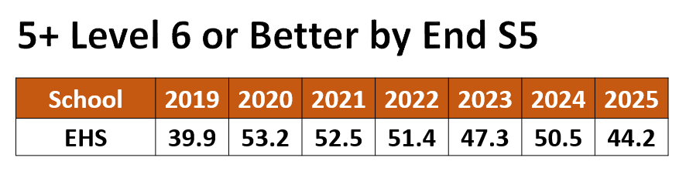
Number of Highers?

Slide 7
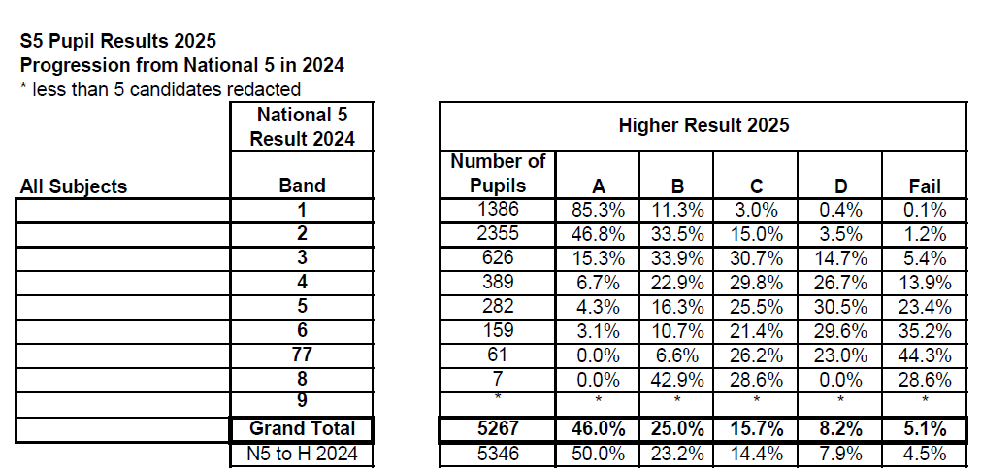
Progression statistics – ERC Overall

Slide 8

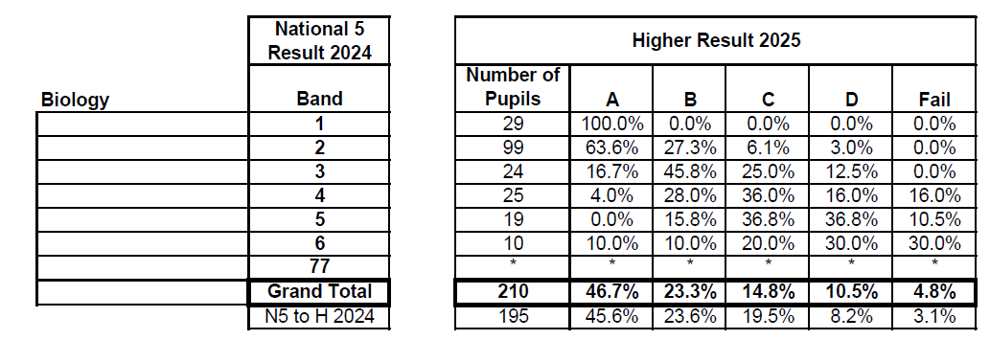
Progression statistics ERC (sciences)
Human Biology

Slide 9
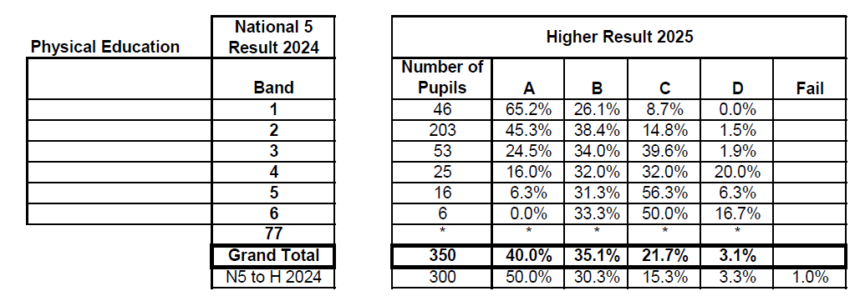
Progression statistics ERC (PE)

Slide 10
Issues
Not choosing the subjects from S4 with best rate for passing
Too many in sciences
Comparing with peers
Ruling out vocational
Hard work – effort required

Slide 11

Chris mckenna
Depute Head Teacher S4

Slide 12

The purpose of tonight
To give you an understanding of the curricular choice process
To offer parents advice on supporting their child through the process
To offer advice on making the right decisions
To give information about the curriculum and the wider supports on offer
To give you the opportunity to visit and speak to staff from all areas of the school
To give you the opportunity to speak to Pastoral Care Teachers (in the Pastoral Base on the Ground Floor) & Skills Development Scotland (in café bar.)

Slide 13

Choice at end of S4
Stay on at school for S5 or until the end of the year
Commitment, hard work and good attendance required
Build on success from S4
Look at recent full/tracking reports and prelim results/written reports
Leave - further education, modern apprenticeship, employment
Need to look at entry requirements for the courses/apprenticeships you are interested in

Slide 14
Attitude/effort
Attendance/time keeping
Work ethic
Time management – school work, folios, assignments
Study skills
Wellbeing

Slide 15

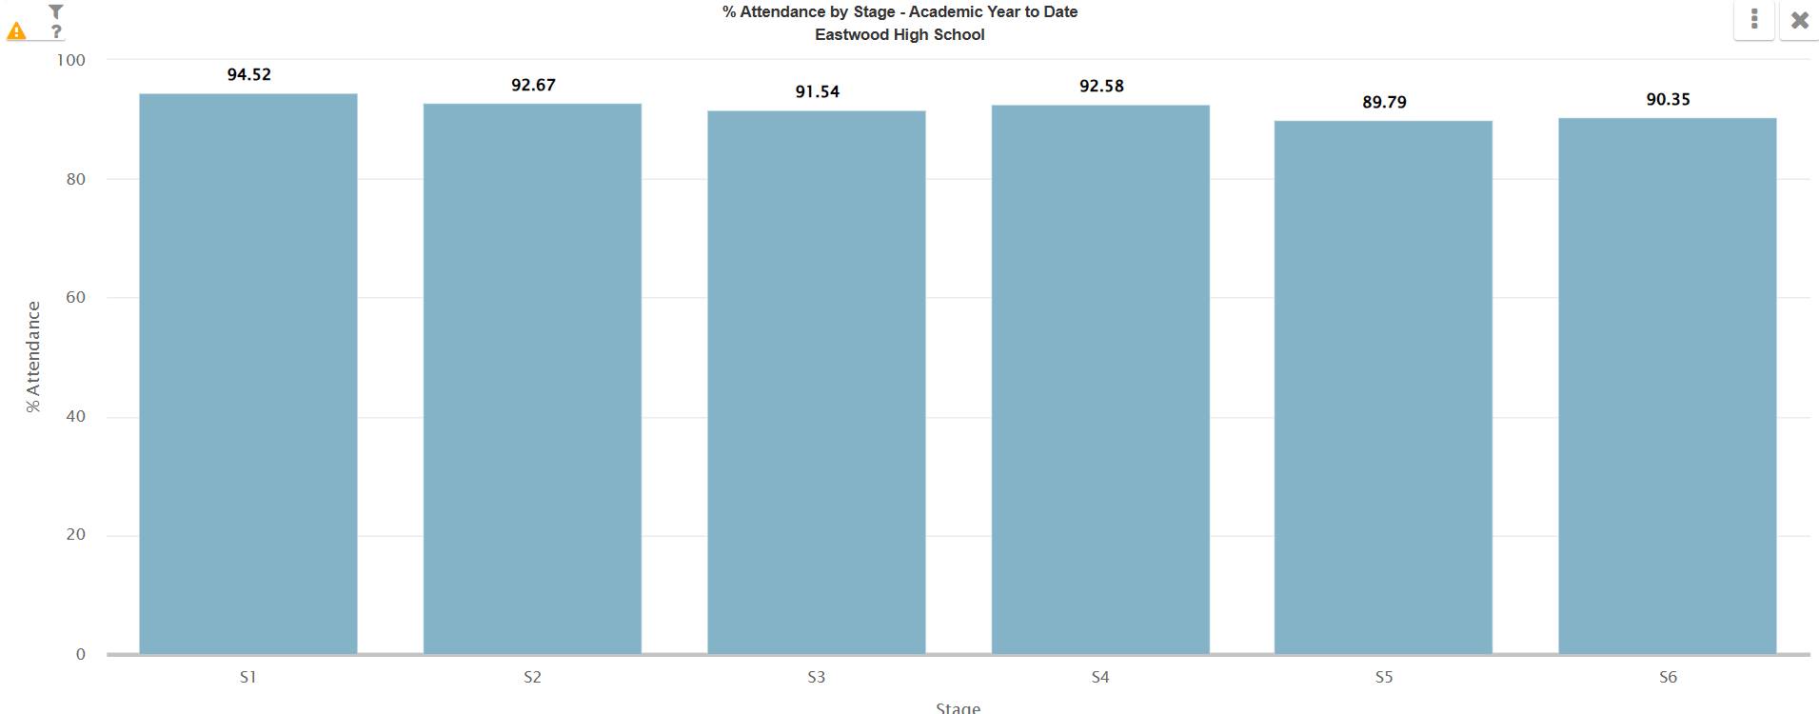
attendance

Slide 16
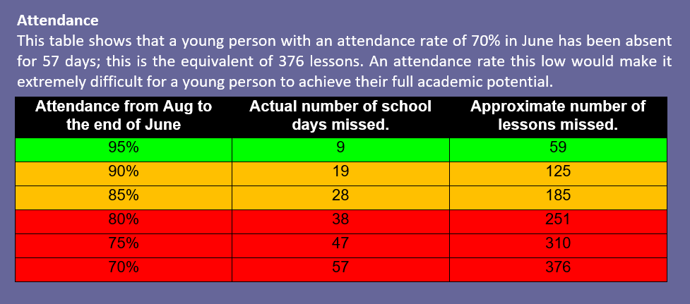

Slide 17
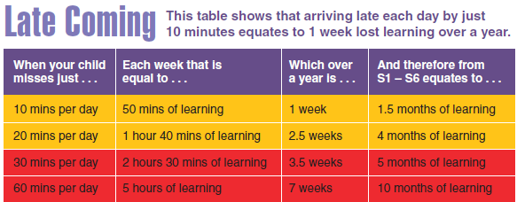

Slide 18

Options lessons in pshe

Slide 19
Options lessons PSHE
Pupils issued with Options Research forms and encouraged to discuss with class teachers
Pupils encouraged to explore best pathway for their future
SDS
Pastoral Care
Class teachers
DHT

Slide 20
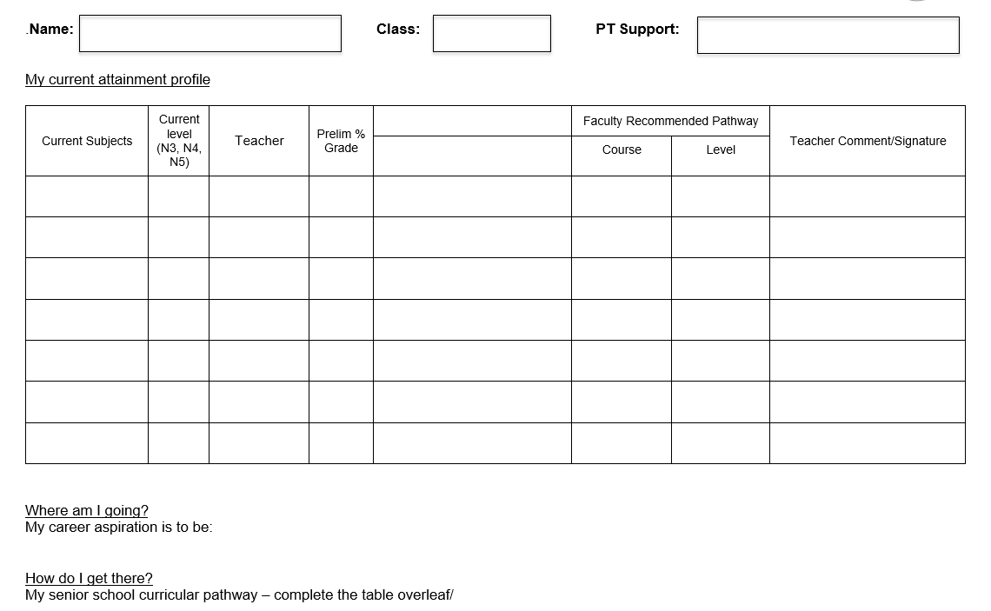

Slide 21
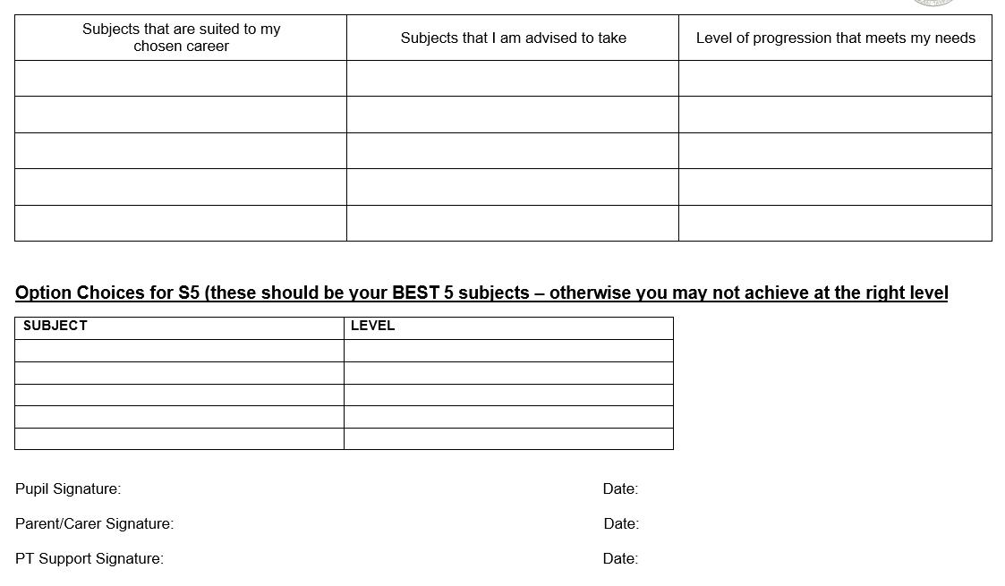

Slide 22
Options Key Dates
Thurs 15th January
Curricular Choice Evening
Presentation and options booklet uploaded to the school website
Week beg. 19th January
Work Experience
Full reports to parents
Week beg. 26th January
Options assembly
Options form emailed to parents
Friday 6th February
Initial options form returned
Monday 9th and Tuesday 10th February
Options interviews
Friday 13th February
Final options form returned
Tuesday 2nd June
S5 timetable begins

Slide 23
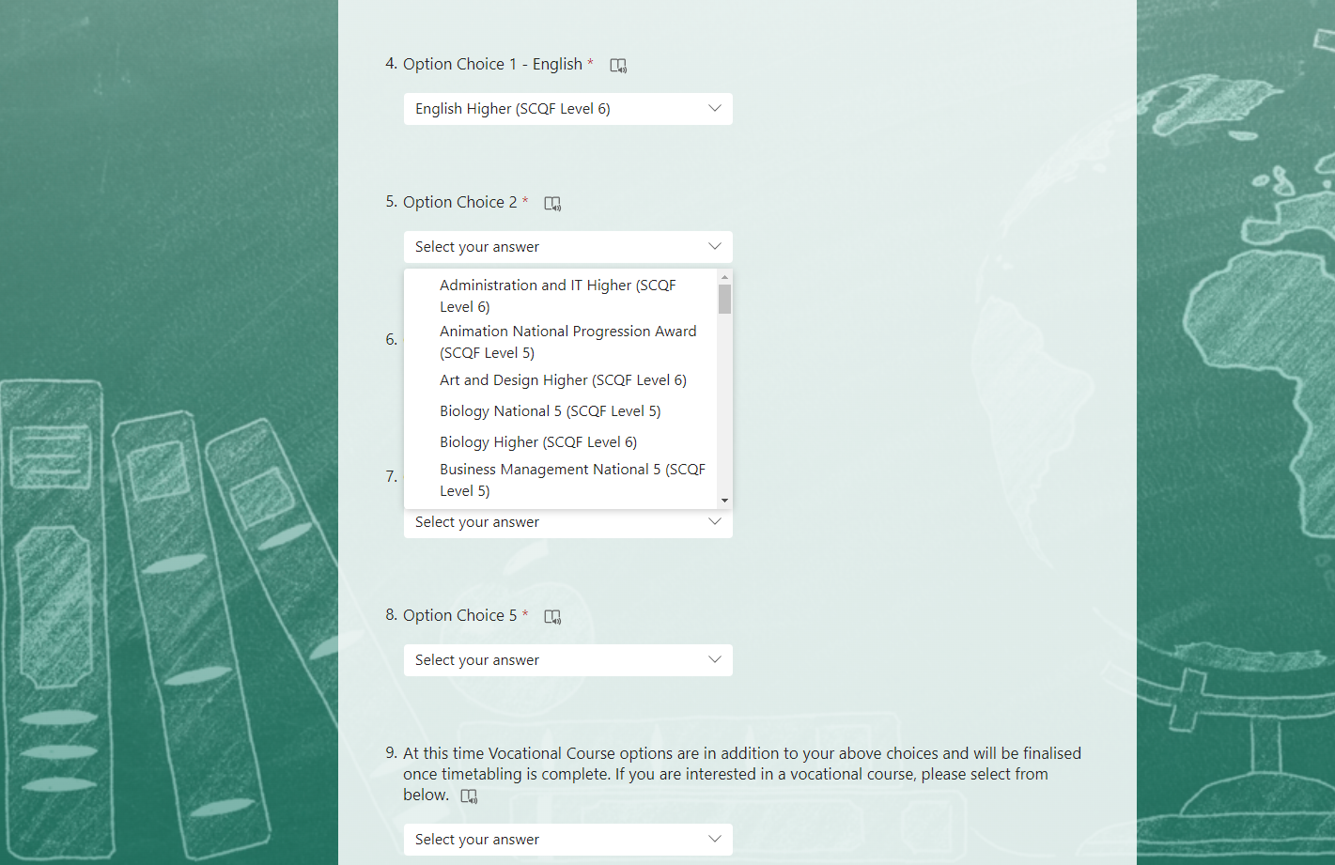

Slide 24
current column structure
A | B | C | D | E
Biology H Business Management H Chemistry H English H/N5 *Level 6 Communication PE H Physics H RMPS H | French H Geography H History H Applications of Mathematics H/N5 Maths H Media N5 Modern Languages for Life and Work (Italian) Level 5 Modern Studies H PE H Spanish H | Administration H Applications of Mathematics H/N5 Biology H/N5 Business Management H Chemistry H Computing H Design & Manufacture H Graphic Communication H Health Sector N5 Health and Food Tech H Mathematics H Music Technology H Physics H Practical Cookery N5 | Art H Business with IT NPA (Level 5/6) Design & Manufacture H Drama H English H Fashion & Textiles H Geography H Health and Food Tech H Music H Musical Theatre NPA (Level 6) Practical Cookery N5 Practical Woodwork N5 Vocational Courses | Administration H Art H Animation NPA (Level 5) Biology H Business Management H Chemistry H Creative Thinking (Level 4/5) Computing H Drama H Geography H Graphic Communication H History H Modern Studies H PE H PE Leadership (Level 5/6) Physics H Spanish H Travel and Tourism N5
Note: Subjects will not be delivered if the uptake is too low

Slide 25


Karen Rees
Claire McCanney
Careers Advisers
Situated in Café Bar (outside Pastoral)
Notes:
Introduce self and session S4 options and routes and pathways beyond school

Slide 26
Bethany Williams
Principal Teacher of Pupil Support

Slide 27
Vocational Programme

Slide 28
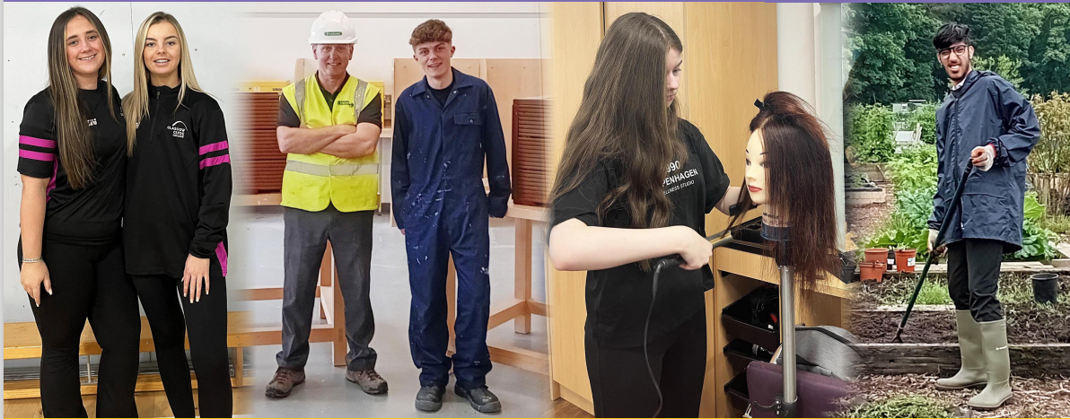
Programme Details
Opportunity to gain relevant qualifications and practical experience
Most courses run from August to May
Progress reports provided
Attendance/attitude/performance monitored
Courses do not run on school holidays or in-service days

Slide 29
Benefits of Vocational Courses
Relevant for career/work
Practical work
New environment/opportunity to try college
Treated as an adult
Qualifications – National 4, National 5, National Progression Awards, Higher, National Certificate & University Level 1 and 2

Slide 30


Programme Details
2 half days
Tuesday and Thursday afternoons
Friday morning
Periods 1 and 2
2.5 days per week
Monday, Tuesday and Wednesday afternoons, Thursday all day
Transport provided or free travel card

Slide 31
Courses are available in the following areas:
Aviation and Travel
Business and Finance
Care, Health, Life Science and Social Care
Construction and Engineering
Creative and Digital Industries and Music
Events Management
Fashion and Design
Hair and Beauty
Horticulture, Hospitality and Landscaping
Humanities and Social Sciences
Sport
Vehicle Systems

Slide 32



Applying for a course
Speak to Principal Teacher of Pupil Support and parent/guardian
Complete application forms – one with parents and one in school with Pupil Support teacher at options interview
Places are not guaranteed as only a small number of places are available to each school. You MUST choose five school subjects during the options process and indicate if you are interested in applying for a vocational college course.

Slide 33
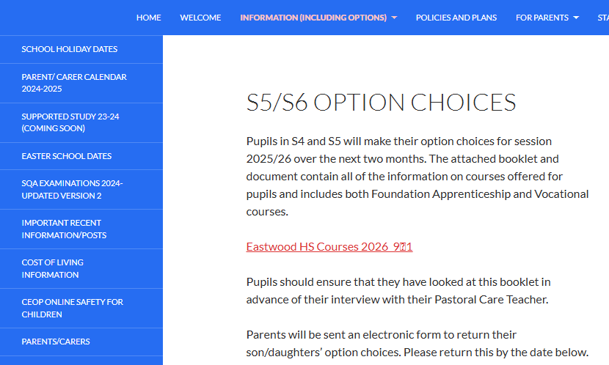
The Vocational Programme is combined within the
school’s options booklet
and can be viewed on the school website.
1
2

Slide 34
NEXT STEPS
Research
Options booklet (available online – school website)
My World of Work website
Ask questions
Electronic options form completed before 6th February
Pastoral will contact you with any changes following interviews

Slide 35

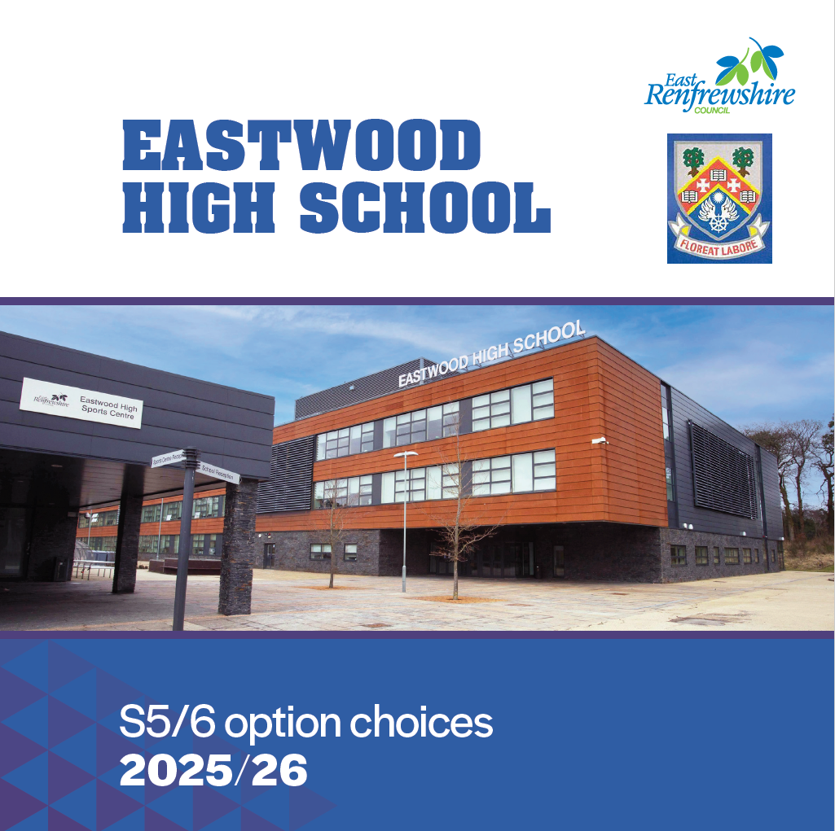
Thank you,
Please remember to sign in when you enter the main building

