Slide 1

S2 Curricular Choice Evening
Welcome

Slide 2

Format
Purpose of this Evening
– Mrs E Gordon (Depute for S2)
Things to Think About
– Mrs K Sinclair (Head Teacher)

Slide 3
Purpose of Tonight
To give you an understanding of the curricular choice process
To offer advice on how best to support your child
To give information about the curriculum
To give you the opportunity to visit and speak with:
Teachers from all subject areas of the school
Pastoral Care Teachers (in the Pastoral Base on the Ground Floor)
Skills Development Scotland (in café bar)

Slide 4
Nov – Jan | Interview with Skills Development Scotland (Careers Advisor) Exploring skills, qualities and future career options in PSHE Pupils issued with Options Research Forms Curricular Choice Evening Departments deliver presentations to pupils about subjects on offer
23rd January | S2 Options Assembly (Pupils) Electronic Options Form and Catalogue sent to parents/carers
29th January | S2 Parents’ Evening Opportunity to discuss your child’s progress and suitability for subjects Pupils complete Options Research Form ahead of interview with Pastoral Care Teacher.
1st February | Deadline for Electronic Options Forms to be submitted
2nd and 3rd February 6th February | Options interview with Pastoral Care Teacher FINAL OPTIONS COMPLETED

Slide 5
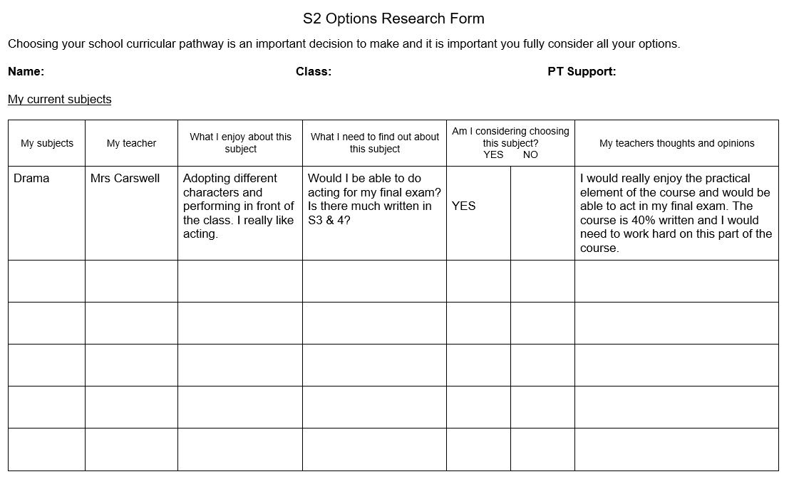

Slide 6
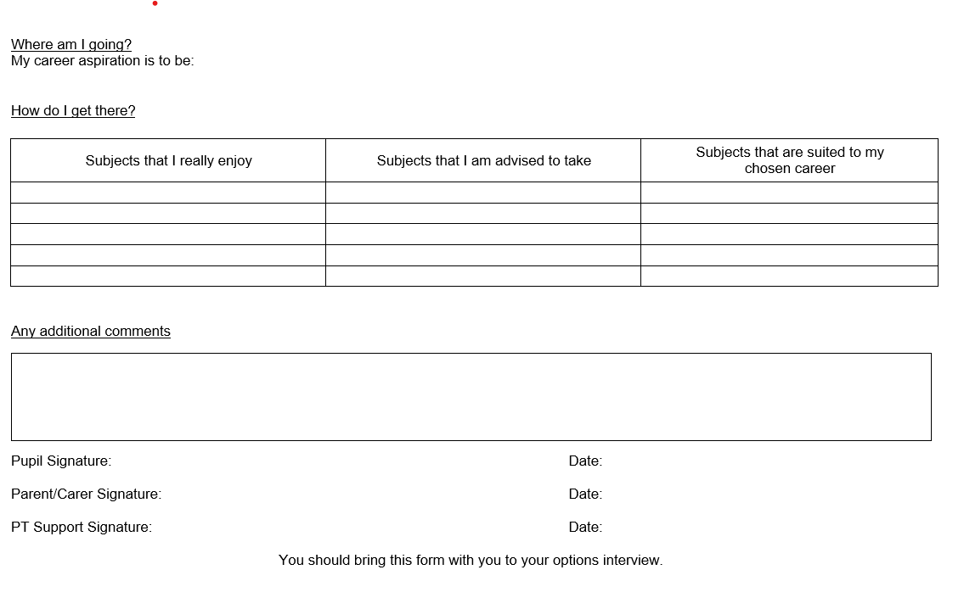

Slide 7


Slide 8
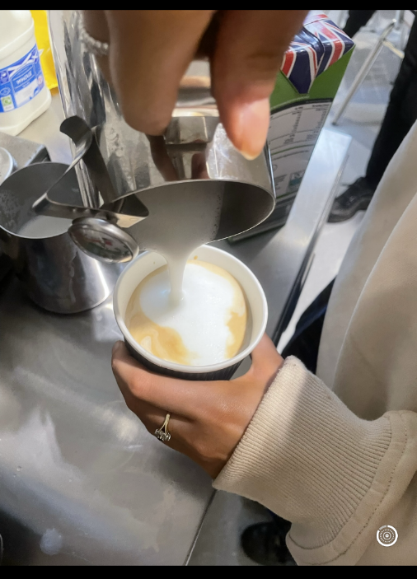


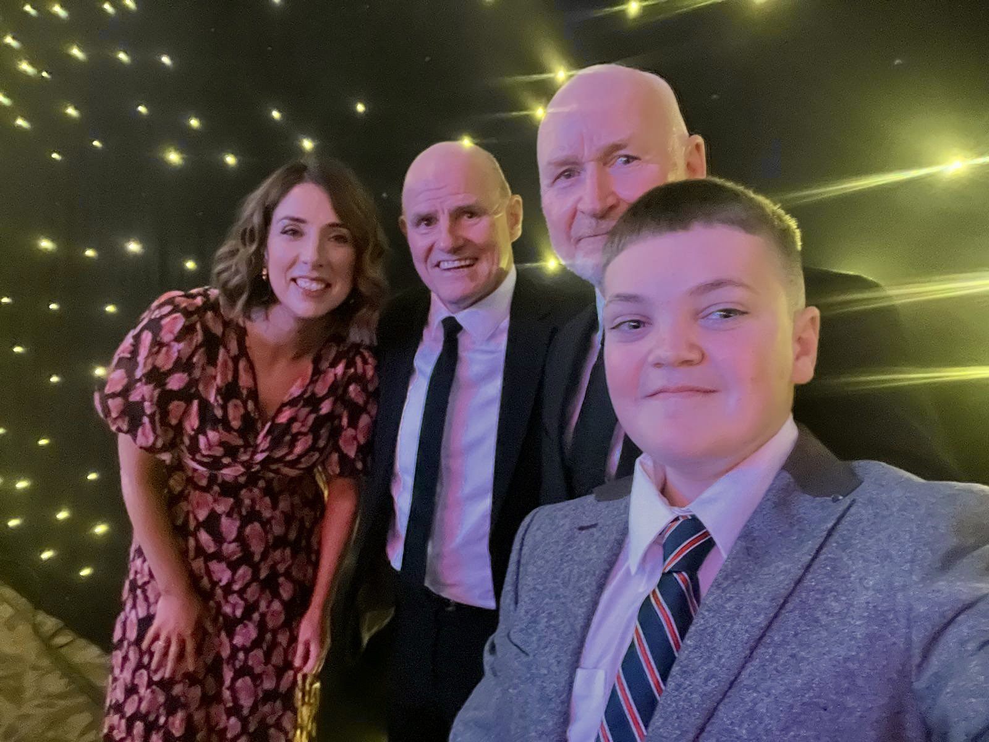

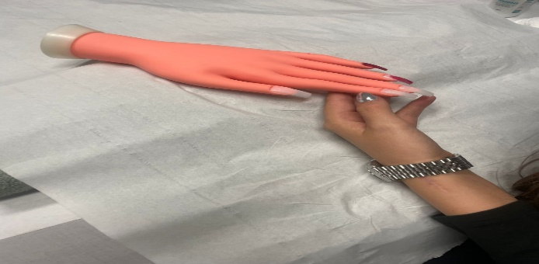
Bespoke Qualifications
Beauty Therapy (Level 4 & 5)
Barista and Retail (Level 5)
Sport and Recreation (Level 5)
Creative Industries (Level 5)
Lab Science (Level 5)
Financial Services (Level 5)
Rangers Foundation Training – Employability qualifications

Slide 9

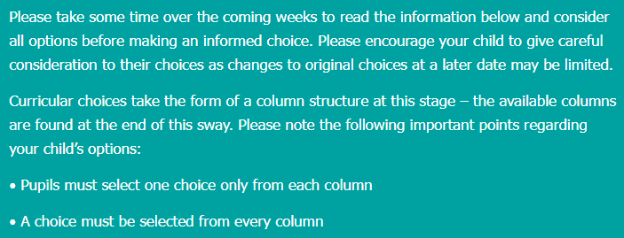

Slide 10


Slide 11
Scottish Credit and Qualifications Framework (SCQF)
It’s Scotland’s lifelong learning framework
It helps pupils visualise and plan their learning journey
It helps people understand qualifications and how they relate/compare to one another
It recognises people’s learning and gives them credit for what they’ve achieved

Slide 12
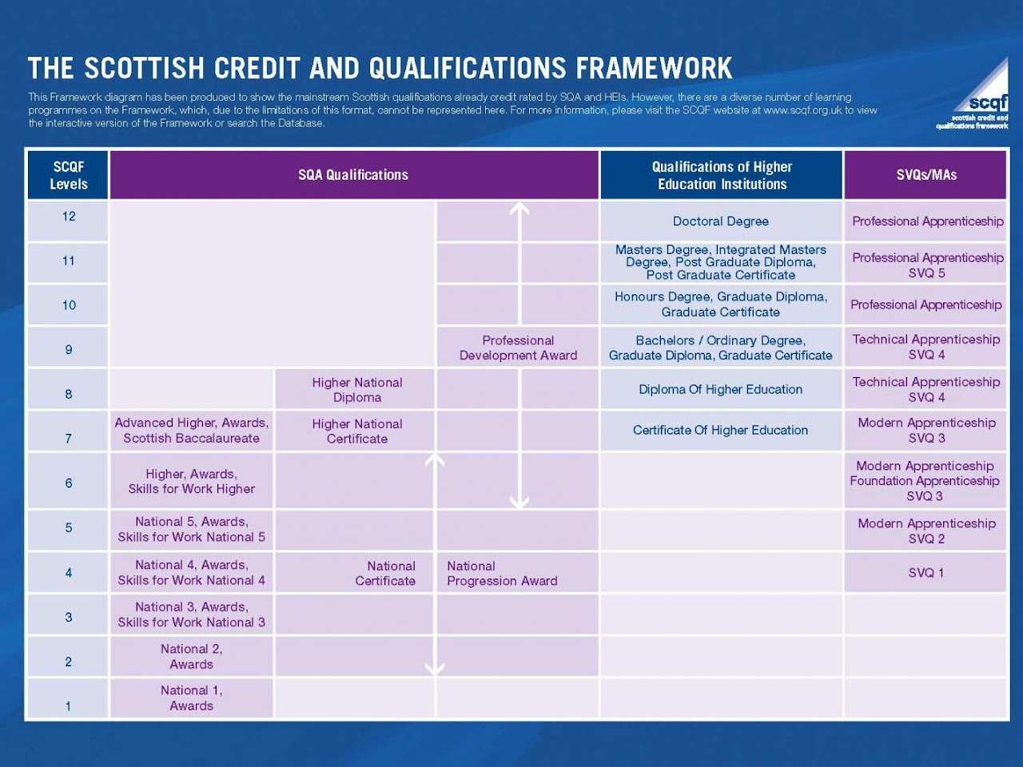

Slide 13
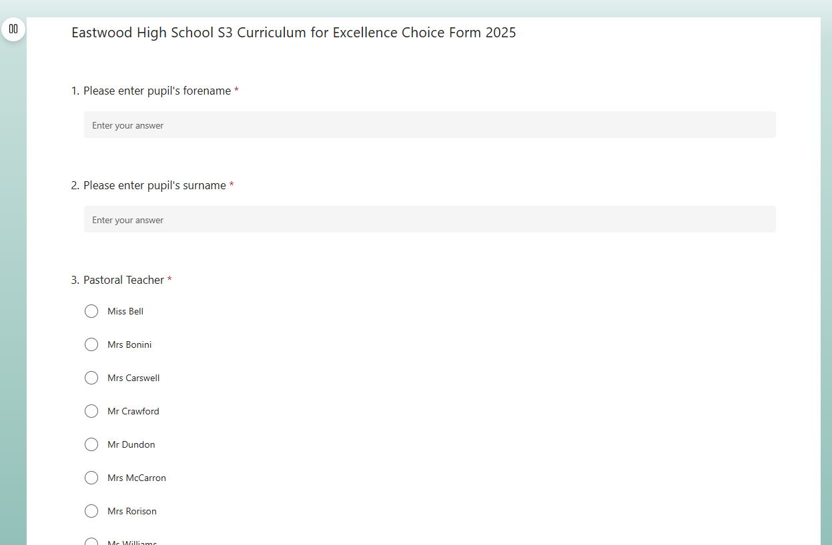
Electronic Options Form

Slide 14
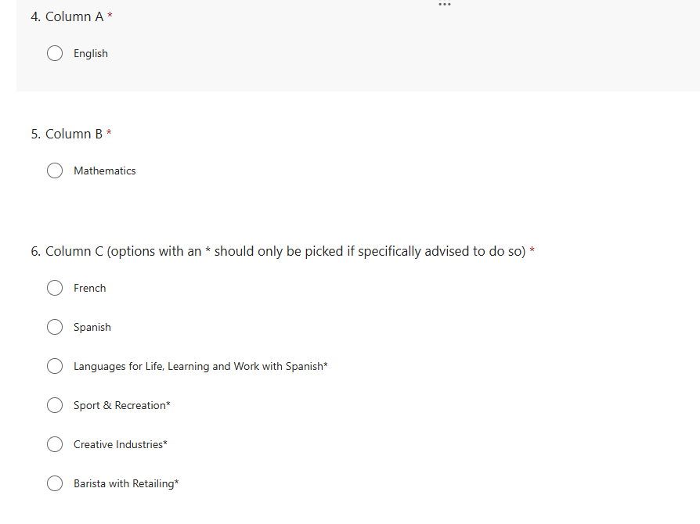

Slide 15
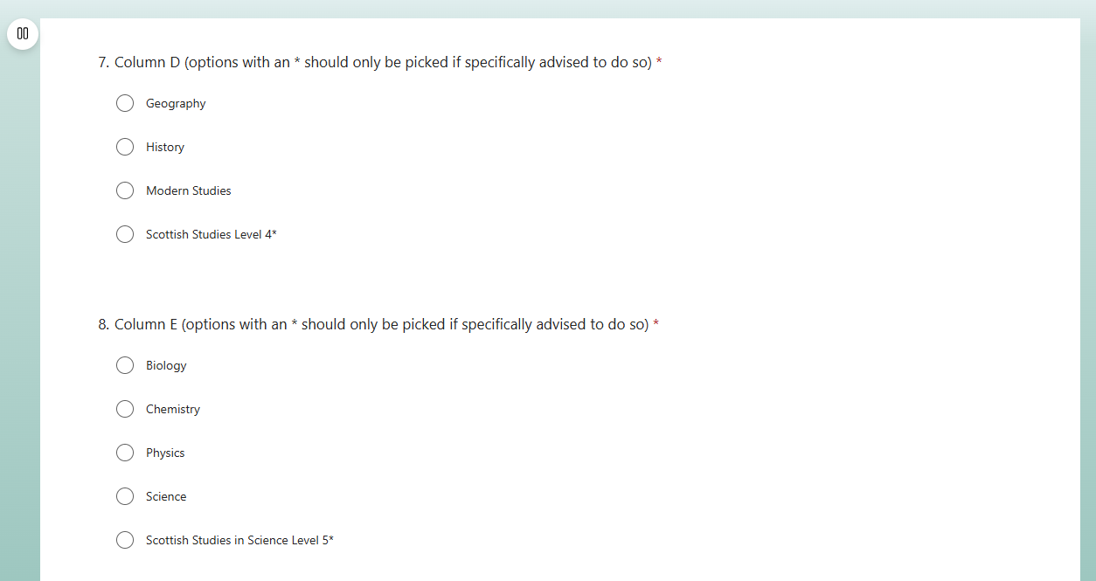

Slide 16
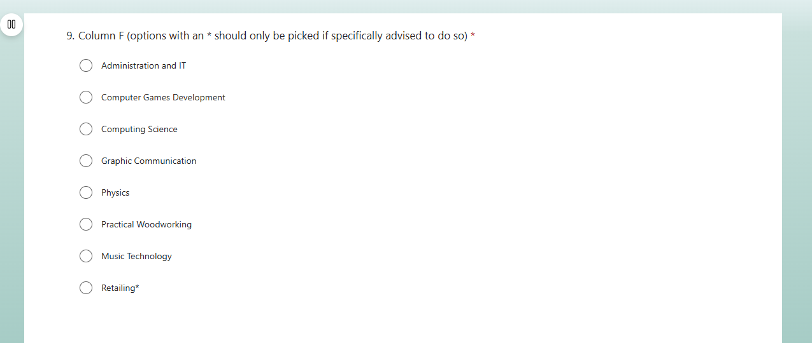

Slide 17


Slide 18


Slide 19
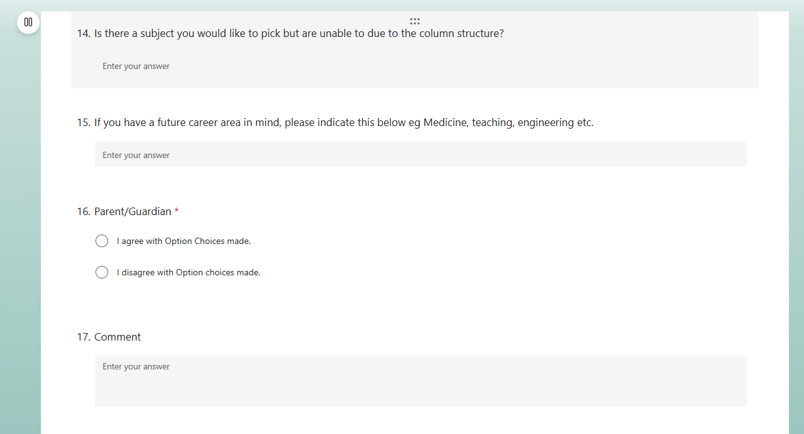

Slide 20
Physical Education
PE – majority of students choose to study N5 PE at beginning of S3
Combination of practical and theory work (approx. 1 period per week)
Assessment = 60% practical mark (one off performances) and 40% theory (portfolio)
Religious Moral and Philosophical Education
Pupils can choose to take National 4 or National 5
Assessment = 80% final exam and 20% assignment
Religion, Morality and Philosophy

Slide 21
Timetable Process
March - Completed option forms sent to ERC
– No changes made after this point.
Timetable - schematic created of our school
April & May – teachers and classes allocated.
New timetable starts on Monday 1st June

Slide 22
Stage | Open Curriculum | Core
S1 – S2 | 13 subjects | PE, PSHE & RE
S3 – S4 | 8 subjects | PE, PSHE & RE
Breakdown of S3 and S4 Curriculum
English and Maths (4 and 5/5 and 4 periods)
French/Spanish – continue from S2 (3 periods)
5 open choices (5 x 3 periods)
PSHE (1 period)
PE – N5 or Core (3 Periods)
RMPS – N4 (2 Periods) N5 (3 Periods & PSHE)

Slide 23
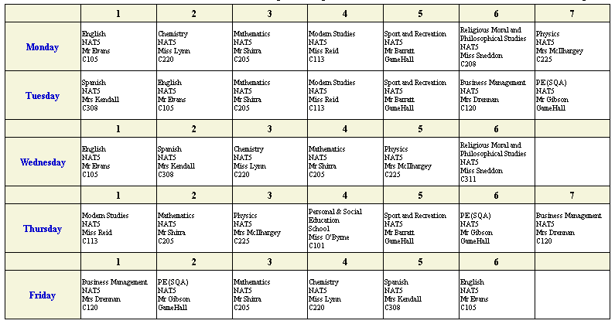

Slide 24


Skills Development Scotland
Our SDS Careers Advisors are available in the café bar this evening
One-to-one interviews and PSHE lesson input so far this year
My World of Work website with focus on Career Management Skills
Please go and see them for advice and guidance on future career options

Slide 25
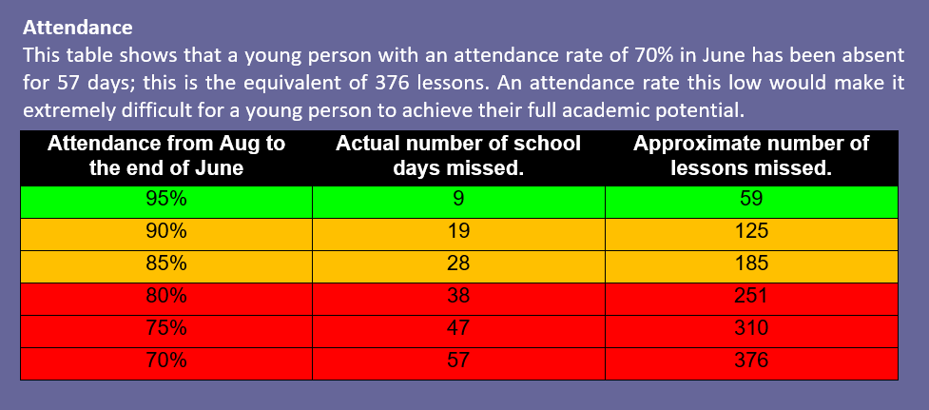

Slide 26
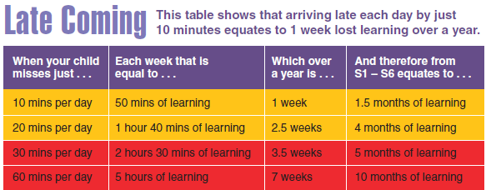

Slide 27

Kate Sinclair
Head Teacher of Eastwood High School

Slide 28
Year Group
Very proud of their progress
School values demonstrated

Slide 29
What To Think About - 2 years in subjects, where do they thrive?
Breadth
Curricular pathways
Issues from our analysis
New subjects/courses – ask questions
Progression – S5 chosen from subjects in S3/S4

Slide 30

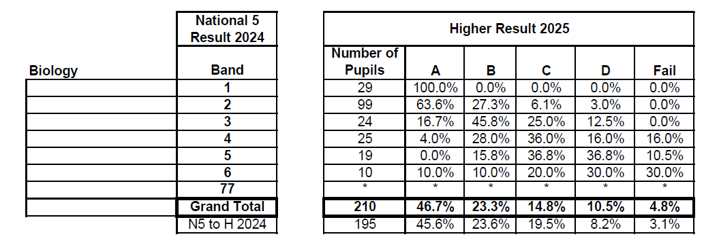
Progression statistics ERC (sciences)

Slide 31
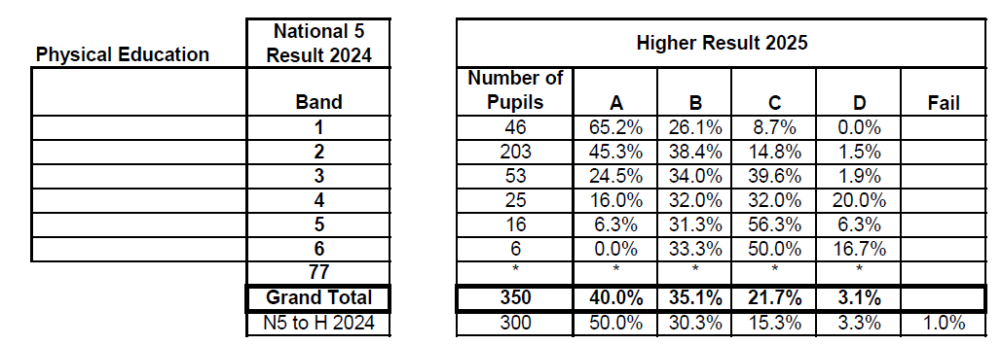
Progression statistics ERC (PE)

Slide 32

NEXT STEPS
Research
Options Research Form
My World of Work website
Visit departments and speak to teachers this evening
Electronic options form submitted by Sunday 1st February
Options Interviews w/b 2nd February
Pastoral Care Teacher will contact you with any changes following interviews
Please sign in when you reach the main building.

