Slide 1

Eastwood High School
P7 Parents’ Information Evening
Thursday 13th June
18:30 Crookfur Primary, Neilston Primary, Uplawmoor Primary and Non-cluster Schools
19:30 Mearns Primary

Slide 2
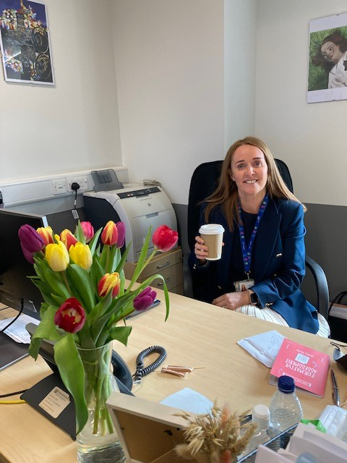
Senior Leadership Team
Head Teacher – Kate Sinclair
DHT S1/S6 – Chris Morris
DHT S2 – Emma Gordon
DHT S3 – Judith Boulton-Jones
DHT S4 – Chris McKenna
DHT S5 – Allison MacKinnon

Slide 3

Principal Teachers Pastoral Care
Audrey Bonini – PT Pastoral Care (Learning)
Laura Carswell– PT Pastoral Care
Jane Sinclair/Stephanie Bell – PT Pastoral Care
Jason Dundon – PT Pastoral Care
Laura McCarron – PT Pastoral Care
Pauline Rorison – PT Pastoral Care
Bethany Williams – PT Pastoral Care
Ross Williams – PT Pastoral Care (Inclusion)
Notes:
The key point of contact will be your child’s pupil support teacher- this should be the same person that older siblings have/ had unless that person has left. This is who you should contact if there are any issues that you need to make the school aware of and they will be your liaison with the school.

Slide 4






Transition information
House System
Extended transition events
Induction days
  Kindness
Lockerbie
  Looking out for each other
Book choice
P7 Sports day
Escaped crocodiles

Slide 5
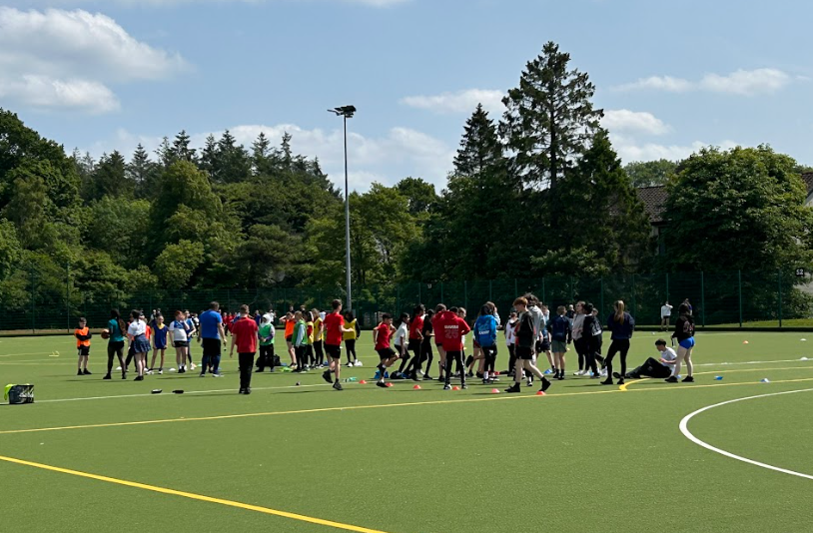

Slide 6
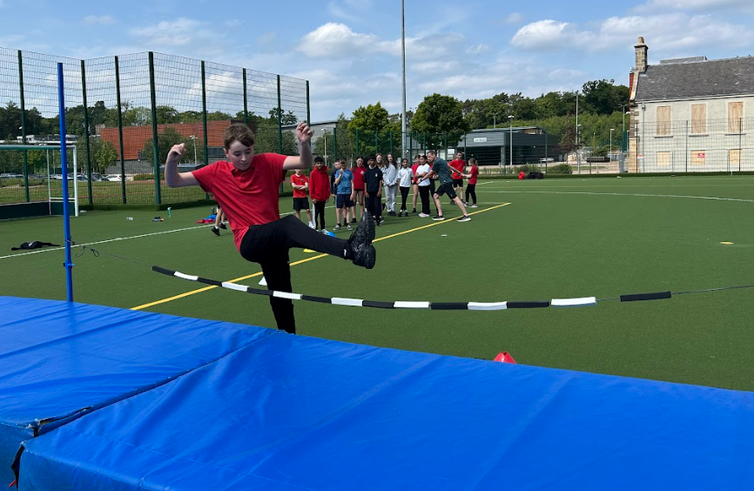

Slide 7
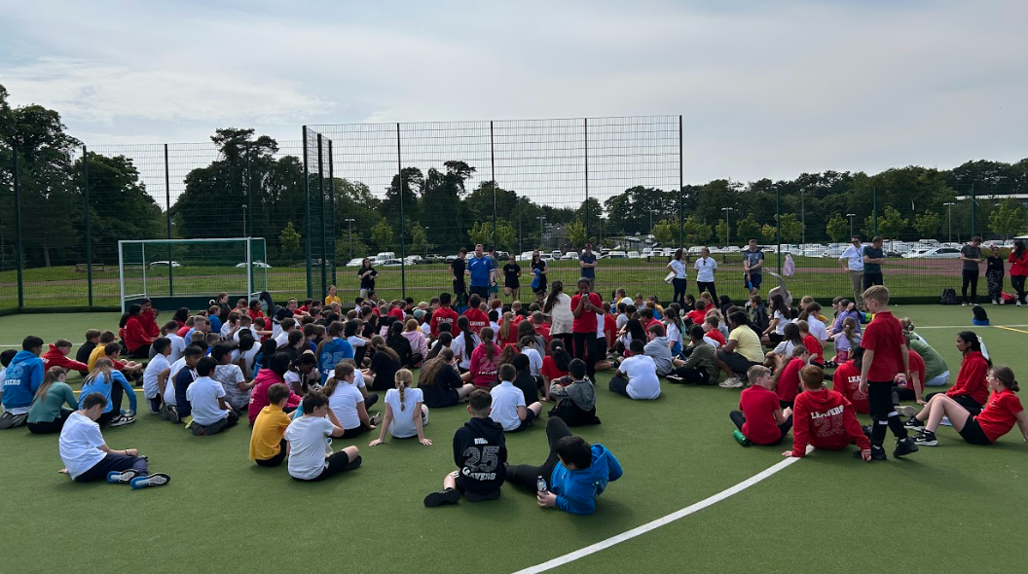

Slide 8
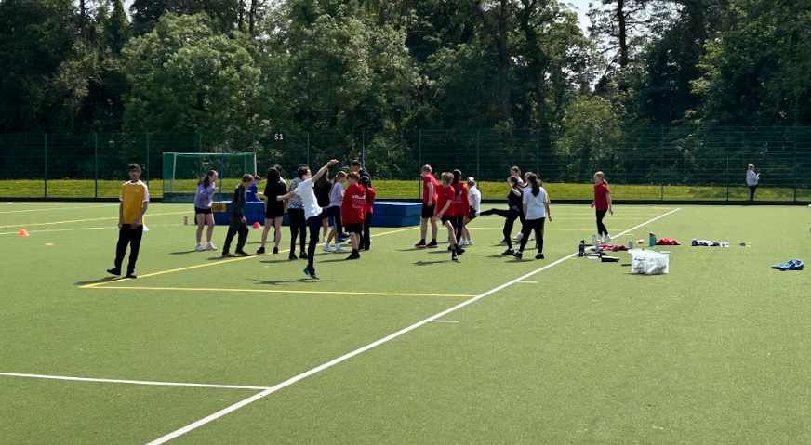

Slide 9
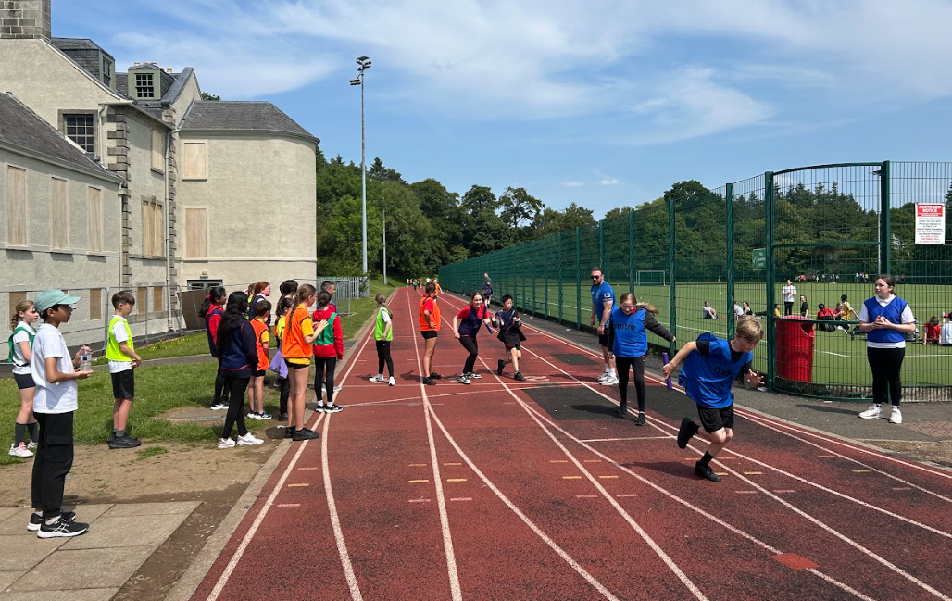

Slide 10
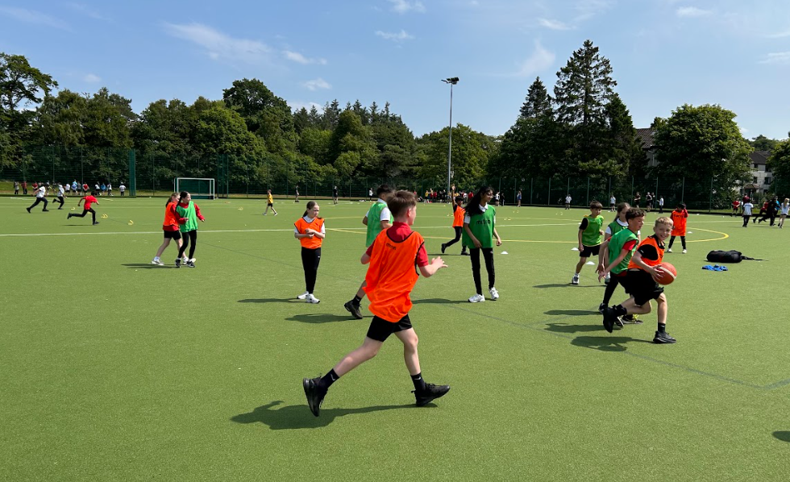

Slide 11
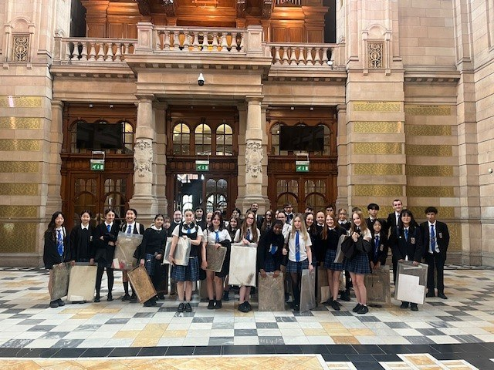
The School Day
Period 1 8.45 – 9.35 (first bell rings at 8.40am)
Period 2 9.35 – 10.25
INTERVAL
Period 3 10.40 – 11.30
Period 4 11.30 – 12.20
LUNCH
Period 5 1.05 – 1.55 (first bell rings at 1)
Period 6 1.55 – 2.45
Period 7 2.45 – 3.35 (Mon, Tues, Thurs)

Slide 12
Timetable Structure Structure
Registration groups (1.1 – 1.8) – Modern Languages, Social Subjects
Practical groups 1A- 1M – Music, Drama, Art, ICT, Science, Technical, Home Economics
English / Mathematics – different sections
Pastoral Care groups – PSE, RMPS, PE (may be mixed)

Slide 13
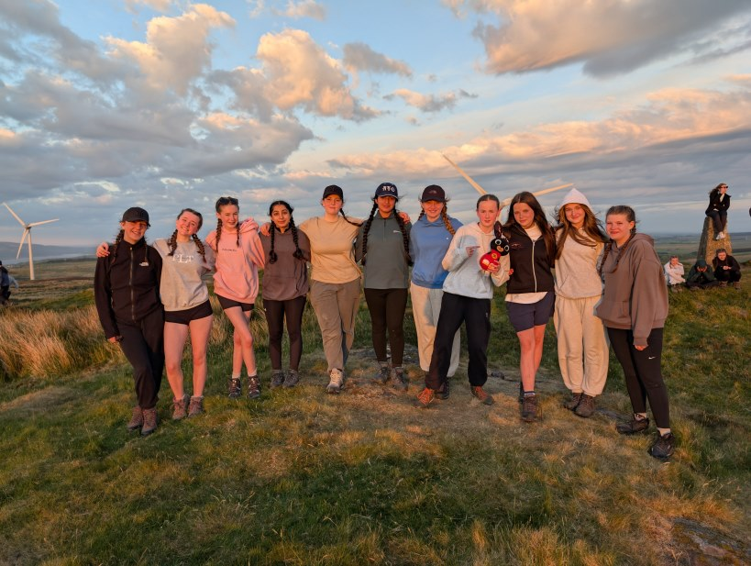
Period Allocation
English – 5 periods
Maths – 4 periods
French – 3 periods
Geography / History – 3 periods
Science – 3 periods
IT/Tech/Art/Drama/Music/Home Ec – 3 of these 3 times per week
PE – 3 periods
RE – 2 periods
PSHE – 1 period

Slide 14
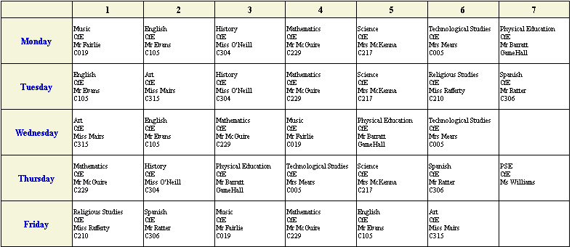
A sample timetable

Slide 15
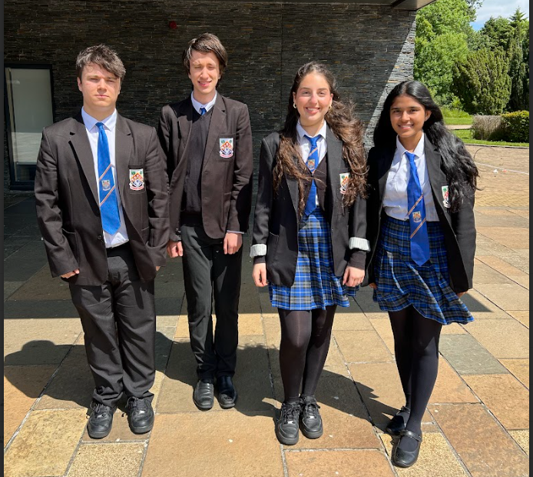
SCHOOL UNIFORM
Black shoes (no trainers)
Black trousers or skirt
White shirt
School tie
Black blazer with school badge
Plain black v-neck or cardigan

Slide 16
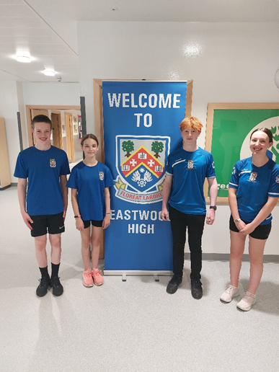
Sports Uniform
PE Kit
  Eastwood HS PE t-shirts – more info coming soon
  Dark blue t-shirt or EHS PE T-shirt
  Dark shorts or leggings
  Appropriate training shoes (clean footwear for indoor use)

Slide 17
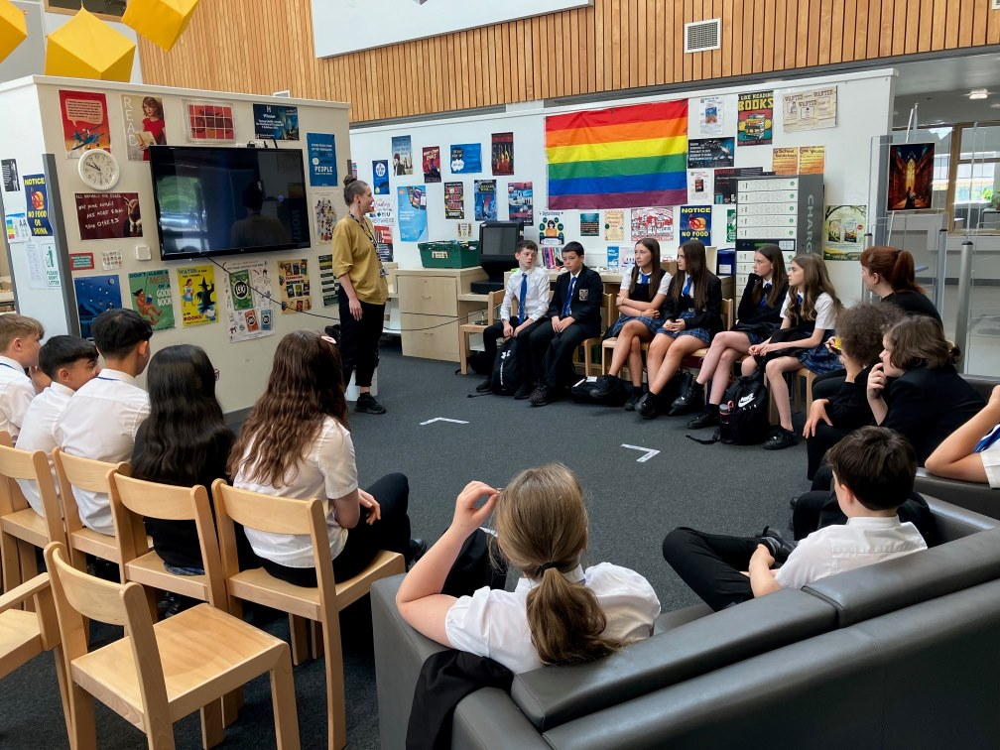
Lunchtime
All S1 pupils remain in school grounds (unless going home)
ParentPay system (all payments)
FSM
Hockey pitch
Extra-curricular activities

Slide 18
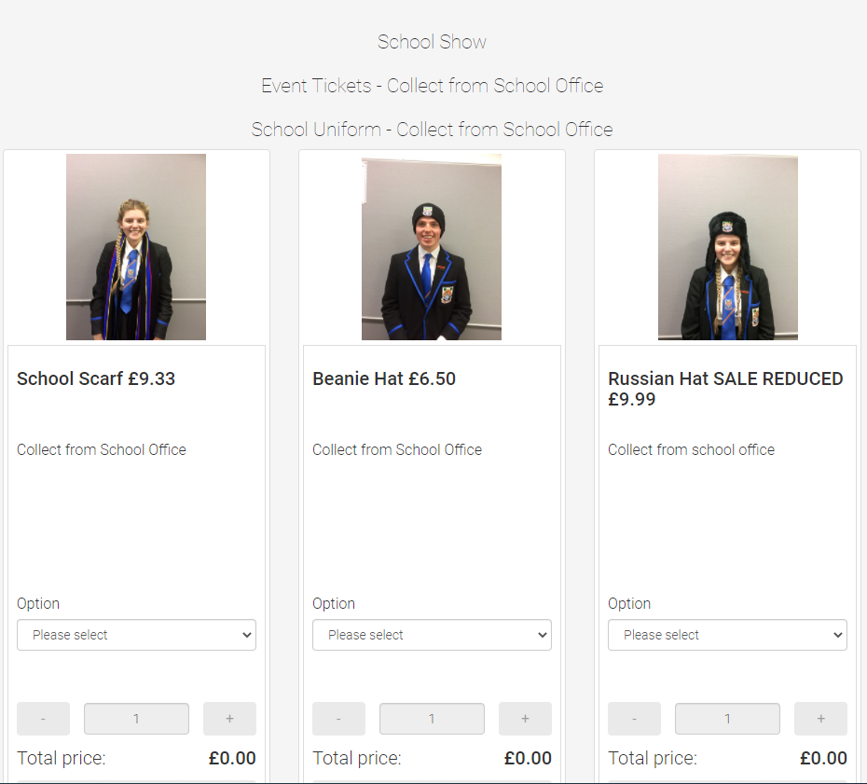
Parent Pay Shop
Lockers
Ties
School hats
Scarves
Link on school website
https://app.parentpay.com/ParentPayShop/Uniform/Default.aspx?shopid=640

Slide 19
What do we expect from your son/daughter?
Attendance / Timekeeping
Classwork / Homework
Uniform
Personal values – respect, kindness, ambition, do their best
Contribution

Slide 20
What should you expect from us?
- support and advice -
Class teachers
Principal Teacher
Pupil Support
  – Pastoral, Learning, Inclusion
Other support
  – Campus Cop, Careers Advisor, Healthier Minds (Educational Psychologist, school counsellor, Children’s First)
DHT – Chris Morris
Do our best

Slide 21
What should you expect from us?
- communication
S1 Information Evening
S1 Tracking report
S1 Parents’ Evening
S1 Full report
Newsletters
Website
Informal communication

Slide 22
Communication
https://blogs.glowscotland.org.uk/er/eastwood/
Text Messaging
Letters from subjects PTs/ Pastoral Care PTs
0141 577 2200
Email : SchoolMail@eastwood.e-renfrew.sch.uk
Notes:
We try to communicate very clearly as there is a lot going on in secondary school. You will find a calendar on our home page of the website for the year, There is a handful of evenings with no events when teachers have training meetings immediately at the end of the school day but the majority of days it is a very busy place with staff volunteering to do clubs and supported study at the end of each day. Please use this calendar and the school website for all the major events. ​
​
You can let us know of achievements by contacting the school office or PTPC. If your child achieves something notable when at Eastwood they may be eligible for school colours or a range of achievement badges. ​
​
In terms of communication our main domain is currently Twitter and the school website. Most depts. In the school have their own Twitter account and regularly use these to celebrate achievements and to highlight what is going on in their dept. We don’t receive or answer any tweets but feel free to like our tweets and retweet them!​
There is a weekly assembly for pupils where I will share any upcoming events or important information.
If your child loses something- please phone the school office. Make sure everything has their name on it or it will be donated to charity after a while.
​
We will text for any unconfirmed absences and if your child is ill please phone or email the school office.

Slide 23
PTA and Parent Council
Denny Henderson

Slide 24

Expectations
Anxiety
Out of Class
Mobile Phones
Be kind
Look after each other
Do your best
Thanks to P7 staff and S6 helpers
Lost property

