Slide 1

S5 Curricular Choice Evening
Thursday 18th January 24

Slide 2
Kate Sinclair
Head Teacher

Slide 3
Transition point
Decision to make – S6/life after school
S5 exams – not taken place yet
“crash” Highers
4 subjects – full time education
Volunteering
Issues
Attendance – next slide
Great year
Go around departments/ask questions

Slide 4
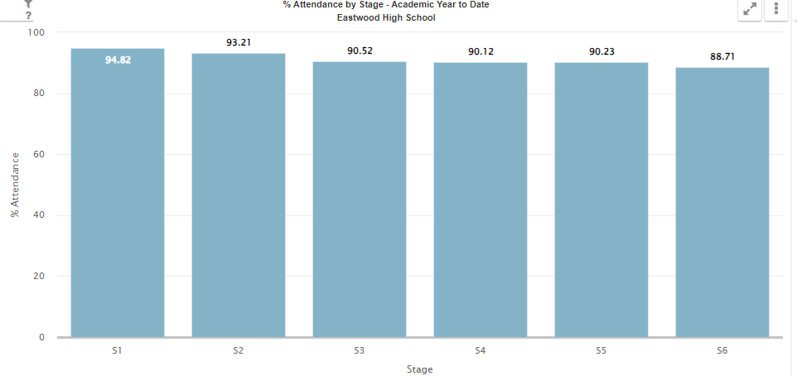
Attendance

Slide 5
Emma Gordon
Depute Head Teacher (S5)

Slide 6
Speakers
Introduction –Kate Sinclair (HT)
Options Process – Emma Gordon (DHT)
Vocational Courses – Bethany Williams (PT Pupil Support)
Pastoral / UCAS – Jane Sinclair (PT Pupil Support)

Slide 7

Options Key Dates
Thurs 18th January: Curricular Choice Evening
- copy of this presentation emailed to parents this evening.
Week beg. 19th February Options form to parents
Week beg. 4th March Options interviews with Pastoral
15th March ALL S5>S6 Final Options Form must be returned
Monday 5th June: S6 timetable begins

Slide 8
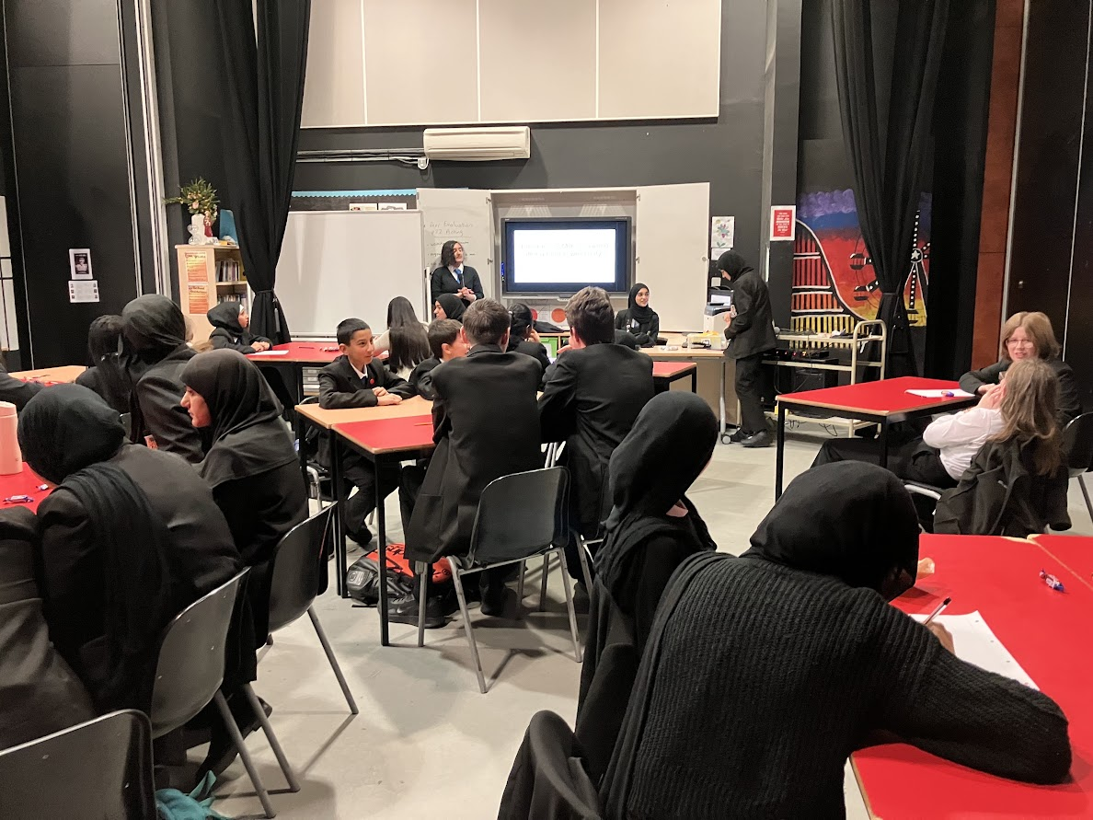
Where to now?
Depends on…
Where are they now ?
What do they want to do in the future ?

Slide 9
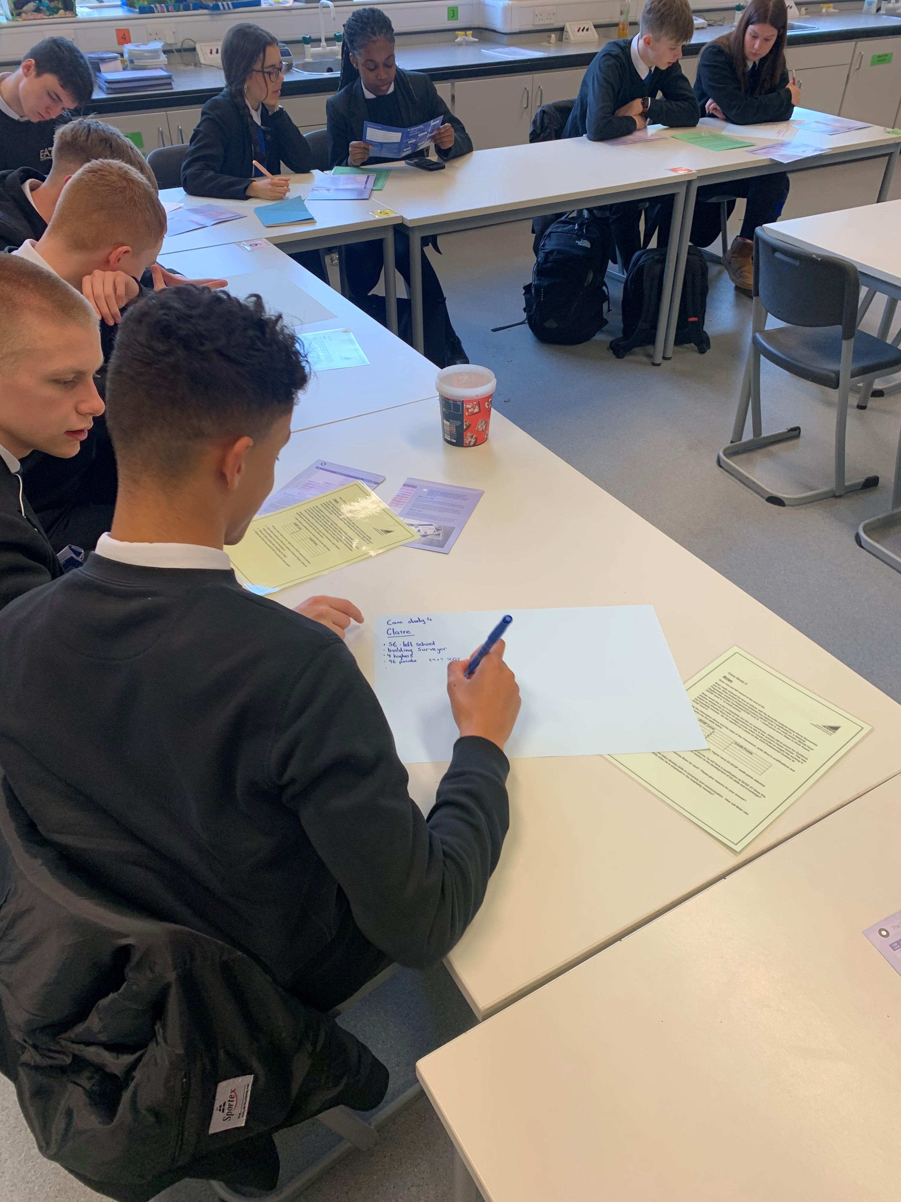
Where are they now?
S4 SQA exam results
Tracking reports in Oct & Dec
Feb prelim results
Full reports (Fri 8th March)
Final exams & Results (Aug)

Slide 10
Where do they want to go when they leave school?
Modern Apprenticeship
Employment
Further Education
Higher Education

Slide 11
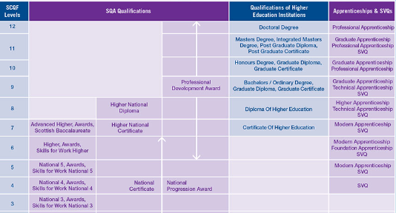
Scottish Credit and Qualifications Framework

Slide 12
S5 into S6 Options Process
Pupils will choose 4 subjects, one of which can be vocational
Except pupils may study 3 Advanced Highers only
Best to consider AH if going to achieve an A or B at Higher and
if required for future employment or university
Subjects on offer will be at SCQF Levels 5, 6 & 7
S6 pupils can ‘crash’ Highers but this involves extra commitment
Choices should be realistic, ensure progression and challenge

Slide 13
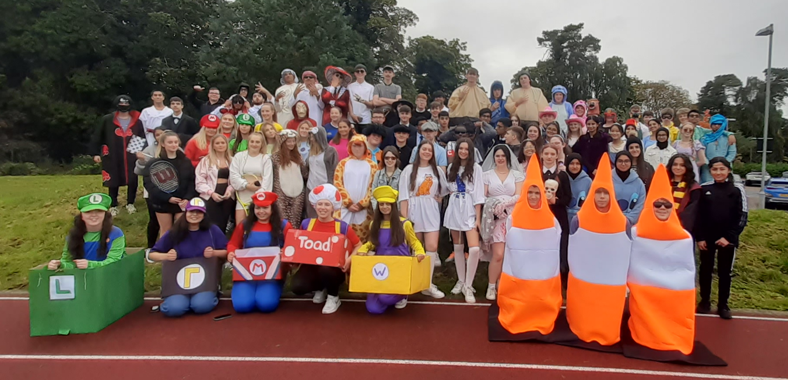
Volunteering
S6 gives pupils the opportunity to build skills that employers, colleges and universities are looking for & to give something back to the school
All pupils will choose a volunteering option
Application forms for Head Boy & Head Girl and Pupil Leadership Team will be distributed in April

Slide 14
Payment of £30 per week to the young person
Household income below £24,421 for one child
Household income below £26,884 for more than one dependent child
Young people between ages of 16 & 19
Paid fortnightly, issued one week later
Not payable during holidays
Need to re-apply each year
Education Maintenance Allowance

Slide 15


Slide 16
Bethany Williams
Principal Teacher of Pupil Support

Slide 18
Programme Details
Opportunity to gain relevant qualifications and practical experience
Most courses run from August to May
Progress reports provided
Attendance/attitude/performance monitored
Courses do not run on school holidays or in-service days.

Slide 19
Benefits of Vocational Courses
Relevant for career / work
Practical work
New environment / opportunity to try college
Treated as an adult (responsibility)
Qualifications – National 4, National 5, National Progression Awards, Higher, National Certificate & University Level 1 and 2

Slide 20
Programme Details
2 half days
Tuesday and Thursday afternoons
Friday morning
Periods 1 and 2
2.5 days per week
Monday, Tuesday and Wednesday afternoons, Thursday all day
Transport provided or free travel card

Slide 21
Courses are available in the following areas:
Aviation and Travel
Business and Finance
Care, Health, Life Science and Social Care
Construction and Engineering
Creative and Digital Industries and Music
Events Management
Fashion and Design
Hair and Beauty
Horticulture, Hospitality and Landscaping
Humanities and Social Sciences
Sport
Uniformed and Emergency Services
Vehicle Systems

Slide 22
Applying for a course
Speak to Principal Teacher of Pupil Support and parent/guardian
Complete application forms – one with parents and one in school
Places are not guaranteed as only a small number of places are available to each school. You MUST choose four school subjects during the options process and indicate if you are interested in applying for a vocational college course.

Slide 23
The Vocational Programme is combined within the school’s options
booklet and can be viewed on the school website.

Slide 24
Foundation Apprenticeship

Slide 25

Foundation Apprenticeship

Slide 26
Eligibility Criteria?
Students are expected to have an interest in developing greater awareness of the industry with a potential desire to pursue as a career
Students must be capable of working at Level 6
Some frameworks require English, Maths or other STEM based subjects as entry requirements.
SQA Foundation Apprenticeship qualification will only be issued on full completion of the programme.

Slide 27
Jane Sinclair
Principal Teacher of Pupil Support

Slide 28
Applying to university through
UCAS

Slide 29
WHAT IS UCAS?
UCAS, is the Universities and Colleges Admissions Service, is an independent charity, and the UK's shared admissions service for higher education.
Every person who wishes to apply to a UK university must do so through UCAS.
They can make 5 choices for £27.50

Slide 30
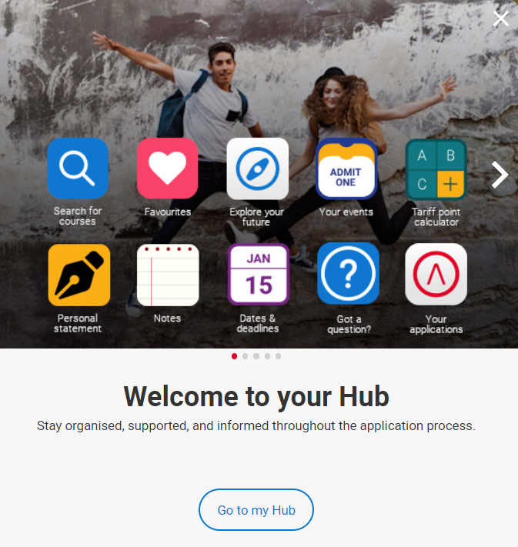
Start research early …
Pupils will star the process in June and will register with the UCAS Hub to:
explore careers, subjects, places, and apprenticeships and find information for over 35,000 courses.
There are many tools for pupils to use in the hub, as well as the online application.

Slide 31
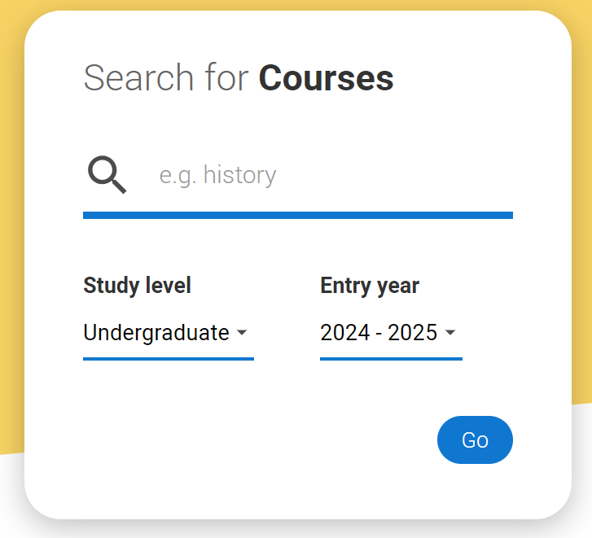
RESEARCH
In June, classes go through lessons focussing on:
Choosing courses and viewing entry requirements
Choosing universities and looking at teaching methodologies
Looking at location and contributing factors like halls of residence, sports facilities, clubs etc

Slide 32







The personal statement
The only section pupils have full control over
UCAS’ similarity detection service:
every personal statement is run through software to check for plagiarism.
The only chance to market oneself as an individual
Its the same statement is used for all of choices
A maximum of 4,000 characters, or 47 lines
A minimum of 1,000 characters
There isn’t a spelling or grammar check
No formatting allowed
18 January 2024
| 32

Slide 33

Start early - June
Included in personal statement:
  academic achievements, past and present
  Why someone is interested in the subject area
  display knowledge of the subject area
  demonstrate enthusiasm to go beyond the syllabus
  what is enjoyable about studying
  details of work experience/on-line courses studied
18 January 2024
| 33

Slide 34
EHS TIMELINES
June – All pupils will create an account on the UCAS hub in PSHE.
June - Pupils applying for medicine, vet medicine, dentistry or Oxbridge (early applicants) must start working on their application and personal statement. Medicine and dentistry applicants should start working on their UCAT – needs to be completed before end of September.
August – All pupils (who wish to apply) will start their application.
September weekend – Early applicants should submit draft to their PCT and ensure all their information has been completed on their online application.
October – early applications must be sent before 15th October – no exceptions.
October break – draft of Personal Statement for pupils submitted to PCT.
November – those who are ready can start to submit their application.
December – ALL applications should be sent before Christmas break.

Slide 35
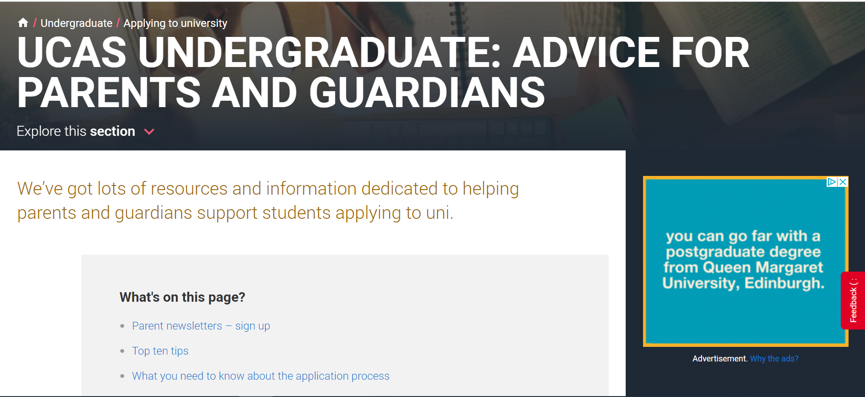
Tools to help …

Slide 36

Thank You
The school Pupil Support Team will answer your enquiries if you wish to phone / email the school.
https://blogs.glowscotland.org.uk/er/public/Eastwood/uploads/sites/83/2024/01/16074215/Eastwood-HS-Courses-2024_25-v2.pdf

