Slide 1
S4 Curricular Choice Evening
Thursday 18th January 2024

Slide 2
Kate Sinclair
Head Teacher

Slide 3
What to think about…
Transition point – vast majority stay on for S5
Choosing from 8/9 subjects
What subjects to take?
Progression statistics

Slide 4
Number of Highers?

Slide 5
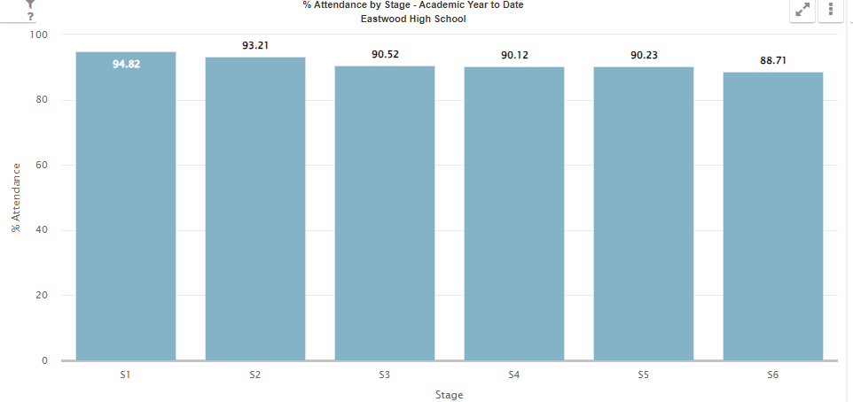
Attitude/effort
Attendance/time keeping
Work ethic
Time management – school work, folios, assignments
Study skills
Wellbeing

Slide 6
Chris Morris
Depute Head Teacher S4

Slide 7
sPeakers
Options Process – Mr C Morris(S4 DHT)
Pastoral/PSE – Mrs P Rorison (PT Pupil Support)
Vocational Courses – Ms B Williams
Stalls for our SCQF Ambassadors and Skills Development Scotland for Careers Advice

Slide 8
The purpose of tonight
To help you understand the curricular choice process
To offer advice on supporting your child
To give information about the curriculum
To explain our offer of wider supports
To give the opportunity to speak with staff

Slide 9
Choice at end of S4
Stay on at school for S5 or till the end of the year
Commitment, hard work and attendance needed
Leave (if 16 years old by the end of September 24) and go to college – further education, modern apprenticeship, employment
Need to look at entry requirements for the courses/apprenticeships you are interested in

Slide 10
Karen Rees
Claire McCanney
Careers Advisers
Notes:
Introduce self and session S4 options and routes and pathways beyond school

Slide 11
My World of Work
What’s out there?
How to find the right information
Notes:
Getting the right information.......
Throughout today we have mentioned sources of information and help.
Highlight MyWoW is a great starting point for pupils and give some examples of use for information

Slide 12
Pauline Rorison
Principal Teacher of Pupil Support

Slide 13
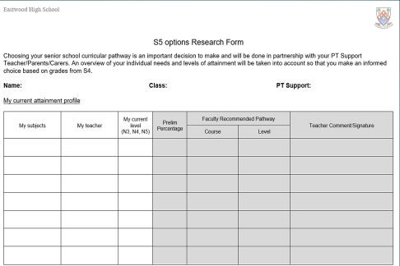
Options research
Options Research Sheets will be issues at assembly
Helps by guiding you through conversations with teachers and conversations at home about your next steps

Slide 14
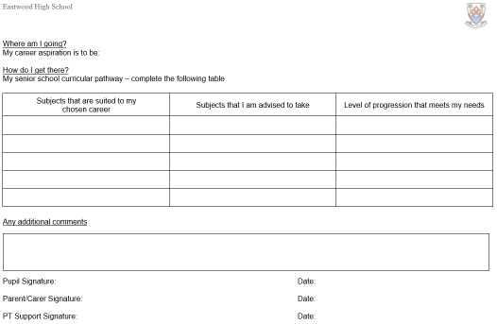

Slide 15
Options lessons PSHE
Over the next few weeks in PSHE:
Pupils will be given information on the S4 into S5 options process
Pupils will become more aware of your options as you turn 16 and consider the best plan of action for your future
Learn how to gather information to make important decisions

Slide 16
Jan/Feb | - Exploring future choices and career pathways in PSHE - Work Experience - S4 Options Assembly (Monday) - Issue Options Research Form
w/b 5th Feb | - Options Form and booklet emailed to parents/carers
w/b 19th Feb | - “Draft” Options Form to be submitted before meeting with Pastoral Care - Options interview with Pastoral Care Teacher takes place
w/b 26th Feb | - S4 Reports Issued
1st March | - Final Options Form completed
22nd March | - Sent to the education department
w/b 5th June | - S5 Timetable begins

Slide 17
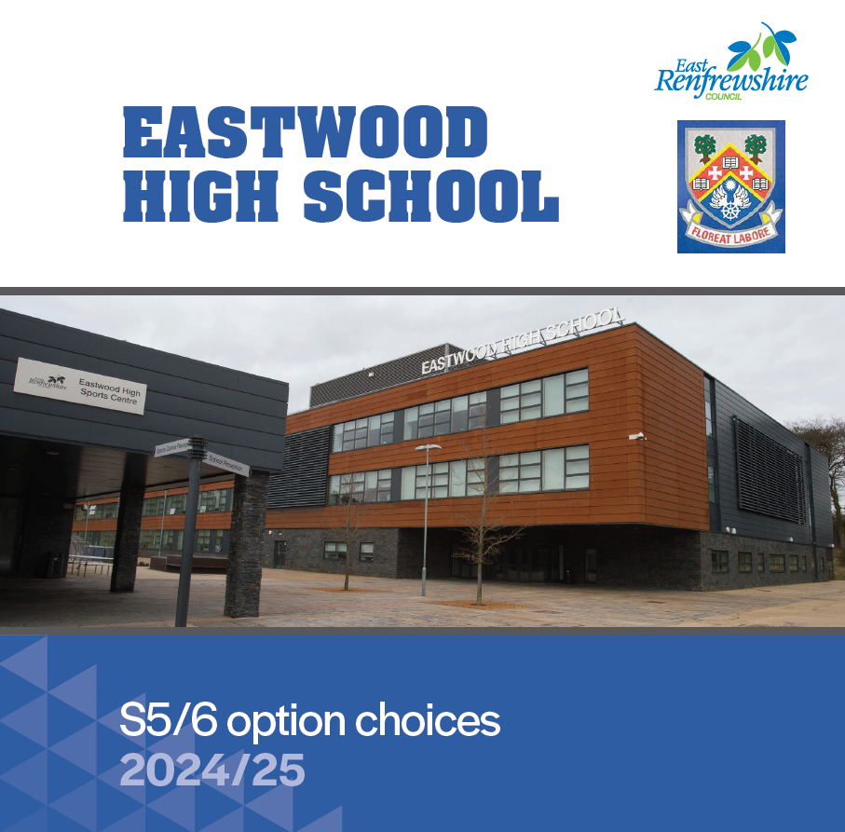

Slide 18
S4 into S5 Option FORM
All pupils choose 5 subjects (English plus 4 other subjects)
S5 pupils are advised to continue with S4 subjects including PSE & PE (‘crash courses’ are typically available for S6 pupils)
Vocational options should be considered in addition to 5 subjects in school
Choose subjects essential for chosen career/course – research entrance requirements
Unsure of chosen career/course – take a balance of subjects
Choose strengths/interest/enjoyment

Slide 20
current column structure
A | B | C | D | E
Biology H Business Management H Chemistry AH/H English AH/H PE AH/H Sports Leadership NPA Physics AH/H | Business and IT NPA Geography H History AH/H Applications of Mathematics H/N5 Maths AH/H Media N5 PE H Sports Leadership NPA Photography H/NPA RMPS H Spanish H | Administration H Biology H/N5 Business Management H Chemistry AH/H Computing H Design & Manufacture H French H Graphic Communication H Mathematics AH/H Music Technology H Practical Cookery N5 Politics H | Art AH/H Biology AH Business Management AH Design & Manufacture H Drama H English H Fashion H Home Economics H Music AH/H Practical Cookery N5 Spanish AH | Administration H Art H Animation NPA Biology AH/H Business Management H/N5 Chemistry H Computing H Drama H Geography AH/H History H Modern Studies H Practical Cookery N5 Physics H Spanish H Travel and Tourism N5
Note: If the uptake of a subject is too low, it may not be delivered

Slide 21
ScotTish CREDIT and Qualifications Framework
Meet the Ambassadors in the Atrium/Canteen

Slide 22
What is SCQF?
SCQF stands for Scottish Credit and Qualifications Framework.
The SCQF is a way of comparing Scottish qualifications to other qualification frameworks. It does this by giving each qualification a level and a number of credit points.
The level of a qualification shows how difficult the learning is.
The credit points show how much learning is involved in achieving that qualification.
It covers achievements from school, college, university, and many work-based qualifications

Slide 24
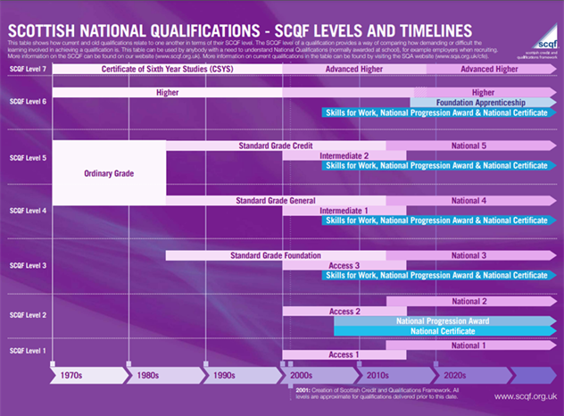
The framework allows parents to compare qualifications that they may have sat at school, to the current qualifications

Slide 25
Bethany Williams
Principal Teacher of Pupil Support

Slide 26
Vocational Programme details
Opportunity to gain relevant qualifications and practical experience
Most courses run from August to May
Progress reports provided
Attendance/attitude/performance monitored
Courses do not run on school holidays or in-service days

Slide 27
Benefits of vocational courses
Relevant for career / work
Practical work
New environment / opportunity to try college
Treated as an adult (responsibility)
Qualifications – National Progression Awards, Higher, National Certificate & University Level 1 and 2

Slide 28
Programme details
Most courses run for 2.5 days in column D
Tuesday and Thursday afternoons Friday morning Periods 1 and 2
Transport normally provided

Slide 29
Courses are available in the following areas
Automotives
Administration, IT, Business and Finance
Childcare, Education, Health, Life Science and Social Care
Construction and Engineering
Creative and Digital Industries, Music and Theatre
Events Management
Fashion and Design
Hair and Beauty
Hospitality
Humanities and Social Sciences
Sport and fitness
Travel
Uniformed and Emergency Services

Slide 30
Applying for a course
Speak to Principal Teacher of Pupil Support and parent/guardian
Complete application forms – one with parents and one in school
Places are not guaranteed as only a small number of places are available to each school. You MUST choose five school subjects during the options process and indicate if you are interested in applying for a vocational college course.
The Vocational Programme is combined within the school’s options booklet and can be viewed on the school website.

Slide 31
NEXT STEPS
Research
Options booklet
https://blogs.glowscotland.org.uk/er/public/Eastwood/uploads/sites/83/2024/01/16074215/Eastwood-HS-Courses-2024_25-v2.pdf
(available online – school website)
My World of Work website
Ask questions
Electronic options form submitted before w/b 19th Feb
Pastoral will contact you with any changes following interviews

Slide 32
Thank you for coming
Please feel free to ask us any questions across in the main building.

