Slide 1
S2 Curricular Choice Evening

Slide 2
The purpose of tonight
To give you an understanding of the curricular choice process
To offer parents advice on supporting your child through the process
To offer advice on making the right decisions
To give information about the curriculum and the wider supports on offer
To give the opportunity to visit and speak to staff from all areas of the school
To give the opportunity to speak to Pastoral Care Teachers (in canteen)

Slide 3
schedule
Things to think about – Mrs K Sinclair (Head Teacher)
Introduction and purpose of the evening – Mr C McKenna (S2 DHT)
Pastoral Input and PSE – Mrs L Carswell (Principal Teacher of Pupil Support)

Slide 4
Kate sinclair
Head teacher of Eastwood High School

Slide 5
What to think about…
2 years in subjects – where do they thrive?
New subjects/courses – get around depts/ask questions
Alternative curricular pathways
Issues from our analysis
Attendance
Progression – S5 chosen from subjects in S3/S4
Wellbeing

Slide 6
Chris McKenna
Depute head teacher S2

Slide 8
December Week beginning January 8th – 2nd February | Interviews with SDS Exploring skills, qualities and future career options in PSHE Pupils issued with “Options Research” forms
22nd January 31st January | Electronic options form and Curricular Choice Sway emailed to parents/carers Draft options forms to be submitted
6th February | S2 Parents’ Evening Pupils to complete options research form ahead of interview with Pastoral Care Teacher
1st February | Draft options forms to be submitted
Wednesday 7th & Thursday 8th Feb | Options interview with Pastoral Care Teacher FINAL OPTIONS FORM COMPLETED AT THIS POINT

Slide 9
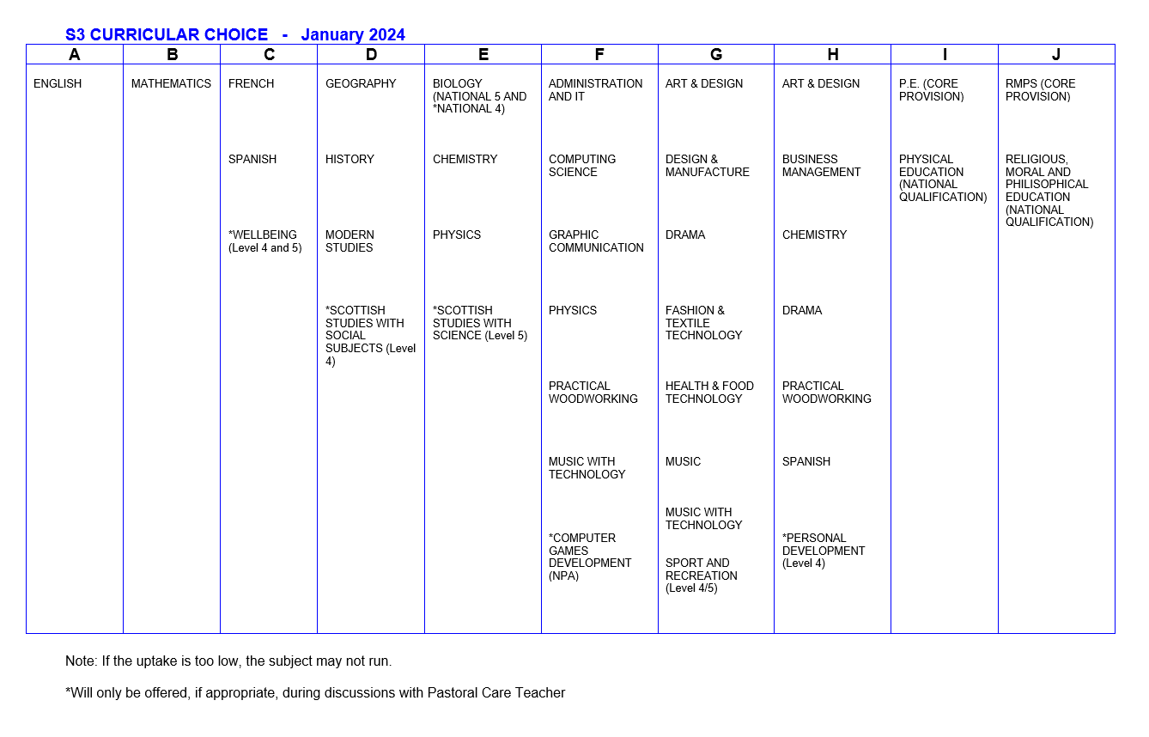
Option FORM
S3 CURRICULAR CHOICE - January 2023

Slide 10
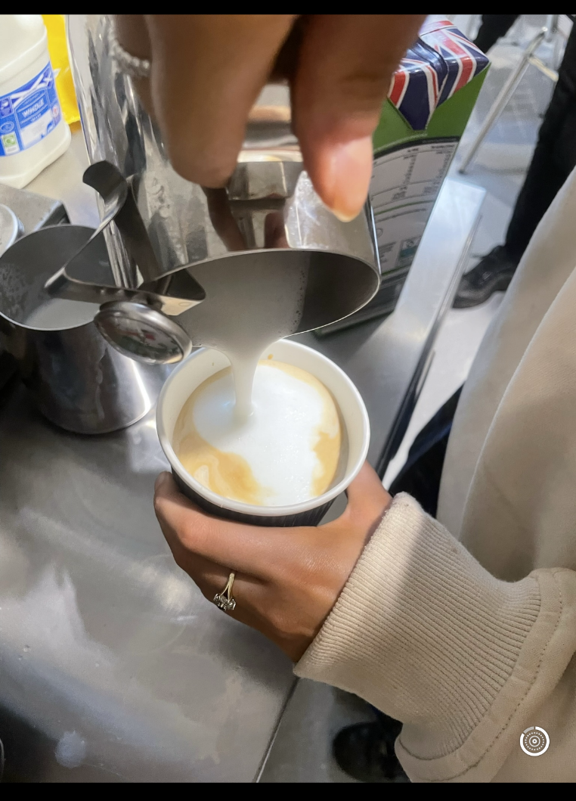
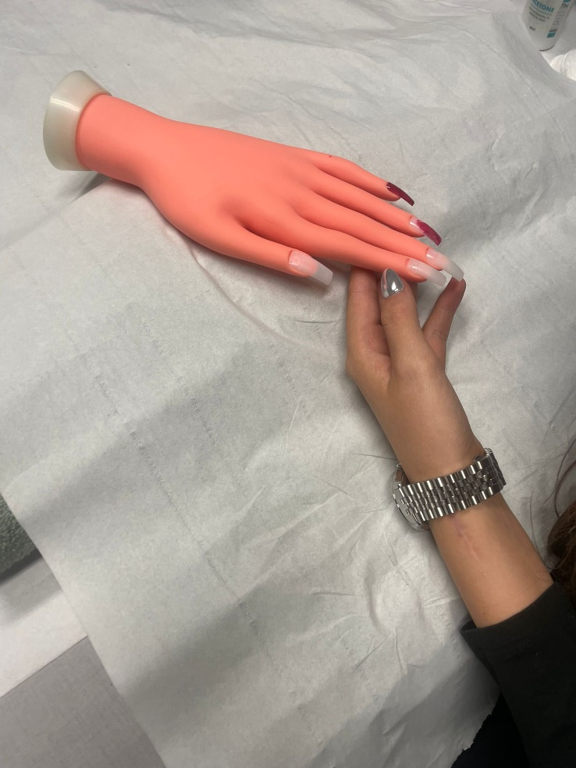
Additional qualifications
Barista qualification
Beauty Therapy (Level 4)
Computer Games Development NPA
Ibrox – Employability workshops
Princes Trust
Scottish Studies – Science and Social Subjects (Level 4/5)
Sport and Recreation

Slide 11
Scottish Credit and Qualifications Framework (SCQF)
It’s Scotland’s lifelong learning framework – designed to help people of all ages and circumstances to access appropriate education and training over their lifetime.
It helps pupils visualise and plan their learning journey.
It helps people understand qualifications and how they relate/compare to one another.
It recognises people’s learning and gives them credit for what they’ve achieved. 1 credit point = notional 10 hours learning

Slide 13
Laura Carswell
Principal teacher of pastoral care

Slide 14
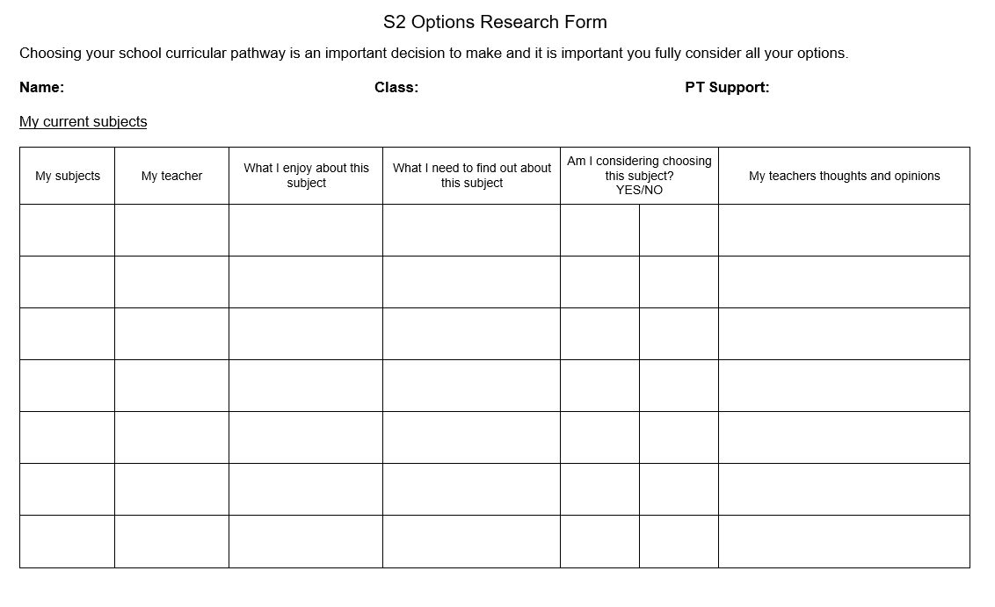
Options Research Form
To encourage pupils to make informed choices and be active participant in the options process.

Slide 15
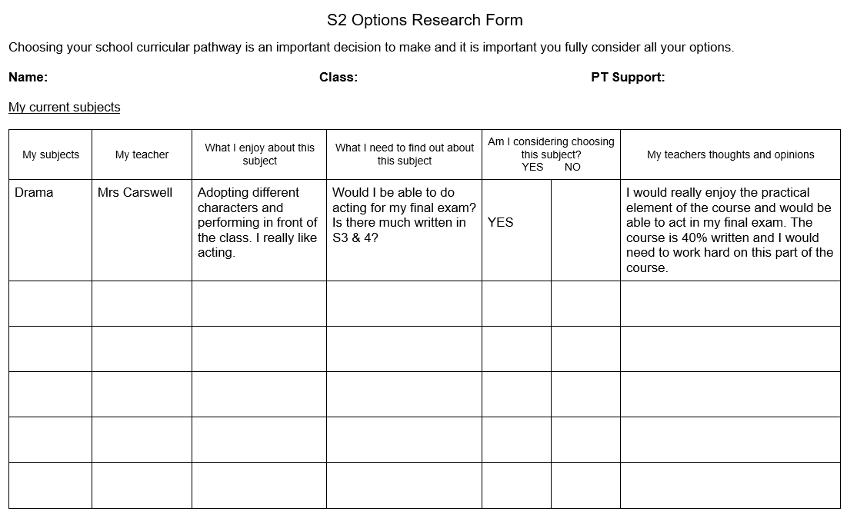

Slide 16
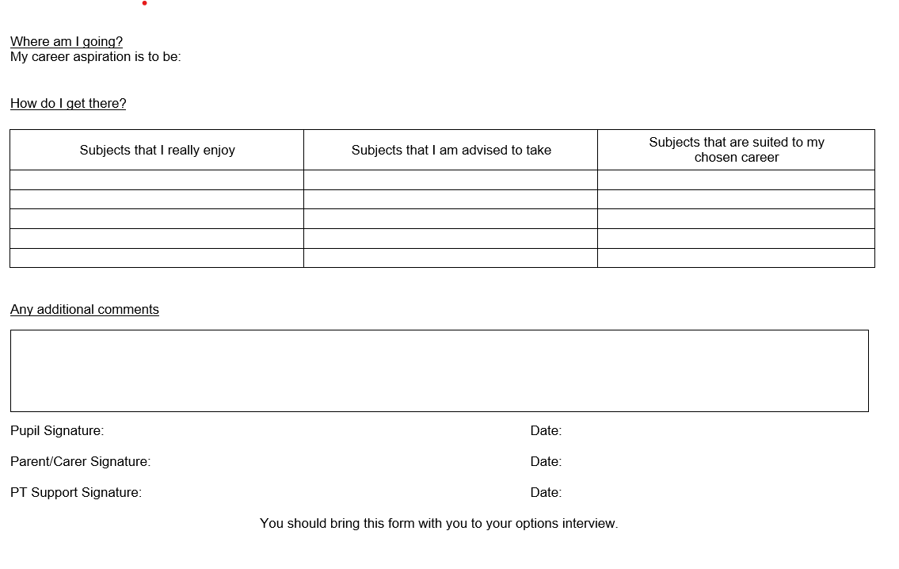

Slide 17
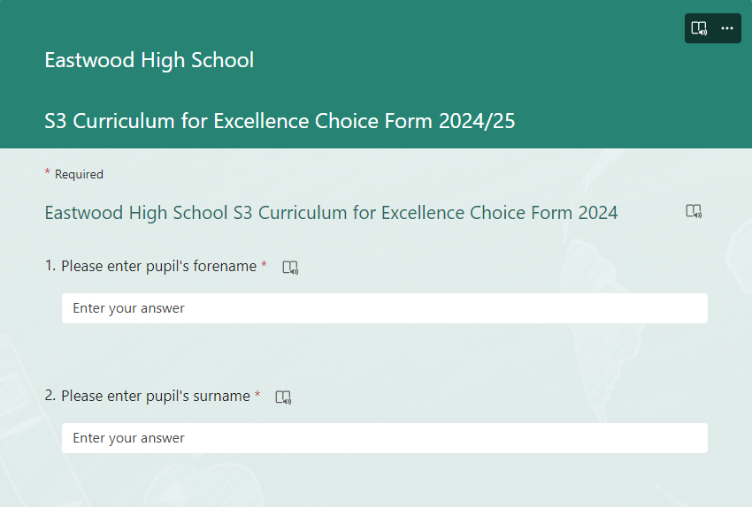
Electronic options form

Slide 18
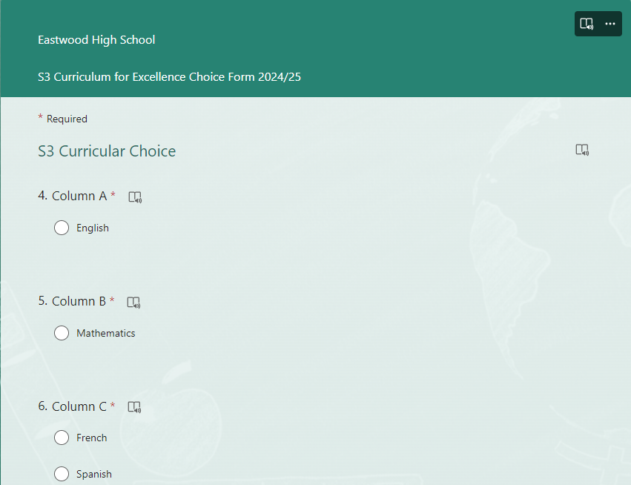

Slide 20
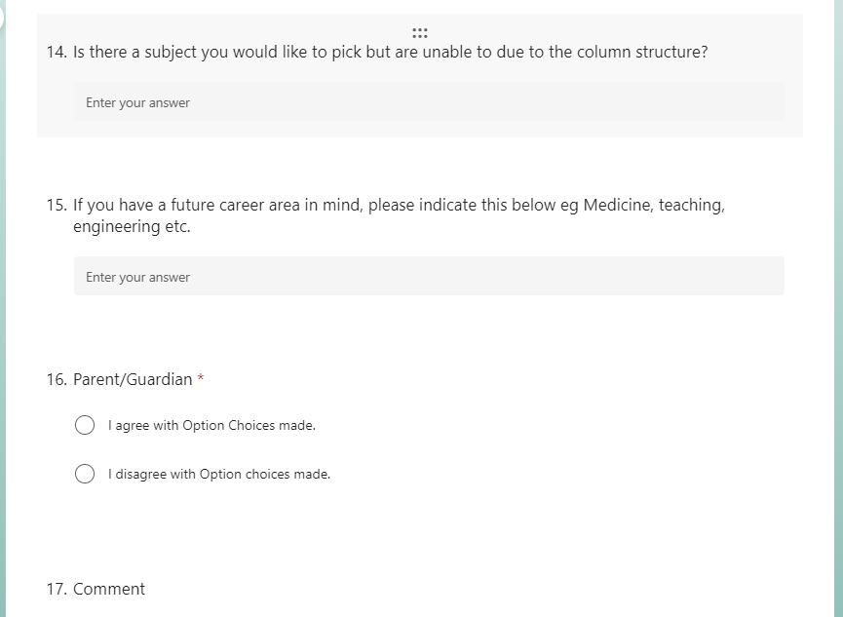

Slide 21
Timetable process
Completed option forms sent to ERC
Timetable schematic created of our school
We put classes and teachers in place
New timetable starts on Monday 3rd June

Slide 22
Stage | Open Curriculum | Core
S1 – S2 | 13 subjects | PE, PSHE & RE
S3 – S4 | 8 subjects | PE, PSHE & RE
Breakdown of S3 and S4 Curriculum
English and Maths (4 and 5/5 and 4 periods)
French/Spanish – continue from S2 (3 periods)
5 open choices (5 x 3 periods)
PSHE (1 period)
PE – N5 or Core (3 Periods)
RE – N5 or Core (2 Periods)

Slide 23
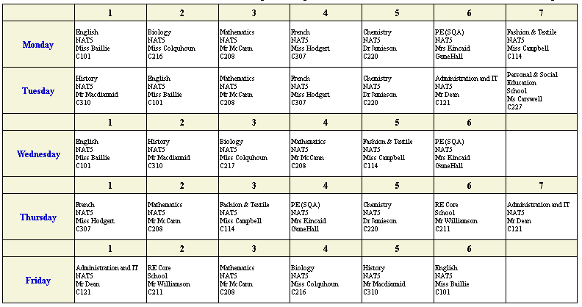

Slide 24
PE & RE – Core or Nat 5?
PE – majority of students choose to study N5 PE at beginning of S3
Combination of practical and theory work (approx. 1 period per week)
Assessment = 60% practical mark (one off performances) and 40% theory (portfolio)
RMPS – all pupils begin the core course in S3 and pupils given the option to choose NQ later in the year.
Assessment = 80% final exam and 20% assignment
Religion, Morality and Philosophy

Slide 25
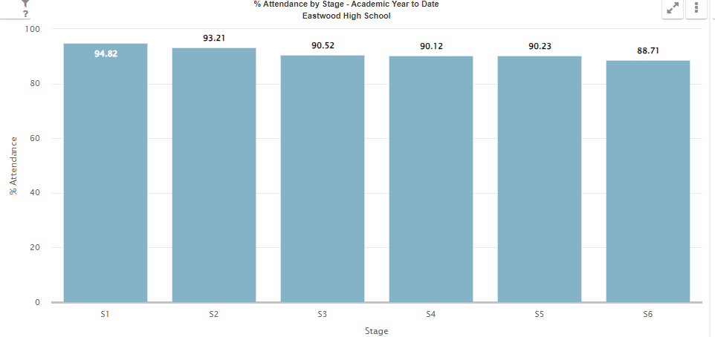
attendance

Slide 26
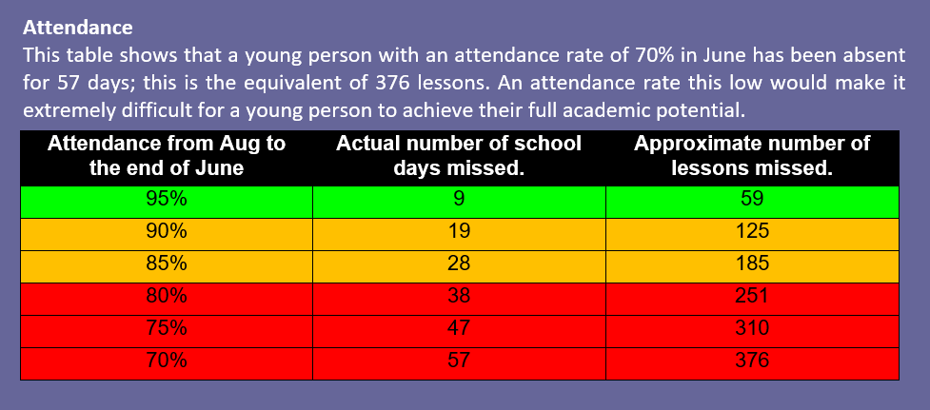

Slide 27
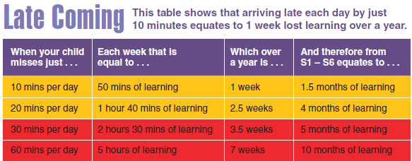

Slide 28
Skills Development Scotland
Our SDS Careers Advisors are available in the school canteen this evening
One-to-one interviews and PSHE lesson input so far this year
My World of Work website with focus on Career Management Skills
Please go and see them for advice and guidance on future career options

Slide 29
DXC Erskine Digital Futures Academy
Introduction to DFA

Slide 30
Introduction to Digital Futures Academy
Parent Pupil Presentation in room 101 at 8pm tonight

Slide 31
NEXT STEPS
Research
Options Research Form
My World of Work website
Visit departments and speak to teachers this evening
Electronic options form submitted by Wednesday 31st January
Options Interviews 7th/8th Feb
PCT will contact you with any changes following interviews

