Slide 1
Home Learning Log P5a
(-_-)

Slide 2
My week Eilidh M
Played on my trampoline
Went on my swing
Went on tik tok and youtube
Played on roblox with my friends
attended ruby's zoom party
Went to my grans house

Slide 3
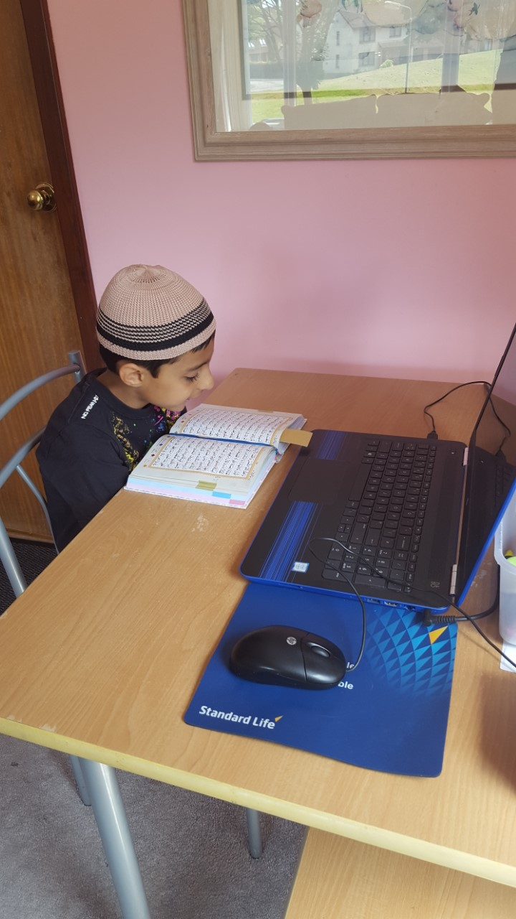
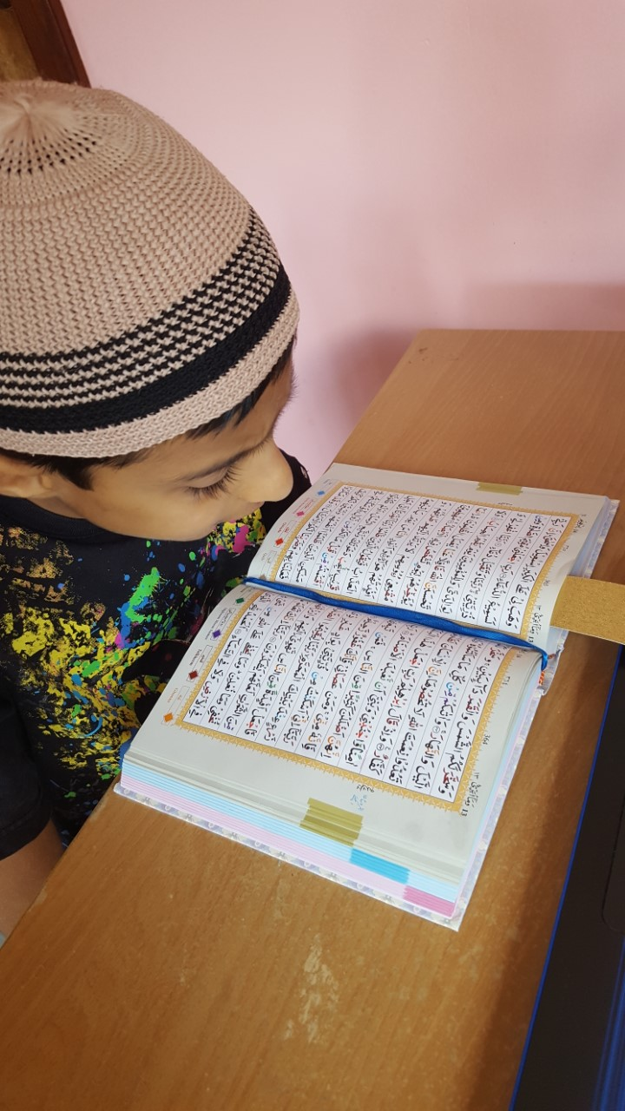
Humza - Completed 15 books out of 30 in arabic
(From the Qur’an)
Continued my arabic classes online on skype with my teacher. I am half way now and my mum says its a big achievement for a 9 year old.

Slide 4
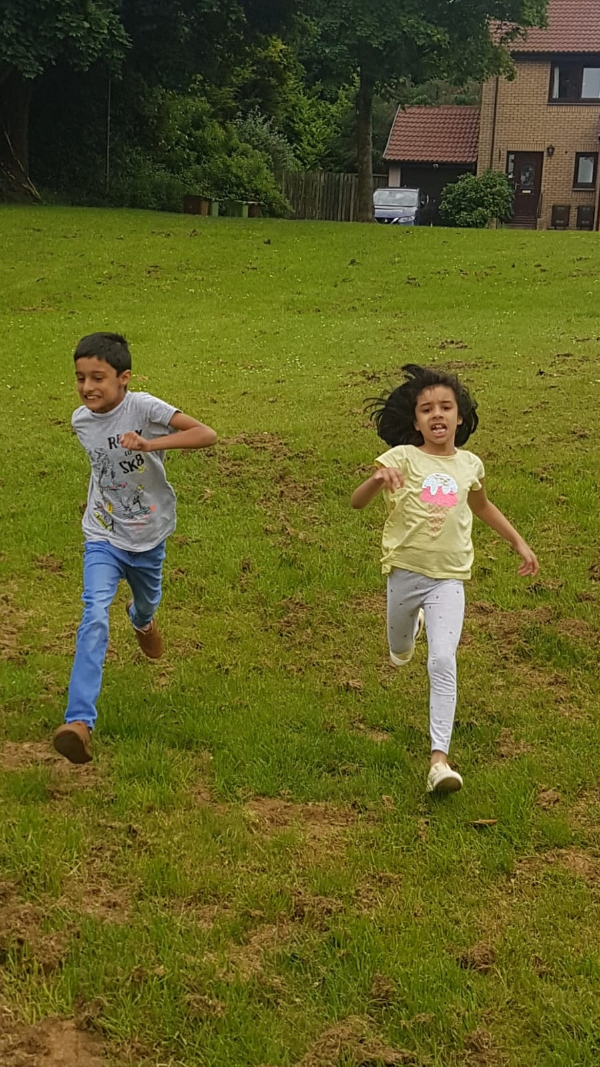
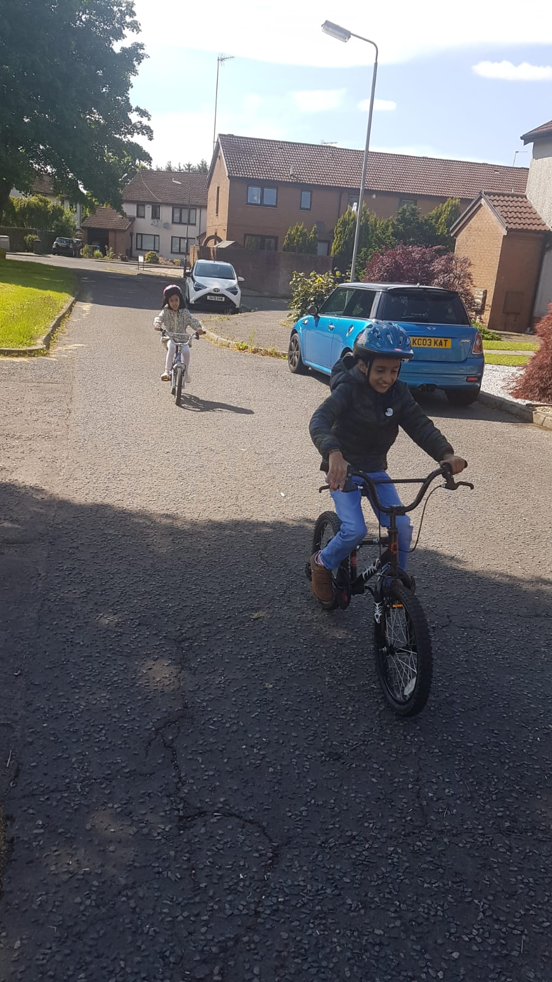
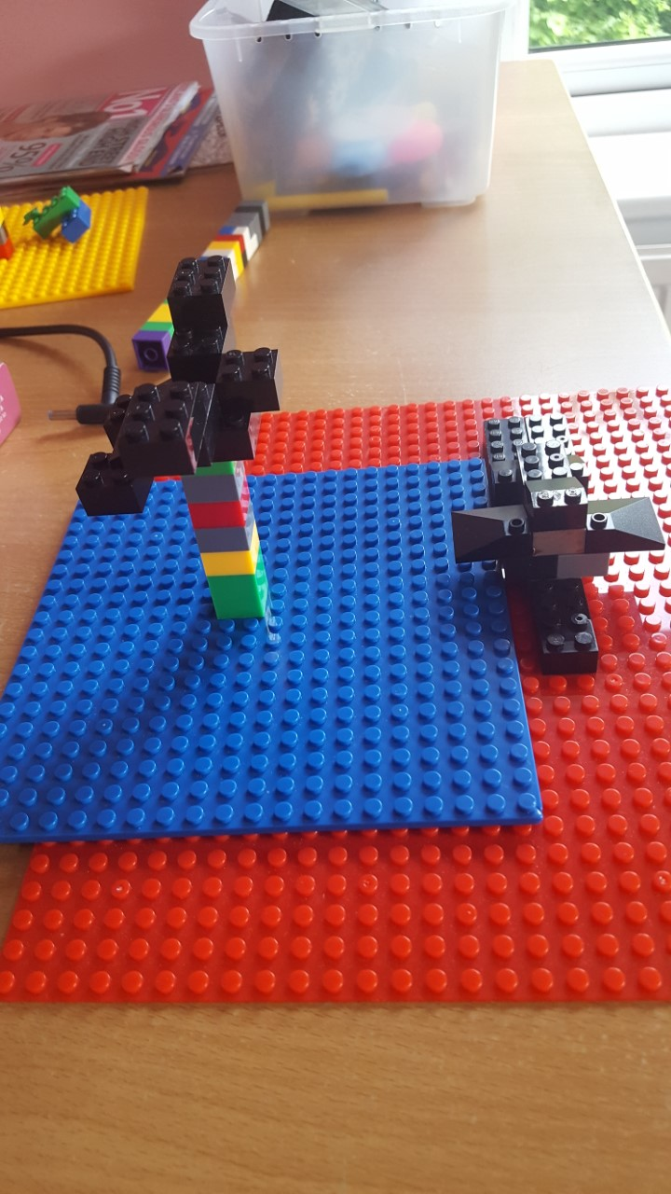
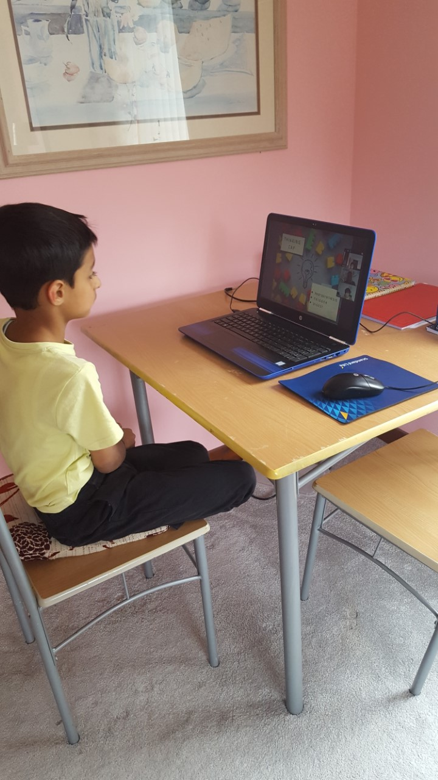
Humza - Sports for sports week and Lego Workshop
12th Lego Workshop in Lockdown on zoom / Running for sports with my sister.
A bat and a flying batmobile

Slide 5
Eilidh
My mum showed me a card game called solitaire.
My dad shaved his hair.
I went with my mum to drop millie of at nursery and she found out her new teacher for P1 and that she is in livingstone.
I went to Ruby's birthday on zoom.

Slide 6
Viraj-
I have drawn myself as a bowling pin i used paint

Slide 7
:i have been playing roblox with my friends with my sister.
:i have been cycling.
:i have been writing stuff in my notebook.
:i have been watching on my xbox
:i have been watching movies
:i have been playing with my new gun

Slide 8
Abbie
I went to drop Millie off at nursery.
I attended Ruby's birthday zoom.
My mum taught me how to play a card game called solitaire.
My dad shaved his head twice (one by accident).

Slide 9
Ben
I went to TESCO!!!! FIRST TIME I’VE BEEN IN A CAR FOR MONTHS🤩🤩🤩
WOOOOO

