Slide 1
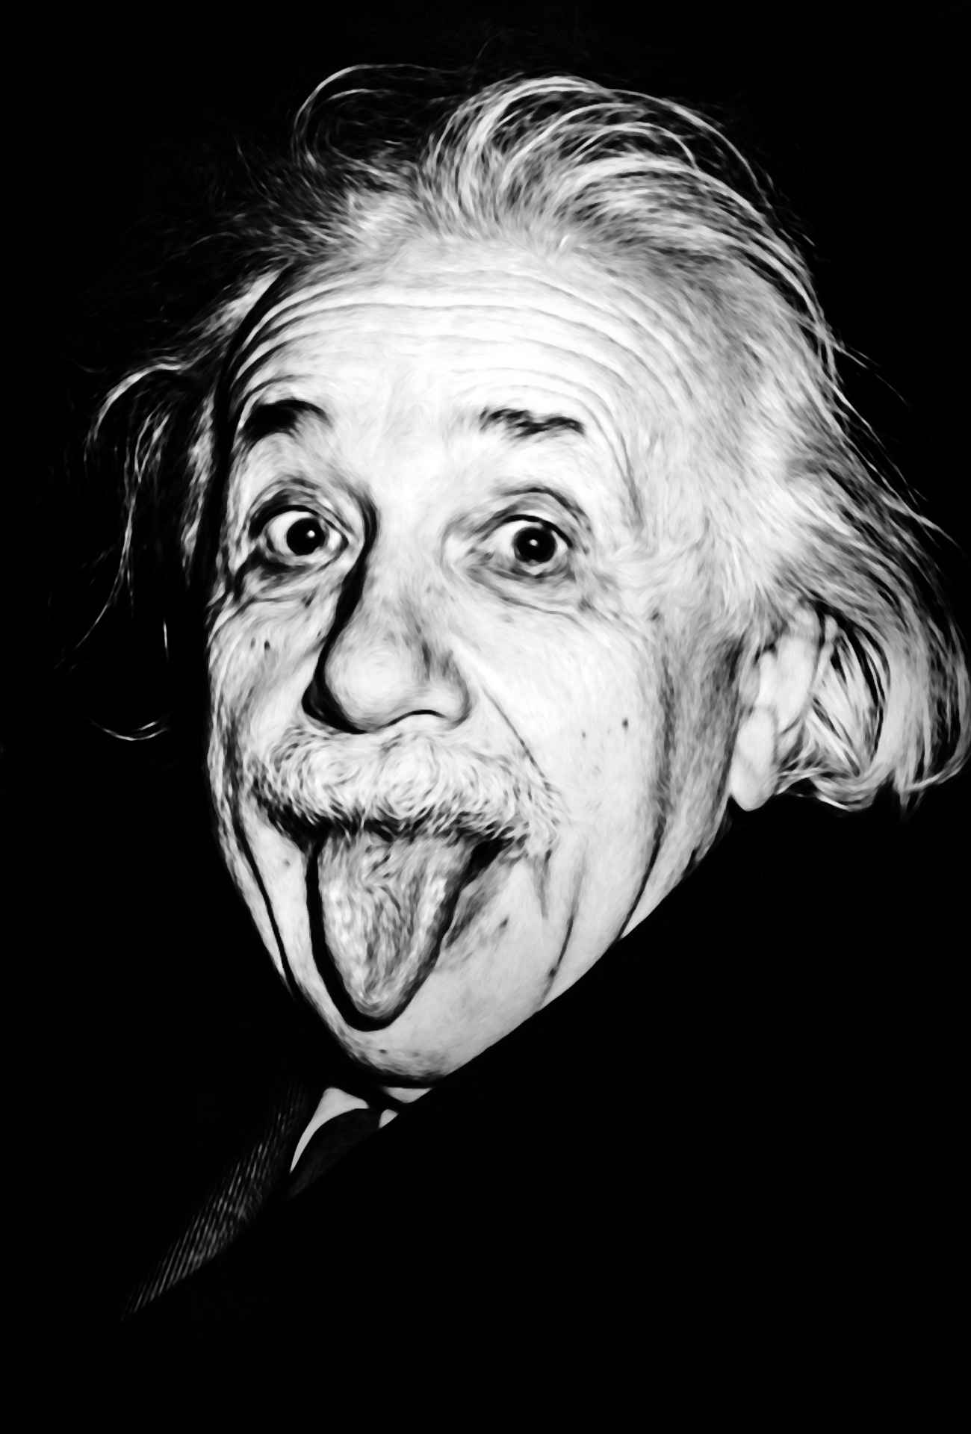
What a clever bunch!
01.06.20 Home Learning Log
Don’t forget to include your name!

Slide 2
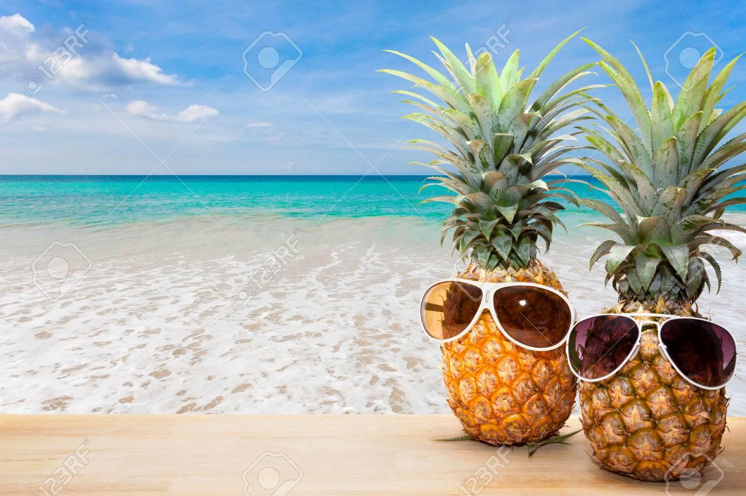
What i have been doing at home during Quarantine
I have been cycling every day.
I have been celebrating my dad birthday.
I have been playing roblox on my laptop
I have been watering my plants so they can grow better and be healthy.
I have been reading my book called the most annoying boy in the world.
I have been doing chores
I have been sleeping
I have been to the beach on a sunny day
Viraj

Slide 3
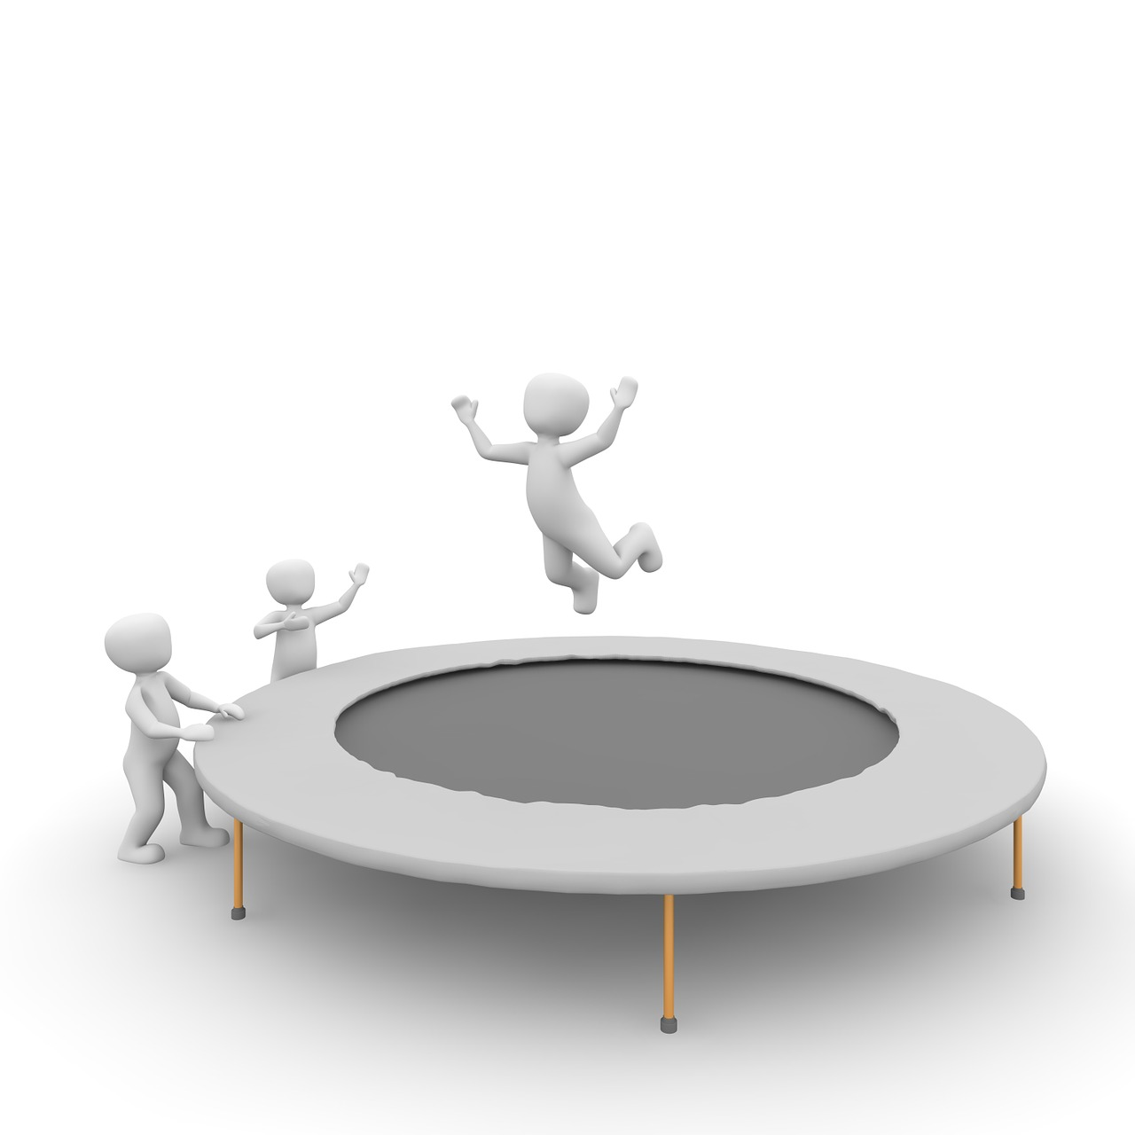
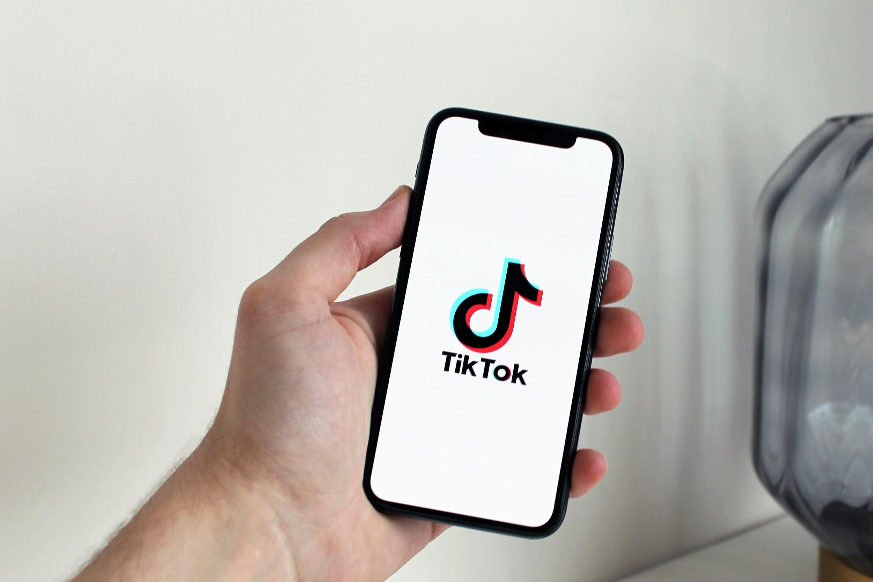
What i have been doing Eilidh M
I played on my trampoline
Made a den on my trampoline
Went to see my grans
Played in my paddling pool
Played with my neighbours( 2 meters)
Had fun in the sun!
Played roblox with my friends
Went on tik tok and youtube

Slide 4
Muhammad
On eid me and my family had fun but not as much fun as the usual eid :(

Slide 5
Braai* - Ben
I am having a Braai* with Alexander and his sister Ella :)
*afrikaans for barbecue (pronounced bry)

Slide 6
Cycling - Ben (again)
Today (01/06/2020) I am cycling with Alexander (maybe)

Slide 7
NEW GAME - Ben (I had a busy weekend)
I got a new game called Trove!!! I’m pretty sure nicolas has this game too but I’m not entirely sure. It’s like Minecraft but with slightly better graphics and new enemies AND DUNGEONS :D (I LOVE DUNGEONS <3). The game is free on steam to play and you can chat to your friends in it.

Slide 8
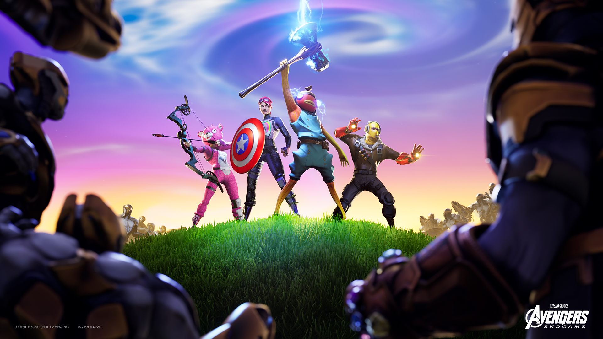
Sabre
We put a couch outside and I sunbathed on the couch with my mum.
I have been on lots of bike rides with my sister and long walks around Newton Mearns with my family.
I get some time in the afternoons to play fortnite and sometimes i get to play online with my friends in New Zealand.
I played fortnite

Slide 9
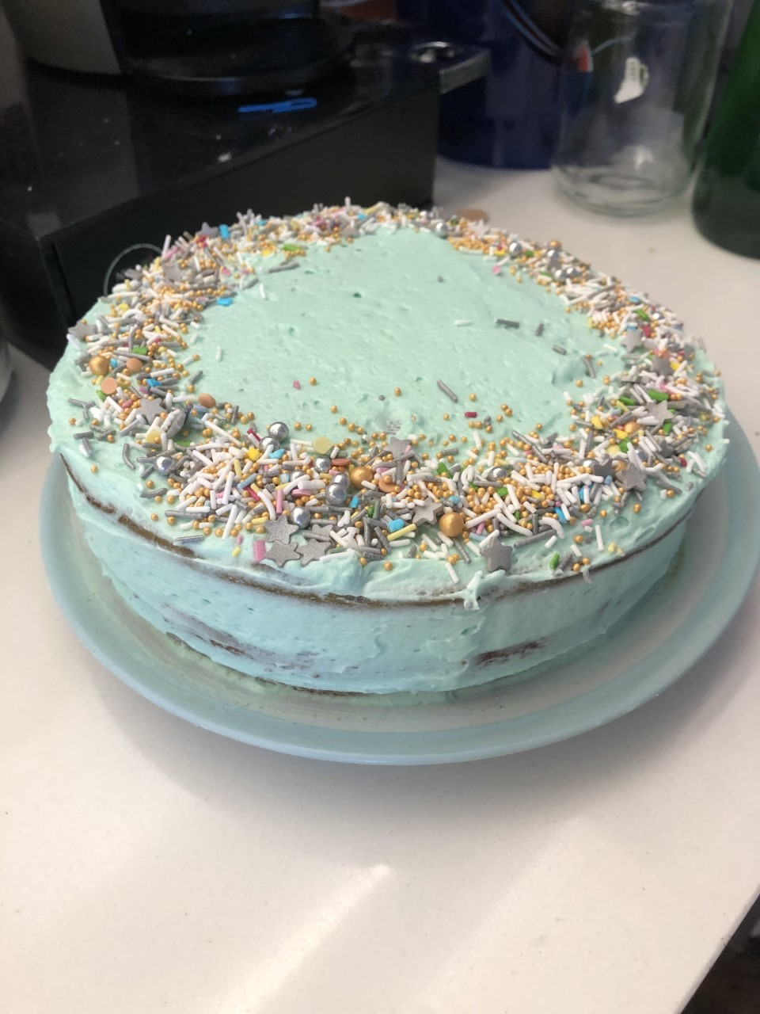
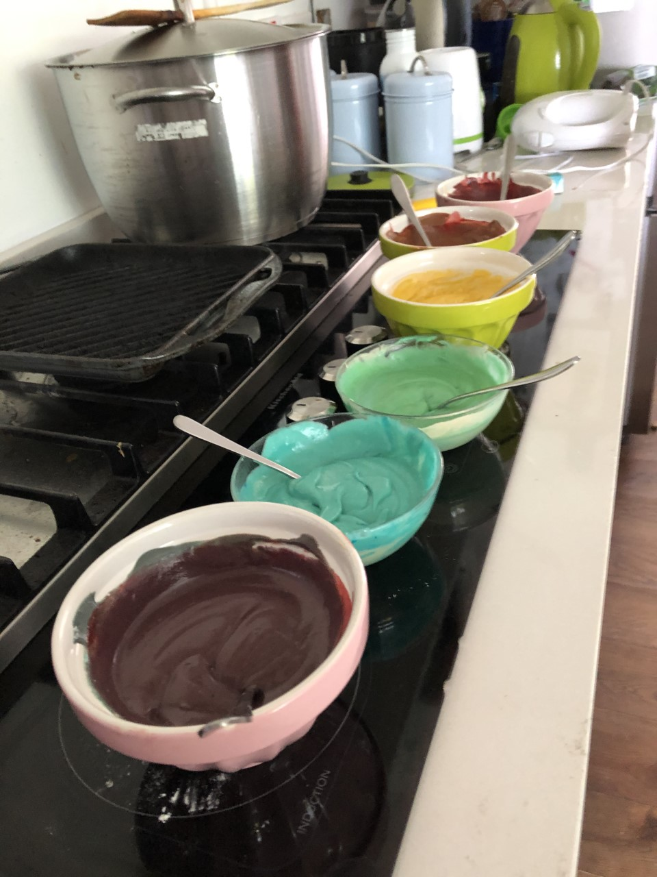
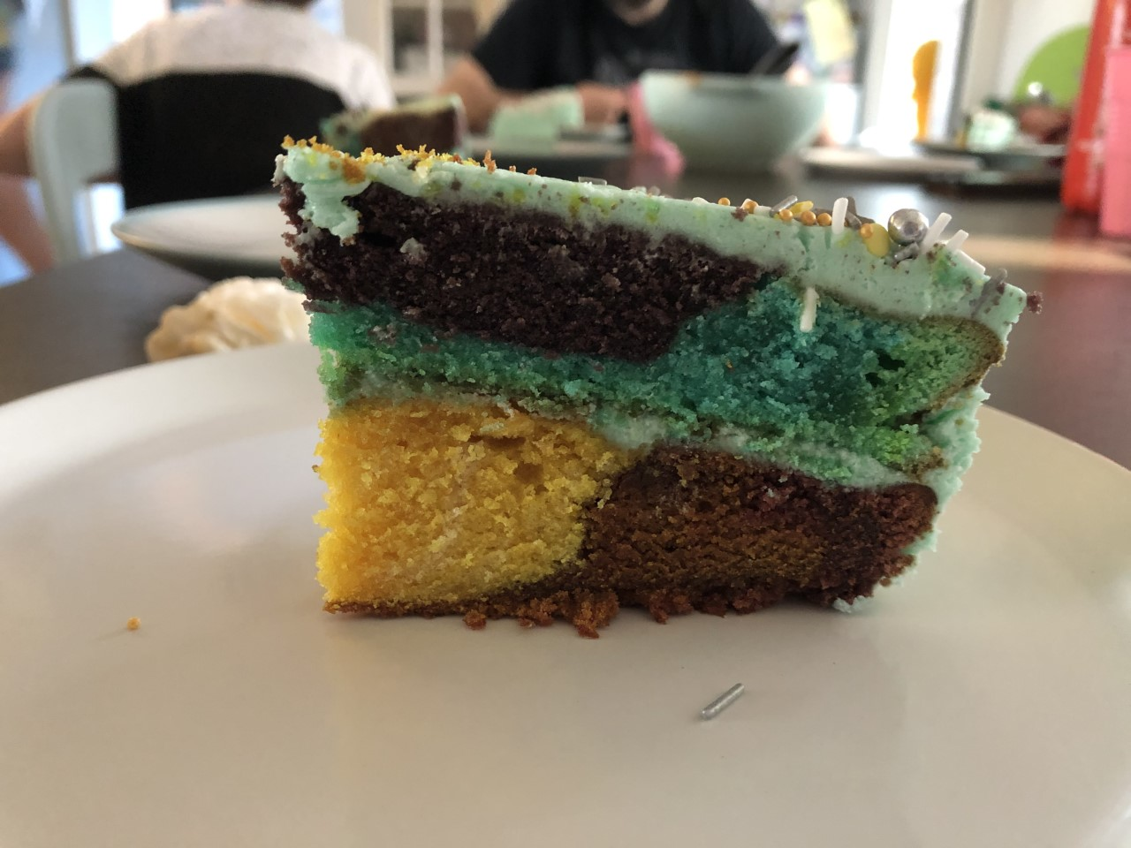
Cake ruby
I made a rainbow cake.

Slide 10
I have been doing…-jamie
Have a barbeque at my grans.
Playing in the paddling pool with my sister
Going on lots of walks with my dog

Slide 11
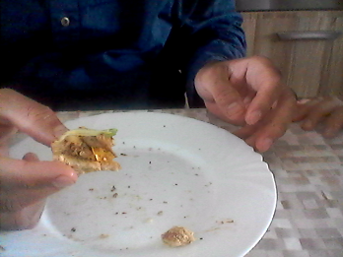
Menahil
I made my dad his break fast
He ate it all up

Slide 12
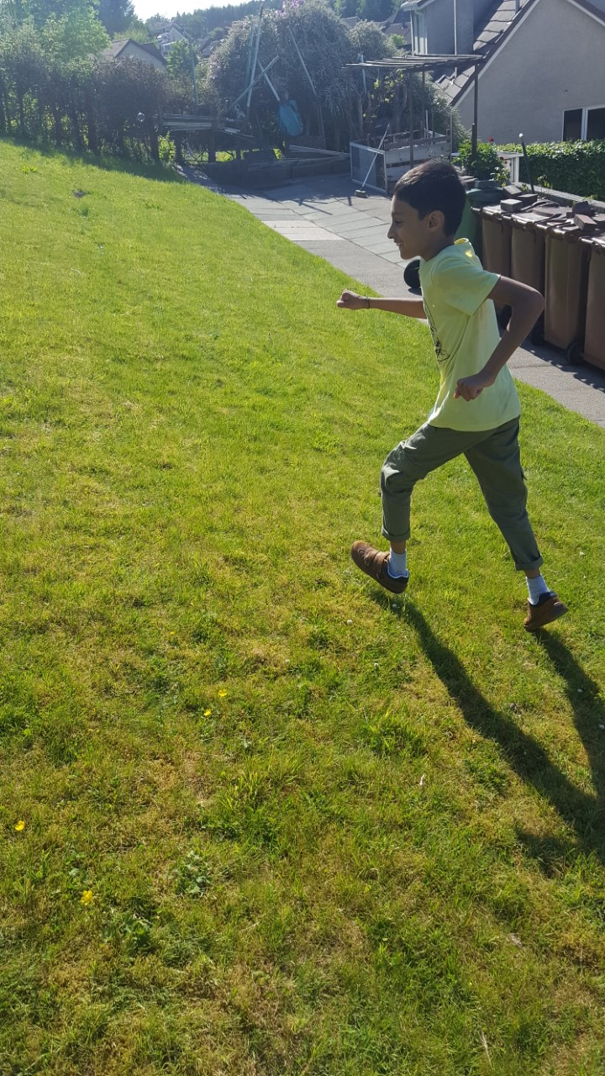
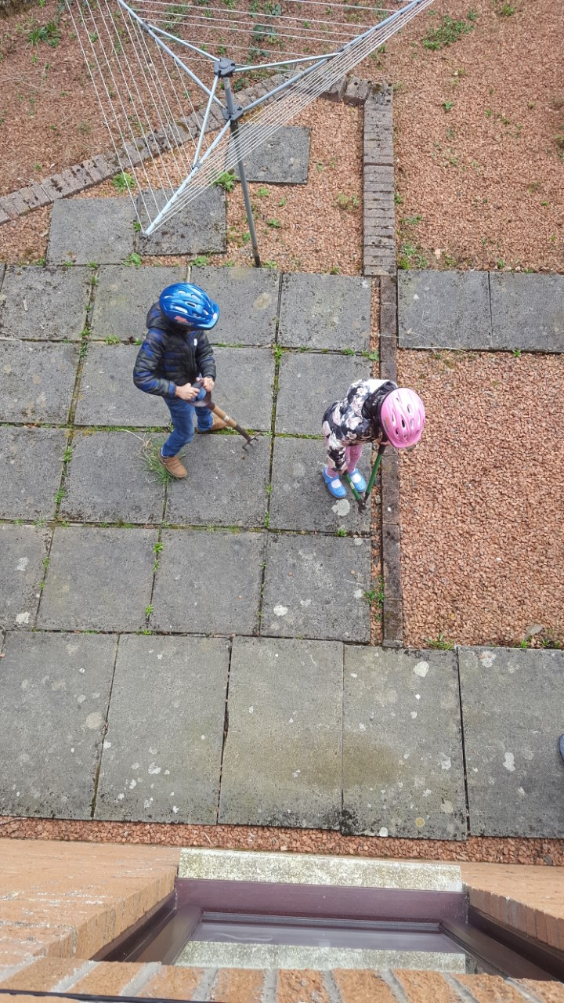
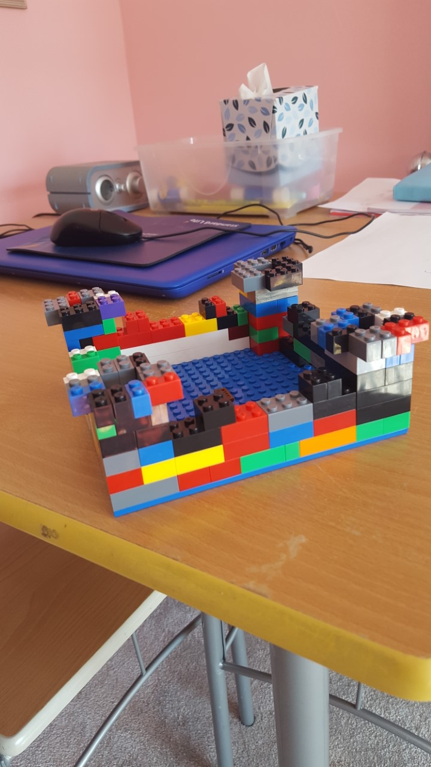
Humza Riaz
Gardening/Weeding after cycling
Running up and down grandfather’s garden hill racing my cousins
King of my Lego Castle

Slide 13
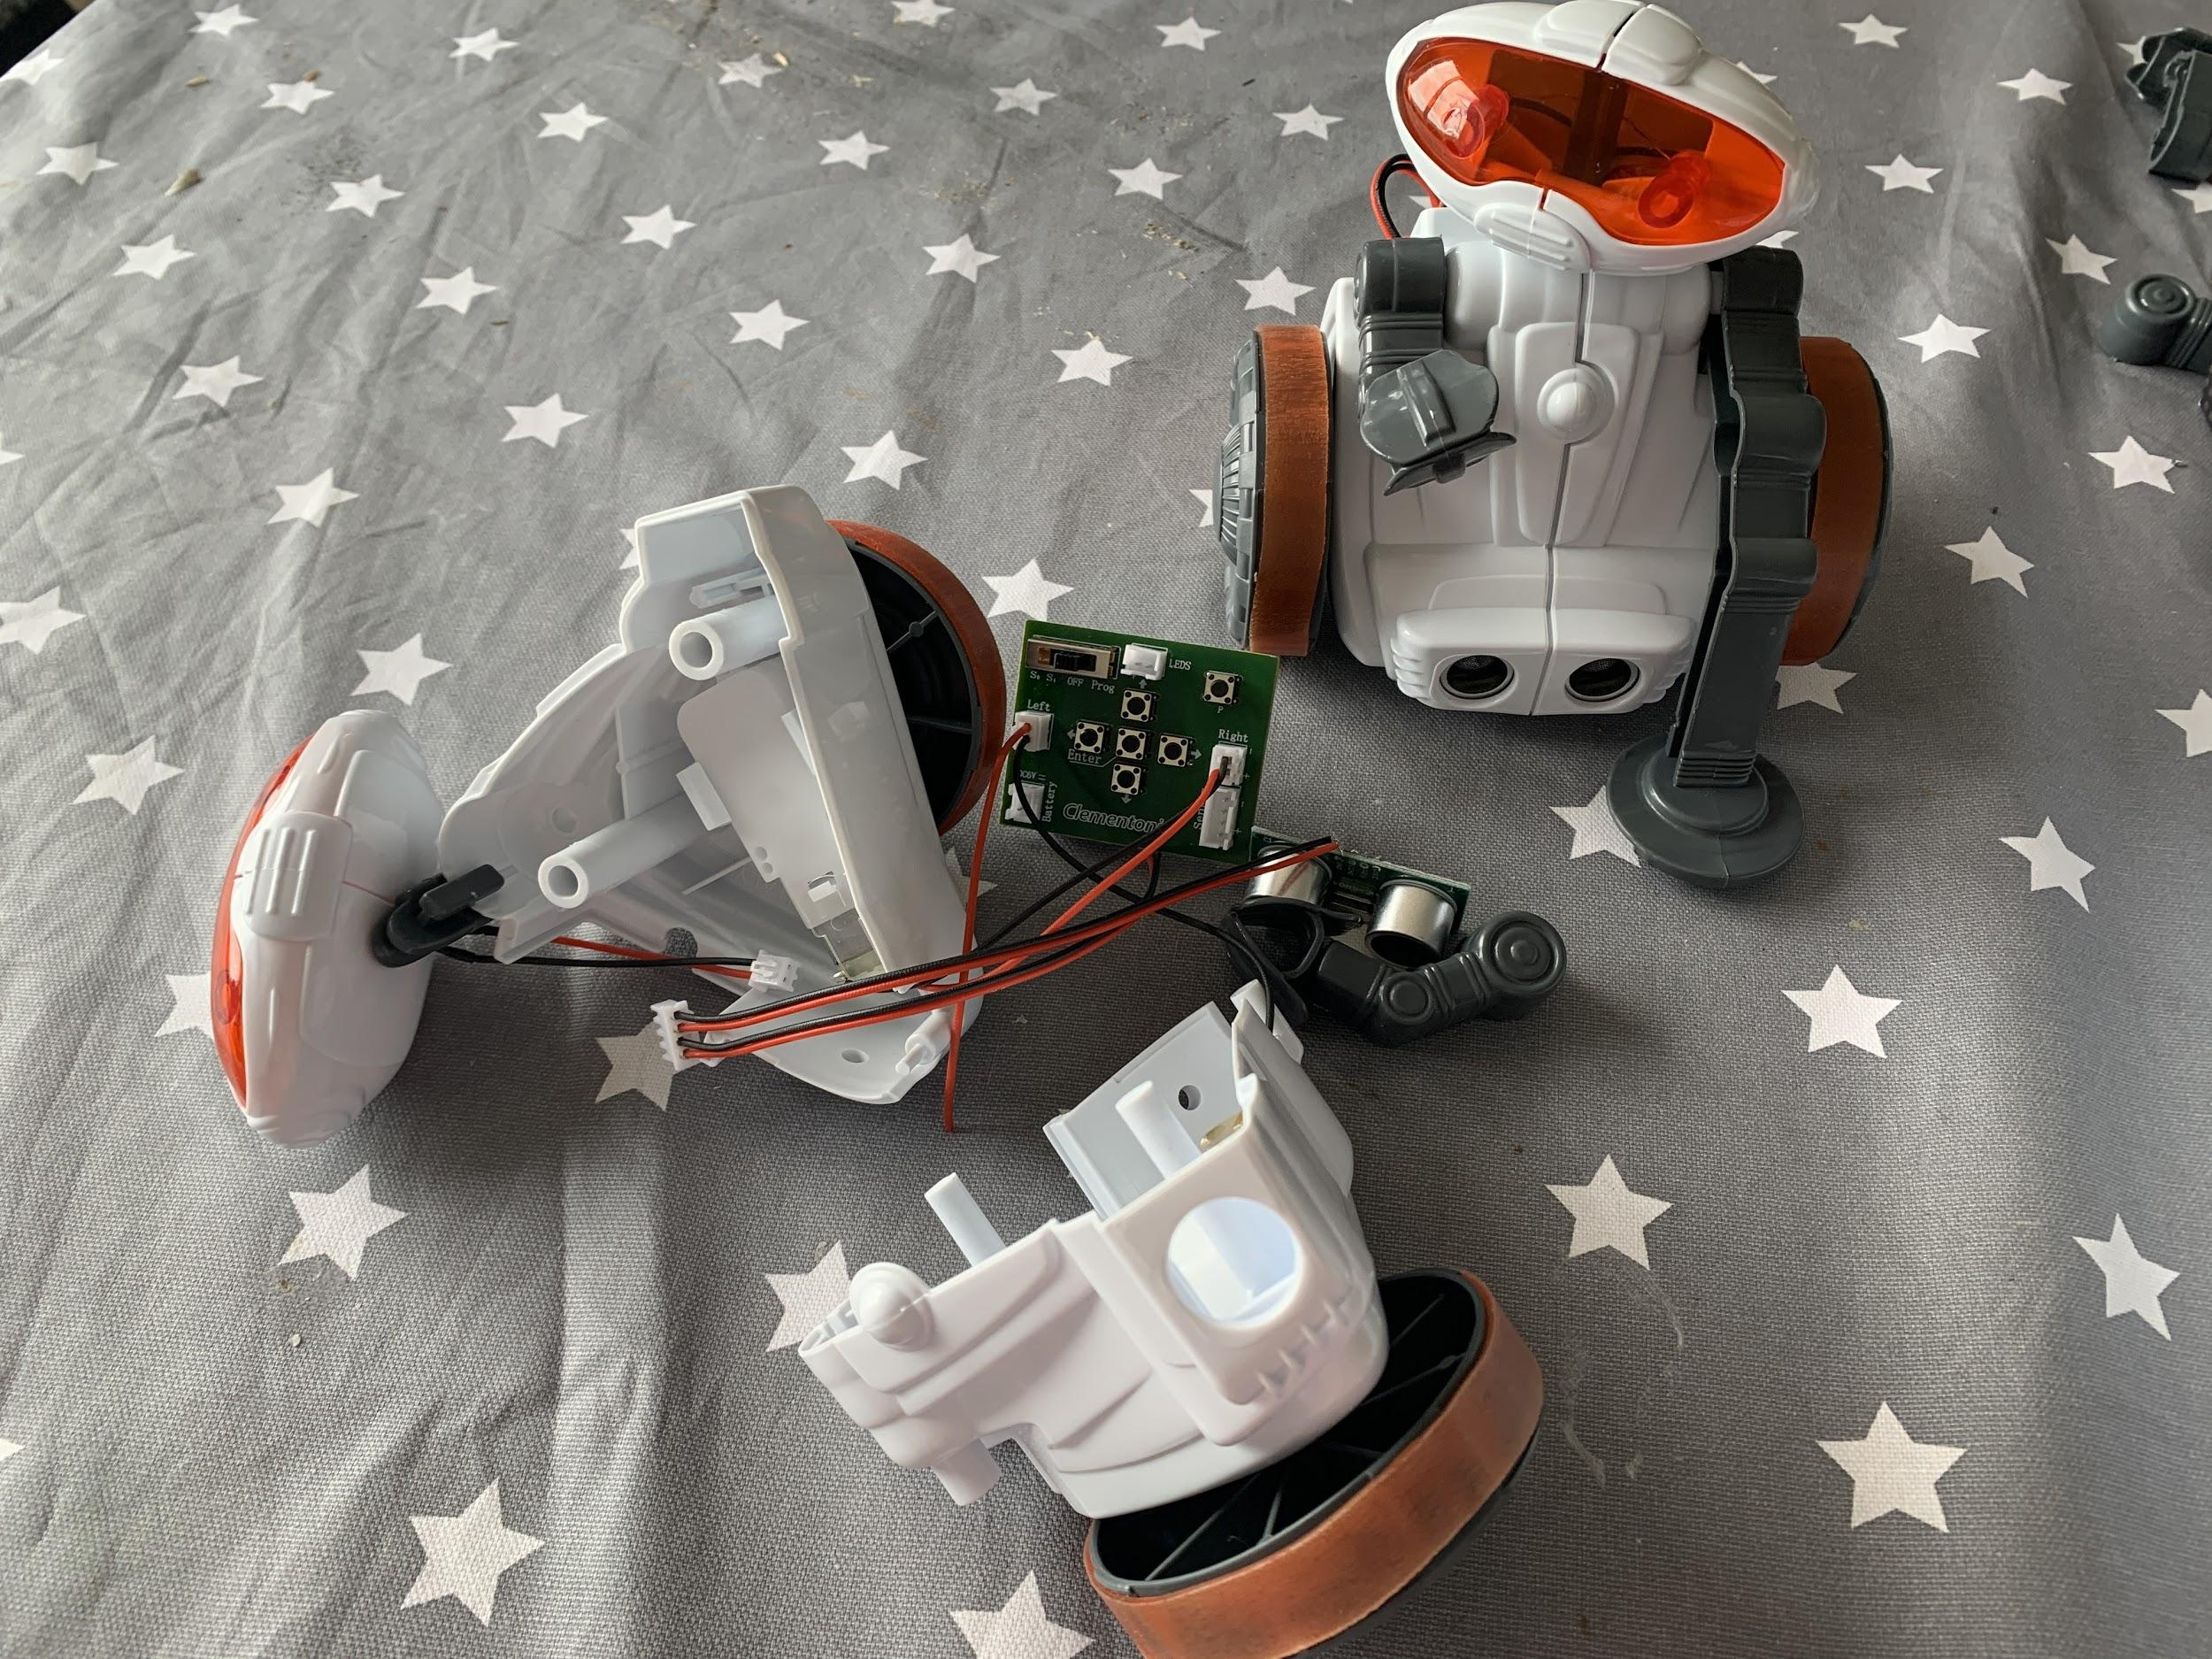
Abbie - I tried to make robots with Eilidh!

Slide 14
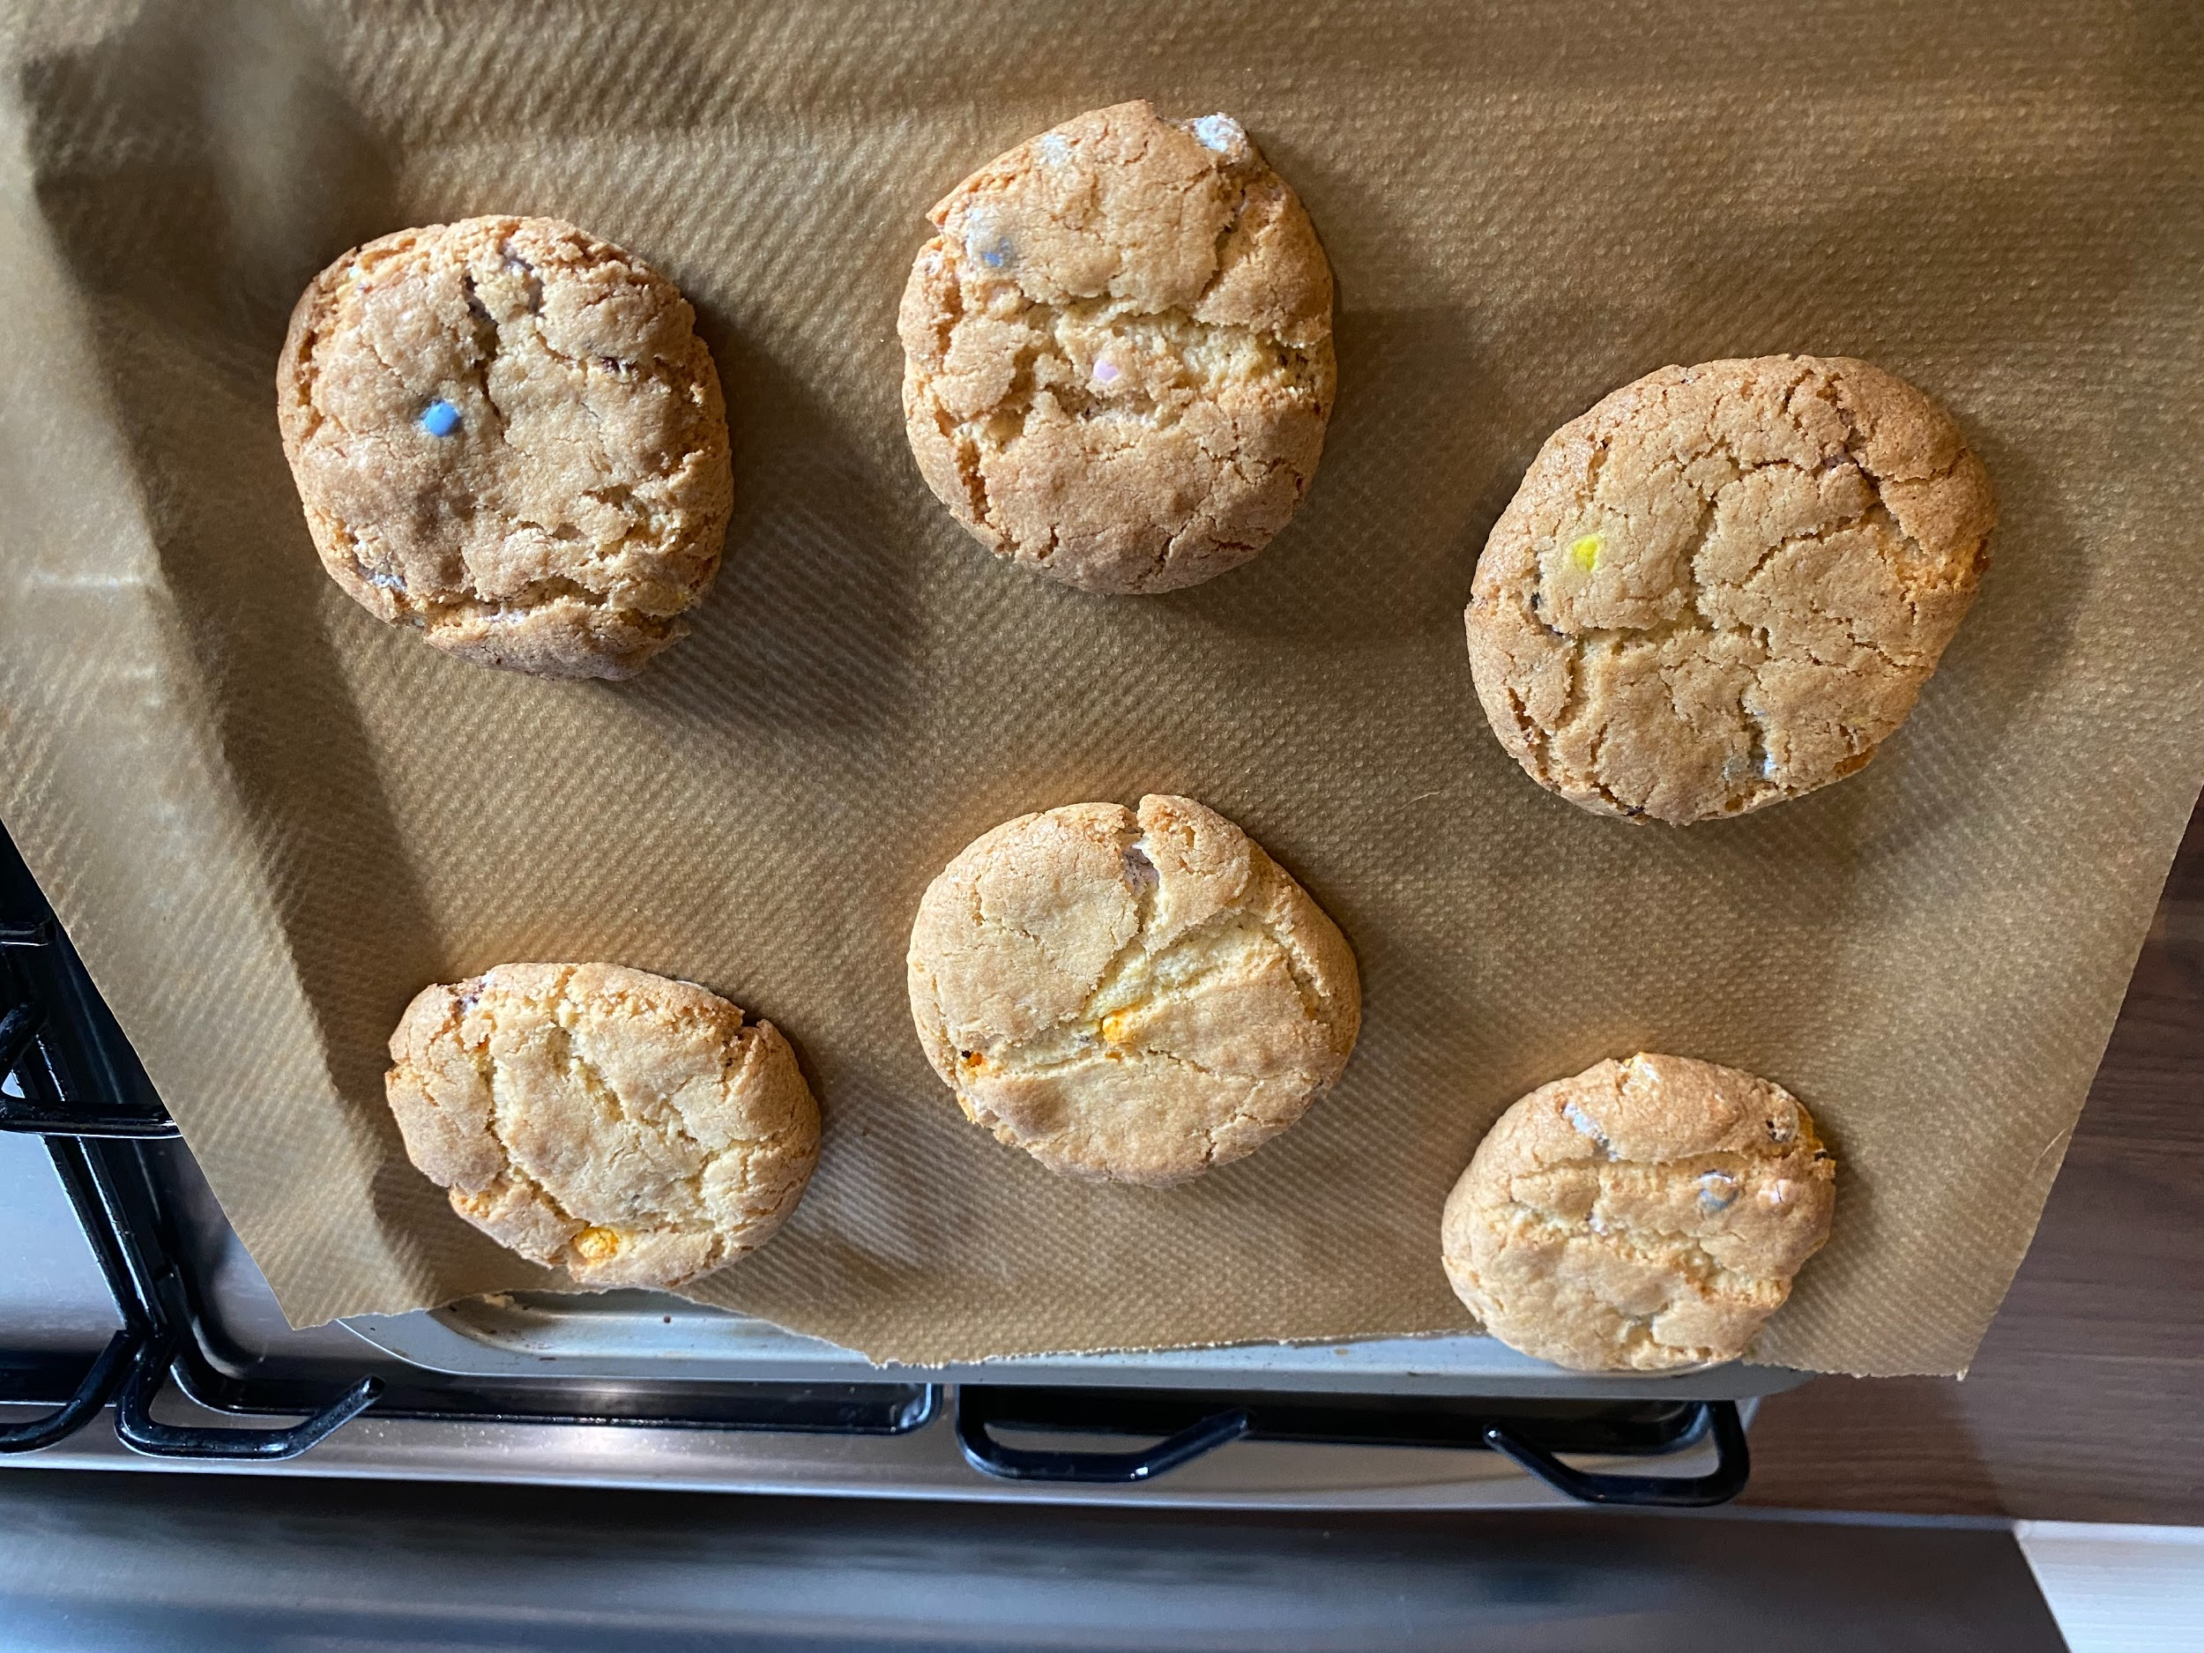
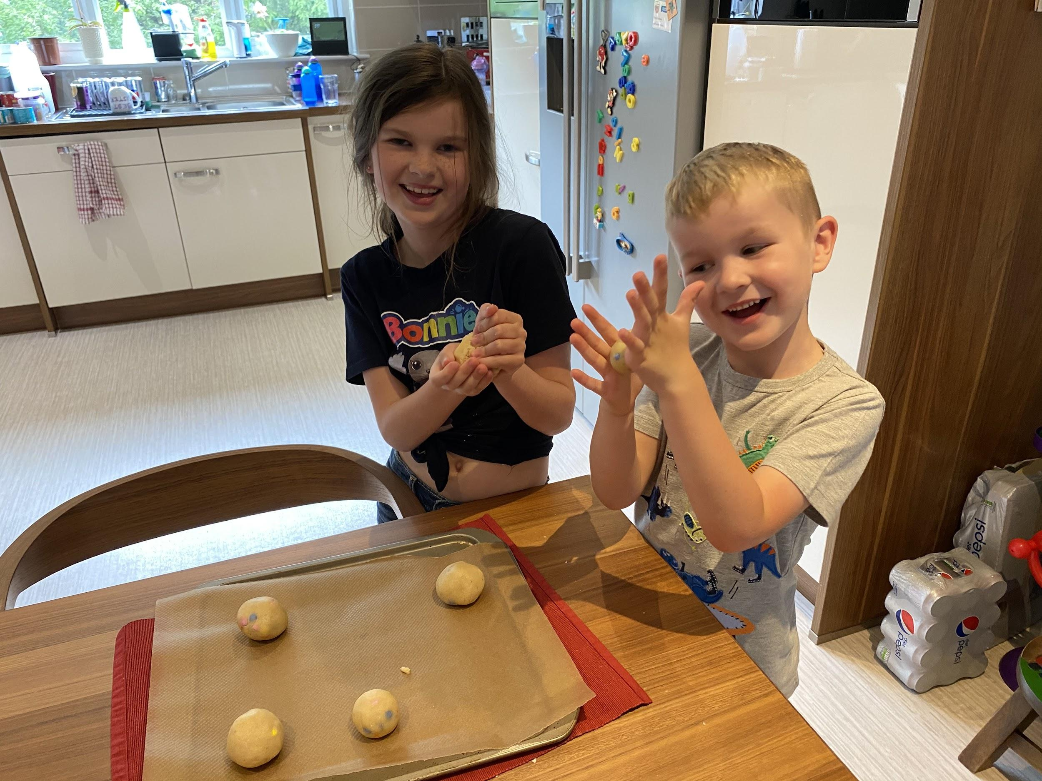
Charlotte - I made Cookies

