Slide 1
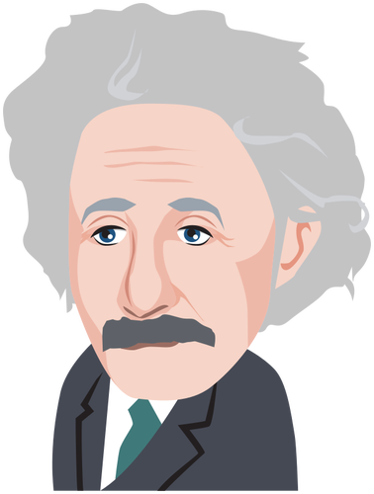
What a clever bunch!
P5a’s Home Learning Log
Week Beginning 11th May 2020
Don’t forget to include your name!

Slide 2
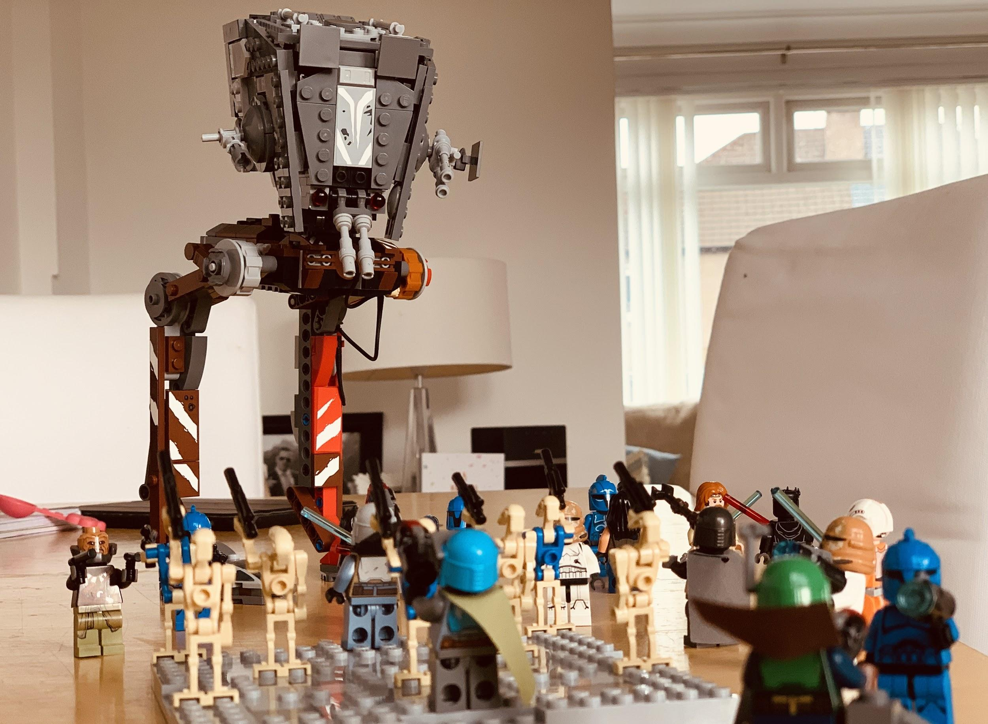
AT-ST and friends vs Mandalorians and Battle Droids and friends

Slide 3
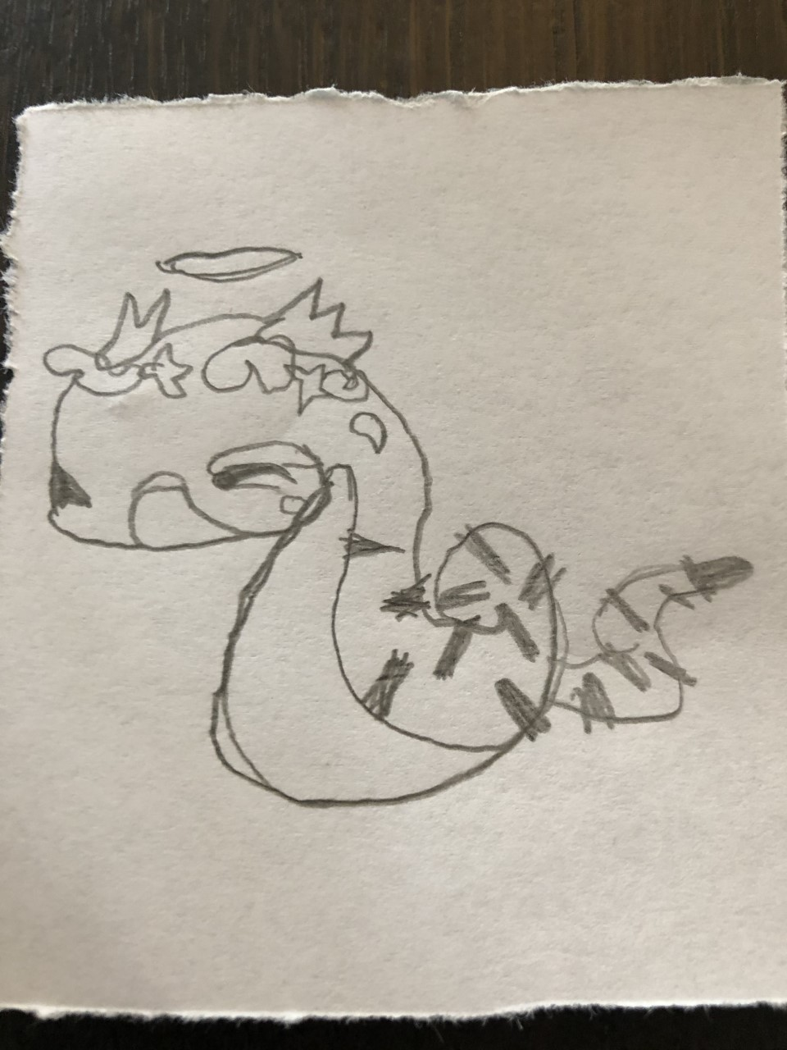
picture(Ruby)
I drew a great picture.

Slide 4
I LEARNED TO DO A FLIP
(i’m also doing a drawing comic cartoon battle with my sister and it’s gonna be so epic!!!)

Slide 5
ZOOM (Ruby)
I learnt how to set up a zoom call.

Slide 6
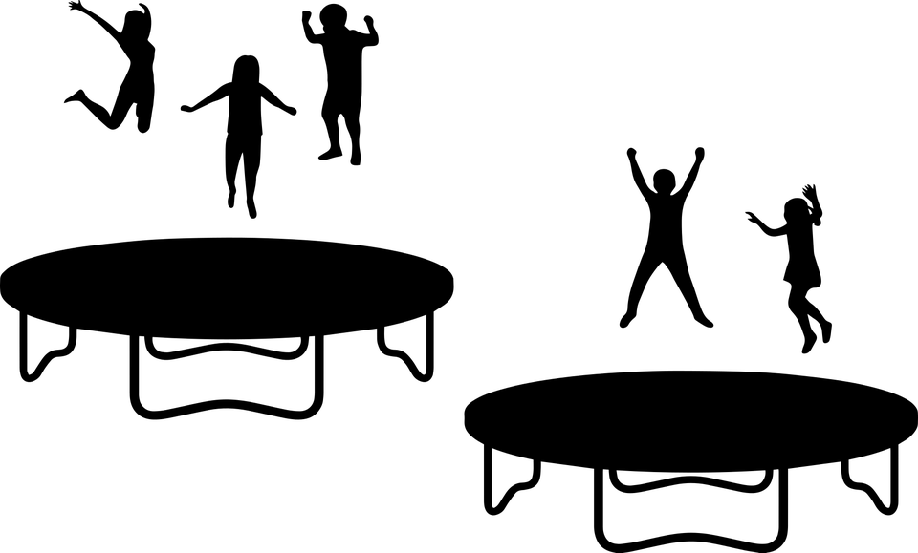
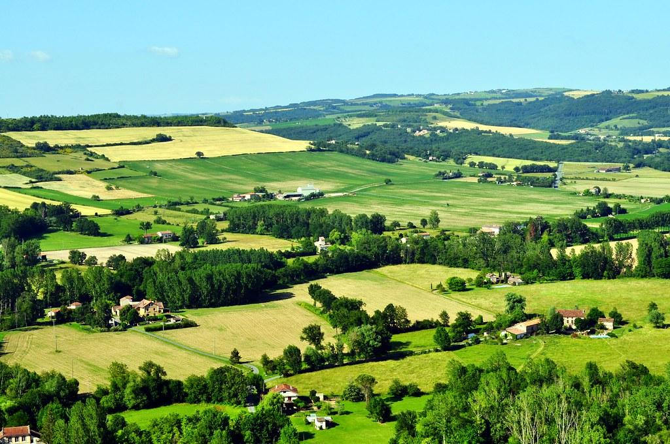
My weekend Eilidh M
Got surprised with a new trampoline
Went out a long walk
Painted a rainbow with my sister
Played roblox
Played outside
Made a den on the trampoline

Slide 7
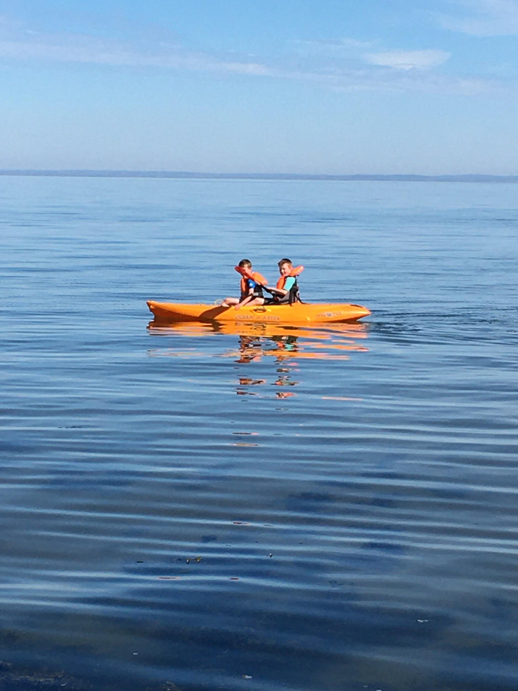
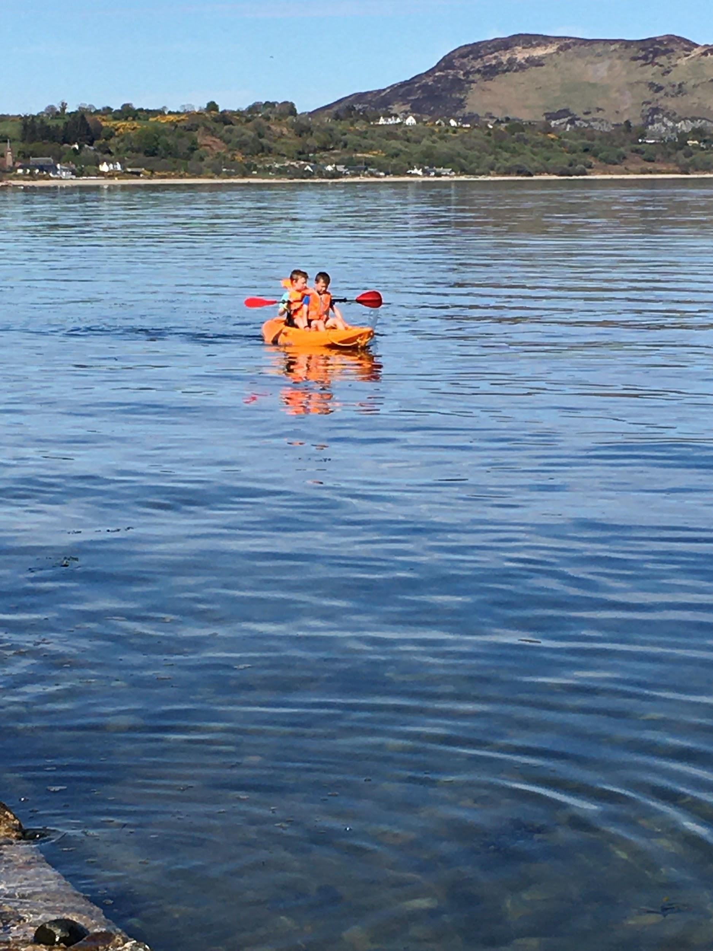
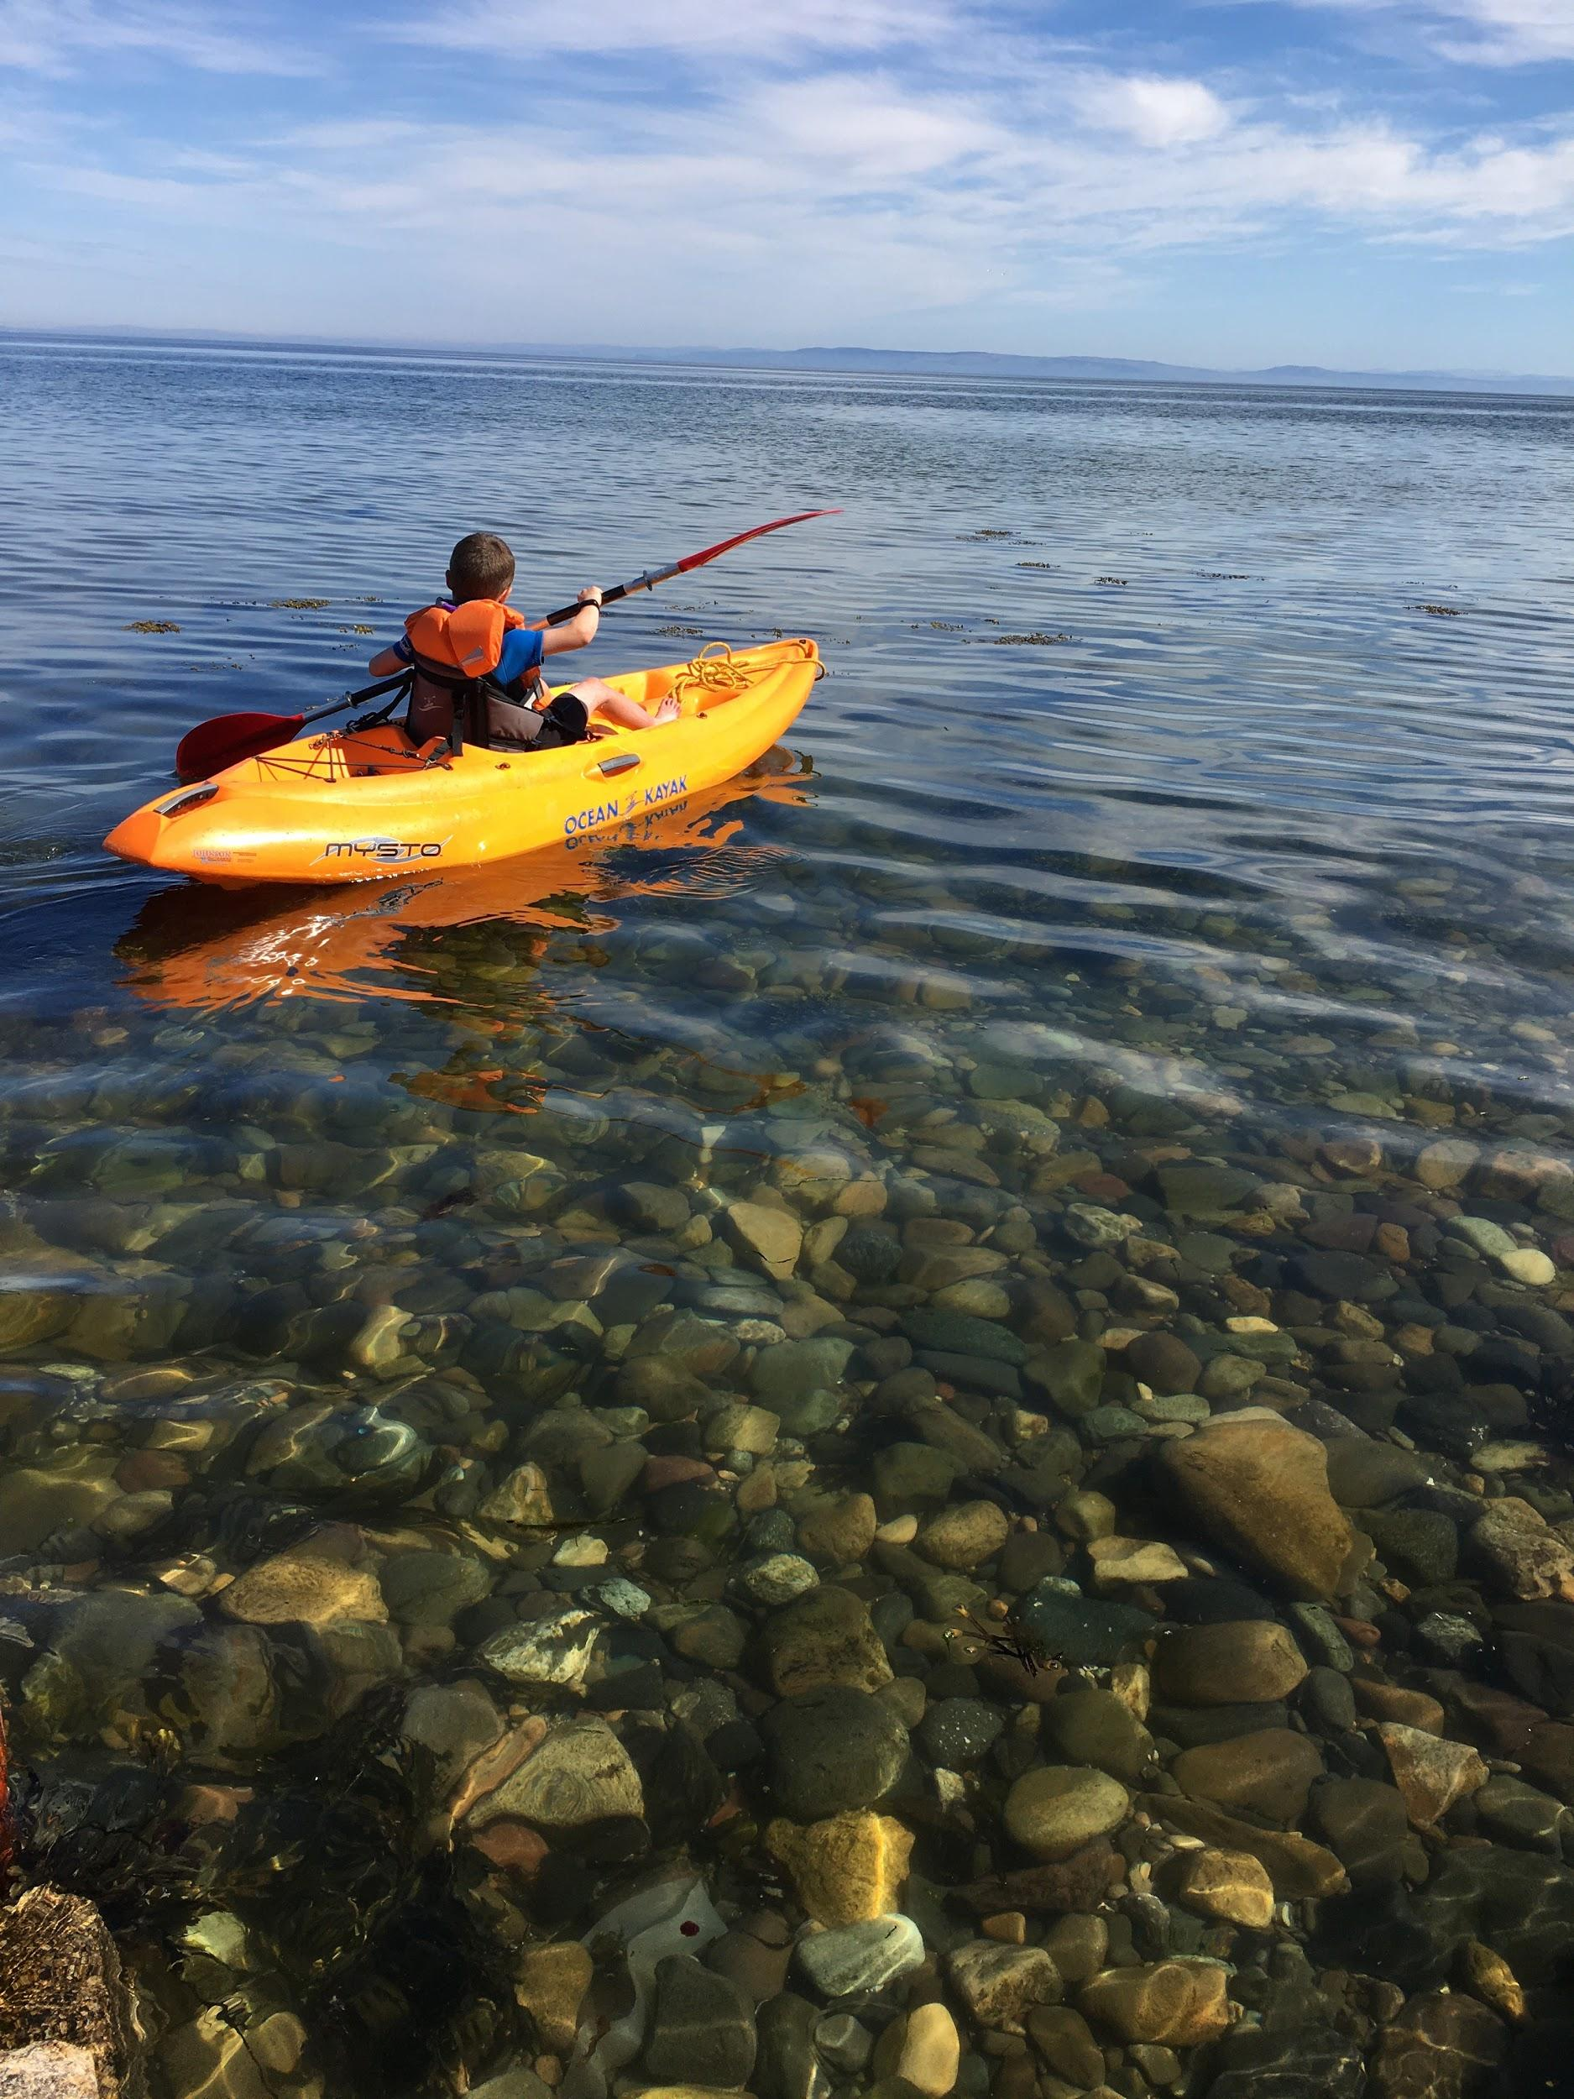
Yesterday I went out on the kayak (Adam B)

Slide 8
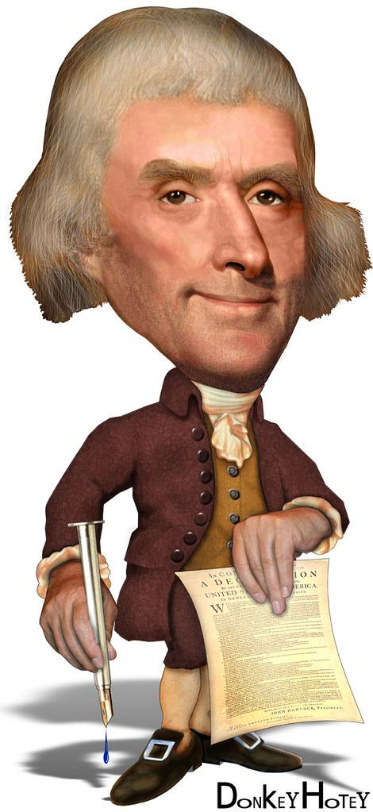
Humza Riaz - Research on American President,
Thomas Jefferson
Thomas Jefferson was a lawyer, diplomat, architect, philosopher, author and the third president of America. He had four children called Mary, Randolph, Madison and Eston Jefferson. He was also known as the ‘father’ of America. Thomas was 83 years old when he died. He was also born in year 1743.
Thomas died because of uremia and cancer. His last words were ” no, doctor, nothing more,”
John Adams was the second president of America. His last words were “Thomas Jefferson survives.” But Thomas Jefferson was already dead.John Adams was Thomas Jefferson’s best friend. Some people say John Adams saw a ghost. Some people say he was mistaken. Thomas Jefferson’s wife was called Maratha Jefferson. Thomas was 6ft 2 in tall. He was born in Virginia. His mother was called Jane she was a Ships Captain . Peter Jefferson was her spouse .His grandmother was called Mary Field. Thousands of us are related to Thomas Jefferson about 18 Thousand.
If you take a DNA test you will know Thomas Jefferson had a cane because Fernandez told him he looked really cool. Thomas Jefferson agreed with him. Thomas Jefferson would be 377 years old if he was still alive right now. Thomas Jefferson also loved reading books. He didn’t always show what he did in his personal life.

Slide 9
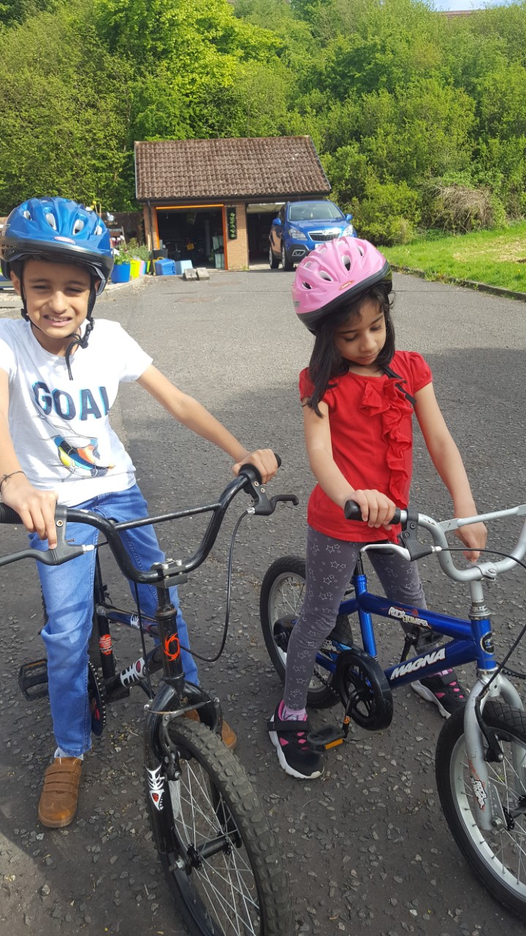
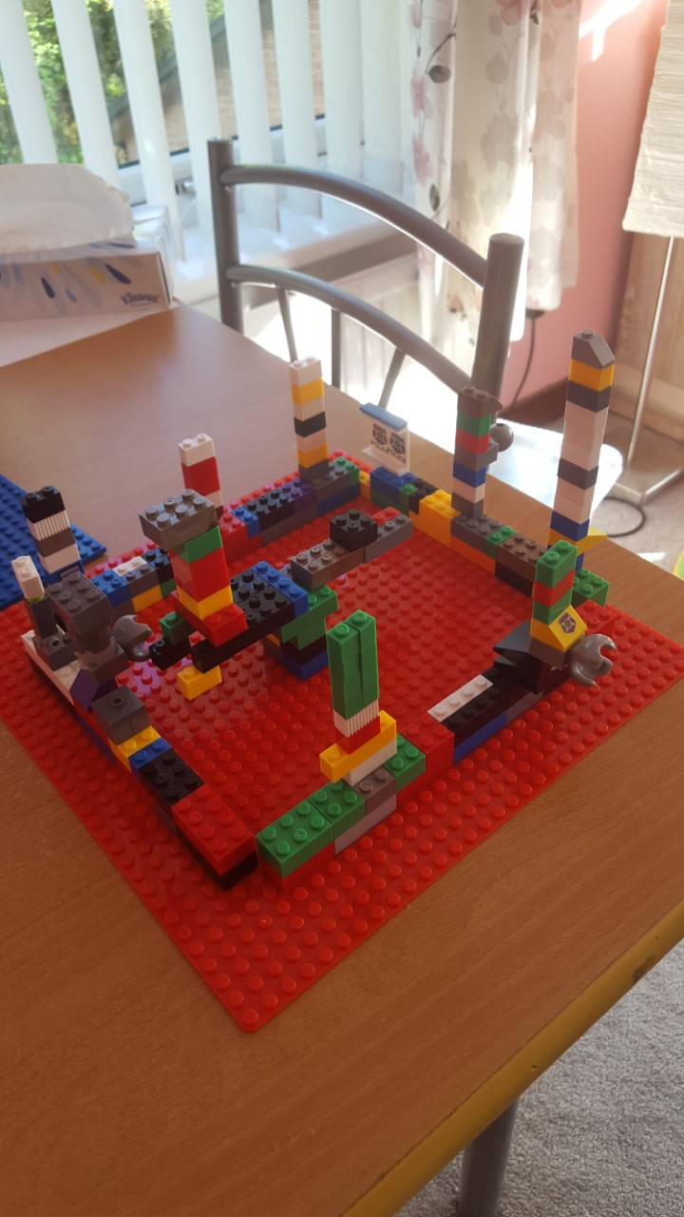
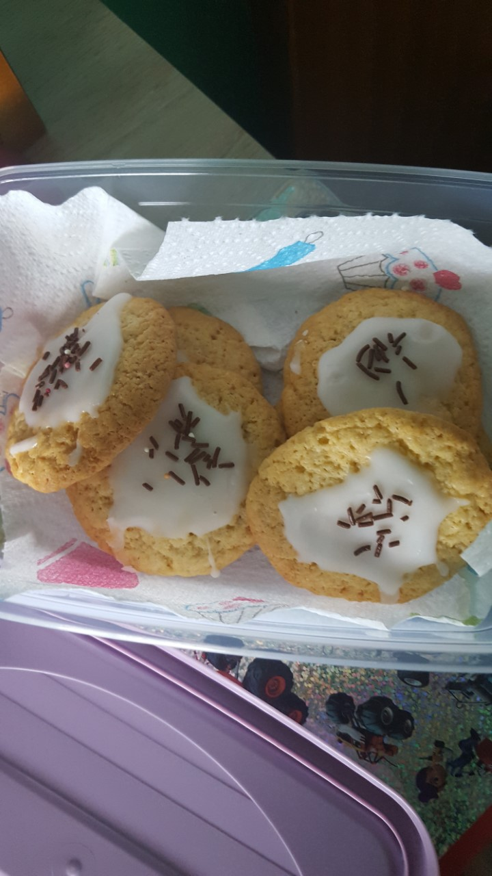
Humza R - This week. Cycling, making biscuits and created my dinosaur den in lego workshop

Slide 10
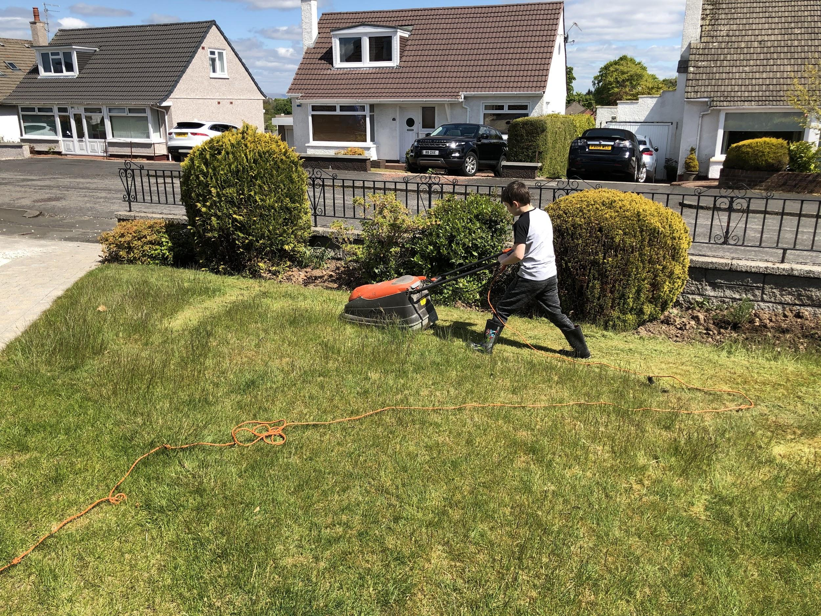
Thomas
I cut the grass

Slide 11
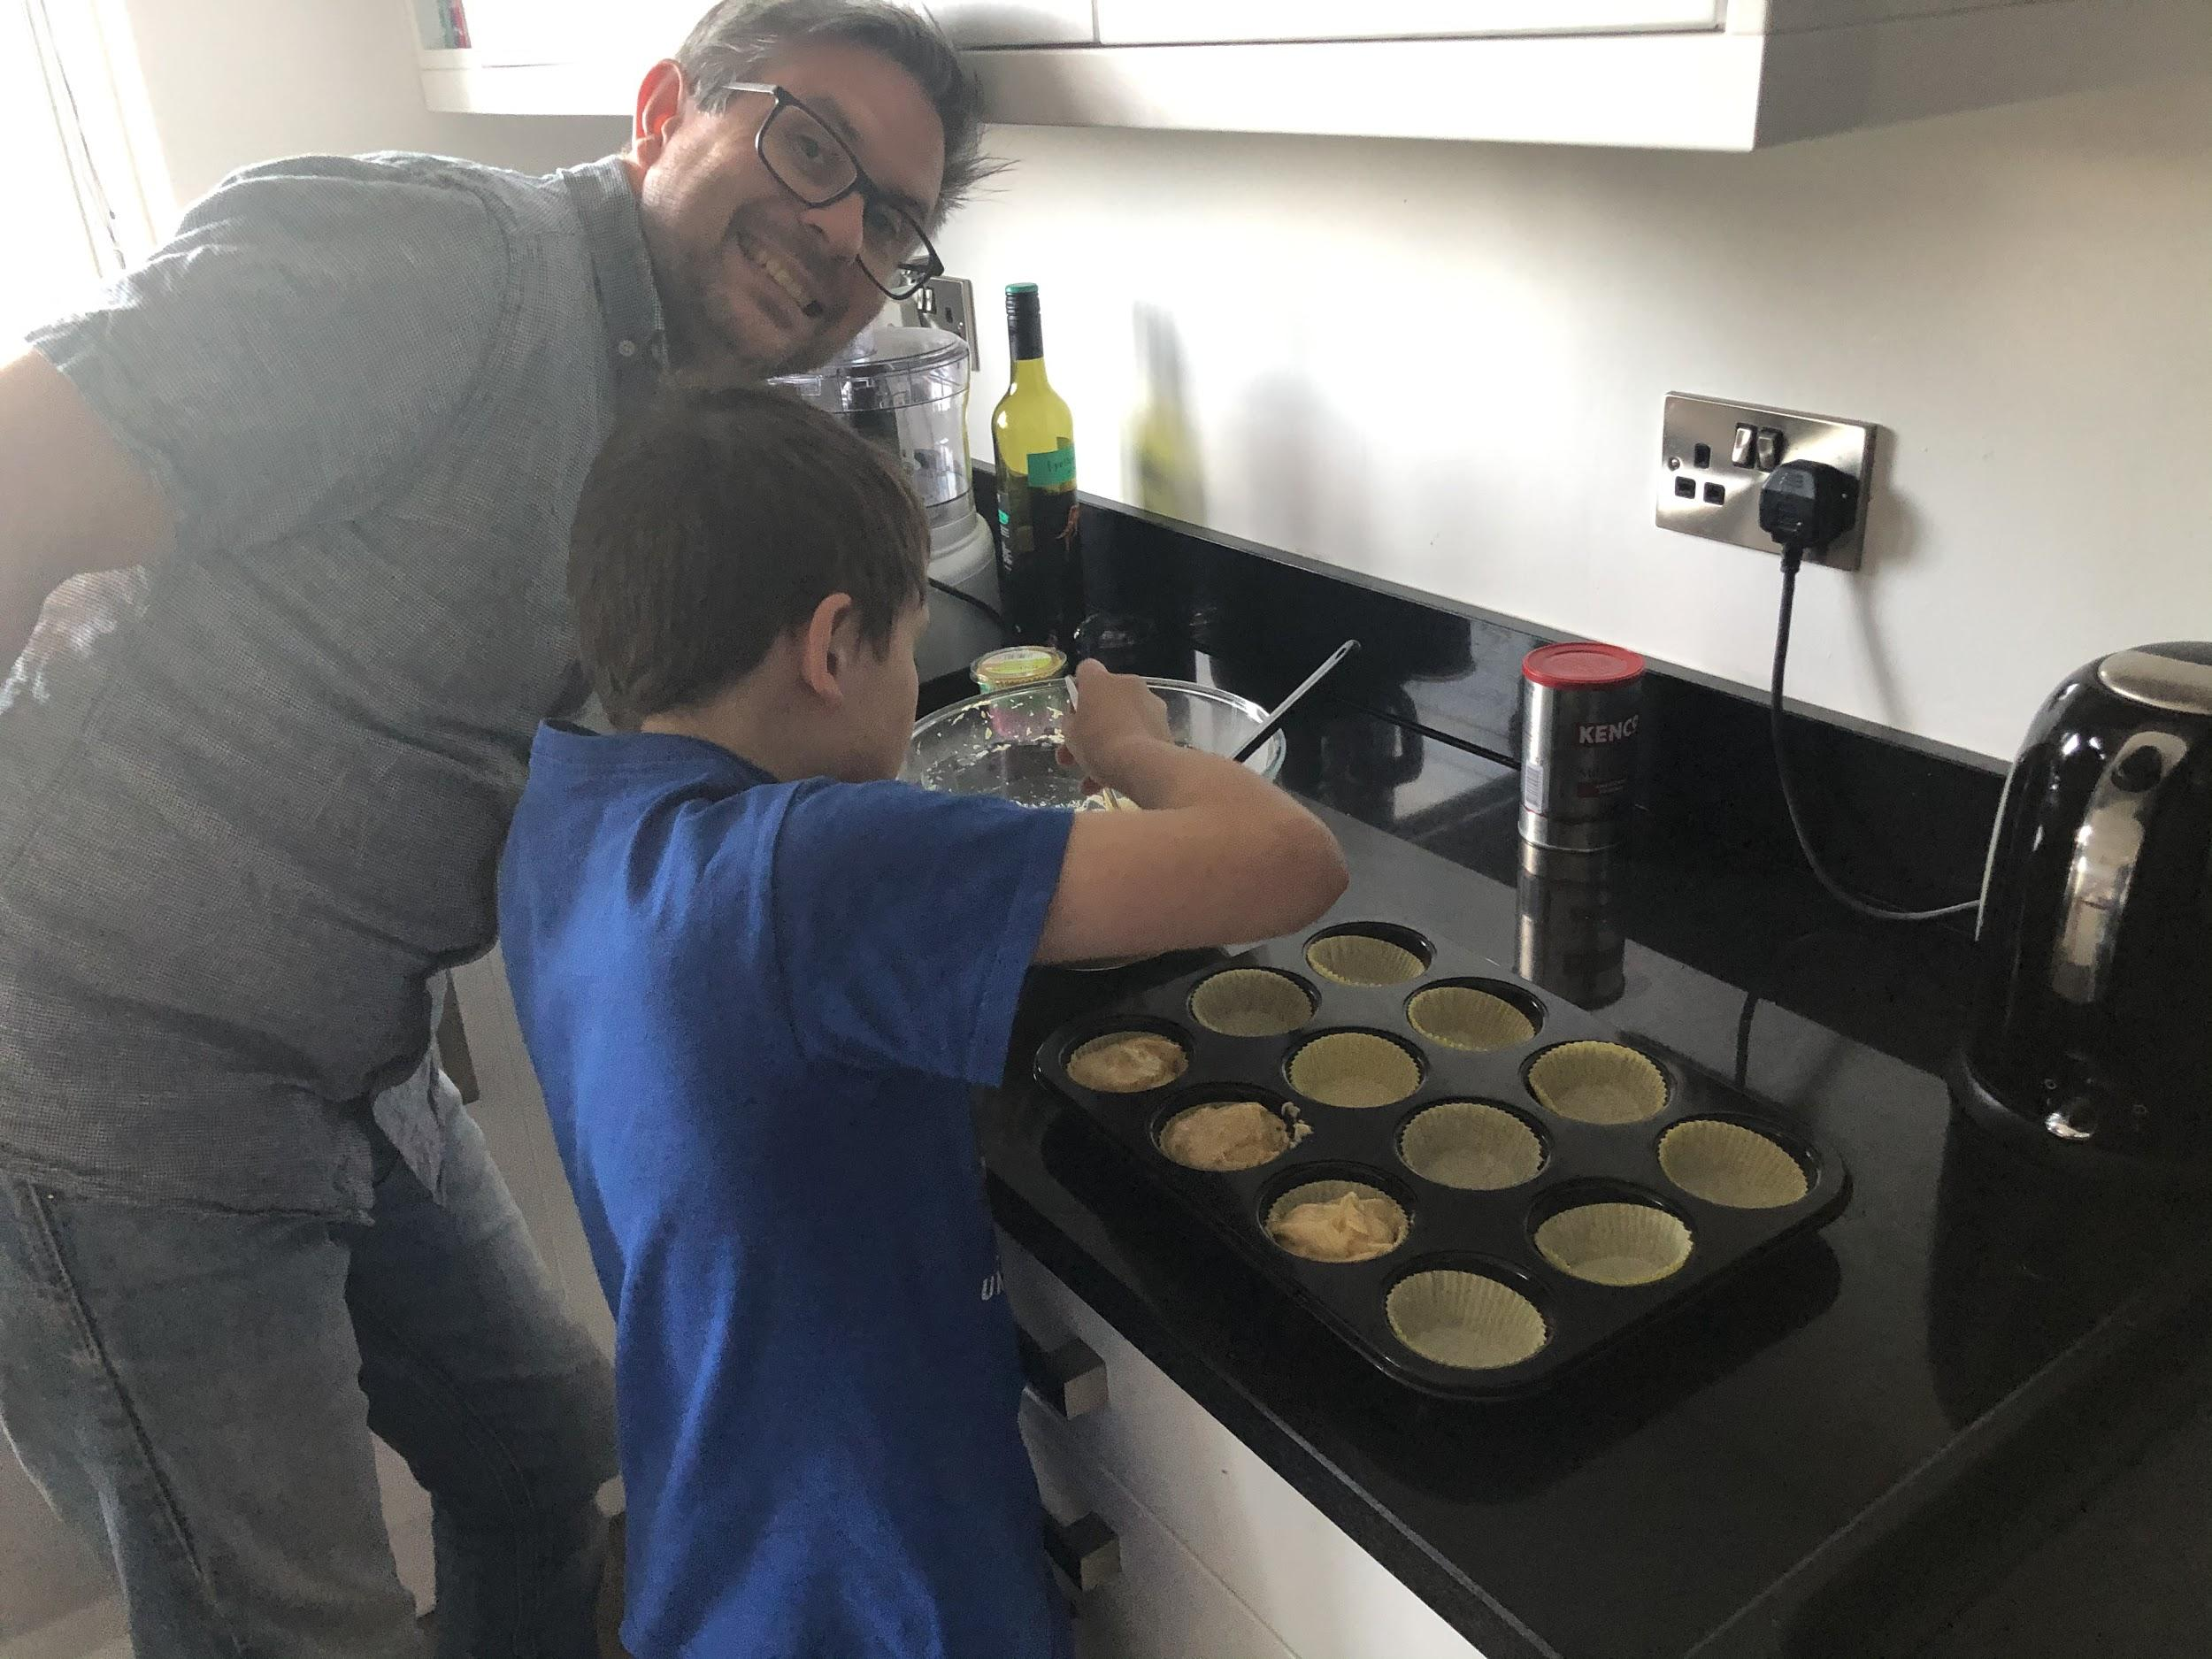
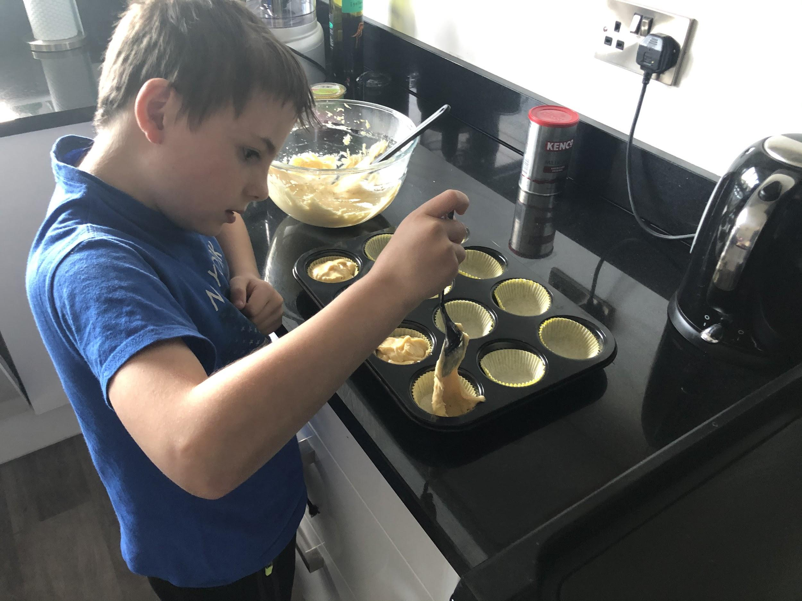
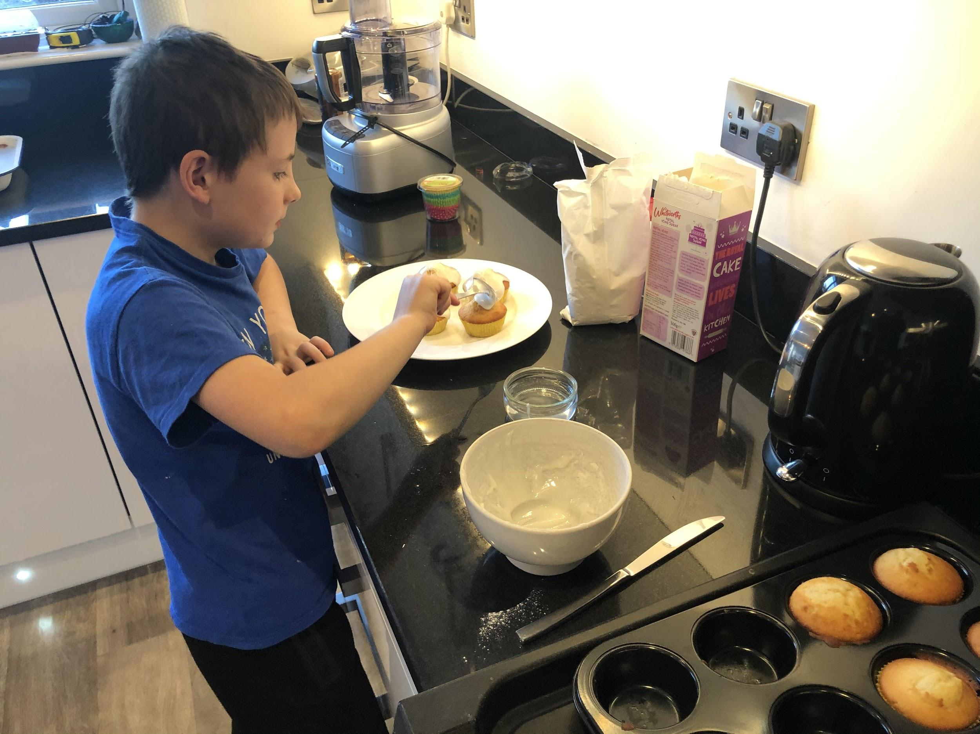
I made cup cakes
Thomas

Slide 12
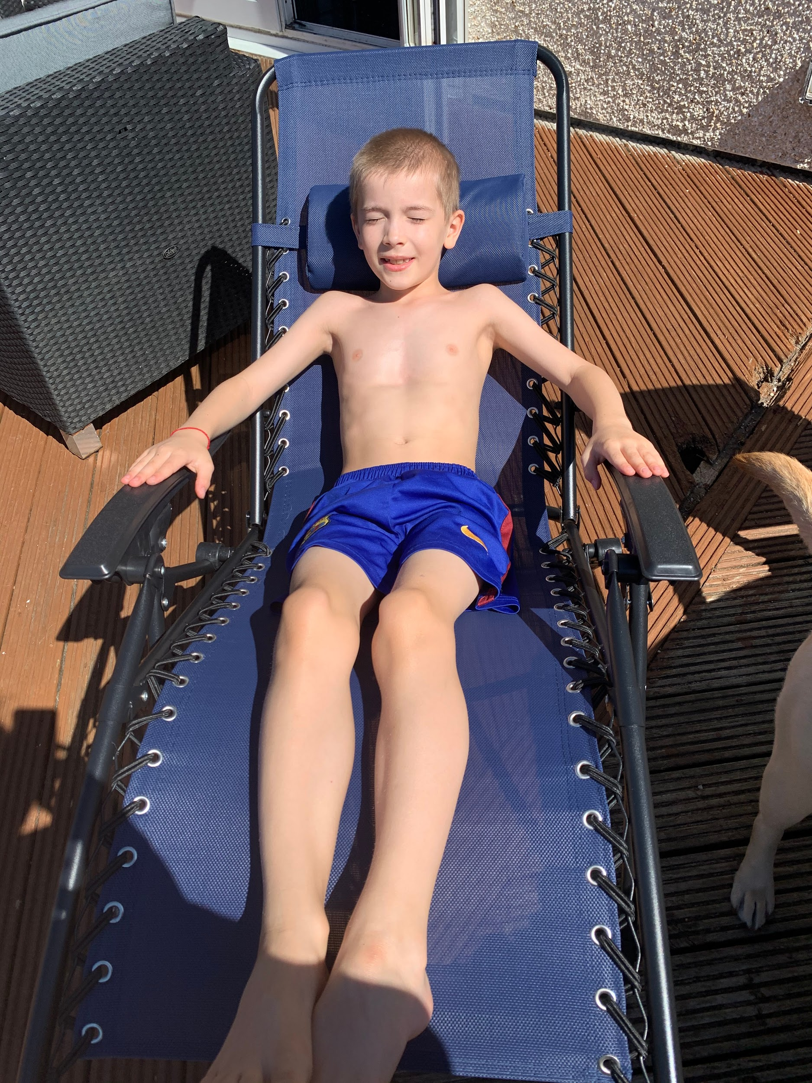
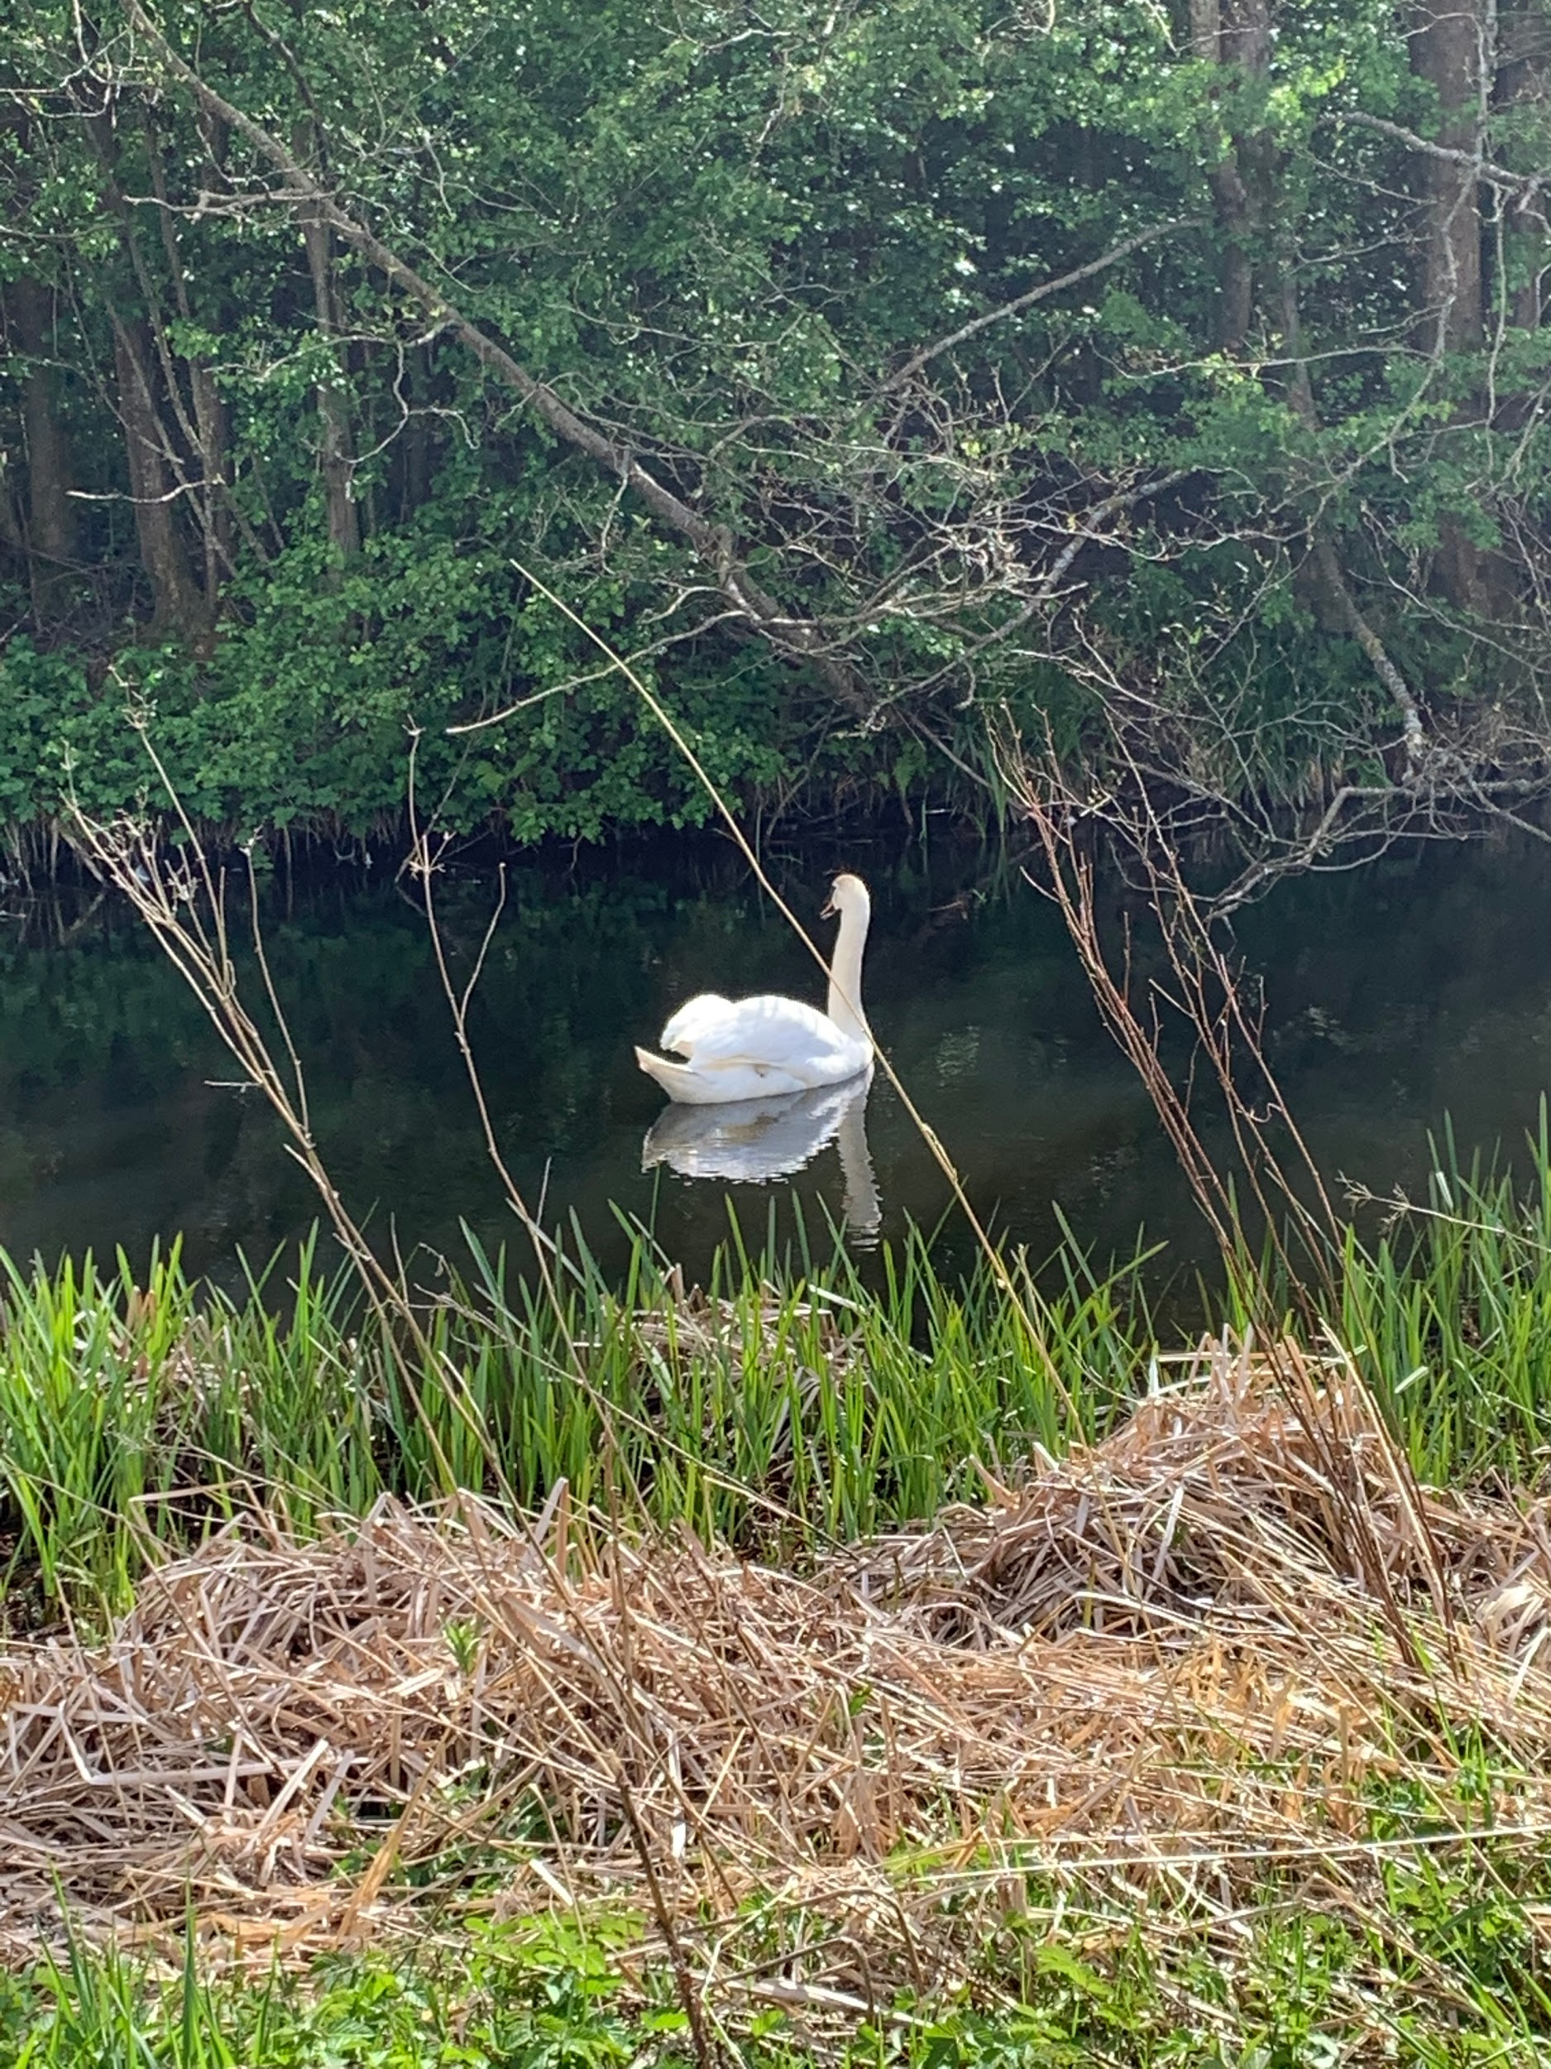
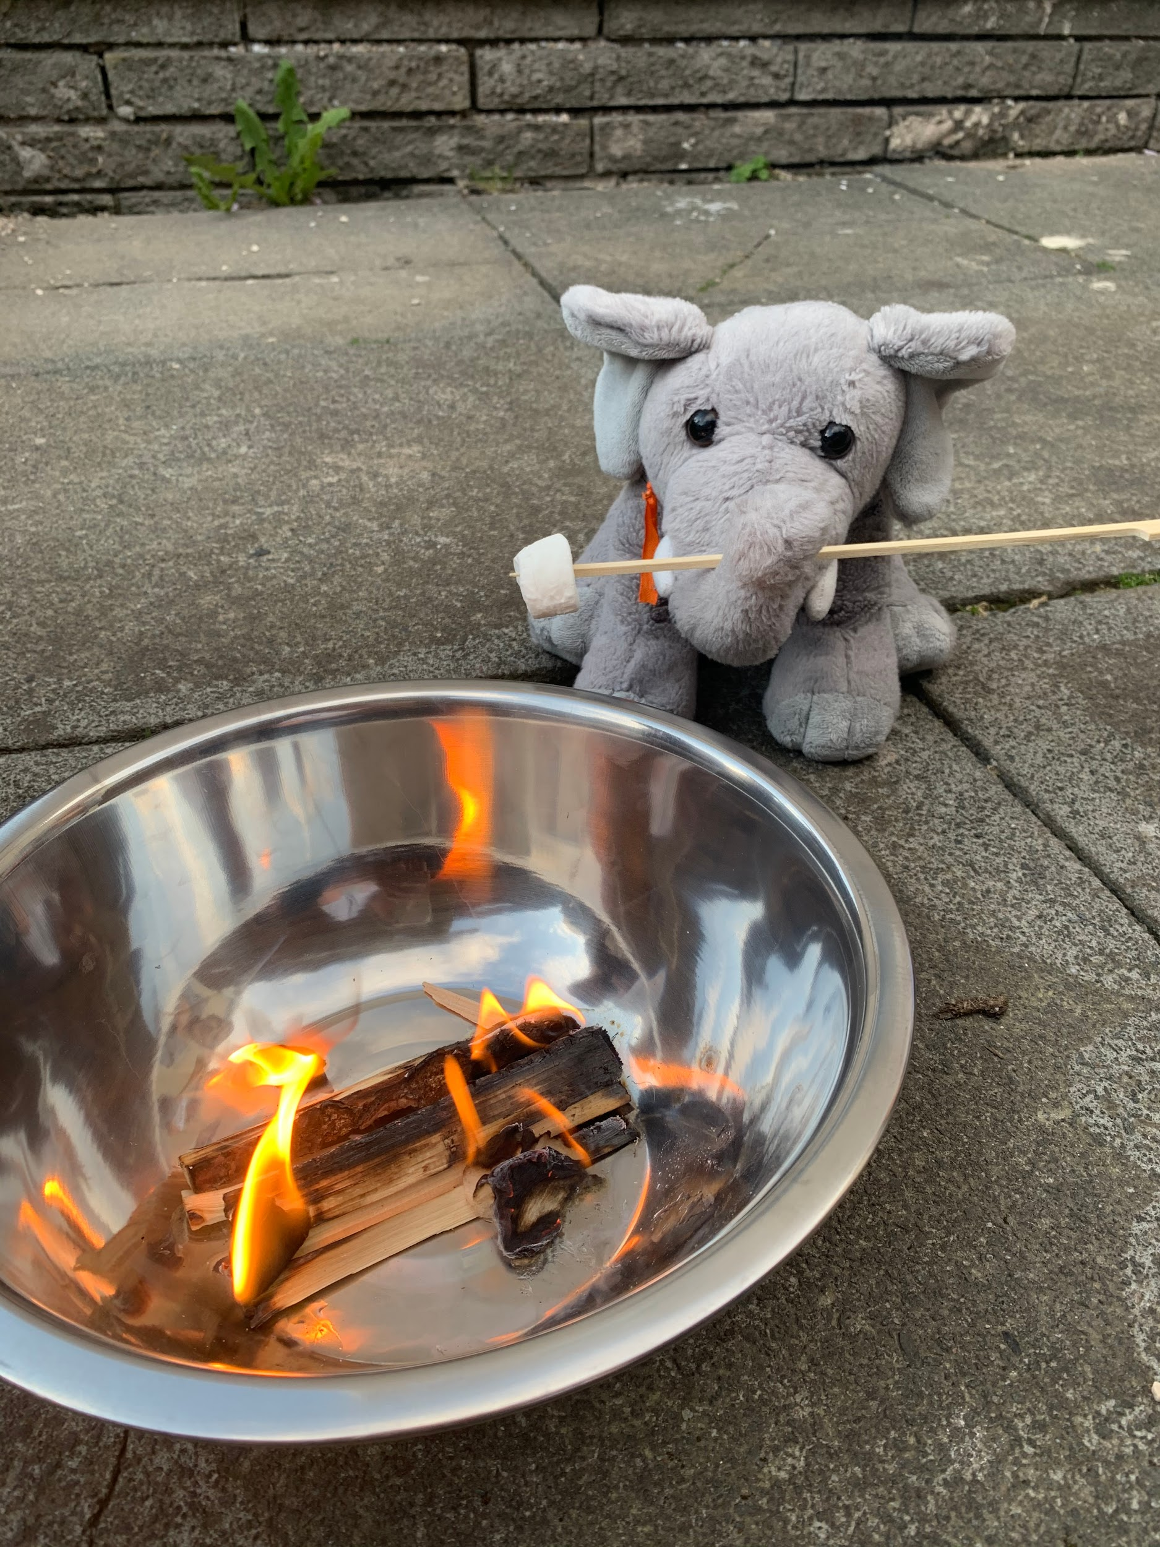
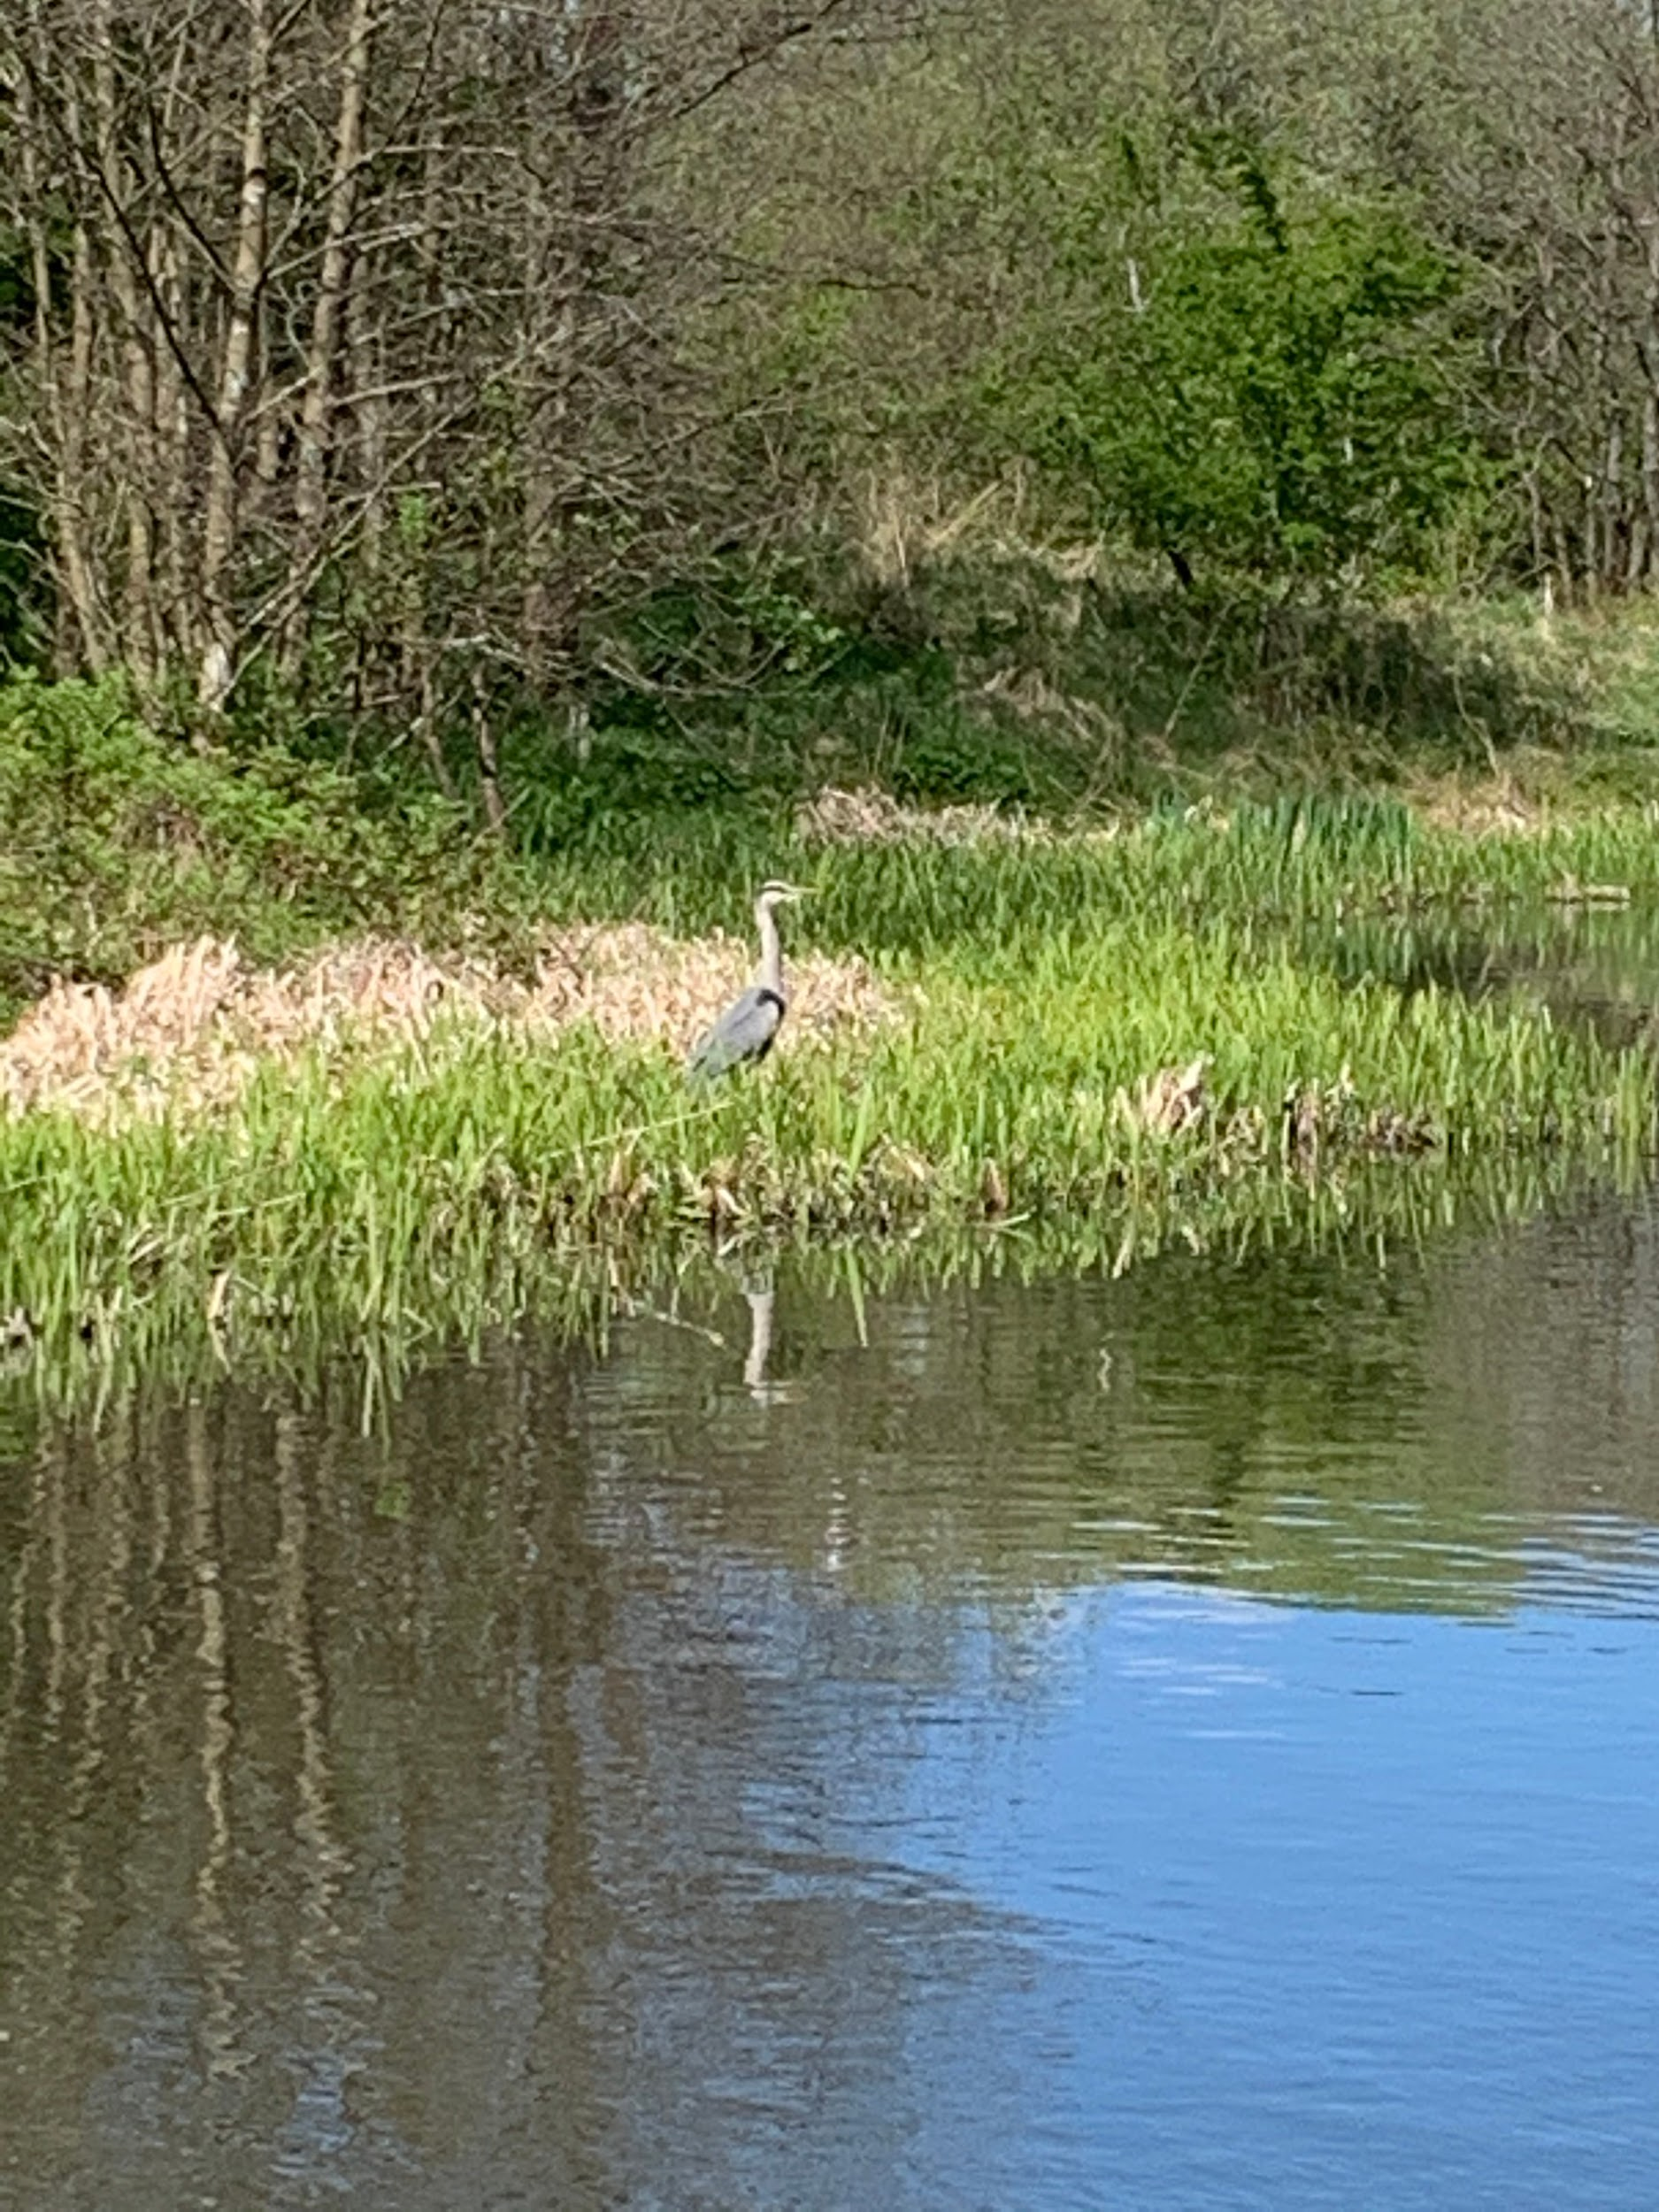
Aaron
< I was sunbathing in the sun
We took Millie for a walk, we saw a swan >
< Me and my family where making marshmallows
We took my dog Millie for a walk and saw a heron and Millie jumped in the water >

Slide 13
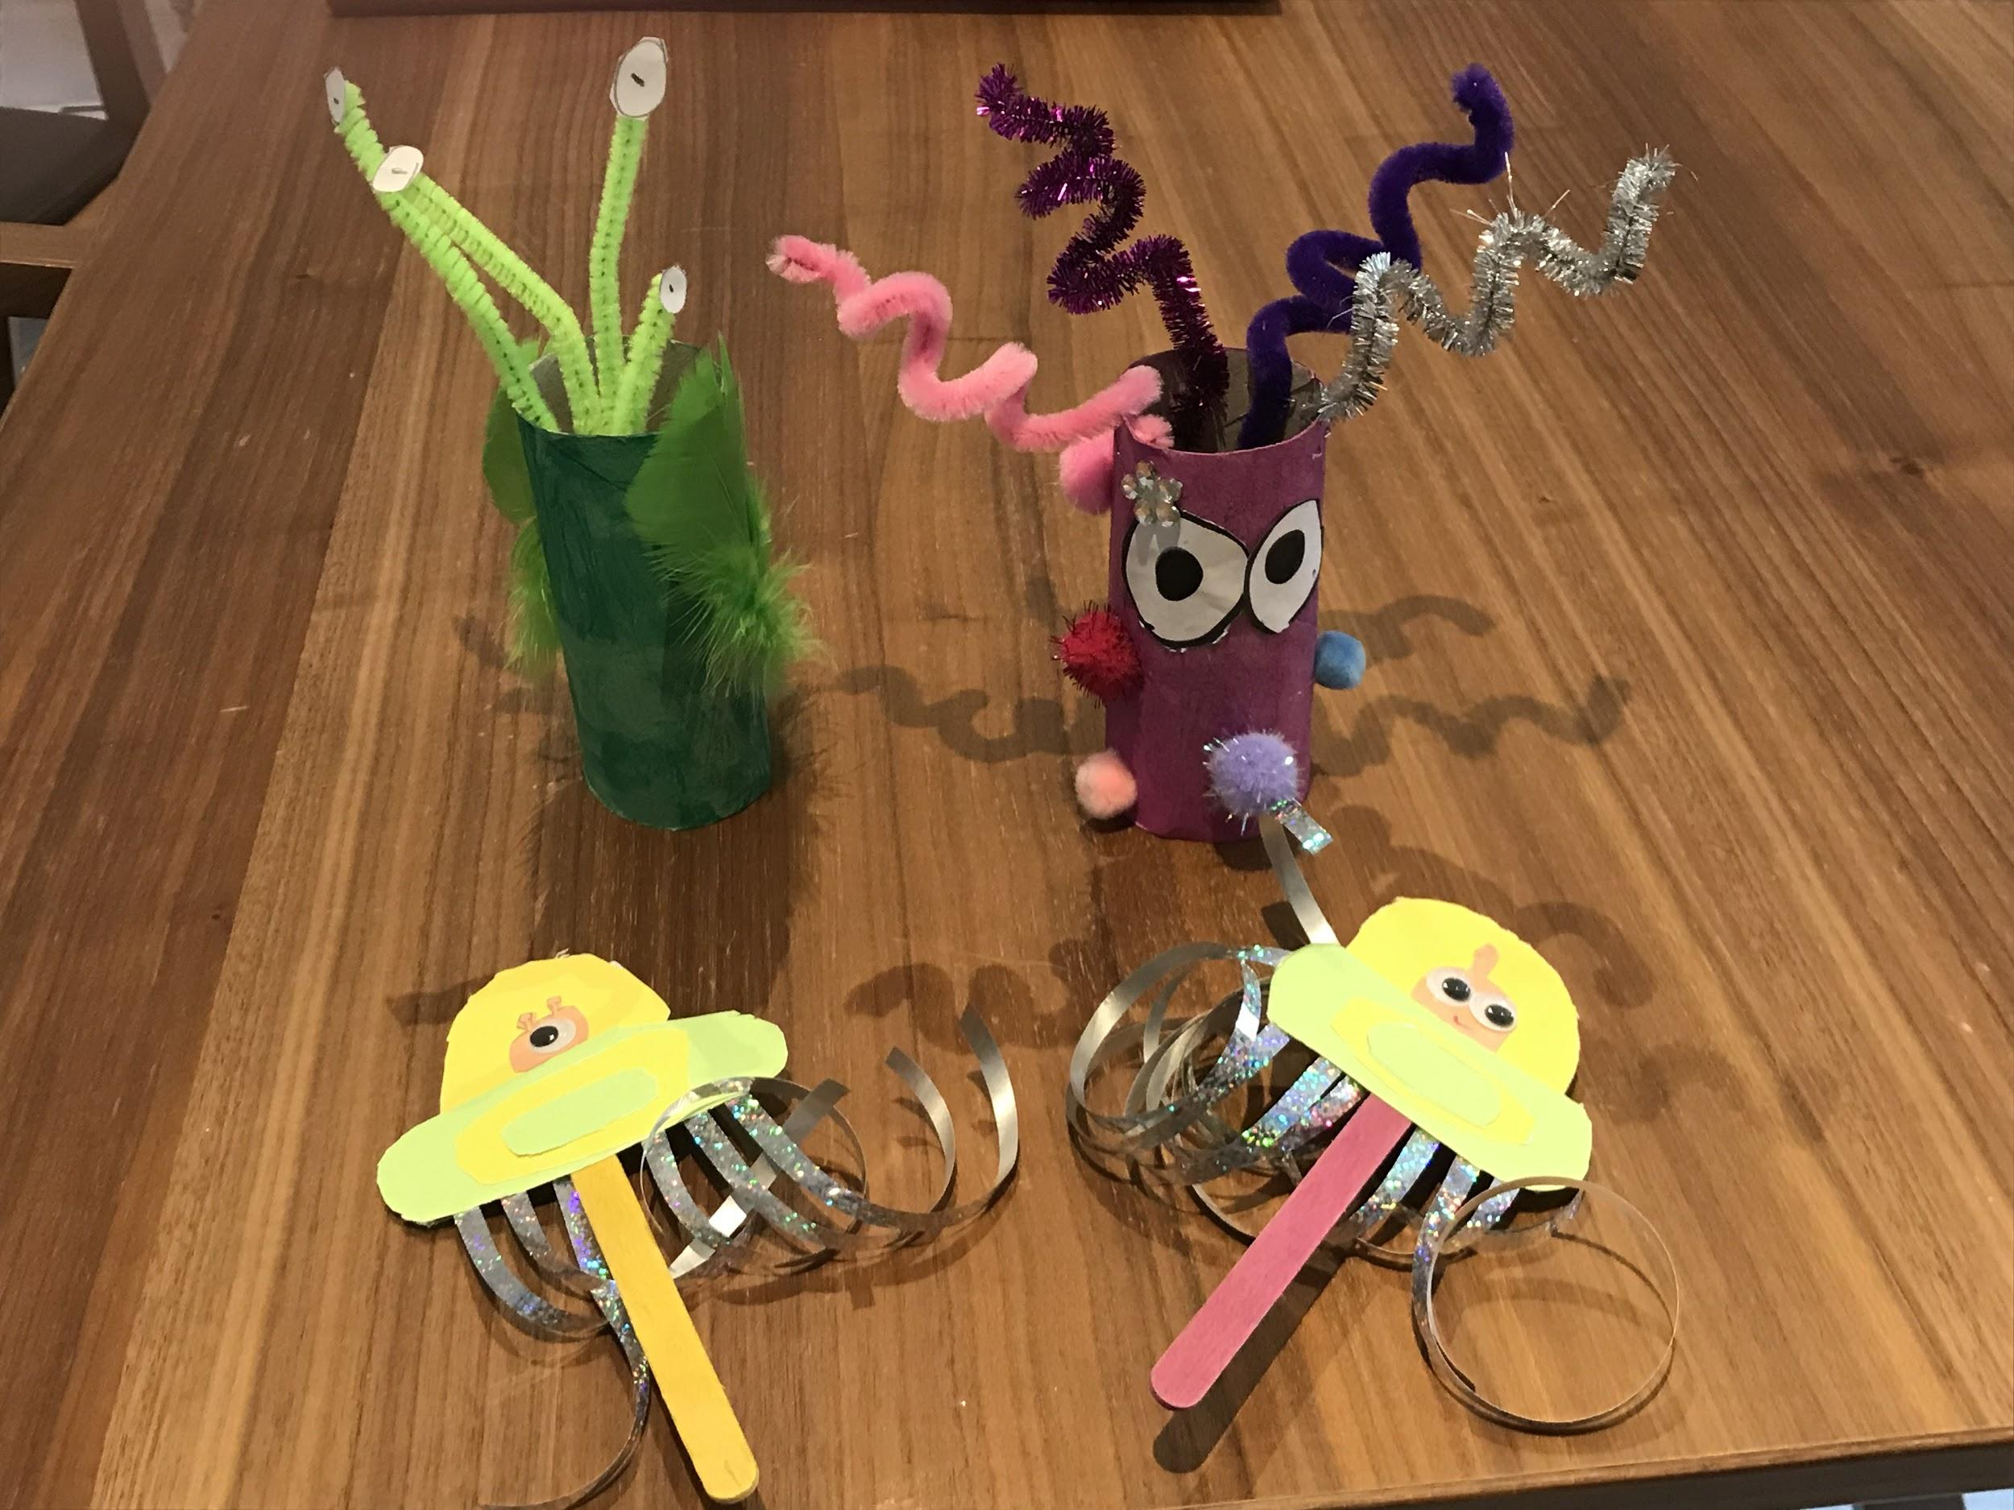
Charlotte
I have been helping my brother make aliens for his school space topic!!

Slide 14
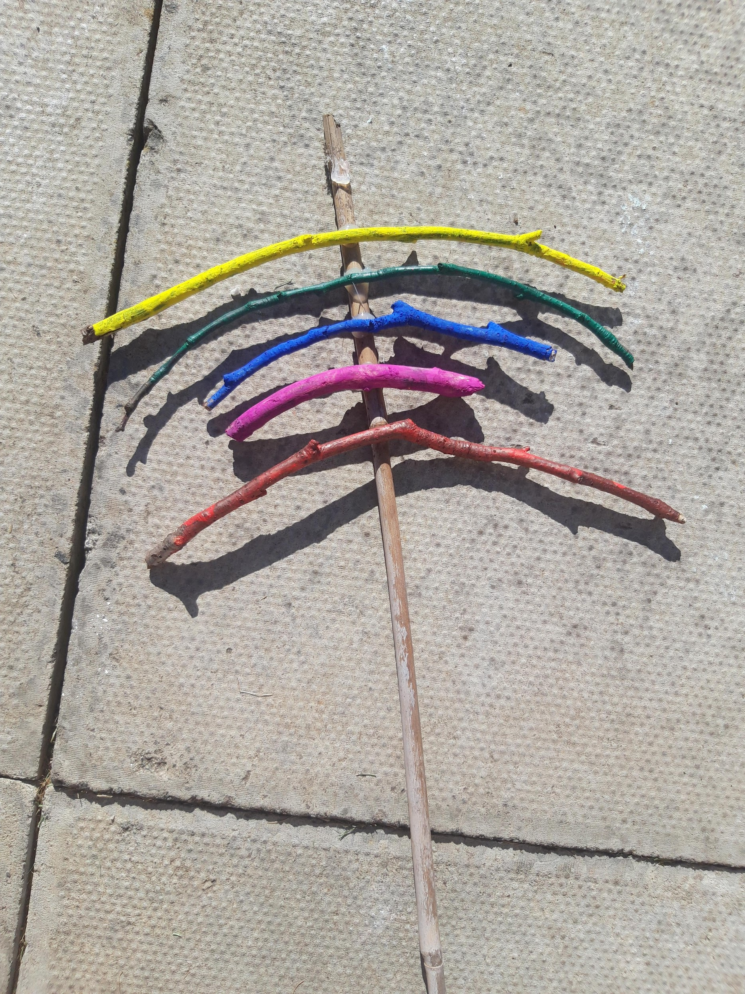
Ailsa
I made a quiz for my family.
We made rainbows from slightly curved sticks.
I am growing sunflowers and we had to repot them.

