Slide 1
What a clever bunch!
P5a’s Home Learning Log

Slide 2
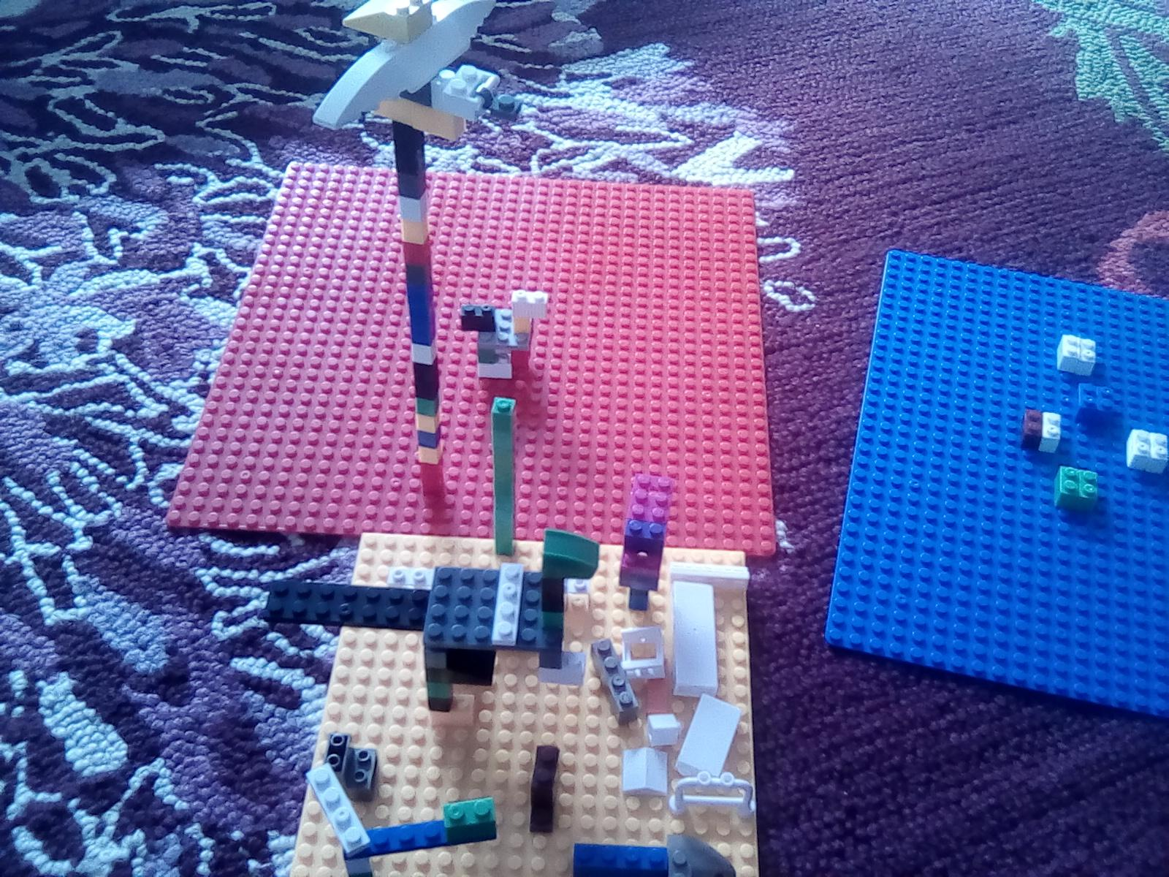
Humza - life science Lego today. Dinosaur land

Slide 3
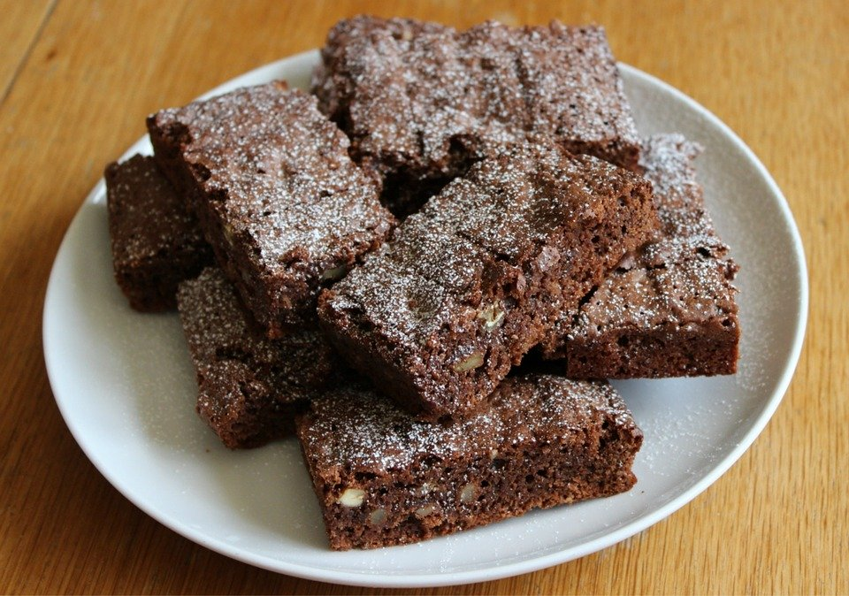
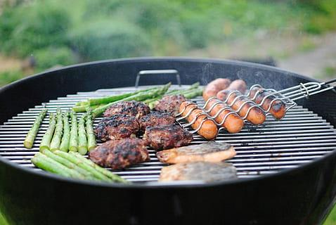
What i have been doing Eilidh M
Had a BBQ
Had a zoom birthday party for olivia’s birthday (in the other class!)
Went out lots of walks,cycles and scoots
Made a den
Played roblox with my friends
Made chocolate brownies with my sister

Slide 4
noor
I have been doing
. some sumdog
. some arts and crafts playing with my little sister#
. and some i pad time
.facetime my little cousin ( she is 1 and she is sooo cute)

Slide 5
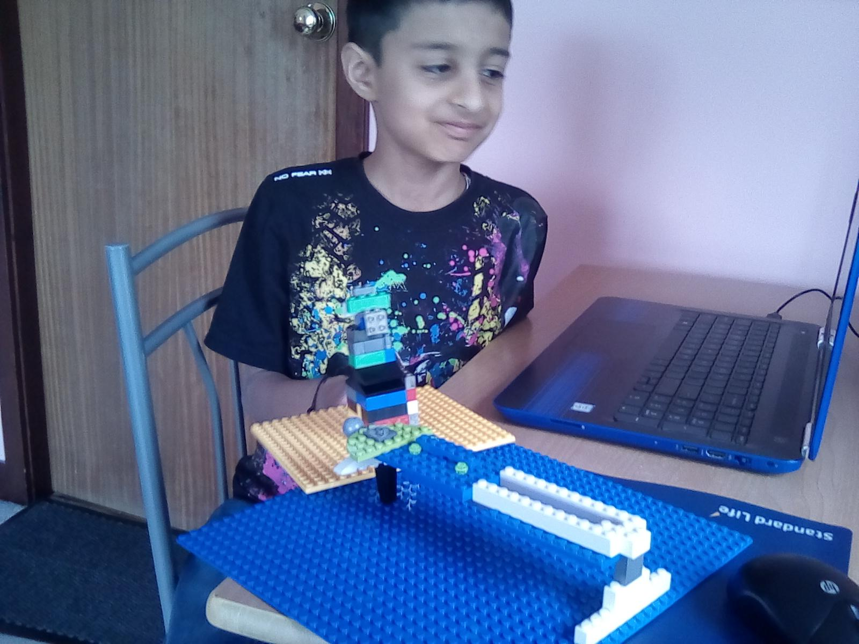
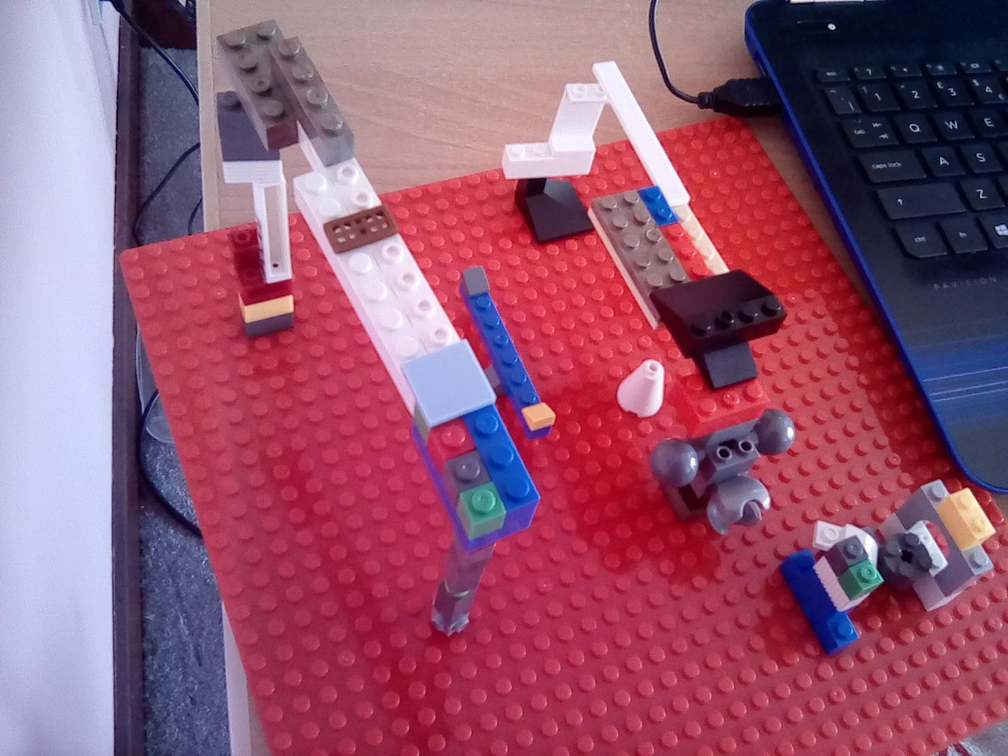
Humza Lego class on Zoom. Engineering
Tower, bridge and the on red plate is a playground. Monkey bars swing see saw and more

Slide 6
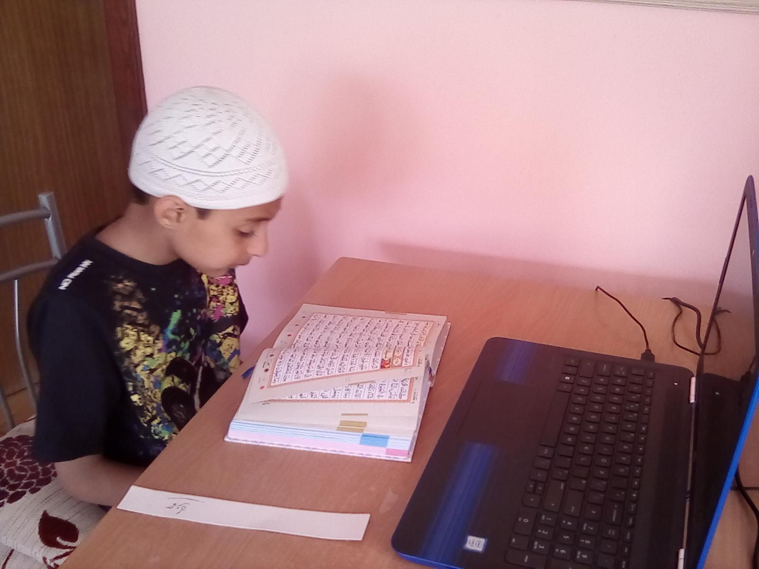
Humza - Arabic class on line

Slide 7
I have been proud of riding a big bike because i was to scared of riding a big bike but then my dad tought me how to ride a big bike in 3 days i lernt how to ride a big bike.

Slide 8
With my whole family i walked a hour or 2 and we had a picnic there. I lernet how to play with a drum my dad tought me and it was really fun it took me 7 days to lern how to play it and i was really happy.

Slide 9
Me and my mum waterd the plants i really like watering plants because i want to see the height of it. We also have a bird feeder and i like how we feed birds that are hungry.

Slide 10
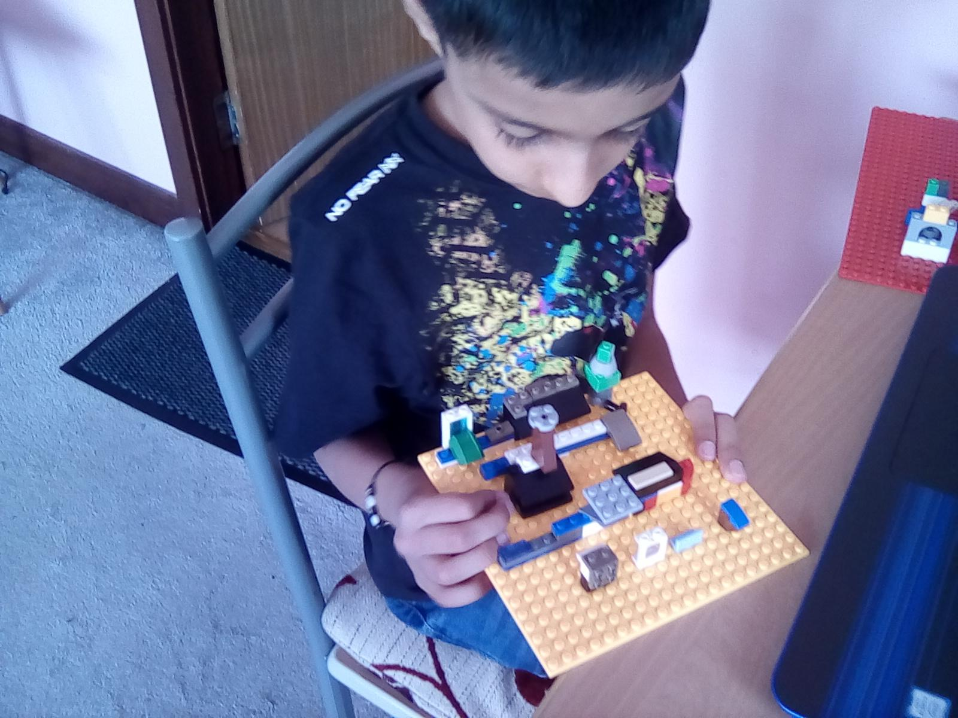
Humza Lego workshop . Cafe
Carrie my Lego workshop superviser is sharing my builds on her Facebook page.

Slide 11
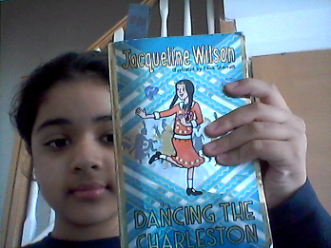
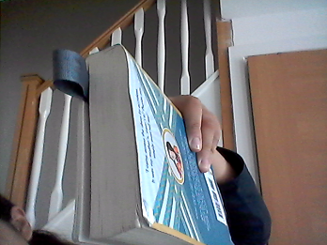
Menahil
I am proud because i am reading the biggest book that i have and so far i have read 2 and a half chapters

Slide 12
jasmine
I am proud because i learned how to fold a papp

Slide 13
Joseph
The Lavender I planted is starting to grow.

Slide 14
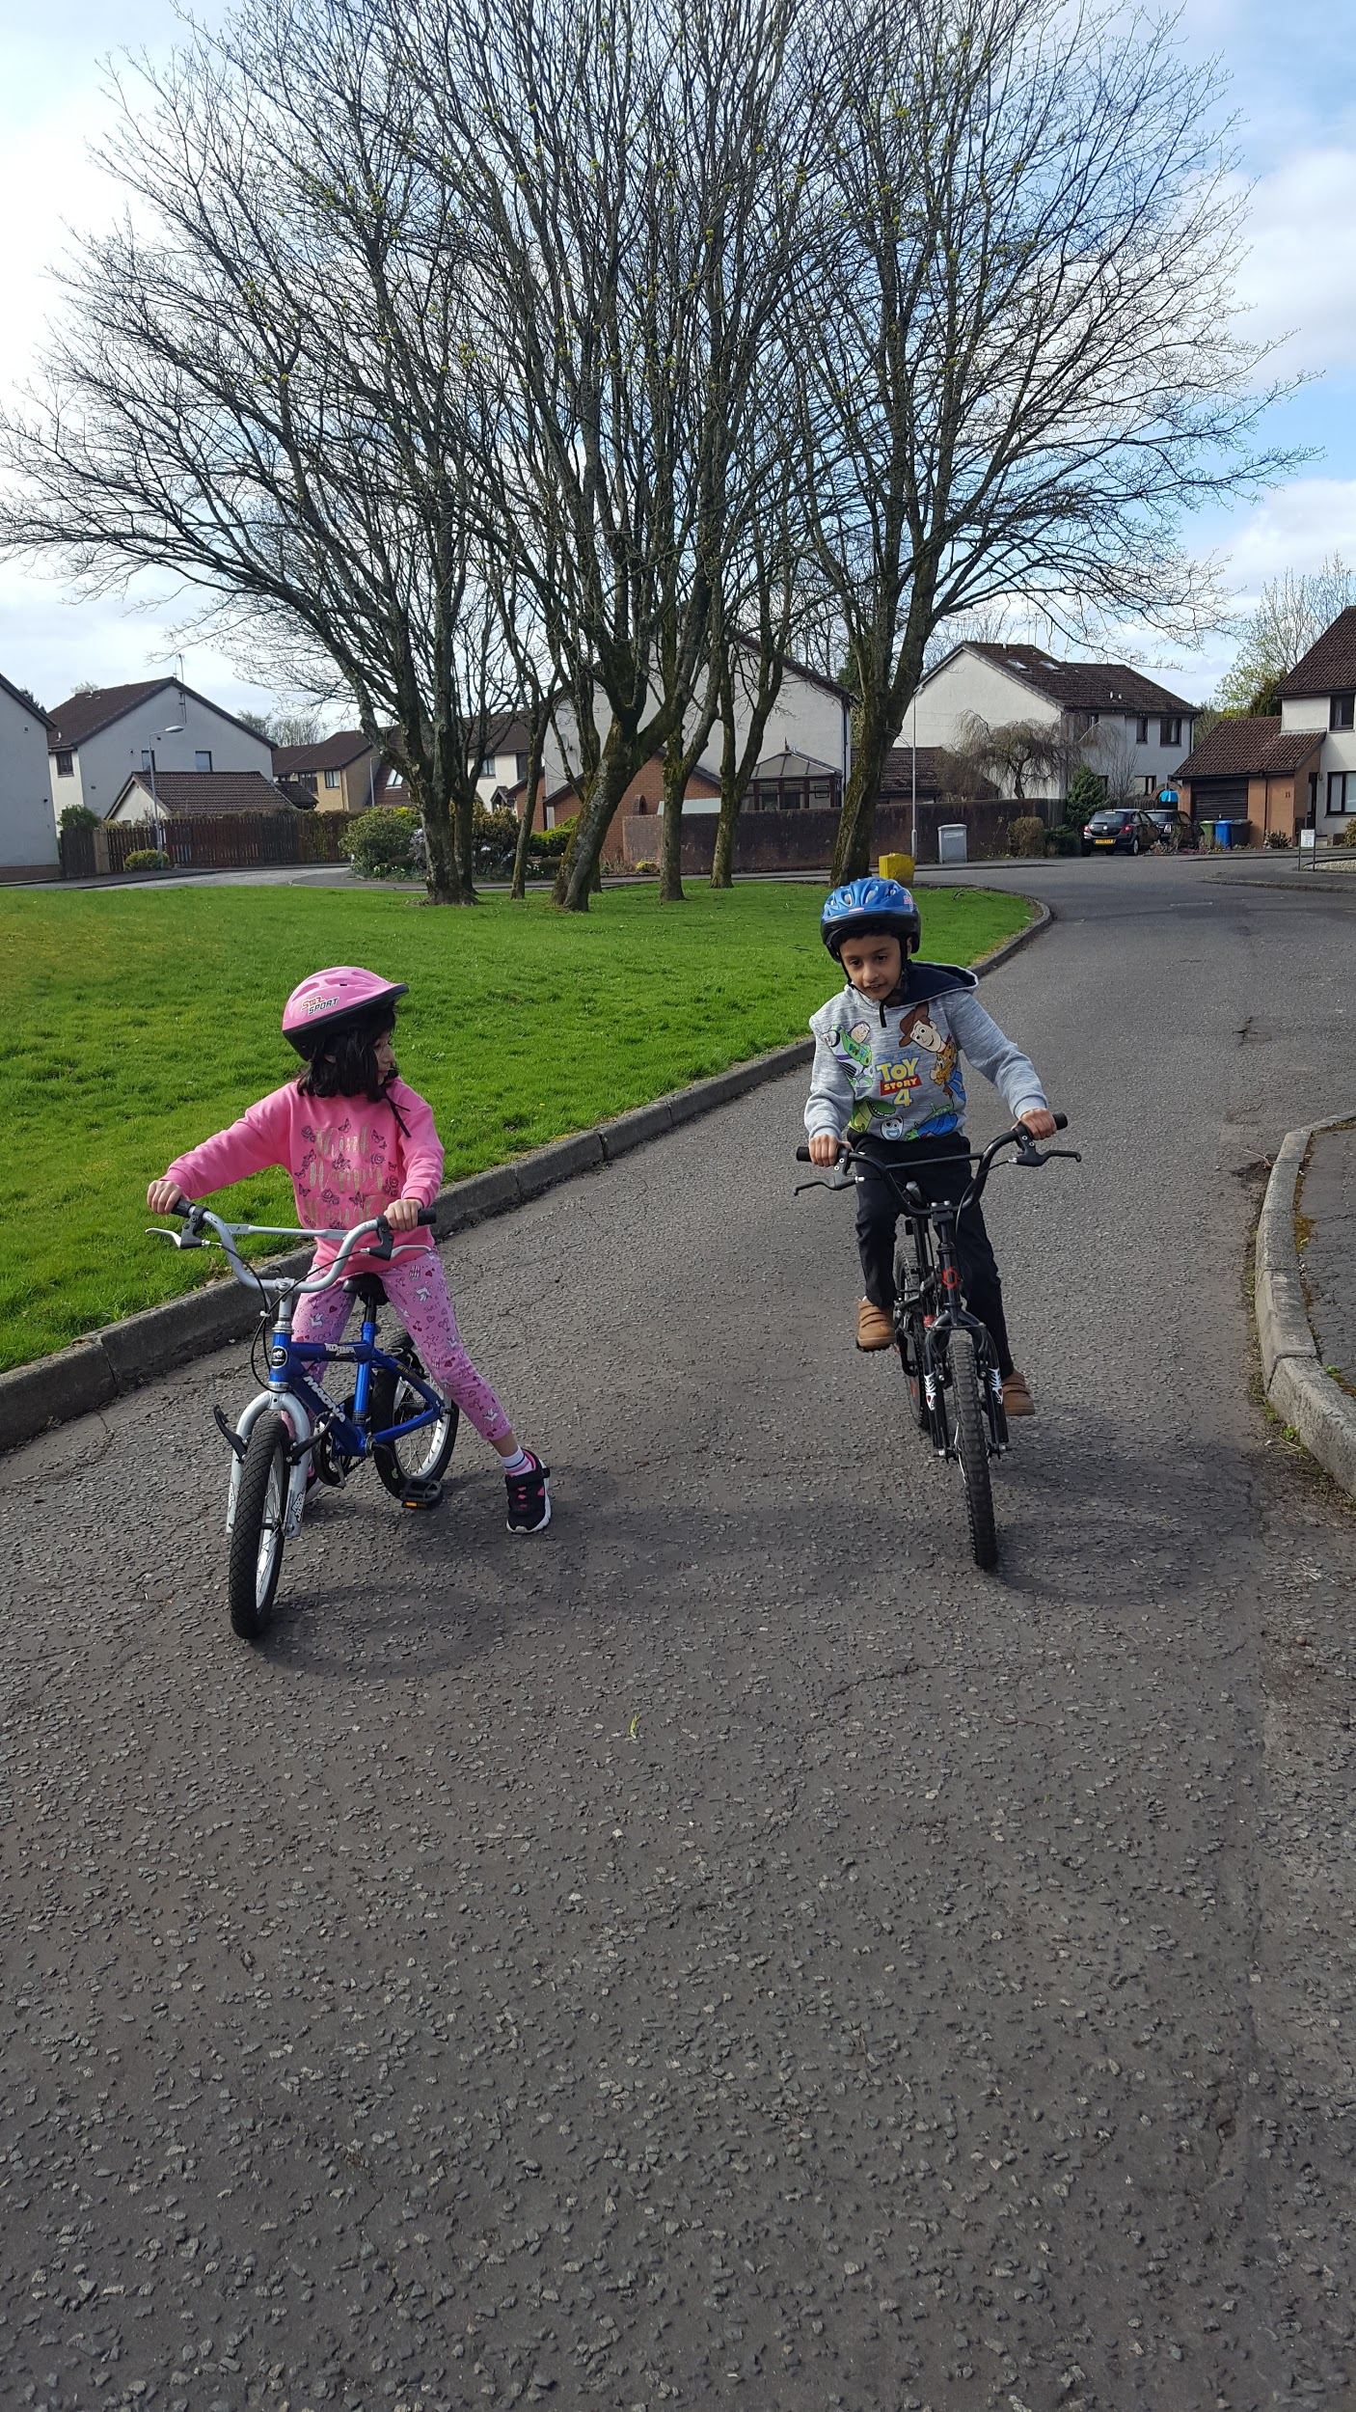
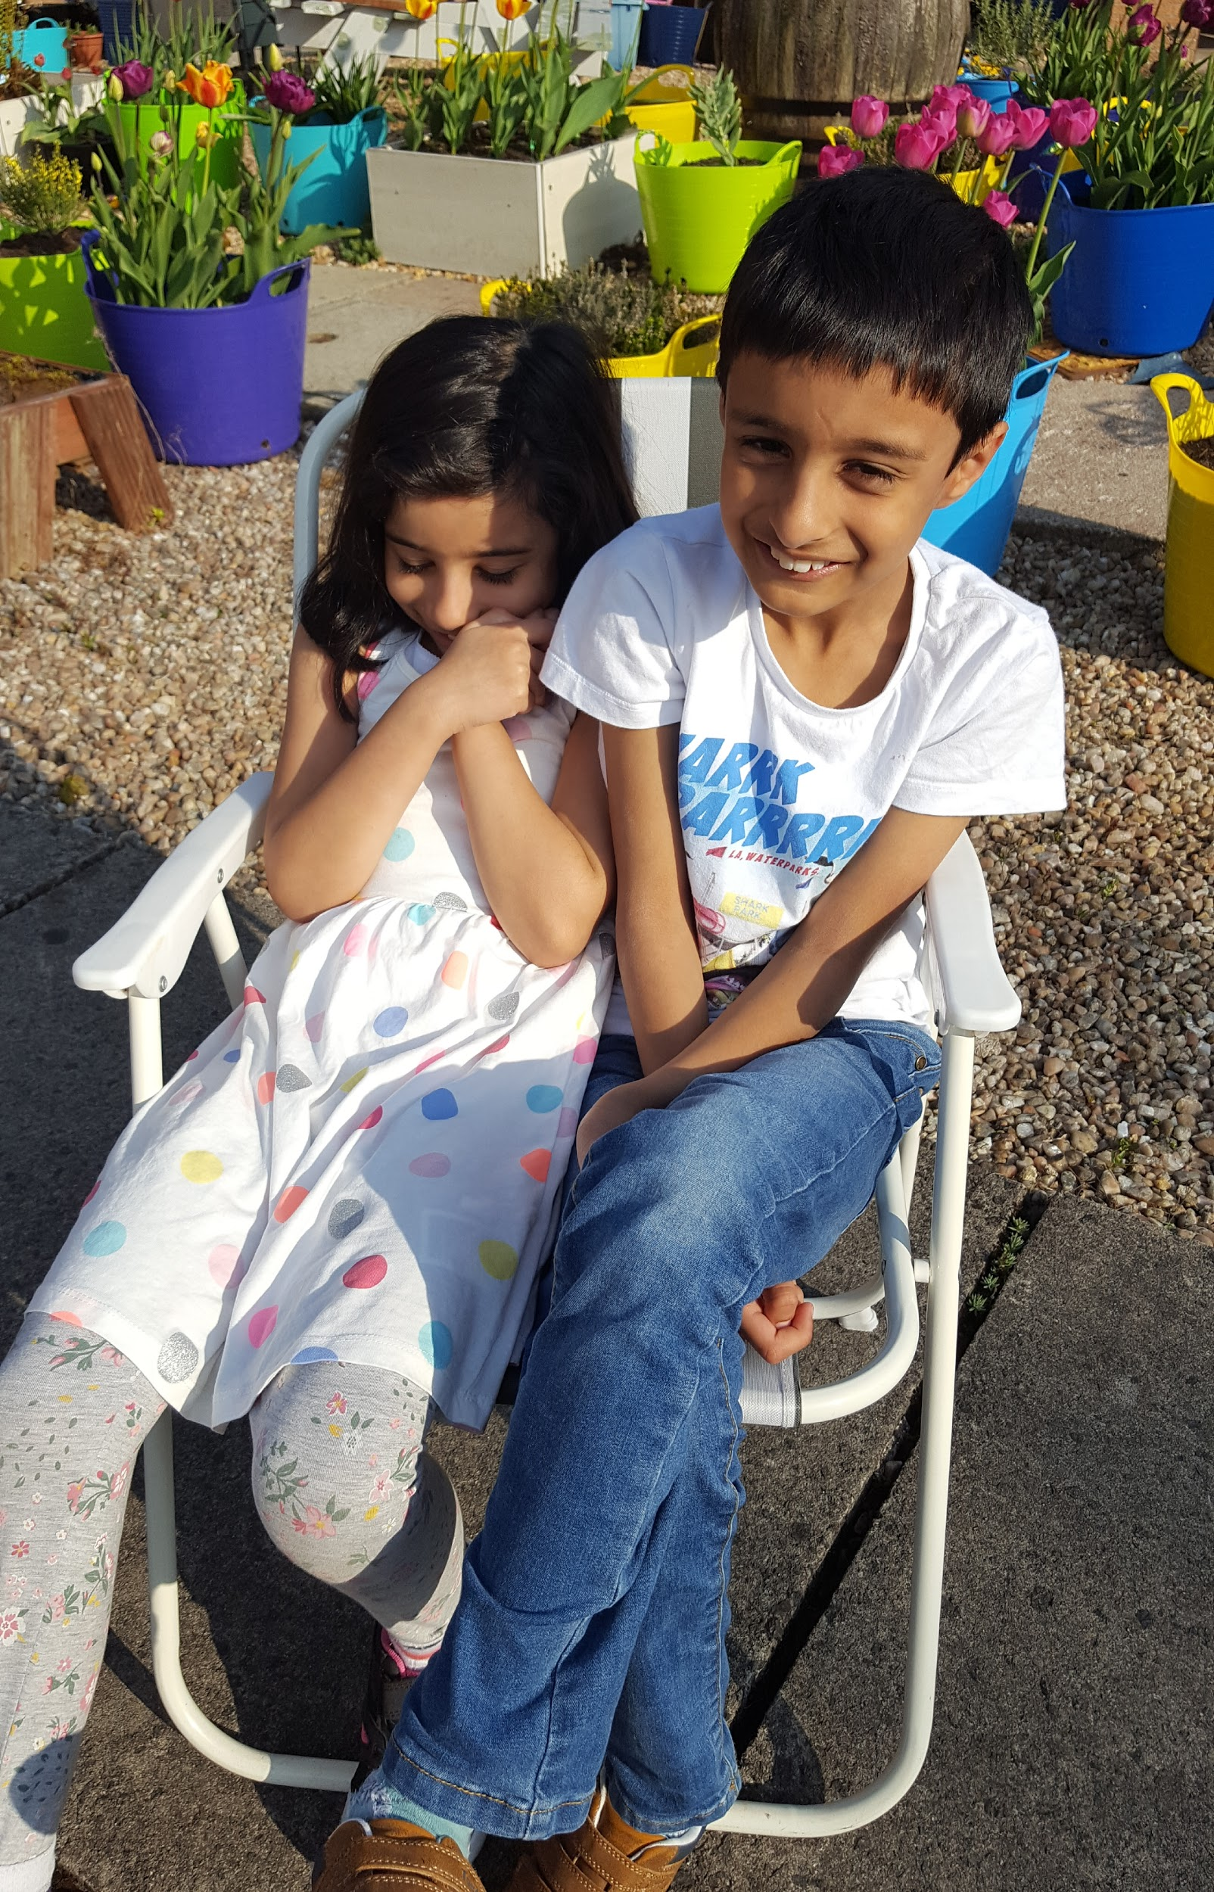
Humza - lots of cycling helping my sister cycle

Slide 15
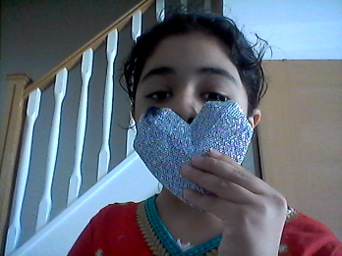
Menahil
I am very proud at my tie dye job my finished result is in 2 weeks
I was supposed to be smiling in the photo

Slide 16
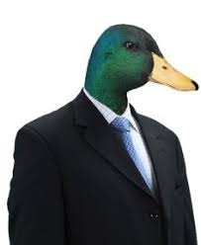
Character (leon)
I have made my ofishal comic character that i will use forever!

Slide 17
JAMIE
I played in the sprinkler and my granny is making my family Corona virus masks in different designs

