Slide 1
Stress and Anxiety: Building Resilience in You and Your Child
East Renfrewshire Psychological Service
Ainsley McGoldrick
Ailsa Darling
April 2018
Notes:
AM
Choose a Different Path

Slide 2
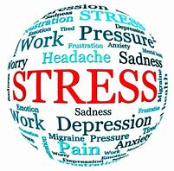
Session Outline – Choose a Different Path
Session 1
Psychoeducation - body and brain
Erosion of, and Nurturing, Resilience
Connecting with your emotional wellbeing
Session 2
Approaches for promoting positive emotional wellbeing:
Attention
CBT
Notes:
AM

Slide 3
Keep Calm and Get Excited!
“Before anxiety inducing tasks, the way we talk about our feelings influences how we feel, which dramatically influences subsequent performance.”
“I am excited” opportunity mindset
Wood Brooks
American Psychological Association (APA), 2013

Slide 4
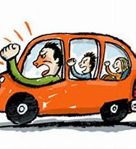
Parents as Role Models
Your child takes cues from your behaviour
They will learn how to respond to ambiguous situations or times of uncertainty
All young people look for role models
The way you tolerate stress is as important as the way we teach your child to cope with stress
Model ways to cope with stress
Be explicit
Normalise stress
Notes:
AD

Slide 5
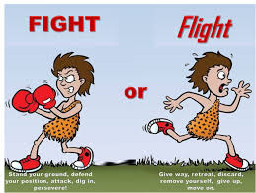
Help Your Child by Helping Yourself: Understand Stress
Stress is a natural response that everyone experiences.
Stress is our unique reaction to a perceived threat
Due to the physical feelings associated with stress it is often misperceived as harmful – this perpetuates stress!!
In fact stress is a very healthy response which helps to protect us through the ‘fight or flight’ response
Triggers physiological reactions in body and
brain
Your body will tell you when you’re stressed
Notes:
AD
The human body responds to stressors by activating the nervous system and specific hormones. The hypothalamus signals the adrenal glands to produce more of the hormones adrenaline and cortisol and release them into the bloodstream. These hormones speed up heart rate, breathing rate, blood pressure, and metabolism. Blood vessels open wider to let more blood flow to large muscle groups, putting our muscles on alert. Pupils dilate to improve vision. The liver releases some of its stored glucose to increase the body's energy. And sweat is produced to cool the body. All of these physical changes prepare a person to react quickly and effectively to handle the pressure of the moment.
This natural reaction is known as the stress response. Working properly, the body's stress response enhances a person's ability to perform well under pressure. But the stress response can also cause problems when it overreacts or fails to turn off and reset itself properly.

Slide 6
What is Stress anyway?
https://www.youtube.com/watch?v=jEHwB1PG_-Q
Notes:
AD

Slide 7
Stress can help performance
Notes:
AD
Refer to work book…
Good Stress and Bad Stress
The stress response (also called the fight or flight response - caveman) is critical during emergency situations, such as when a driver has to slam on the brakes to avoid an accident. It can also be activated in a milder form at a time when the pressure's on but there's no actual danger — like stepping up to take the foul shot that could win the game, getting ready to go to a big dance, or sitting down for a final exam. A little of this stress can help keep you on your toes – it acts to increase the alertness of the mind so you are ready to rise to a challenge. The nervous system quickly returns to its normal state, standing by to respond again when needed. That is it can be good to be a little stressed in performance situations.
Longer Term Stressors
But stress doesn't always happen in response to things that are immediate or that are over quickly. Ongoing or long-term events, like being bullied, moving to a new neighborhood or school, can cause stress, too.
Long-term stressful situations can produce a lasting, low-level stress that's hard on people. The nervous system senses continued pressure and may remain slightly activated and continue to pump out extra stress hormones over an extended period. This can wear out the body's reserves, leave a person feeling depleted or overwhelmed, weaken the body's immune system, and cause other problems.
A certain amount of stress is good for us. It can . . . .
But when we get too stressed our body uses up lots of energy and we can get tired quickly
This can get in the way of our thinking. It can help us to use relaxation to clam down and think. More blood flows to our brains and we can think more clearly. We’ll talk more about this later.

Slide 8
What Happens in your Body and Brain?
The human body responds to stressors by activating the nervous system and producing more of the hormones adrenaline and cortisol.
These hormones cause physical changes in the body and brain to occur in order to react quickly and effectively to handle the pressure of the moment.
What do these hormones do to your body??
Notes:
AM

Slide 9
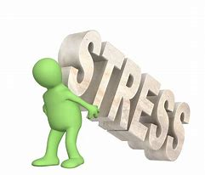
What do these hormones do to our bodies?
They make your heart beat faster to supply more blood to the muscles.
The produce more sweat to cool you down.
They tense our muscles to get them ready for action.
They make you take deeper and quicker breaths to supply more oxygen to your muscles.
They shut down body functions that aren't needed at the time e.g. digestion.
Notes:
AM

Slide 10
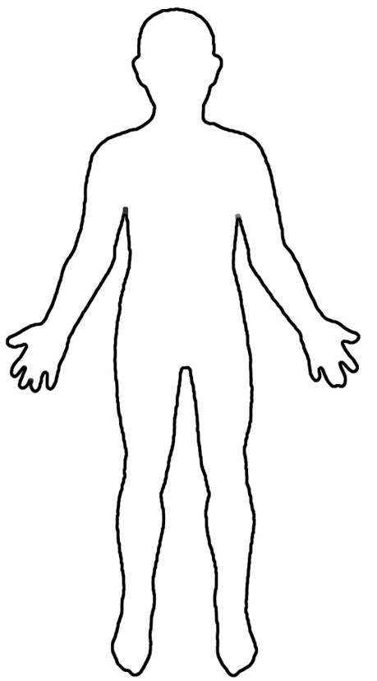
What does stress feel like to you?
Understand your own body’s warning signs
Help your child to understand their warning signs
Talk to your child about what stress is, what is happening in their body, and why
Notes:
AM
Many young people don’t know what they are feeling when they are stressed, and it can be very frightening and overwhelming: They might think they are very ill or that they are having a heart attack.

Slide 11
Common Physical signs of stress
Headaches
Stuttering/ tongue tied
Blushing/feeling hot
Racing heart
Muscle pain
Rapid shallow breathing
Butterflies/feeling sick/changes in appetite
Going to the toilet more or less
Sweating
Jelly legs
Feeling tense all over
Twitchy legs
Notes:
AM

Slide 13
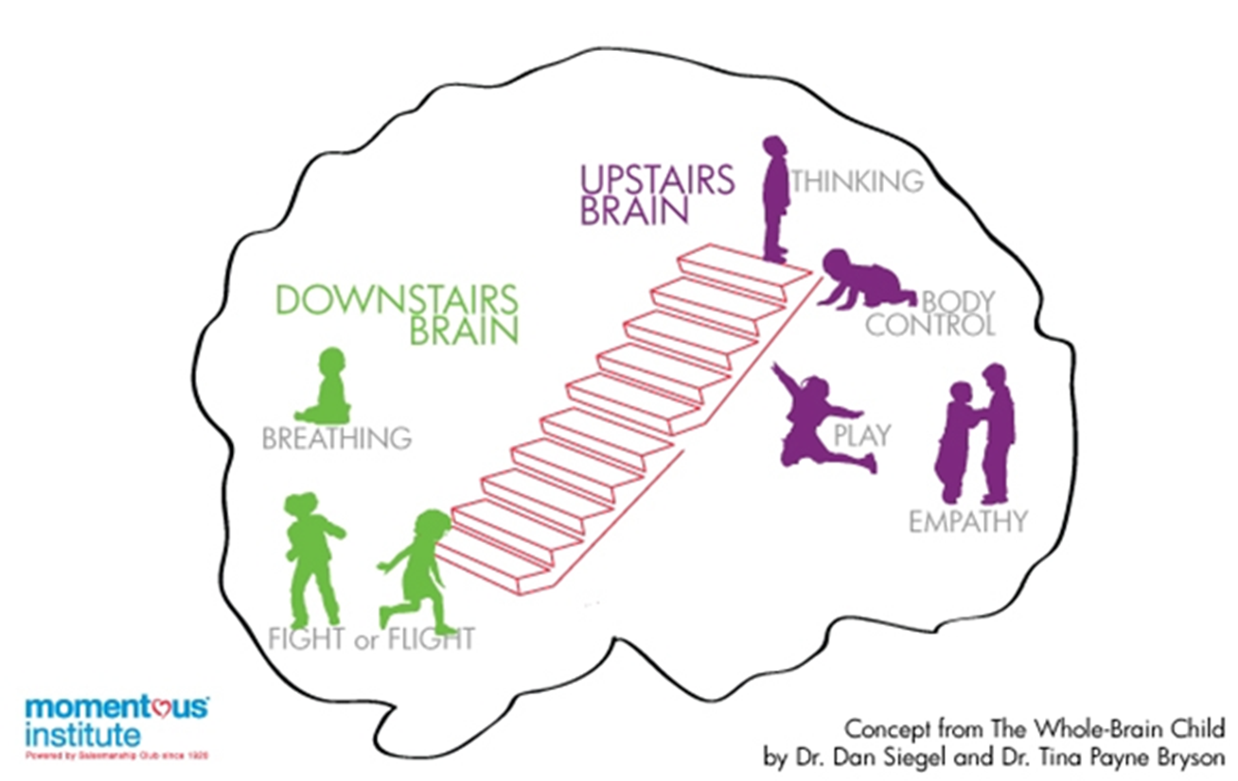
Helping Children understand stress
‘Thinking’ part of the brain – Upstairs brain
Cerebral cortex
Decision making, planning and organisation, problem solving, empathy and morality
Slow to develop
‘Emotional’ part of the brain – Downstairs brain
Brain stem and limbic region
Breathing, digesting food and also controls emotions
Fight, flight, freeze – amygdala hijack
Children need help to understand
Physical symptoms of stress
Why our brain reacts in this way
When the brain can be wrong
Notes:
AD
Notes…..helping children understand stress

Slide 14
What Happens in your Brain?
30%
Notes:
AD
The same hormones shut off the thinking part of your brain so you can make a quicker response and not be caught up in decision making!
Explaining it to kids – stress and anger makes your body work like a superhero but zaps brain power – reduction in intelligence of about 30%

Slide 15
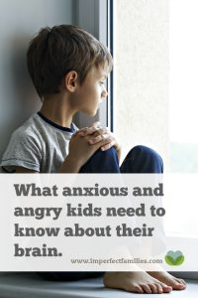
Downloadable script
Can be adjusted to match your child’s developmental age
Support to manage and understand their feelings
https://imperfectfamilies.com/what-anxious-and-angry-kids-need-to-know-about-their-brain/

Slide 16
What do we mean by
resilience?
Notes:
AD

Slide 17
RESILIENCE
Emotional wellbeing against the odds
The ability to bounce back
Adaptability in the face of adversity
The ability to carry on, and even flourish, after setbacks
Notes:
AD

Slide 18
https://www.youtube.com/watch?v=ZbifXxy0mG0
Notes:
0.35- 5.30

Slide 19
Support and Challenge
Notes:
AD
Black Mirror

Slide 20
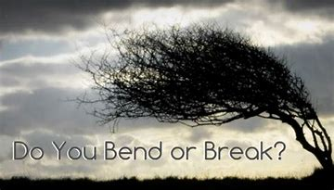
Why are children less resilient these days?
Notes:
AD

Slide 21
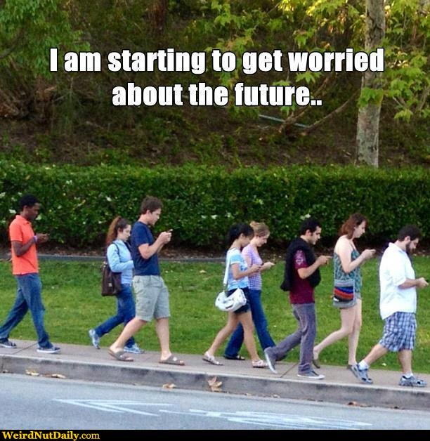
The Erosion of Resilience
Social media
Celebrity culture
Sense of entitlement/
high expectations
The need to be perfect
Too much choice
Notes:
AD
Celeb culture and entitlement
I want it all NOW
Our society makes people feel that they are entitled
Celebrity culture suggests success should be instant
This makes people think that effort and hard work are not important
This increases self-obsession and undermines resilience
Being perfect
Mass media encourages people to believe that they need to be perfect
This encourages us to feel inadequate and, again, exaggerates our inevitable problems and difficulties
This undermines resilience when the person sees that perfection is not attainable
Mass media encourages us to compare ourselves with the rich and famous
So where did the comparing yourself with others come from? Carl Rogers believed that we arrive in the world with great potential and that gradually over time society gets us to define success in a number of ways. Then….if we don’t meet these ‘conditions of worth’ we feel unhappy. An exaggerated version of this is the media re size and the influence this has on young people…and the forever young syndrome
CHOICE
We now have more choice than ever
Paradoxically this make people
Not choose
Regret their choices
Feel depressed
Overwhelmed

Slide 22
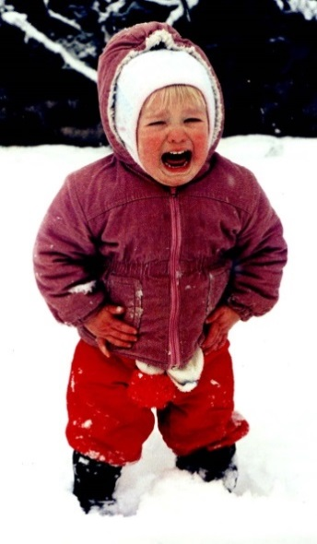
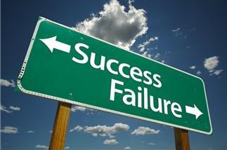
The Erosion of Resilience
The cotton wool effect
The belief that negative emotions are wrong
Lack of understanding about the importance of negative feelings
Adult response to failure
Notes:
AD
1. Cotton wool effect
Parents now do not want their child to have any negative experiences
This means that they try to protect them from life's knocks and blows
Doing this undermines their resilience
2.Treating young people like infants
We often think young people:
Need us do everything for them or it won’t get done
Can’t be trusted to handle responsibility
Will make poor decisions
Aren’t capable thinkers
Are moody and selfish
Are controlled by hormones
Research shows that treating yp people like infants makes them behave like infants
People are frightened of negative emotions
This encourages people to try to supress their emotions
Paradoxically, research shows this causes more of the negative emotions that they didn’t want
People think that bad feelings don’t have a purpose.
And that bad feelings such as guilt, shame and frustration are only negative.
But research shows that bad feelings can galvanise us to do things differently: we need them to succeed.
All or nothing thinking
Our culture views people as fixed entities, which are unchangeable
People are born smart/stupid
This type of thinking exaggerates the significance of failure and difficulties
Inhibits the finding of solutions
GROWTH MINDSET

Slide 23
Growth vs Fixed Mindsets
Notes:
AD

Slide 24
Notes:
AD

Slide 25
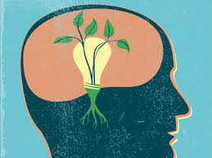
Growth mindsets
Research highlights a growth mindset can:
Support academic achievement and greater academic improvements Blackwell et al. (2007)
Help us to cope with challenge and failure
Impacts on our motivation to learn
Research shows children pick up on the way adults view intelligence
This can affect children's’ mindsets towards learning
Importance of modelling a growth mindset
Notes:
AD

Slide 26
Praise and Mindsets
Praise about the process of learning supports children to develop a growth mindset e.g. ‘well done you tried hard with that one’ (Gunderson et al. (2013)
helps them to understand their achievement is because of the effort they put in
Praise about them as a person
promotes a fixed mindset
think achievement due to ability
(Zentall & Morris, 2010)
Research shows children as young as
2 and 3 years old can pick up on this
Notes:
AD

Slide 27
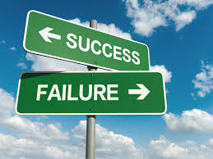
Adult response to failure
Adults’ messages concerning success and failure can have significant implications for children’s academic achievement
Haimovitz and Dweck (2016) found :
Children are more likely to have a growth mindset when parents view failure as a learning experiences
Children more likely to have a fixed mindset when parents express worries about their child’s failure or abilities and consider failure as a debilitating experience
Their children felt their parents focused more on their child’s academic performance than their learning
Led children to believe their intelligence is fixed
Parents who viewed failure as a chance to learn supported their children to develop a growth mindset
Notes:
AD

Slide 28
Play
“Free play gives the growing child the cognitive ability to solve problems, the emotional ability to withstand hardship, the social ability to help each other, and the physical ability to carry it all through. Play is the foundation stone of resilience in children, no matter what life may throw at them.” (Dr Mike Shooter, 2015)
Play is a safe way for children to have a number of important experiences and practise key skills
Negotiation
Managing emotions
Sharing
Cooperation
Trust
Empathy
Creativity and imagination
Encouraging a sense of control in their world
Notes:
Key to promoting wellbeing and resilience in young children is through play

Slide 29
Connecting With Yourself

Slide 30
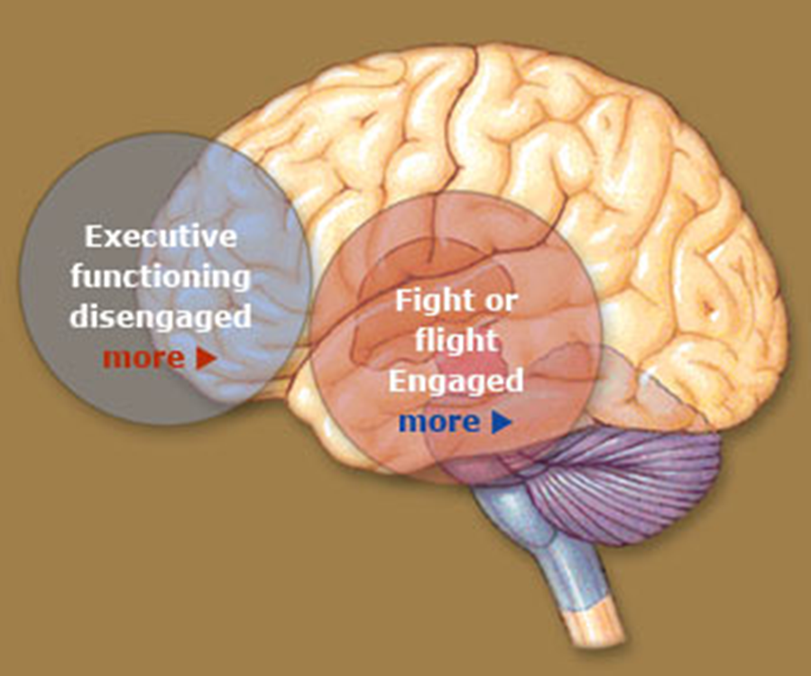
Visualising the Super-Brain
Notes:
Play dough brain and fist
Wont make the feelings of anger and anxiety disappear but will allow you to feel more in control and think more clearly about your actions

Slide 31
Chaotic/Off Balance (no-brain state)
Excited/ Assertive
AROUSAL
Calm
Shutdown/Inflexible
Notes:
Green – wide range of emotions that we largely cope well with on a daily basis.
Red – Chaotic/reactive/’no-brain’ state/out of balance
Blue – out of balance/shutdown/inflexibility

Slide 32
Recognising Arousal Levels and Learning to Check - In
Accept all feelings are ok to have
Teach a child to be aware of which zone they are in (even challenging emotions can be in the green zone)
Widen the green zone by knowing “what keeps me in the green”?
Start to work on strategies which get you back from the red and blue zone – knowing there is a potential way back is calming in itself
Name It to Tame It:
“I’m feeling really angry, I’m in the red zone”
“I’m frightened, I’m in the blue zone”
“I think you might be feeling scared I understand why you feel that way, I know you’re finding this really hard”
“It’s ok to be in the red zone I’m going to help you to find a way back to the green zone”
Notes:
Dan Siegel

Slide 33
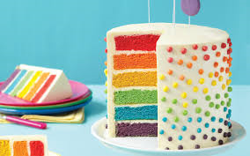
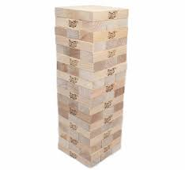
Layer cake pic
Know your layers
Notes:
All structures need layers to keep them balanced. When layers are removed the balance is compromised and the structure can becomes out of balance. Buildings like people often cope with some imbalance – Jenga can take hours to fall down! But too much pressure on what is left of the structure will result in collapse.

Slide 34
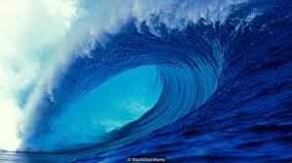
Take Control Calming the Mind and the body
The Wave
Visualise the stress as a wave
and help them to ‘ride’ or ‘surf’ the
wave and see how it gets smaller after it peaks
Negative feelings are normal, they rise and fall
and come and go.

Slide 35
Use arts to write /draw/ be creative
Make a list of activities for when body signs appear
Progressive Muscle Relaxation
Breathing Exercises
Calming the Mind
(and the body)
Be Proactive
Get active
Worry box
Model a growth mindset
Make a picture/poster of your child’s talents and qualities
Take a Break

Slide 36
Refocus your day - pay attention to good things
Cultivate gratitude – what are we grateful for/proud of/looking forward to ?
Just listen………sometimes!
Create a Calm area in the house
Calming the Mind (and the body)
Be Proactive
Make use of fidget objects
Empathise with your child’s feelings
Pin a poster of feelings faces on the wall to encourage your child to identify their feeling without words
Model your own positive coping techniques, actions and words

Slide 37
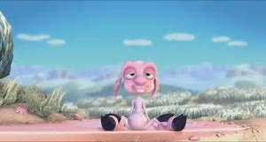
https://www.youtube.com/watch?v=L_-k_1WQ5As

