Slide 1
Meet the Staff Evening
Tuesday 30th August

Slide 2
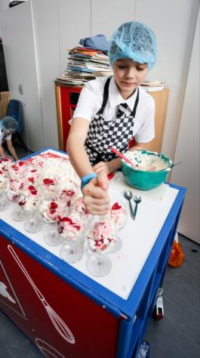
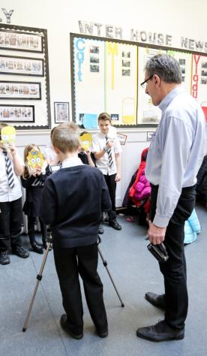
Where are we now?

Slide 3
Ethos
“Busby Primary School has a very inclusive and supportive ethos”
RRS Level 2 Assessor, June 2016

Slide 4
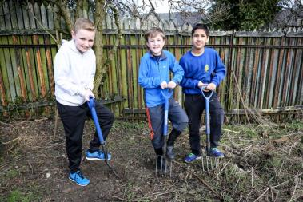
“I think the Skills academy programme is engaging and covers a range of crucial skills. We recognise the on-going commitment to planning and resourcing these wonderful experiences.” – P7 parent

Slide 5
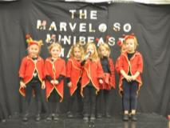
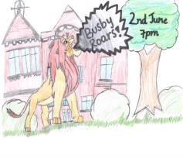
Creative Arts 2015/16 – School Performances
Nursery Nativity
P1 ‘Marveloso Minibeast Maloo’
P2-P4 ‘Jack and the Busby Beanstalks’
P5-P7 ‘Busby Roars’

Slide 6
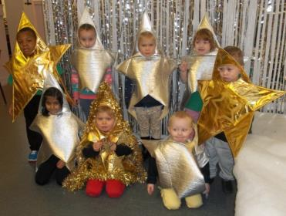
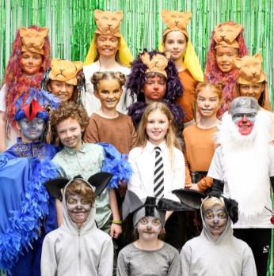
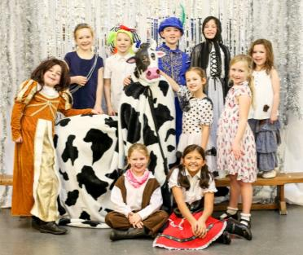

Slide 7
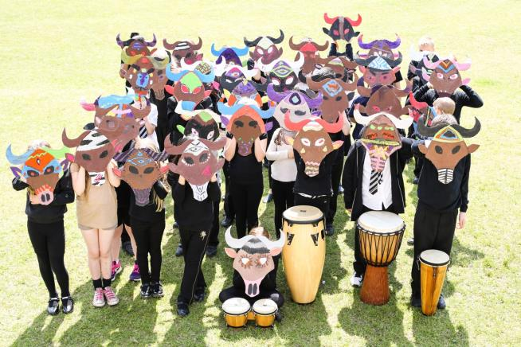
“ It was wonderful to see the enthusiasm sparked in every single child in the upper school. It was totally inclusive and completely wonderful” - P6 Parent

Slide 8
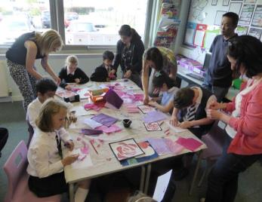
Parent Partners
After school clubs
STEM Week
Learning Workshops
Focus Groups
“Class workshops have it all. We see how our kids learn, get to talk and ask HT questions and even get coffee and biscuits. Result! Thanks.”

Slide 9
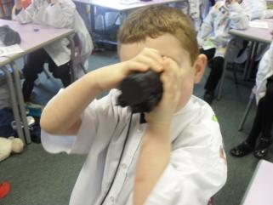
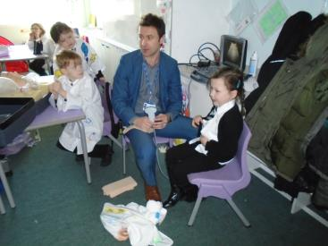
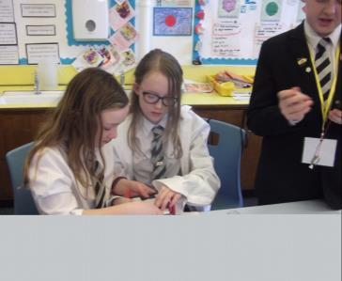
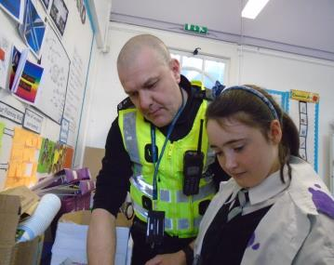
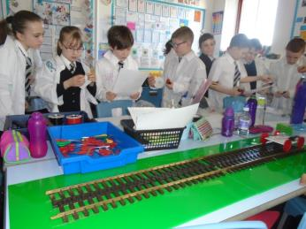
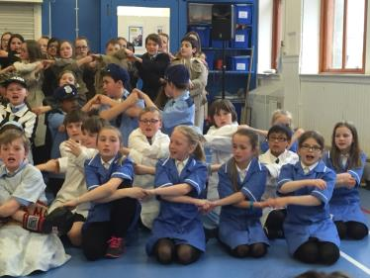
STEM Week 15/16

Slide 10
STEM Week 15/16
“The enthusiasm and commitment of all the pupils in Busby PS was evident throughout STEM Week and all members of the school community worked together effectively to make the week a success and solve the crime.” David Cunningham Campus Cop
“It’s great to see an inspired, practical approach to learning about Science.” Parent

Slide 11
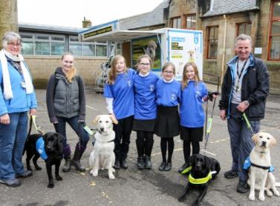
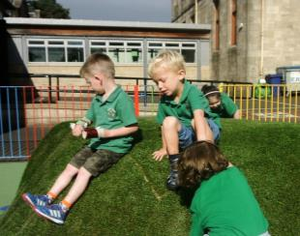
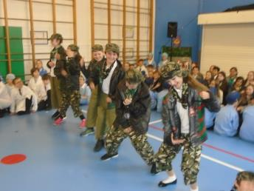
Achievements 2015-16
Guide Dog Takeover Day
Cluster Maths Champions
Nursery Playground Opening
FEVER!

Slide 12
What are we doing next?
Focus for session 2016/2017:
Leadership for all.
Whole school achievement
Continued Curriculum Improvement.
Outdoor Learning
Increased Parental Engagement

Slide 13
Pupil Leadership 2016/2017

Slide 14
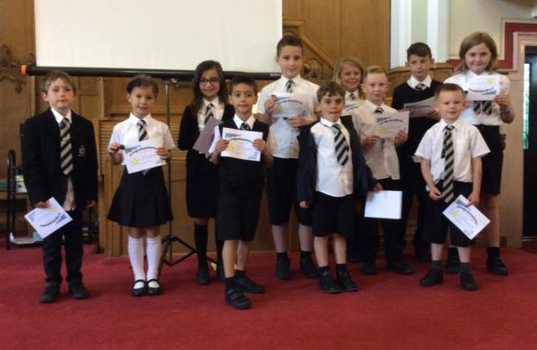
Sports Committee

Slide 15
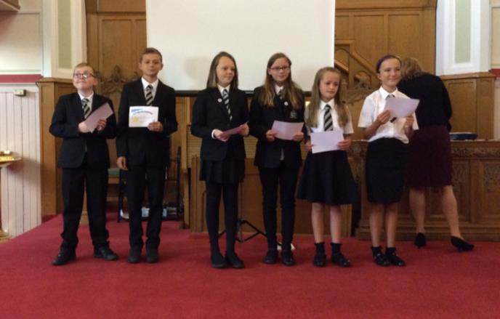
Nursery Play Leaders

Slide 16
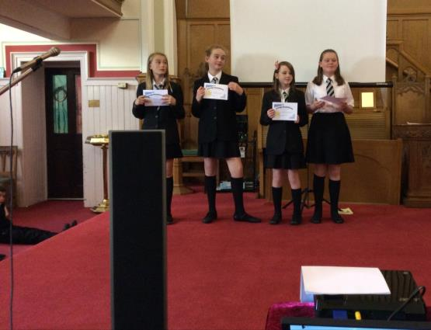
Golden Time Team

Slide 17
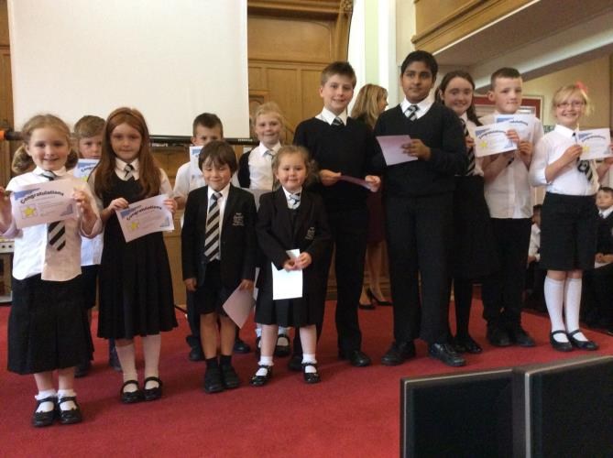
Eco Committee

Slide 18
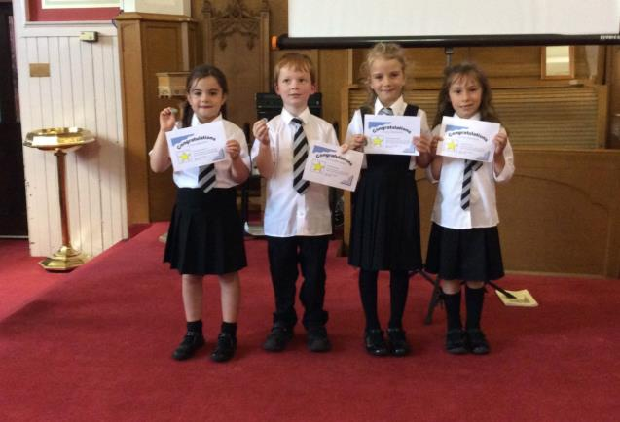
Hydro Heroes

Slide 19
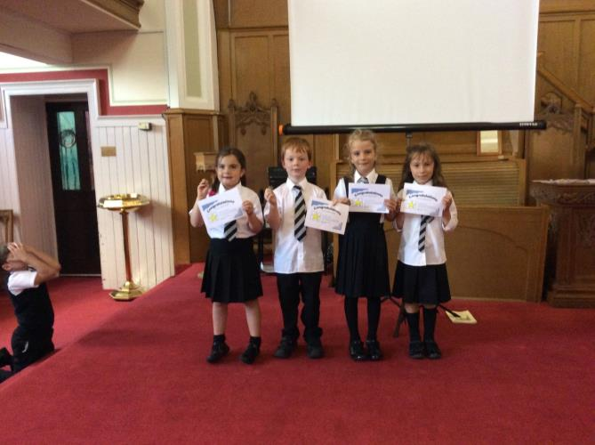

Slide 20
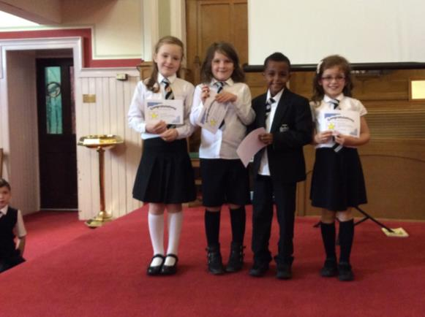
Composters

Slide 21
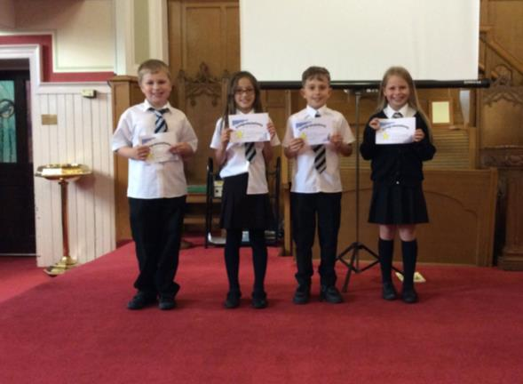
Junior Jannies

Slide 22
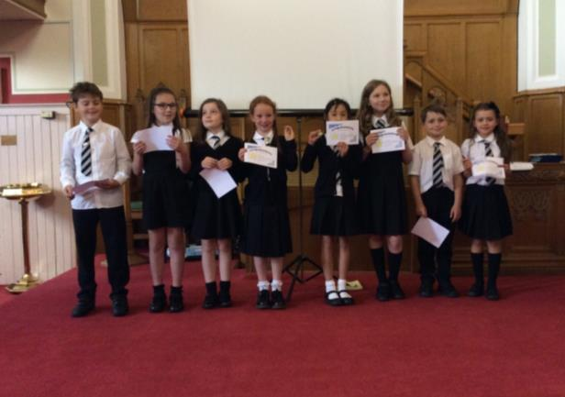
Energy Monitors

Slide 23
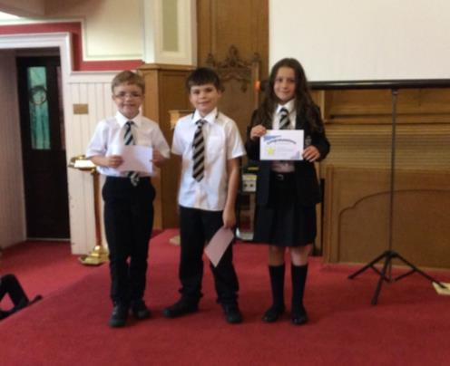
Waste Watchers

Slide 24
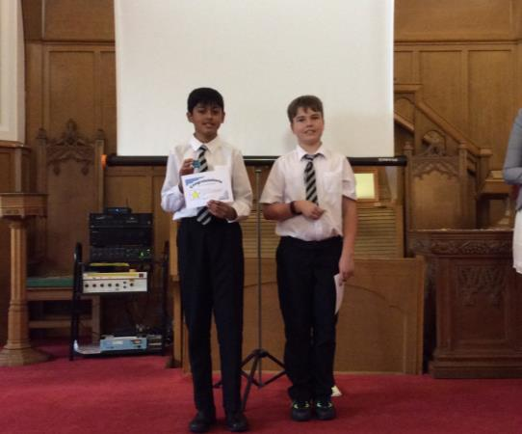
RRS Ambassadors

Slide 25
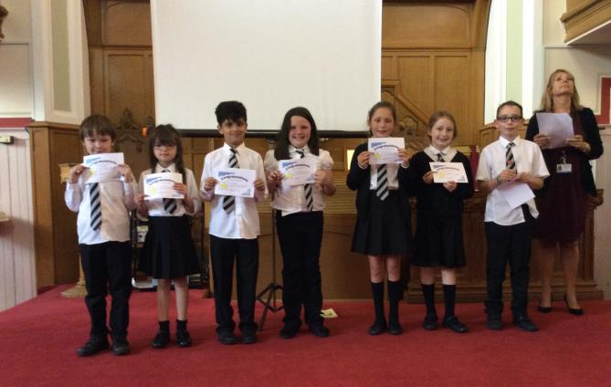
Fairtrade Committee

Slide 26
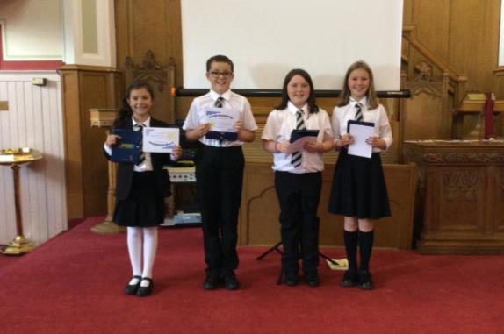
Junior Road Safety Officers

Slide 27
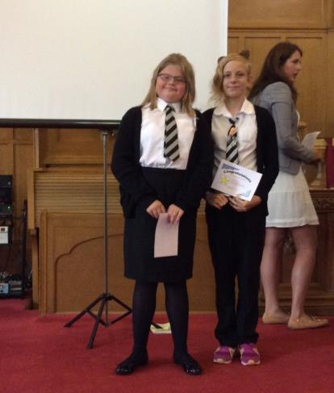
Peer Mediators

Slide 28
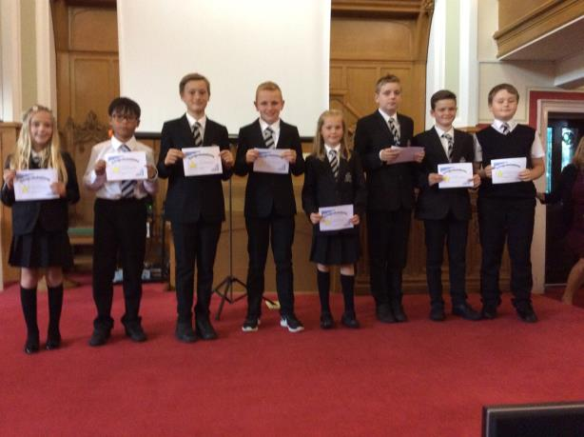
House Captains

Slide 29
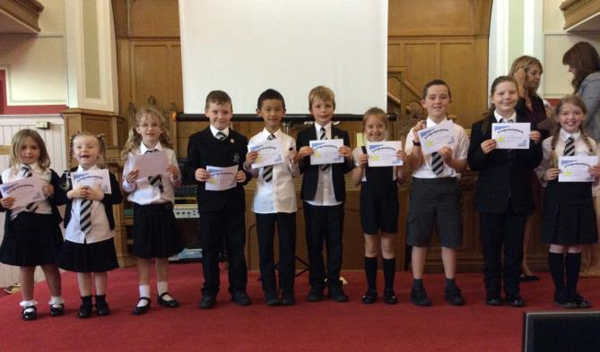
Pupil Council

Slide 30
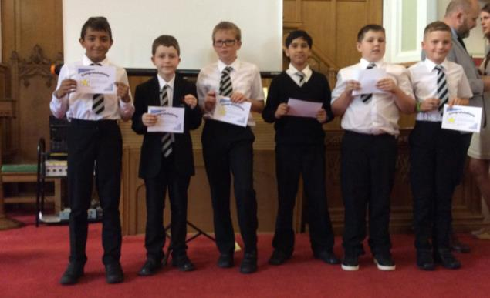
STEM Leaders

Slide 31
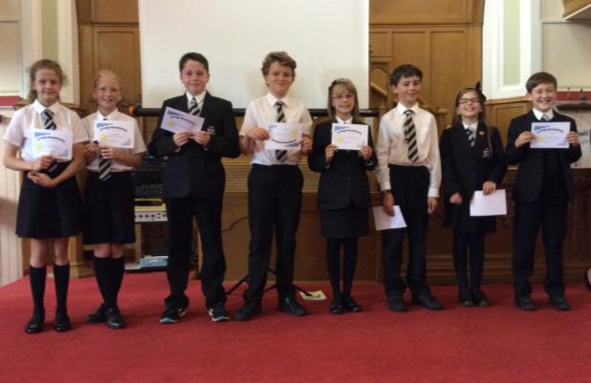
Pupil Management Team

Slide 32
Whole school achievements

Slide 33
Awards we are working toward this session:
Family Friendly Silver Award – School
Family Friendly Gold Award – Nursery
John Muir Award – All P7 pupils
Dynamic Youth Award – All P6 pupils
Renewal of Eco, RRSA and PSQM

Slide 34
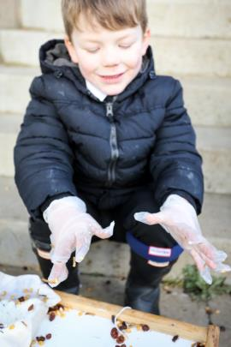
Outdoor Learning

Slide 35
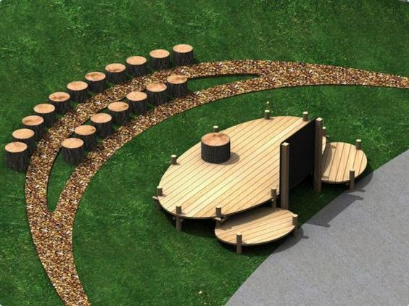
Enhancing pupil Learning Experiences

Slide 36
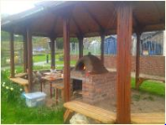
Outdoor Kitchen

Slide 37
Tracking Your Child’s Progress
Formative Assessment
Summative Assessment
Teacher Judgements
Standardised Tests
Attendance
Reports

Slide 38
What we are doing for your children

Slide 39
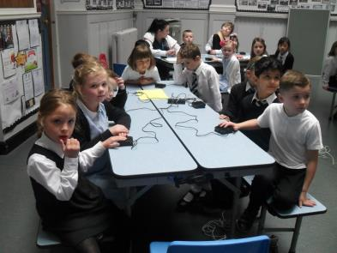
Trauchles

Slide 40
Residential Trips

Slide 41
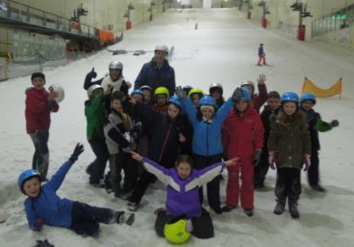
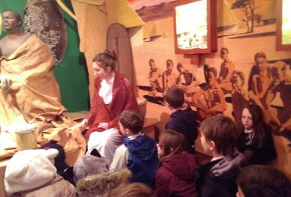
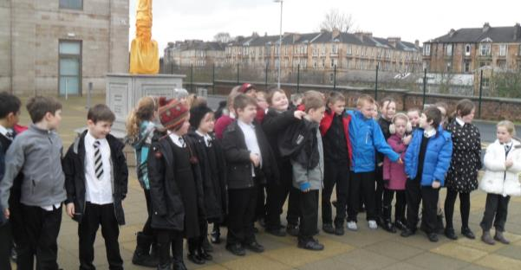
Educational Visits

Slide 42
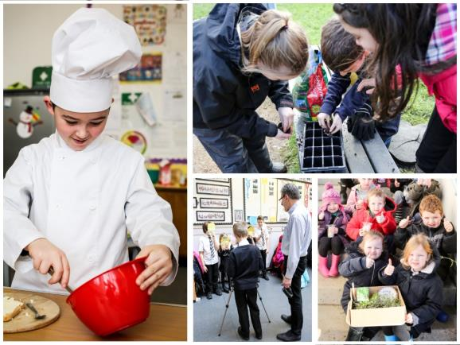
Skills Academy

Slide 43
Fun Days

Slide 44
Parental Engagement
Skills Academy
After School Clubs
Golden Time
Achievement Awards Working Party

