Slide 1

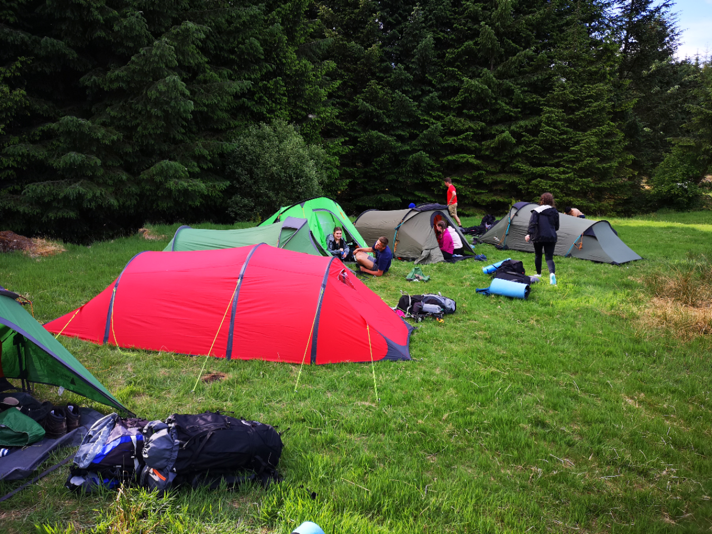

Slide 2
Staff
Mr Boag – DofE Coordinator
- Emergency First Aider
Mr Lamont – DofE Supervisor
Mrs Robison - DofE Supervisor
Follow us on Twitter: @Barrhead_DOFE

Slide 3
DofE - Parents’ Evening Agenda
Aim of the Award
Student Training
Staff Training
Expedition Dates & Routes
Emergency Procedures
Kit Guide
Food Guide
Supervision
Parental Assistance
Costs
Health & Wellbeing
Follow us on Twitter: @Barrhead_DOFE

Slide 4
Aim of the Award
“To provide an enjoyable, challenging and rewarding programme of personal development for young people, which is of the highest quality and the widest reach.”
Follow us on Twitter: @Barrhead_DOFE

Slide 5
Bronze Requirements
Volunteering involves working with young people, elderly, environment, charity or animals.
Skills creative, performance, care of animals, music, foreign language, life skills.
Physical Recreation team, individual, water, racquet, dance, fitness
From the three categories above two are for 3 months duration, one is for 6 months.
Expedition - Two days/one overnight camp.
Follow us on Twitter: @Barrhead_DOFE

Slide 6
Bronze Requirements
IMPORTANT DEADLINES
Most students are somewhat behind with their DOFE evidence.
All students have been given a target of completing all sections prior to the expeditions starting in April.
  To complete a section students should:
  1. Submit each section to me for approval, that includes having a measurable aim and all of your assessor’s details (full name, phone number and email address)
  2. Upload 12 pieces of text evidence, four photos and have their assessor complete an assessor’s report.
  THIS IS TOP PRIORITY FOR ALL S3 DOFE STUDENTS
Follow us on Twitter: @Barrhead_DOFE

Slide 7
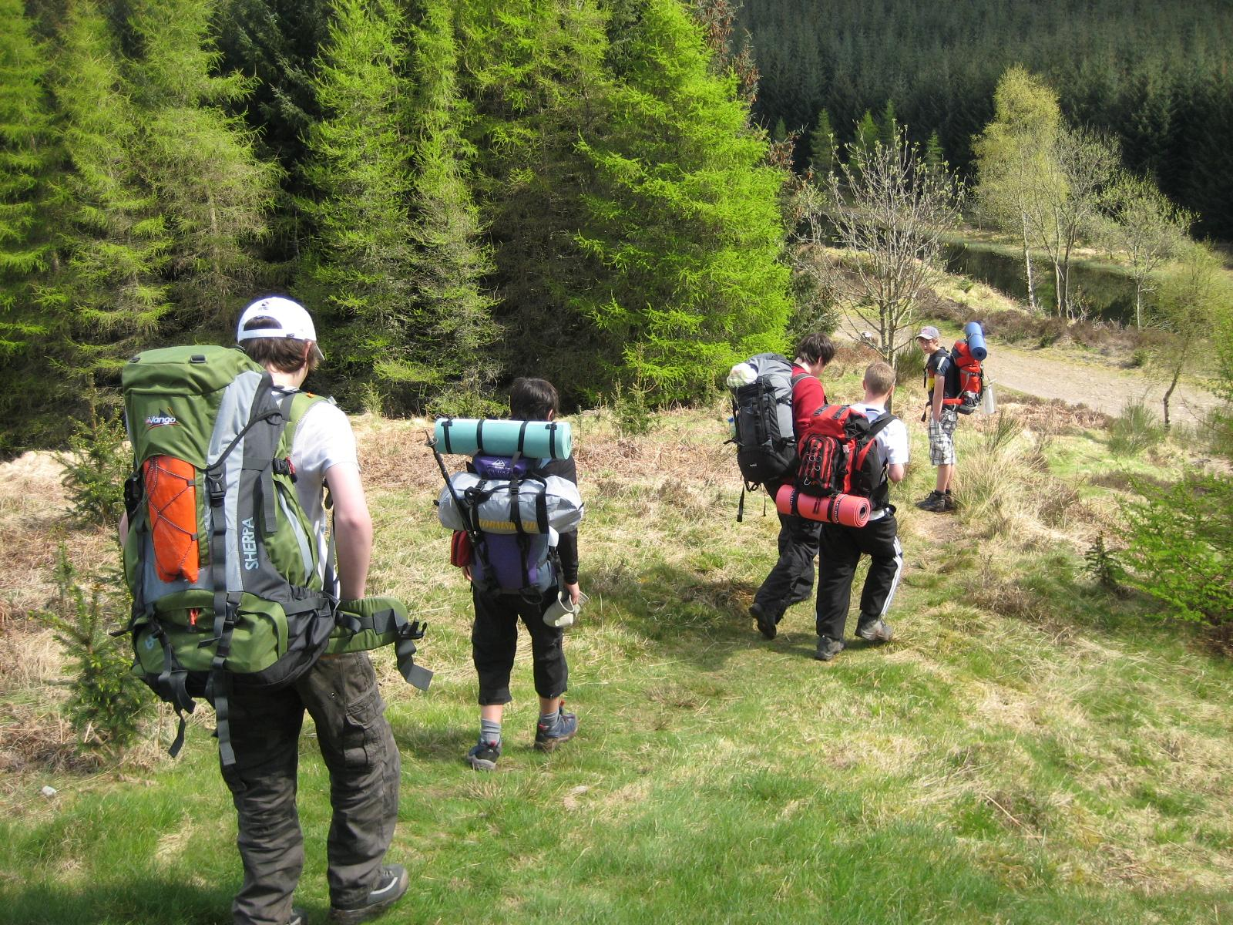
The Expeditions
Follow us on Twitter: @Barrhead_DOFE

Slide 8
The Expeditions
- The 20 Conditions
The 20 conditions are as follows:
The team must plan and organise the expedition.
2. The expedition must have an aim.
The aim can be set by the Leader at Bronze level only.
All participants must be within the qualifying age.
There must be between four and seven participants in a team .
The expedition should take place in the recommended environment.
Accommodation must be by camping or other simple self-catering
accommodation.
The expedition must be of the correct duration and meet the
  minimum hours of planned activity.
Follow us on Twitter: @Barrhead_DOFE

Slide 9
The Expeditions
- The 20 Conditions
The 20 conditions are as follows:
All expeditions must be supervised by an adult who is able to accept
responsibility for the safety of the team.
Assessment must be by an accredited Assessor.
Expeditions will usually take place between the end of March and the end of October.
Participants must be adequately trained to safely undertake a remotely supervised expedition.
All expeditions must be by the participants’ own physical effort, without motorised or outside assistance.
All expeditions must be unaccompanied and self-sufficient.
The team must be properly equipped, and supervision must be carried out remotely.
Teams must possess the necessary physical fitness, first aid and expedition skills required to complete their expedition safely.
Follow us on Twitter: @Barrhead_DOFE

Slide 10
The Expeditions
- The 20 Conditions
The 20 conditions are as follows:
Groups must adhere to a mobile phone use policy as agreed
with their Expedition Supervisor and Assessor.
This agreement should also include use of other electronic equipment.
Participants must behave responsibly with respect for their team
members, leaders, the public and animals.
Groups must understand and adhere to the Countryside/Scottish
Outdoor Access, Highway and Water Sports Codes (as appropriate).
Participants must plan an appropriate expedition menu, including cooking and eating a substantial hot meal on each day.
Participants must actively participate in a debrief with their Assessor
  at the end of the expedition.
A presentation must be prepared and delivered after the expedition.
Follow us on Twitter: @Barrhead_DOFE

Slide 11
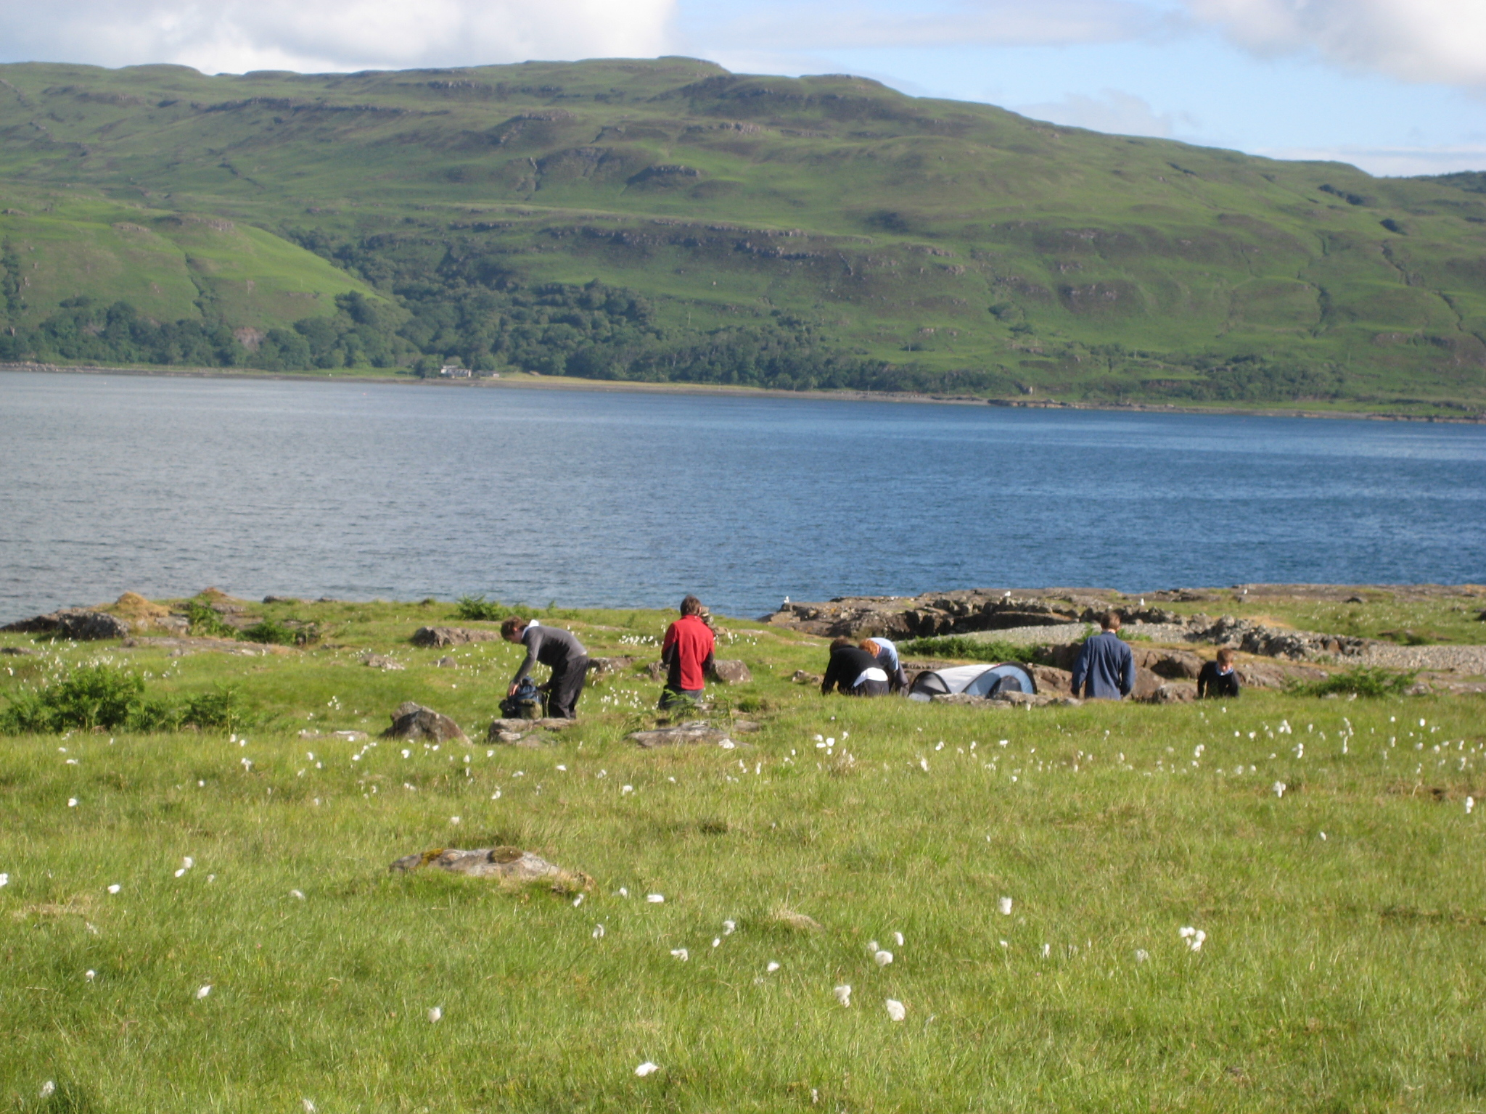
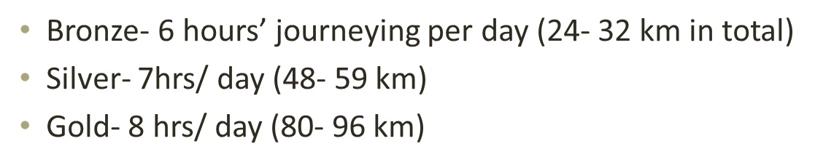
Staffing
Follow us on Twitter: @Barrhead_DOFE

Slide 12
Benefits to Participants
Self- belief
Self- confidence
A sense of identity
Independence of thought and action
A sense of responsibility
An awareness of potential
New talents and abilities
An understanding of strengths and weaknesses
The ability to plan and use time effectively
The ability to learn from and give to others in the community
New relationships
Skills involving problem solving, presentation and communication
Follow us on Twitter: @Barrhead_DOFE

Slide 13
DofE Perspective
The Award is not an extra qualification
The award is pupil-focused.
The emphasis is on the student to take the initiative and to complete the award under their own steam.
Follow us on Twitter: @Barrhead_DOFE

Slide 14
Student Training
Follow us on Twitter: @Barrhead_DOFE

Slide 15
Student Training
- Campcraft
- Trangia stove
- Map reading skills
- Navigation and route planning
    - First Aid Training
- Equipment and hygiene
- Expedition Prep
- Country code, plus revise all above
- Packing rucksacks, revise all above
Follow us on Twitter: @Barrhead_DOFE

Slide 16
Staff Training
Follow us on Twitter: @Barrhead_DOFE

Slide 17
Staff Training
Staff have attended numerous training sessions.
  Mr Boag – DofE supervisor / assessor /Emergency First Aid (Jan 2023)
  Mrs Robison – DofE Supervisor
  Mr Nelson – Mountain leader
  In addition, the group are always joined by the DOFE staff appointed by the DOFE Manager.
Follow us on Twitter: @Barrhead_DOFE

Slide 18
Kit Guide

Slide 19
Kit Guide – BORROWING KIT
Participants can borrow:
  a tent, rucksack, rollmat, sleeping bag, stove, compass and map.
Equipment is issued from the Fairweather Hall, Newton Mearns at a designated time. YOU MUST COLLECT YOUR KIT AT THIS TIME
A deposit of £50 (cash or cheque placed in a sealed envelope with your child’s name on it) must be handed in when collecting kit.
The deposit is returned when the kit is returned
Follow us on Twitter: @Barrhead_DOFE

Slide 20
Kit Guide – Additional Kit
Participants must have:
  A pair of worn-in boots.
  A waterproof jacket and trousers
Participants should also have:
  A midge net, head torch, gloves, hat, extra socks and underwear, a change of shoes, suncream and blister plasters (Decathlon).
ALL CLOTHES/SLEEPING BAG SHOULD BE PUT INSIDE A RUBBLE BAG TO STOP CLOTHES GETTING WET - NO Jeans please!
Follow us on Twitter: @Barrhead_DOFE

Slide 21
Kit Guide – Returning Kit
Students are responsible for the kit they borrow.
A return date will be issued (after the expedition) for when all kit should be returned to the Fairweather hall.
All kit needs to be clean, dry and ready to be re-issued to another group.
  Students are responsible for drying all of the tent parts, washing any sleeping bags and scrubbing the Trangia stove.
Students can group their kit together and have one parent/carer return two or three students kit.
The £50 deposit is returned assuming all kit is suitably clean and dry.
Follow us on Twitter: @Barrhead_DOFE

Slide 22
Expeditions
- PRACTICE
Thursday & Friday,
24th & 25th April 2025
Follow us on Twitter: @Barrhead_DOFE

Slide 23
Practice Expedition
Day 1
Students make there own way to Strathaven
We will meet in Strathaven (Lethame Road, Strathaven ML10 6DU) at 9.30am.
Groups will aim to have group 1 walking by 10am.
Walking into the Whitelees Windfarm
Follow us on Twitter: @Barrhead_DOFE

Slide 24
Practice Expedition
Day 2 – Friday, 25th April 2025.
Walking from Carot (windfarm) to Williamwood High School.
Students should be collected from Williamwood High School from 2pm onwards.
Students are responsible for cleaning & drying all kit. This should be kept clean & dry until the assessed expedition later this month.
Follow us on Twitter: @Barrhead_DOFE

Slide 25
Expeditions
- ASSESSED
Thursday & Friday,
8th & 9th May 2025
Follow us on Twitter: @Barrhead_DOFE

Slide 26
Assessed Expedition
Day 1
From Thursday, 8th May 2025
Students will take the train from Barrhead to DRUMFROCHAR (accompanied by BHS staff).
The expedition starts and ends at Drumfrochar train station.
Walking the Greenock Cut and camping near Loch Thom.
Follow us on Twitter: @Barrhead_DOFE

Slide 27
Assessed Expedition
Day 2
Walk around Loch Gryffe, returning to Drumfrochar train station.
Students then return to Barrhead train station at around 3pm/4pm on Friday, 9t May 2025.
Students are responsible for cleaning & drying all kit. This should be returned to The Fairweather Hall.
Date for kit return TBC
Follow us on Twitter: @Barrhead_DOFE

Slide 28
Emergency Procedures
Follow us on Twitter: @Barrhead_DOFE

Slide 29
Emergency Procedures
- Practice Expedition
Regular Contact with Teachers
Students will be issued with a couple of mobile phone numbers to call in an emergency
Walking groups (six students) will be issued with a couple of walkie-talkies as well.
Students make contact with a teacher/leader if someone is injured.
Important that students work in pairs to relay their six-figure grid reference as we will navigate to this point; Or use the app – What3Words.
** Getting lost (for a while) is not an emergency.
Follow us on Twitter: @Barrhead_DOFE

Slide 30
Emergency Procedures
- Assessed Expedition
Less Contact with Teachers
Students still issued with a couple of mobile numbers and two walkie-talkies.
Students will spend their time walking in their groups, remotely supervised, and will be required to use their training if an emergency occurs.
Follow us on Twitter: @Barrhead_DOFE

Slide 31
Food Guide

Slide 32
Food Guide
Students must bring enough food to last two days – i.e. breakfast, lunch and dinner.
Students will sleep three to a tent and it is expected that students will coordinate their meals – particularly where cooking is required - such that everyone in the tent eats the same meal.
Students must prepare a substantial meal each evening – pot noodles and super noodles do not count!!
No tins please.
Fresh pasta is preferred to dry pasta – it cooks quicker.
Follow us on Twitter: @Barrhead_DOFE

Slide 33
Food Guide
Please pre-cook food before the expedition i.e. pre-cook any pieces of chicken, sausage or bacon.
Water – preferably stored in a camelbak rather than sports bottles – students can walk and drink at the same time.
Students will replenish their camelbaks each day from our water supplies.. although local streams can be used if checked properly!!
Students should think carefully about how much food they can carry, rather than how much food they want to consume!
Follow us on Twitter: @Barrhead_DOFE

Slide 34
Supervision

Slide 35
“Remote supervision”
Practice Expedition
Students will be supervised remotely, with navigational/moral support as required.
Students will be given the opportunity to practice their DOFE skills – this will require them to navigate to areas, unsupervised – Teachers will be observing from a distance.
Assessed Expedition
Students will be supervised remotely, with less navigational/moral support.
Teachers will observe at times from a distance, but students must be able to navigate and deal with emergencies – initially on their own until staff are notified and arrive.
Follow us on Twitter: @Barrhead_DOFE

Slide 36
COSTS

Slide 37
The Cost – Practice Expedition
Payment 1 - £50 paid last October.
  Most students have now paid this.
Payment 2 - £75
    Was due by the end of January.
Payment 3 - £75
      This payment was due by the end of February - should be paid through Parent Pay – Thank you!
Costs – Two additional staff will join the group. They are ML trained and First Aid Trained.
Follow us on Twitter: @Barrhead_DOFE

Slide 38
The Cost – Assessed Expedition
Costs involved are:
  Train tickets (Barrhead to Drumfrochar return)
  (Train tickets are all purchased by DOFE Manager from payments already made).
  Gas for Trangia Stoves
  Sundries (food, cans of coke, sweets, sun cream, after sun etc)
  Costs associated with a DOFE ASSESSOR.
  Costs – Two additional staff will join the group. They are ML trained and First Aid Trained.
Follow us on Twitter: @Barrhead_DOFE

Slide 39
Parental Assistance

Slide 40
Parent Assistance
Please stick with the ethos of DofE by encouraging your son/daughter to organise as much of their DofE themselves.
This includes packing their rucksack and organising their meals for the expeditions.
We have had students who don’t know if they have a jacket, or waterproofs, or where their medication is in their rucksack, because they haven’t packed it.
Follow us on Twitter: @Barrhead_DOFE

Slide 41
Travel Arrangements

Slide 42
Travel Arrangements
- Practice Expedition
Students to make their own way to Strathaven for 930am on Thursday, 24th April 2025.
  Please work together – one parent/carer could drop-off three students; another could pick the students up from Williamood High School on the Friday.
Follow us on Twitter: @Barrhead_DOFE

Slide 43
Travel Arrangements
- Assessed Expedition
Thursday & Friday, 8th & 9th May 2025
Students start and finish their assessed expedition from the Barrhead train station.
Students just need to be dropped and collected from there.
Follow us on Twitter: @Barrhead_DOFE

Slide 44
Health & Wellbeing

Slide 45
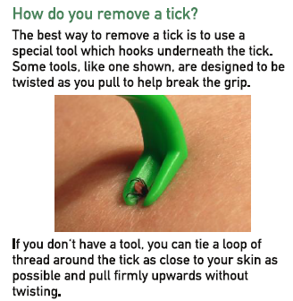
Health & Wellbeing
- Sheep Ticks
You may have heard that sheep ticks are on the increase.
We would encourage all students to check themselves for sheep ticks once they are back from their expeditions.
If you find one, don’t pull it out. You need a special tick removal tool.
Follow us on Twitter: @Barrhead_DOFE

Slide 46

Health & Wellbeing
- Sheep Tick - Lyme Disease
Some ticks carry Lyme’s disease, which is a serious condition.
If you develop a rash or feel ill in the first six weeks of having a tick bite, then seek medical attention.
PS – I’m not aware of any student having being bitten by a tick while out on DOFE. This is purely precautionary.
Follow us on Twitter: @Barrhead_DOFE

Slide 47
Completing the Bronze DOFE Award

Slide 48
Completing Bronze DOFE
1. Have 12 text uploads for each 12-week section & 4 photographs
2. Have 24 text uploads for the 24-week section & 4 photographs
3. Have an Assessor’s report uploaded for all 4 sections (Physical, Skill, Volunteering and Expedition).
4. Complete both the Practice and Assessed expeditions successfully.
5. Complete the expedition section within edofe, including dates, expedition aim and starting and finishing points.
Follow us on Twitter: @Barrhead_DOFE

Slide 49
We Made It!
Any Questions?

