Slide 1
The Duke of Edinburgh – Bronze Award Parent & Carer Information Evening 11th October 2023
Camera – ON/OFF
Microphone – OFF

Slide 2
The Benefits

Slide 3
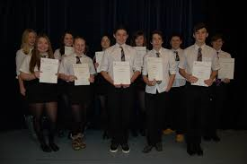
Benefits
New skills and confidence relevant to work
Recognition for things that you do
Valued by employers, colleges and universities (automatic interview for those who have the award with some employers)

Slide 4
The Bronze Award

Slide 5
Bronze Requirements
Skill – 3 months
Volunteering – 3 months
Physical – 3 months
+ an additional 3 months on one of these.
(You pick which one is undertake for 6 months)
Expeditions – two expeditions (1 Practice – June)
(1 Assessed – Sept)
– Both expeditions are for normally 2 days, 1 overnight
All three sections (Skills, Volunteering & Physical) must be completed before participants go on expedition.

Slide 6
DOFE - 4 sections:
Skill: Developing practical and social skills and personal interests
Volunteering: undertaking service to individual or community
Physical Activity: improving in an area of sport, dance or physical activity
Expedition: planning, training and completing an adventurous journey
Top Tip: Try and undertake activities that you are already involved with.

Slide 7
The Skill Section

Slide 8
Skill Section

Slide 9
Skill Section

Slide 10
The Volunteering Section

Slide 11
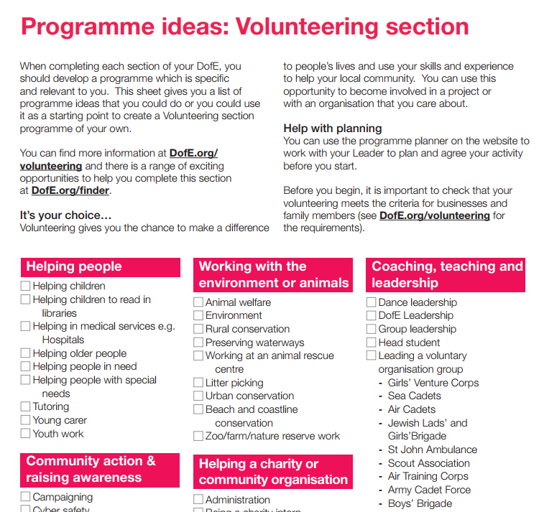
Has to be one of these 5 categories

Slide 12
Volunteering Section
Reminder: You cannot volunteer for a
profit making company.

Slide 13
The Physical Section

Slide 14
Physical Section

Slide 15
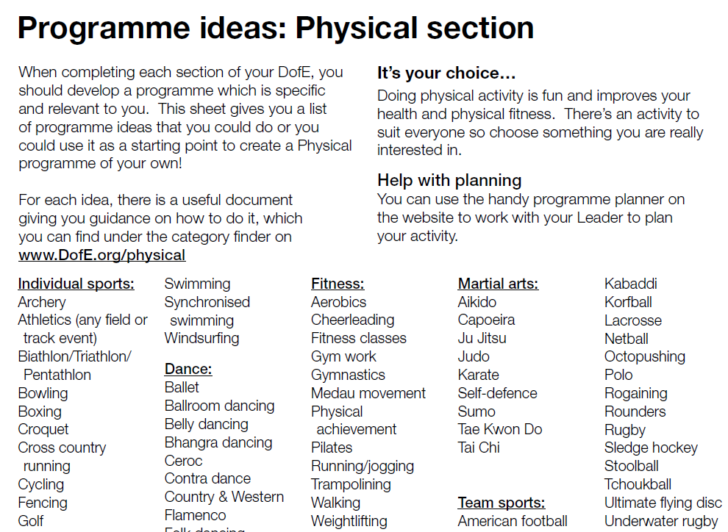
Physical Section

Slide 16
The BEST Section

Slide 17
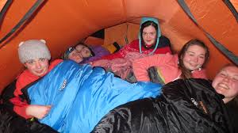
Expeditions
2 expeditions
Expedition 1 – practice
Expedition 2 – assessed
Day 1 – Walk approximately 12km using a route card and a map for navigation.
– Camp overnight
Day 2 – Walk approximately 12km using a route card and a map for navigation.

Slide 18
I want to do DOFE?

Slide 19
I want to do DOFE
Registration for DOFE will take place in Nov, once students have came along to the group for a few weeks.
We will be asking for a £47.50 payment to be made through ParentPay.
This pays for a DOFE registration & admin fee
will get you an account on the www.eDOFE.org system.
This payment is non-refundable
Students entitled to FME or SIMD 1-3, will not need to make this payment.

Slide 20
Registering for DOFE
Please think carefully about signing up for DOFE.
Don’t sign up just because your friends are!
Don’t sign up because your parent’s/carer’s tell you to.
ONLY SIGN UP BECAUSE YOU WANT TO!
Drop out rate – we need to fix this.
(2021-22 – Started with approximately 50 students, 12 went on expedition in Sept. This is approx 75% dropped-out rate)

Slide 21
Completing the Bronze DOFE Award

Slide 22
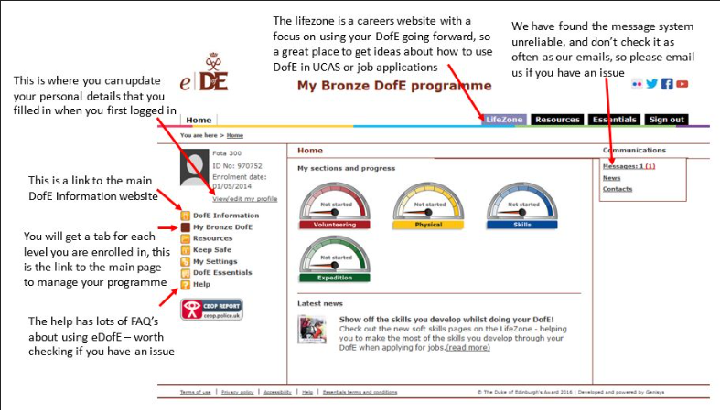
Completing the DOFE Award
DOFE Training Videos

Slide 23
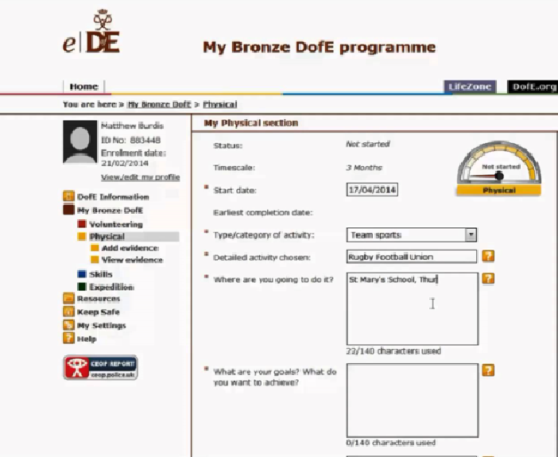
Completing the DOFE Award
DOFE Training Videos

Slide 24
Completing the DOFE Award
Each of the three sections (Skill, Physical and Volunteering) require:
An HOUR of activity, per section, per week.
Your evidence has to be uploaded into your eDOFE account.
As a minimum:
a. Students must have a piece of text FOR EACH WEEK OF ACTIVITY. This should explain what you undertook
AND
b. FOUR photographs per section
AND
c. An Assessor’s report per section

Slide 25
Completing the DOFE Award
ONCE YOU ARE REGISTERED AND HAVE ACCESS TO YOUR eDOFE ACCOUNT, students should:
1. Decide what activities you plan to undertake to fulfil each section.
Check that your activity is recognised by DOFE – using the DOFE Programme Ideas PDF
3. Identity an adult who can be your assessor:
a. This maybe a teacher or volunteer in the community
b. An Assessor CANNOT be a family member or family friend.

Slide 26
Completing the DOFE Award
4. Login to your eDOFE account, and enter in the dates, your aim and Assessor’s details INCLUDING their TELEPHONE NUMBER AND EMAIL ADDRESS
The Aim HAS TO BE measurable.
“Get fitter at the gym” is a rubbish aim.
“Bench press 20kg and be able to run 5k in 45mins” is a brilliantly measurable aim.
** You do not fail your DOFE if you do not achieve your aim **
6. Once approved by Mr Boag, you can then start gathering your weekly evidence.
7. Target: Be ready to start gathering evidence by the end of October.

Slide 27
Completing the DOFE Award
DOFE Training Videos

Slide 28
Gathering Evidence

Slide 29
Gathering Evidence
You can gather evidence in two ways:
Login into https://m.edofe.org/ on your mobile.
This is the quickest way to upload photographs and text as evidence.
Or
2. Login to eDOFE and upload you evidence using a PC.

Slide 30
Nearing the End (of your DOFE Award, not this presentation!)

Slide 31
Nearing the end of your Award
1. I need to approve each piece of evidence (text or photograph):
2. Now you have completed the 12 or 24 weeks, you now need to ask your assessor for an “Assessor’s Report”

Slide 32
Assessor’s Reports

Slide 33
Assessor’s Report
Your Assessor now needs to confirm that you have met your aim:
You should give your Assessor the following details:
i: Your eDOFE ID Number (e.g. 1645536)
ii: Your Level (e.g. BRONZE)
iii: The section they are assessing (e.g. Skill)
iv: And ask them to enter their report online here:
https://www.edofe.org/assessor

Slide 34
Assessor’s Report
3. The Assessor’s Report does not need to be too lengthy – a paragraph is fine.
Be aware:
Your assessor can be contacted to confirm that you have completed all the work that you are evidencing.
5. You need an Assessor’s Report for each section.
https://www.edofe.org/assessor

Slide 35
What I need from you

Slide 36
Commitment
Participants must:
Attend the weekly/fortnightly meetings at lunch time or after school.
We will meet every two/three weeks throughout the winter at lunch time.
Once the better weather returns we will meet after school, for an hour, to complete all the camp craft activities (putting up tents, trangia stove cooking, navigation, First Aid etc)
commit to your chosen activities
log your evidence regularly online

Slide 37
Commitment
By the end of MAY 2024, you should have:
1. All THREE Sections completed
(Physical, Skill and Volunteering).
2. This means you will have uploaded:
1. 12 pieces of text, 4 photos and an assessor’s report for physical
2. 12 pieces of text, 4 photos and an assessor’s report for skill
AND 3. 24 pieces of text, 4 photos and an assessor’s report for volunteering

Slide 38
Additional Recognition

Slide 39
Additional Recognition
With the volunteering section, you/we can apply for a Saltire Award if you complete a minimum of 15 hours of volunteering:
More information here:
https://saltireawards.org.uk/

Slide 40
The cost of DOFE

Slide 41
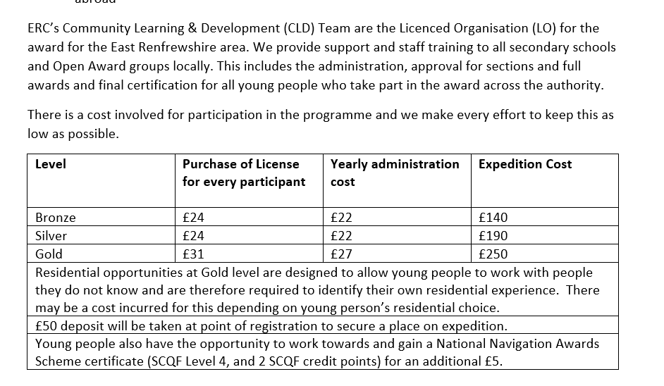
NEW Costs of doing DOFE (2022)
£25.50 £22 £150

Slide 42
Further Costs
Payment 1 - £47.50 to be paid in Nov
(£25.50 Fee & £22 admin fee)
Payment 2 - £90 to be paid in January
1st instalment towards the expeditions
Payment 3 - £60 to be paid in May
2nd instalment towards the expeditions
(The expedition costs are:
Hiring minibus and transit vans, diesel, gas for stoves, Assessor’s fee, Assessor’s expenses, train fares, sundries, supervising staff expenses).

Slide 43
Further Costs
Walking Boots - £25 upwards
Midge Net - £6 - £10
Waterproofs - £20 upwards
First Aid Kit - £6 upwards

Slide 44
Hiring Expedition Equipment

Slide 45
Hiring Equipment
Students can borrow:
A Tent, Rucksack, Sleeping Bag, Roll Mat and Stove.
i. All Equipment is collected from The Edge (beside ASDA in The Mearns).
ii. Students must hand over a £50 deposit, which is returned when the kit is returned.

Slide 46
Next Parents’ Meeting

Slide 47
Next Parents’ Meeting
I will have another meeting in March to talk through the procedures for the expeditions.

Slide 48
Communicating with students

Slide 49
Communication
Information for parents/carers
All information will be posted on our twitter account (@Barrhead_DOFE) and on the school website.
Information for students
All information will posted on:
DUKE OF EDINBURGH (S3 started Sept 2023) Google Classroom.
Students are expected to check this Google Classroom regularly for the latest updates & information.
See Mr Boag if you don’t have access

Slide 50
Student Meetings

Slide 51
Next Student Meeting
Students should meet in Mr Boag’s room (room 202)
Meeting 1: Wednesday, 25th Oct @ 2.45pm
Meeting 4: Wednesday, ??

Slide 52
Student Meetings
A register is taken at all DOFE meetings.
If a student misses three meetings, then a letter will be sent home to make parents/carers aware that your child is at risk of being removed from the award.
If a student misses a further two meetings after a letter being sent home, then they would be removed from the award.
Students would still have a DOFE account and could join a community DOFE group.

Slide 53
Actions!

Slide 54
Student Meetings
Decide what physical, skill and volunteering you can undertake – by the end of October.
Check each of your physical, skill and volunteering against the DOFE PDF documents. ** Make sure your section is permitted!! **
Speak to each of your assessors:
a. Ask them to be your assessor.
b. Work with them to create a realistic aim.
c. Make sure they are aware that they will need to write a short report at the end of the 12/24 weeks.
d. Obtain your assessor’s full name, email address and mobile number as this needs to be entered into eDOFE system.

Slide 55
Student Meetings
Decide which section you can undertake just now…and get started.
Until you get your eDOFE login, write down what you do each week. A sentence or two is fine.
Speak to each of your assessors:
a. Ask them to be your assessor.
b. Work with them to create a realistic aim.
c. Make sure they are aware that they will need to write a short report at the end of the 12/24 weeks.
d. Obtain your assessor’s full name, email address and mobile number as this needs to be entered into eDOFE system.

Slide 56
Well Done! Any Questions?

