Slide 1
Digital Learning
@
Barrhead
High School

Slide 2
Aims for tonight's session:
How Glow can be used to support learners, specifically looking at applications like Google Classroom.
To gain an understanding of other Google functions like Meet and Guardian Summaries and how they can support learners.
Digital Literacy
@
Barrhead

Slide 3
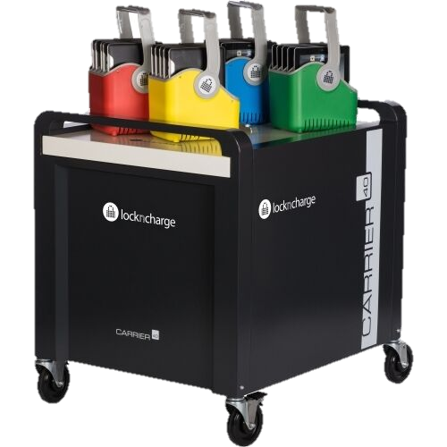
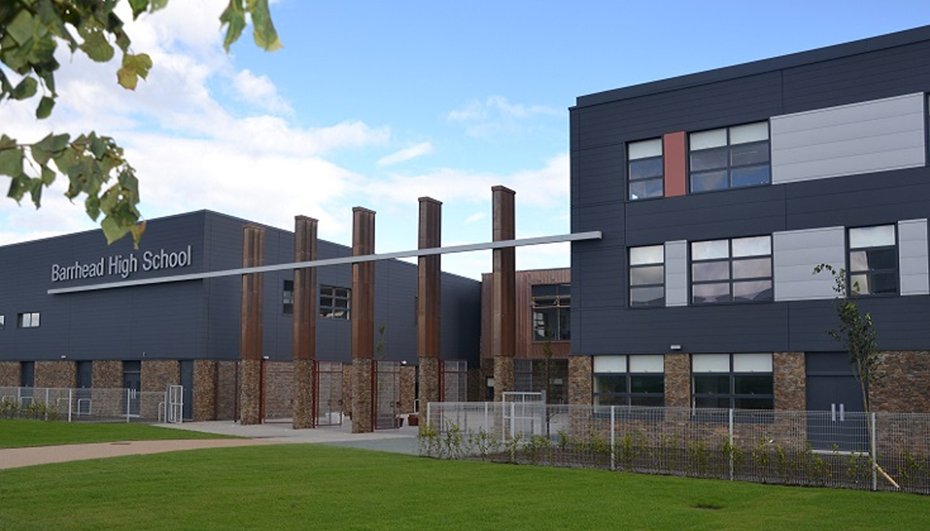
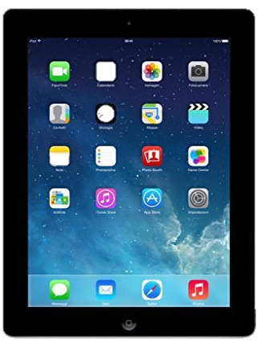
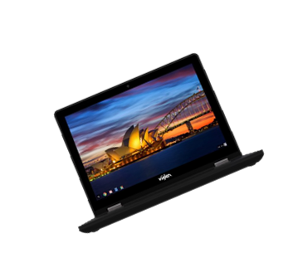

Slide 4
Glow is the national online education service funded by Scottish Government and provided by Education Scotland. This learning environment provides learners and educators across Scotland with access to a wide set of innovative digital services and resources designed to enhance learning and teaching across the whole curriculum.

Slide 5
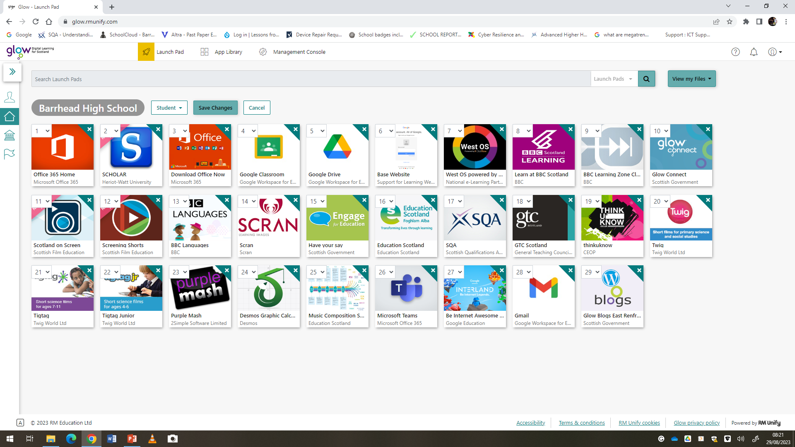

Slide 6
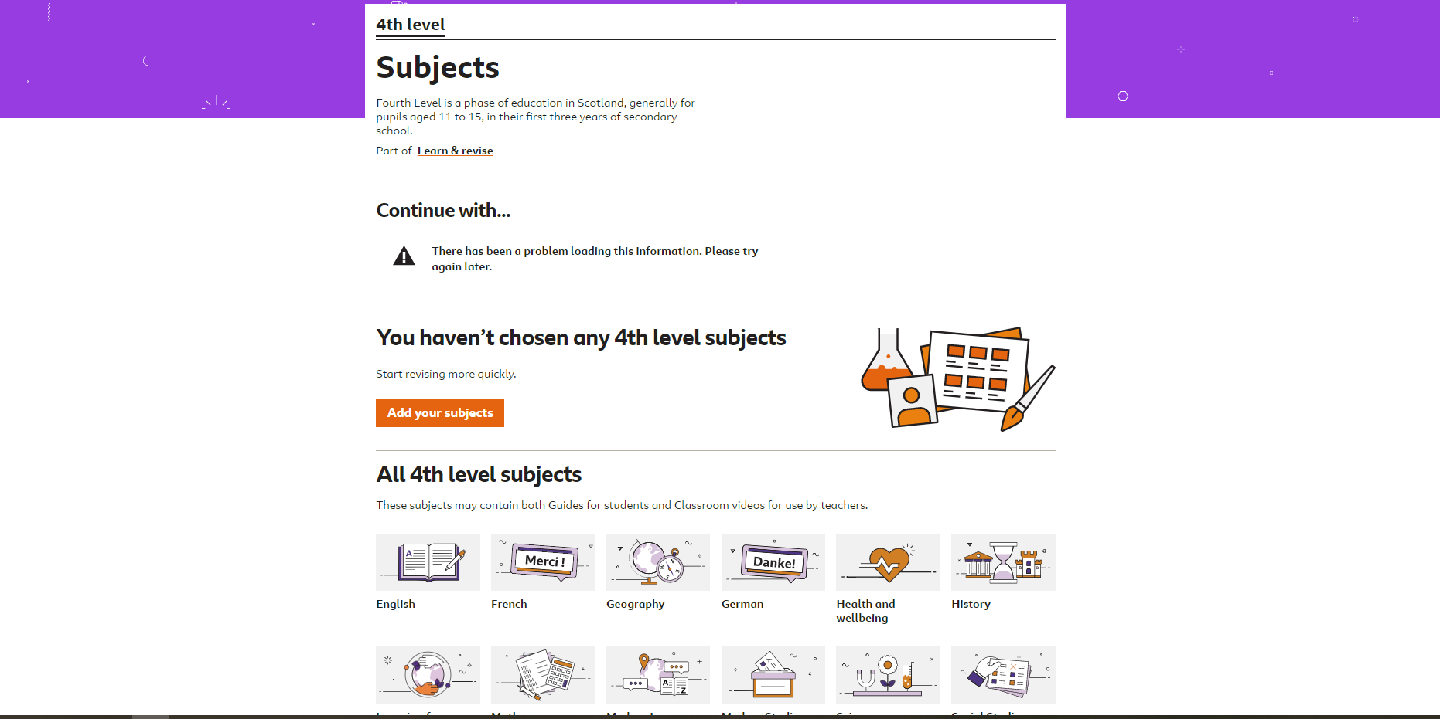
WEST OS – Recorded lessons and resources
BBC Learn –
All subjects supported
Support videos, knowledge checks and interactive quizzes.

Slide 7
What is Google Classroom?
Google Classroom is an online classroom. These are created by teachers, and pupils are then added or asked to join using a code.
Within the online classroom the teacher can:
Post messages e.g. reminders to bring in certain materials
Create assignments to be completed in class using chromebooks/laptops
Assign tasks to be completed in pairs/groups using devices
Assign HW tasks to be completed and handed in electronically
Provide online feedback on assignments/homework where appropriate
Issue link to forms for feedback
Pupils access Google Classroom via their GLOW login.
They can also access via the app (All S1 classes will be given an additional digital session, to help them set this up on their devices.)
Once in app they can:
See announcements sent by teacher
Access any class materials posted by teacher
Access homework assignments and instructions
Access class tasks assigned by the teacher e.g. PP presentation task
Contact teacher/peers for support with tasks.

Slide 8
What does this look like for pupils?

Slide 9
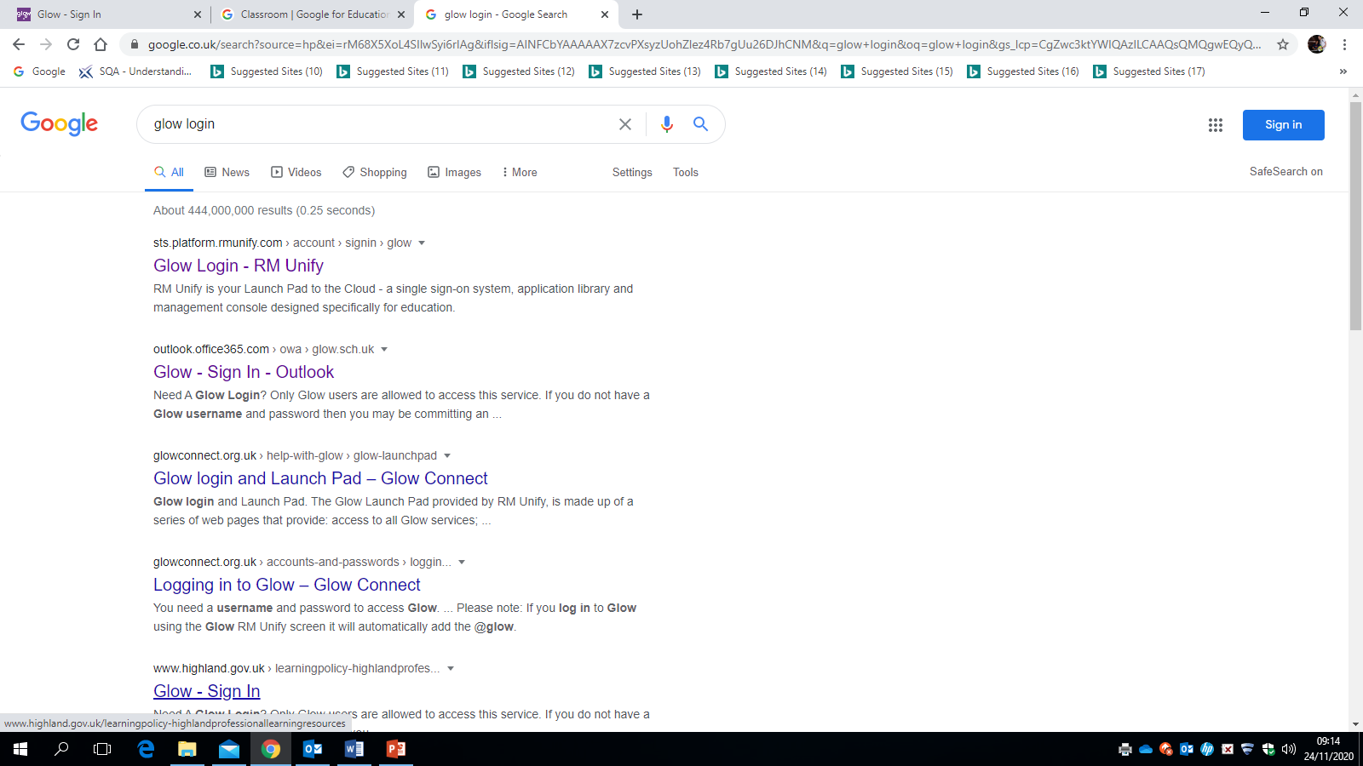

Slide 10
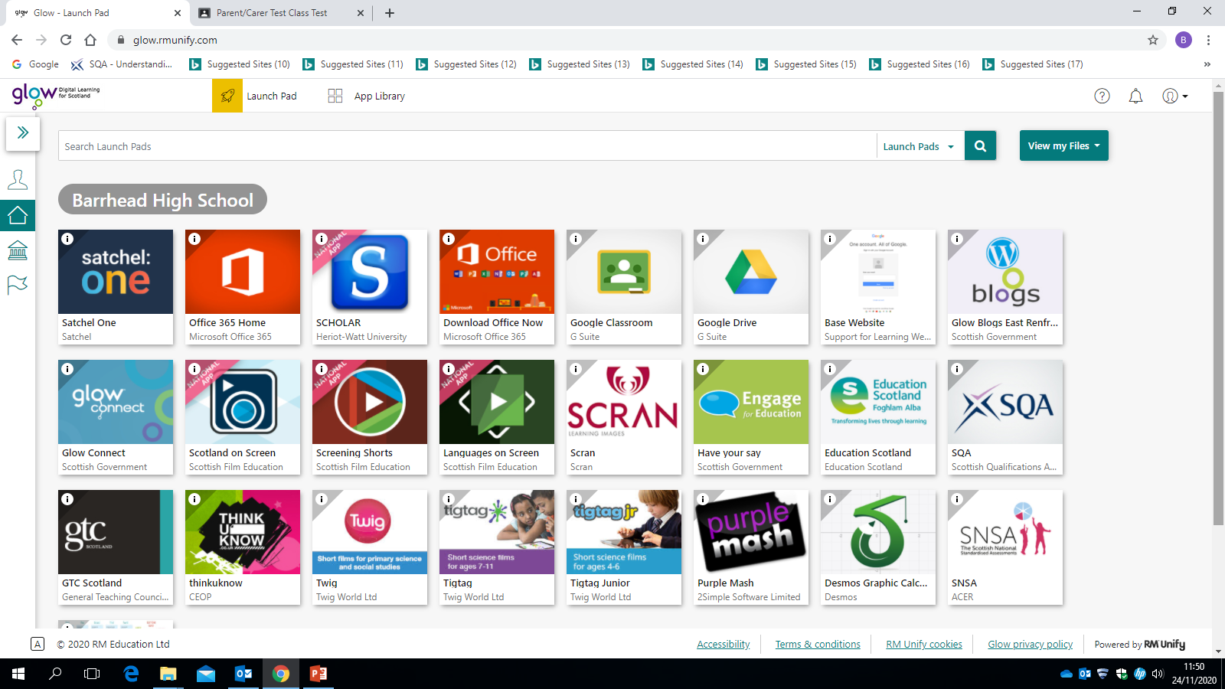

Slide 12
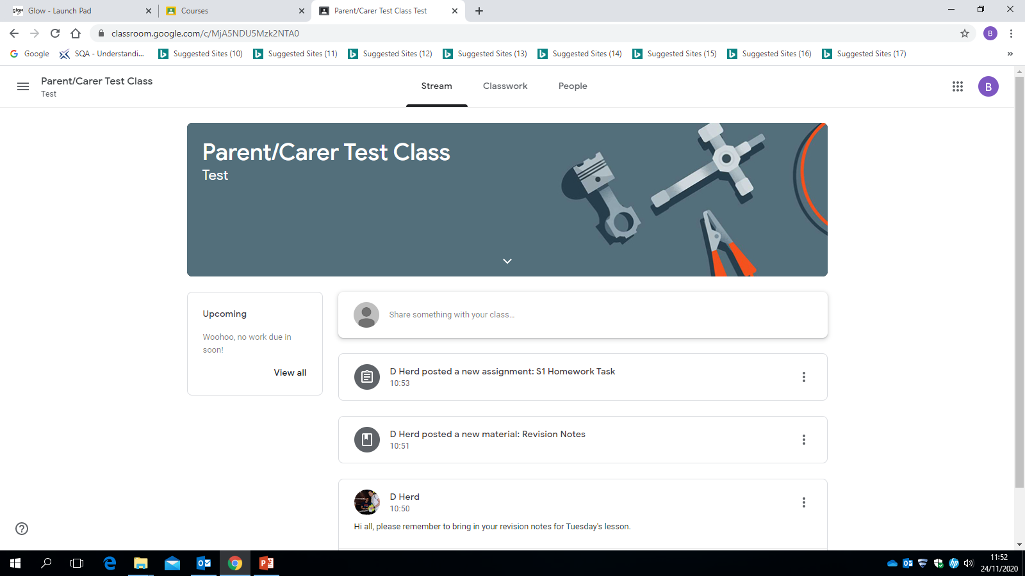

Slide 13
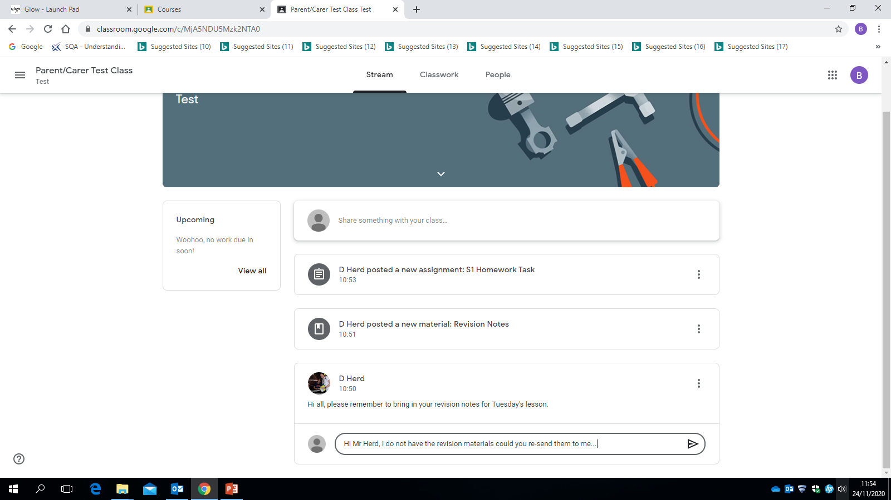

Slide 14
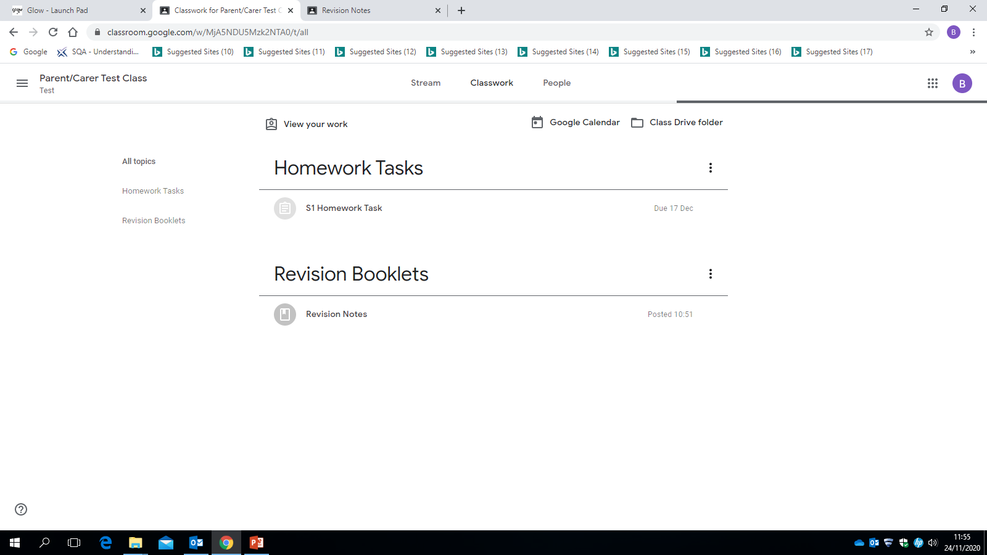

Slide 15
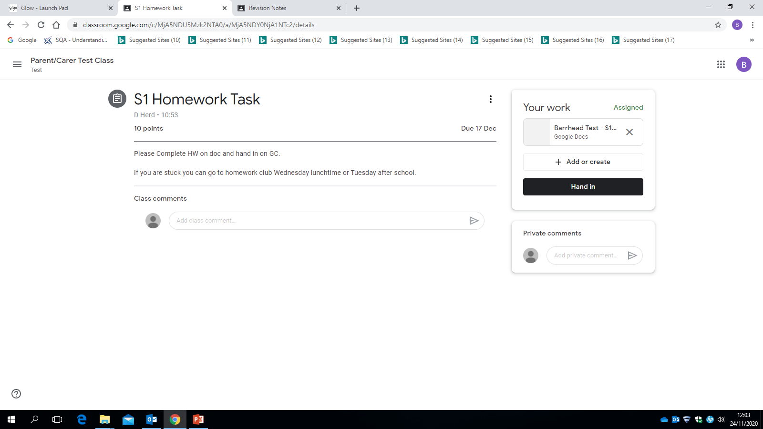
Number of marks displayed at top.
Instructions provided.
As this is to be completed online, the document is also available in the top right hand corner.
If pupil stuck they can add a private message to teacher to ask for help.

Slide 16
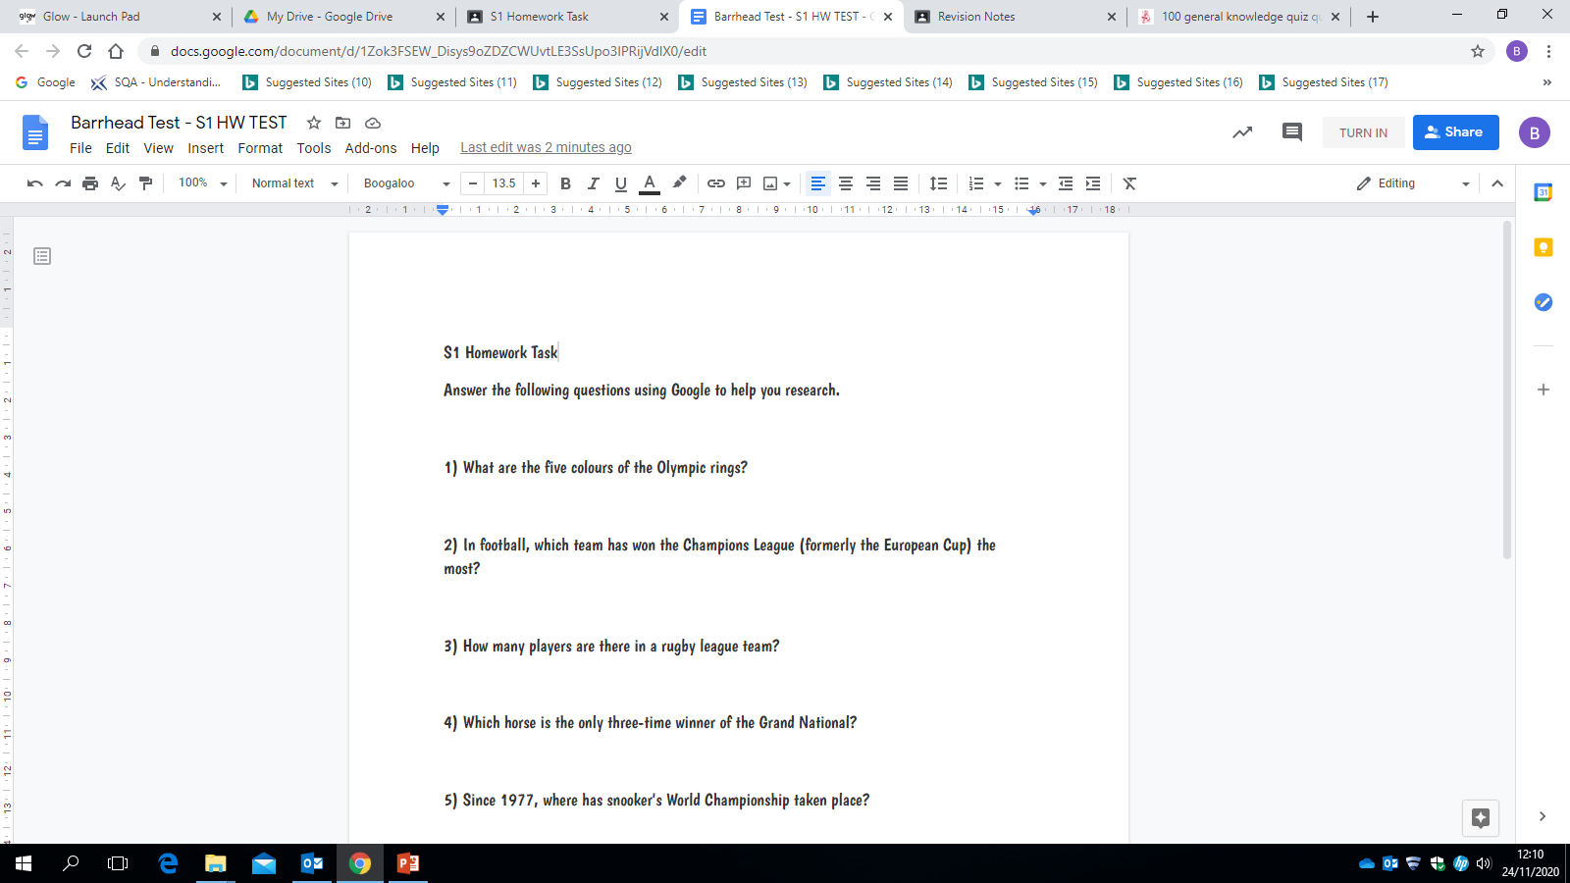

Slide 17
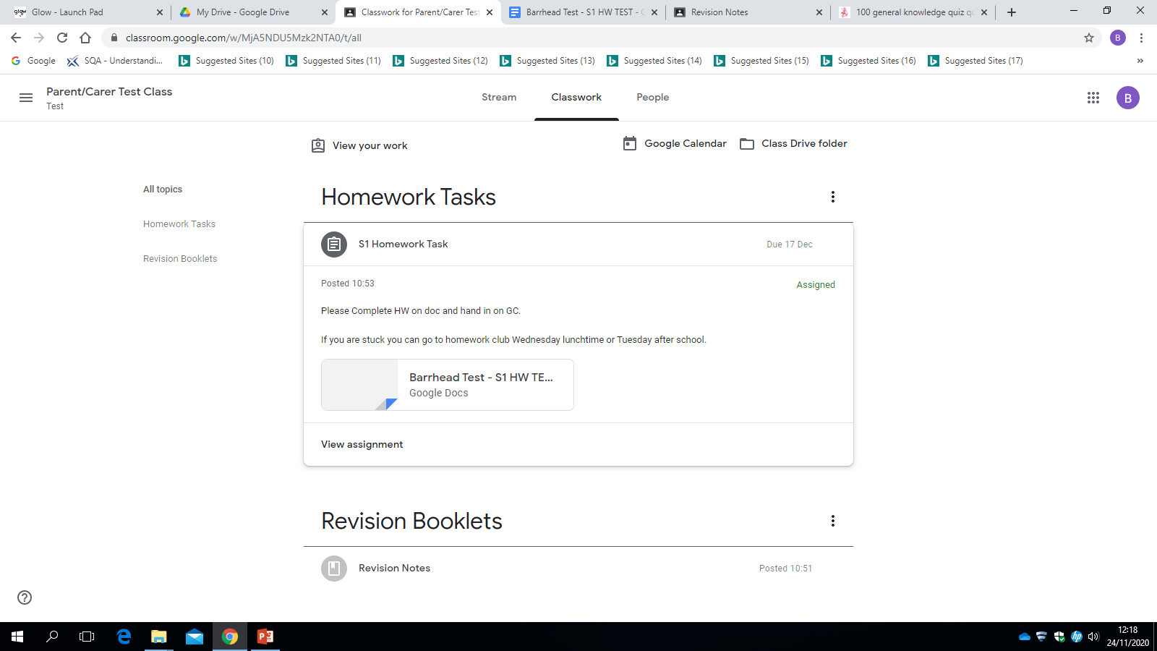

Slide 18
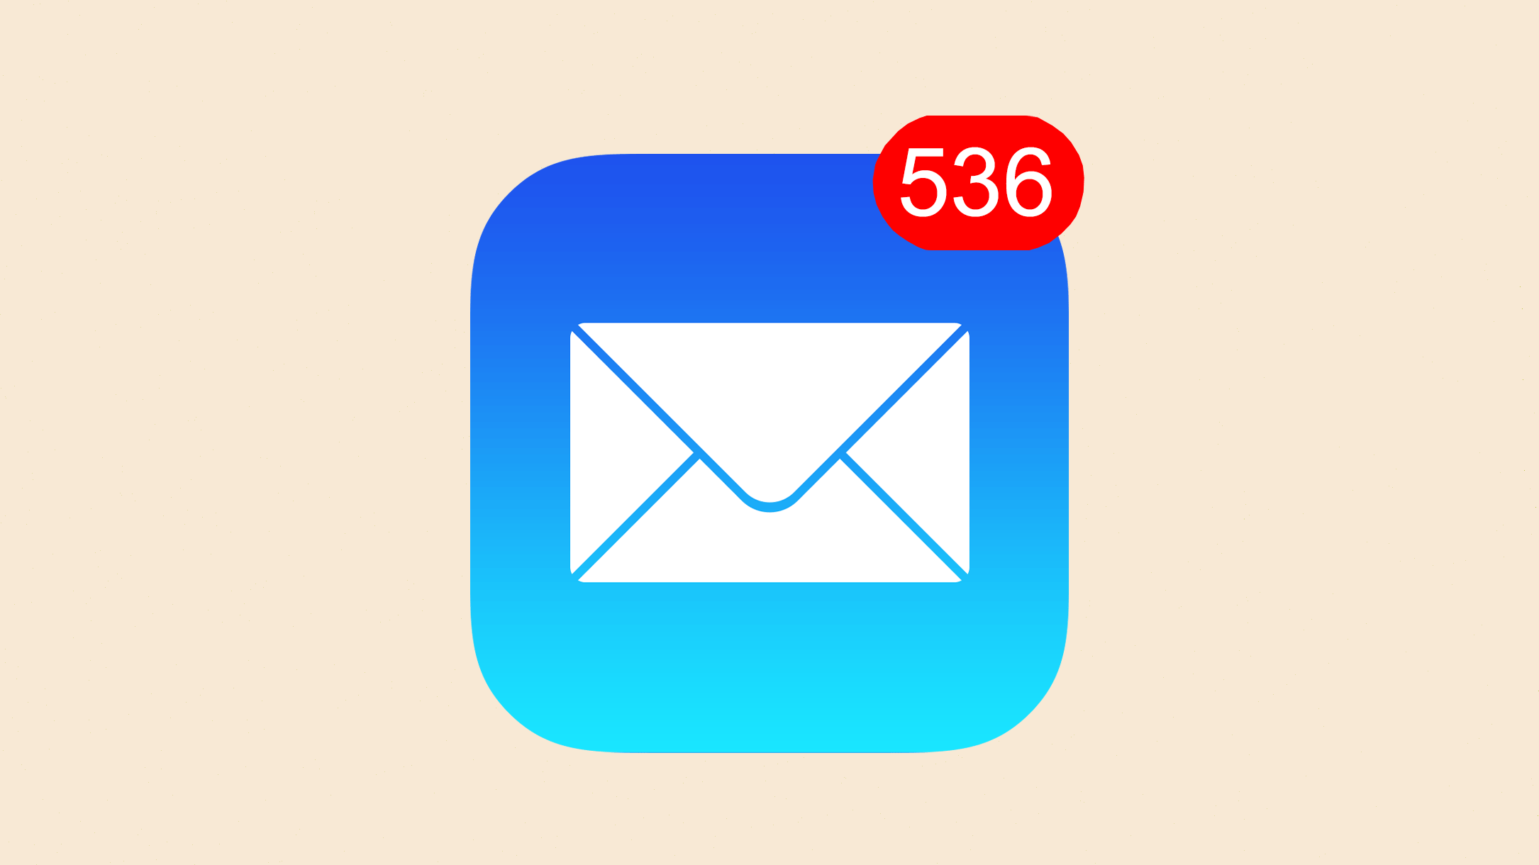
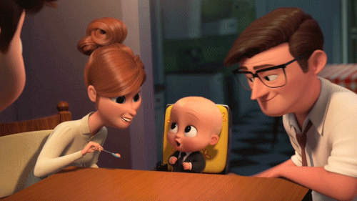
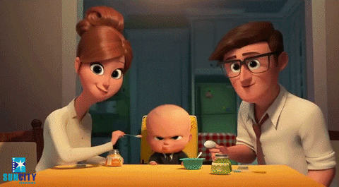
What are Guardian Email Summaries?
As a guardian, you are set up to receive email summaries about your student’s activity in Classroom.
In email summaries, you will see:
Missing work—Work not turned in when the summary was sent.
Upcoming work—Work that’s due in the upcoming week.
Class activities—Announcements, assignments, and questions recently posted by teachers.

Slide 19
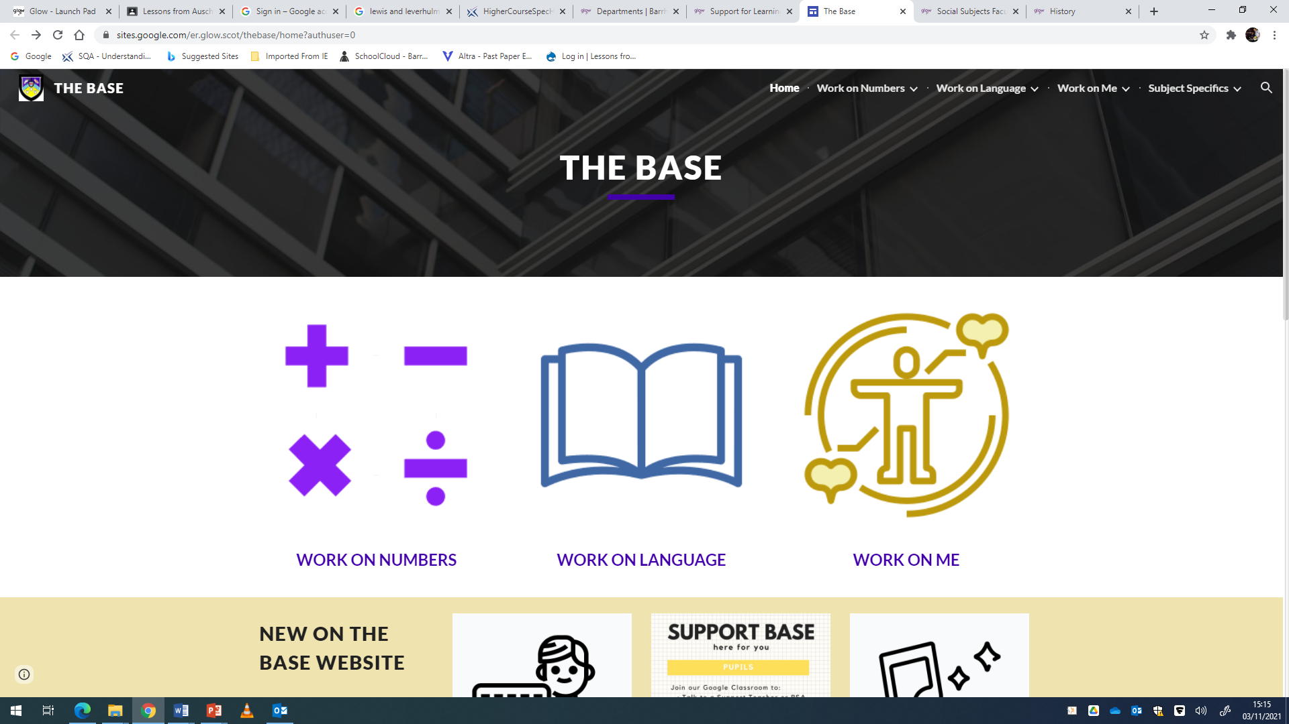
‘The Base’ website can be accessed via the departments section of the school website.

Slide 20
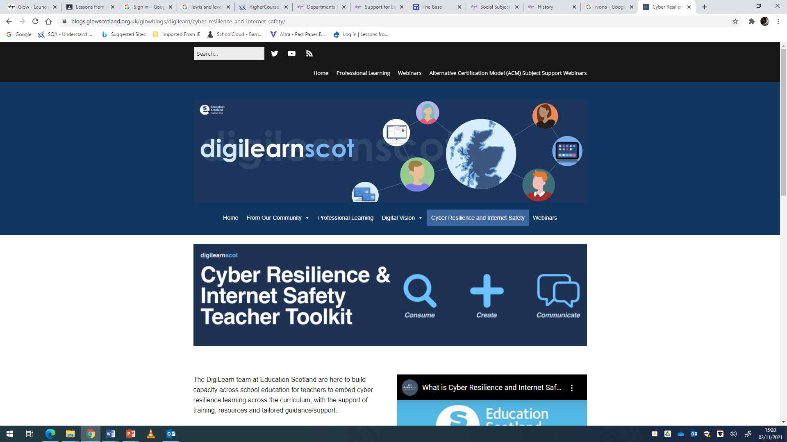
https://blogs.glowscotland.org.uk/glowblogs/digilearn/cyber-resilience-and-internet-safety/

Slide 21
Digital Learning
Should you have any questions please feel free to email gw11herddavid@glow.sch.uk and I’ll happily try and help.
School Website Support Link:
https://forms.office.com/Pages/ResponsePage.aspx?id=oyzTzM4Wj0KVQTctawUZKeebBTcdzKdNiJFUyHrRuOtUM0k5NkpOODhUQjNMNFVMMU4yUkhSQUtFQS4u

Slide 22
Feedback
https://forms.office.com/Pages/ResponsePage.aspx?id=oyzTzM4Wj0KVQTctawUZKeebBTcdzKdNiJFUyHrRuOtUMzNNNkI5TVJOR0RQMlRYWURIOUNNNDdQOS4u

Slide 23
Questions

