Slide 1
Antiracism in Scottish Education
Barrhead High School Parent Council
Monday 28th February 2022

Slide 2
Antiracism in Scottish Education
Nuzhat Uthmani
Primary Teacher, Glasgow City Council
EIS Rep and Vice Convenor Antiracist Sub Committee
Member of Scot Gov Race Equality and Antiracism in Education Programme
Notes:
As a mum

Slide 3
Aims
Current focus on Race Equality – Why now?
Addressing misconceptions
Manifestation of racism in schools
National approaches
School based approaches
Q & A

Slide 4
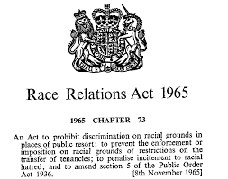
Current context for Race Equality
Are we Getting It Right For Every Child?
Child protection
Digital Security
LGBT
Gender
Learning difficulties
Race equality

Slide 5
Our Duty of Care
Article 2 – Non discrimination
Article 8 – Right to an identity
Article 12 – Respect their views
Article 42 – Knowledge of rights

Slide 6
Our Duty of Care
Respecting individual difference and supporting learners’ understanding of themselves, others and their contribution to the development and sustainability of a diverse and inclusive society (Social Justice)
Promoting and engendering a rights respecting culture and the ethical use of authority associated with one’s professional roles. (Trust & Respect)
Challenging assumptions, biases and professional practice, where appropriate (Integrity)
Creating opportunities for learning to be transformative in terms of challenging assumptions and expanding world views. (Professional Skills & Abilities)

Slide 7
The structure of racism
Personal | Social | Institutional
The racism scandal at Yorkshire Cricket Club: racial slurs. Every day micro-aggresions: *”So and so is from Pakistan, do you know him?” *”Your English is really good.” | Threads of racism are woven through our society and its institutions. Power of influence remains with dominant group. Racism is not the same as prejudice, which does not have power structures influence. | Planning doesn’t take into account impact or needs of minorities. Systems are set up to suit the majority, whether individuals are racist or not. Eg: using traditional texts or authors that portray minority stereotypes without questioning whether these are acceptable.

Slide 9
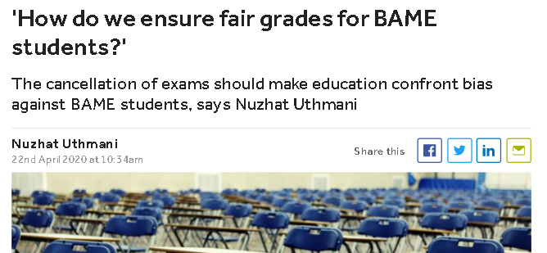
Current focus on Race Equality

Slide 10
Addressing Misconceptions
Notes:
Whataboutery means ignoring an argument, undermining it by talking about other equality issues, not focusing on the main issue.
All lives matter, but not equally, and haven’t done so for 1000s of years – this needs to change now
Equality is not about treating everyone the same, it’s about treating everyone according to their needs.
BLM was started in 2013 after the police murder of a 13 yr unarmed black boy, whether being politicised or not, the focus should be on the call for equality – human right not political
Antiracism is about standing up actively against racism in all it’s forms, and promote equality, not against any particular group – unfortunately racism has occurred because of the colonisation of the global south by white european nations
20% of white population live in poverty, while more than 50% of minorities live in poverty in the UK
Everyone in poverty faces barriers and challenges, but if you are white, you don’t face more challenges simply because of the colour of your skin
Ethnic minority groups the only ones were poverty rates are increasing
Some jobs priorities ethnic minorities over white people – the facts prove otherwise, look at graphic
Also: Minorities have to send 74% more applications to get the same opportunities, muslims suffer the highest unemployment rate of all groups in the UK, 1/8 Pakistani women has been illegally asked about marriage and personal commitments compared to 1/30 white women

Slide 11
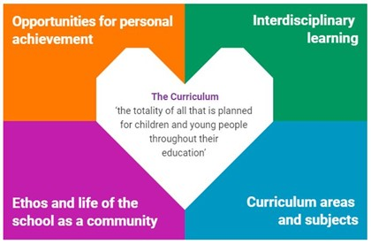
Manifestation of racism in schools
*Sense of identity
*Valuing background and lived experience
*Why do we teach what we teach?
*Whose perspective is it from?
*Whose perspective is missing?
*Stand alone events
*Inclusion and parental engagement
*Knowledge of racial literacy
*What resources do we use?

Slide 12
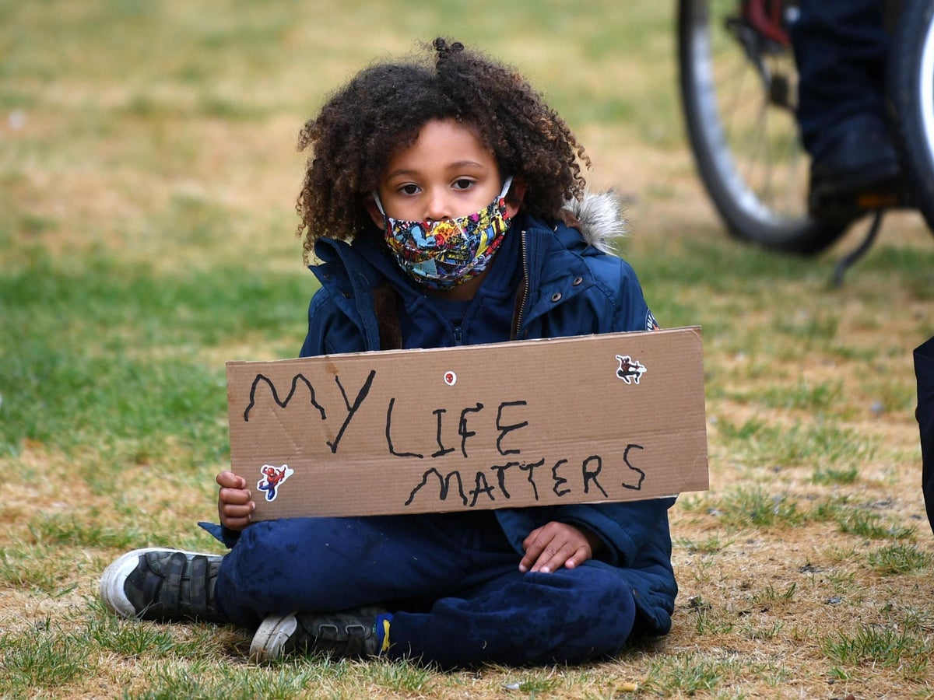
National Approach
Race Equality and Antiracism in Education Programme
Diversity in the Education Workforce
Curriculum Reform
Tackling Racist Incidents
Professional Leadership and Learning

Slide 13
Diversity in the Education Workforce
1.6% of teaching workforce identify as BAME
There are 3 Head Teachers in all of Scotland that are not white
There are 0 Head Teachers in East Renfrewshire or Glasgow
Promoted posts across the whole profession is 75 or 0.6% of the total number.
Aim to increase to minimum 4% by 2030
Challenge:
Retention
Recruitment
Statistics for Initial Teacher Training
67% rejection rate 50%
79% qualify v 84%
75% complete probation v 86%
70% permanent employment v 84%
WHY?
Notes:
How many BAME HTs do we have in Scotland? East Ren? Glasgow?
1.6%: most in secondary
Highly likely to go through education without bame teacher
Benefits

Slide 14
Curriculum Reform - Decolonising
Notes:
Eurocentric curriculum
Racism a tool for oppression – a social construct at the time of colonisation to categorise people into inferior groups
Decolonsing – freeing us of the colonial ideology that has shaped our thinking and curriculum

Slide 15
Encouraging Critical Thinking
Notes:
Venessa Nakate

Slide 16
Encouraging Critical Thinking
Guess the headline?

Slide 17
Tackling Racist Incidents
Pupils against pupils
Pupils against staff
Staff against pupils
Staff against staff
Notes:
Listen to lived experience
Don’t trivialise
Understand the trauma – health issue

Slide 18
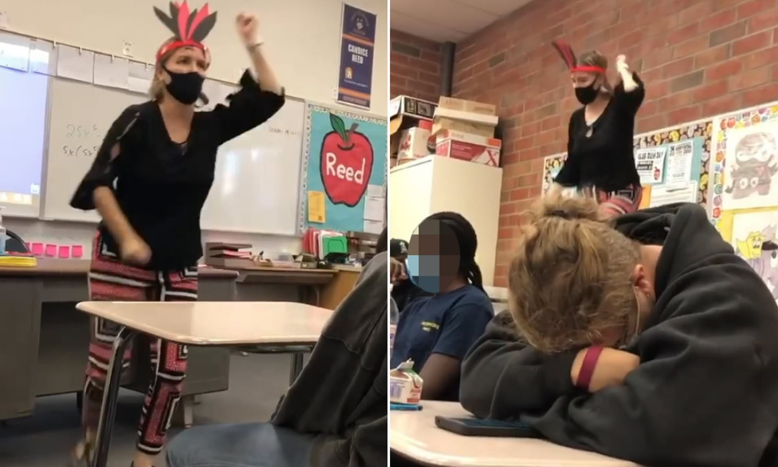
Professional Leadership and Learning
Building Racial Literacy
Understanding how to identify
inappropriate resources
Avoiding negative stereotyping
Engaging in critical thinking and difficult
conversations
Challenging on own assumptions
Notes:
The ability to understand what race is, why it is and how it is used to reproduce inequality and oppression.

Slide 19
Q & A
Notes:
Changes are coming
Change only happens when majority population is on board
Minorities will always face a battle to be heard

