Slide 1
Social Media
Barrhead High School Parent Council

Slide 2
Barrhead High School
Responsibility
Excellence
Success
Perseverance
Equality
Confidence
Teamwork
Social Media can be a wonderful tool, but there are some areas where they need support.

Slide 3
Our Pupils

Slide 4
Our Pupils

Slide 5
Our Pupils

Slide 6
Our Pupils

Slide 7
Grooming
The Sexual Offences Act (2003) defines online grooming as:
“A course of conduct enacted by a suspected paedophile, which would give a reasonable person cause for concern that any meeting with a child arising from the conduct would be for unlawful purposes”

Slide 8
Grooming
According to the CEOP website:
Often, this is adults who want to engage children in sexual acts, or talk to them for sexual gratification.
They will often use a number of grooming technique including building trust with the child through lying creating different personas and then attempting to engage the child in more intimate forms of communication including compromising a child with the use of images and webcams.
Child sex abusers will often use blackmail and guilt as methods of securing a meeting with the child.

Slide 9
Grooming
We are going to look at a video which describes a true case of grooming.
It can be distressing for some people. Produced by Leicestershire Police, it’s recommended that no child under 11 watches it.
https://www.youtube.com/watch?v=WsbYHI-rZOE

Slide 10
Kayleigh’s Story
Kayleigh Haywood began peaking to Luke Harlow, a man she had never met, on 31st October 2015.
Over the course of 13 days they exchanged 2643 messages. Harlow told a teenage girl all the things she’d want to hear: she was beautiful, how much he cared, that she was special.
Harlow was grooming Kayleigh and she finally agreed to his requests to spend the night of Friday 13th November 2013 at his house.
She spent the next day with him too and in early hours of 15th November, having been held against her will by Harlow and his neighbour Stephen Beadman, Kayleigh was raped and murdered by Beadman.

Slide 11
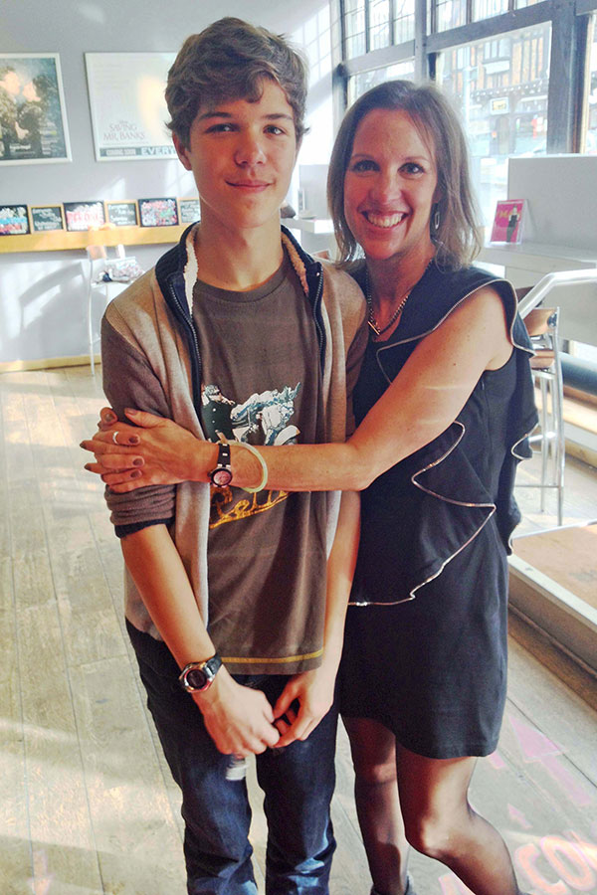
Grooming
It’s not just girls who are at risk of grooming.
14 year old Breck Bednar was groomed by 19 year old Lewis Daynes through online gaming.
After a long period of time, Breck agreed to meet Daynes and was murdered.

Slide 12
Radicalisation
The radicalisation process is focussed on an extremist ideology that seems appealing and credible.
This is often because it appears to make sense of the young person’s feelings of grievance or injustice.
Radicalisation is an issue which is becoming increasingly prevalent.

Slide 13
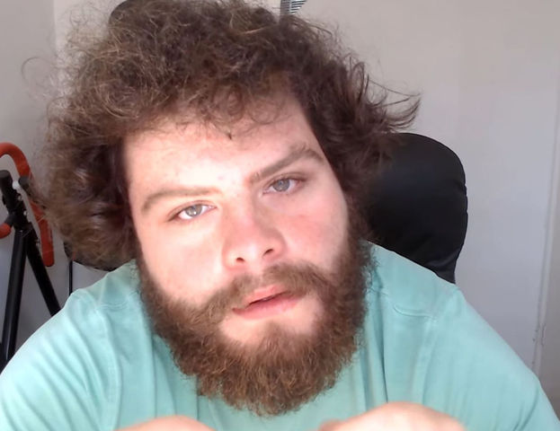
Radicalisation
Factors that may lead to radicalisation:
Sense of not belonging
Behavioural problems
Issues at home
Lack of self-esteem
Criminal activity
Being involved with gangs
Groups will often be attractive as they may offer solutions to feelings of being misunderstood, not listened to, or being treated unfairly.
https://www.youtube.com/watch?v=NHmOnCRAGvw

Slide 14
Signs of Radicalisation
Outward appearance
Not listening to other points of view
Abusive towards people who are different
Embracing conspiracy theories
Feeling persecuted
Changing friends and appearance
Converting to a new religion
Being secretive of movements
Increasingly argumentative
Distancing themselves from old friends
No longer doing things they used to enjoy

Slide 15
NSPCC advice on how to challenge radicalisation:
Speak with your child about what they do online
Ask them to show you some of their favourite sites
Show an interest in their online friends
Ask them how they decide who to be friends with
Try to get them to friend you online as well
Agree the amount of time they spend online and the sites they visit
Think about installing parental controls on their devices
Raise the issue of inappropriate content and if they’ve seen any
Make sure they know how to report abuse online

Slide 16
Simple Ways to Keep Children Safe Online
Get to know your child’s online habits.
Stay alert to any sudden changes in mood or appearance, or to any major change in habits or to increased secretiveness.
Keep lines of communication open.
Spend some time surfing the internet yourself.
Install internet filtering software showing a Child Safety Online Kitemark on your computer.

Slide 17
What is sexting?
When people talk about sexting, they usually mean sending or receiving:
Naked pictures or ‘nudes’
Underwear shots
Sexual or ‘dirty pics’
Rude text messages or videos.

Slide 18
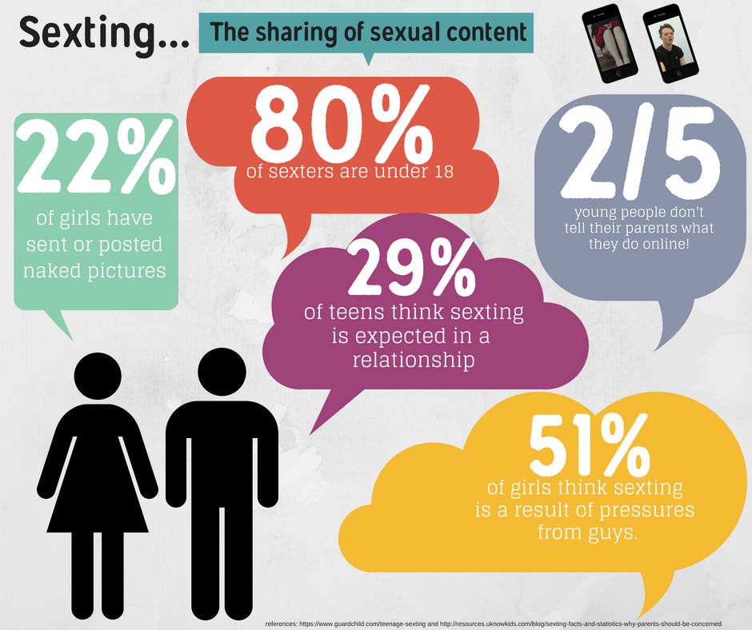

Slide 19
Sexting and the Law

Slide 20
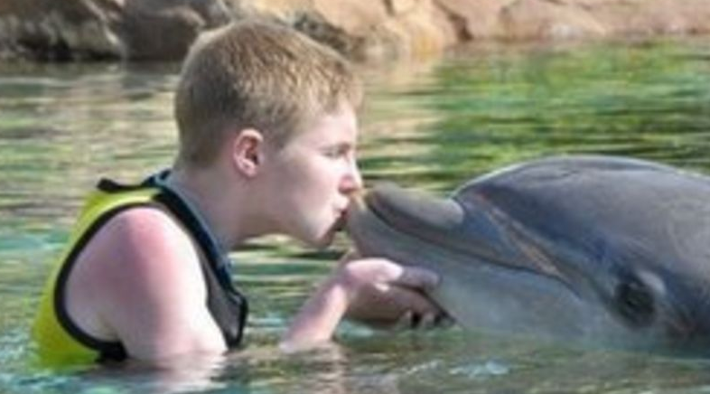
Sexting
Daniel Perry, a 17 year old from Fife, participated in sexting with someone who he thought was a girl his own age.
He was then blackmailed. Told the pictures would be sent to his family and friends unless he paid. He took his own life.

Slide 21
Group Chats
Most social media platforms have a group chat function.
There are often a large number of people within these group chats. Commonly our pupils use:
Facebook messenger
Snapchat
Whatsapp
Instagram
Discord

Slide 22
What are the issues with a group chat?
You cannot take something back that you’ve written down.
You cannot delete videos or images that are sent – your only option is to leave the chat.
It is an easier space for unkind or nasty things to be said which would not be said face to face.
There is an evidence trail of inappropriate comments.

Slide 23
Advice to children if something happens on a group chat.
Screen shot any comments that concern you.
Show them to an adult you trust
Remove yourself from the group – don’t stay in a toxic environment.
Do not retaliate in any way. Do not comment back or respond, as you could end up in as much trouble as the first person to comment.
If you need further advice, contact our police officer – PC McFarlane – for information.

Slide 24
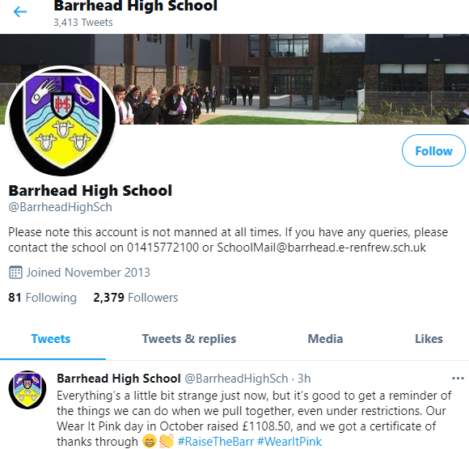
Social Media
Not everything on a mobile is bad – there are some great examples:
School Twitter pages
Lots of excellent apps for school
Can help to teach people about responsibility.

Slide 25
Websites for further advice:

