Slide 1
Social Media Information Evening
Barrhead High School
16/03/2021

Slide 2
Tonight’s Aims
Tonight we will:
Develop our understanding of the social media use of our young people
Explore some of the vulnerabilities that our young people face with social media.
Find resources and strategies to help your support your young people navigate their anxieties of social media.

Slide 3
Barrhead High School
Responsibility
Excellence
Success
Perseverance
Equality
Confidence
Teamwork
Social Media can be a wonderful tool, but there are some areas where they need support.

Slide 4
Grooming
The Sexual Offences Act (2003) defines online grooming as:
“A course of conduct enacted by a suspected paedophile, which would give a reasonable person cause for concern that any meeting with a child arising from the conduct would be for unlawful purposes”

Slide 5
Grooming
According to the CEOP website:
Often, this is adults who want to engage children in sexual acts, or talk to them for sexual gratification.
They will often use a number of grooming technique including building trust with the child through lying creating different personas and then attempting to engage the child in more intimate forms of communication including compromising a child with the use of images and webcams.
Child sex abusers will often use blackmail and guilt as methods of securing a meeting with the child.

Slide 6
Grooming
We are going to look at a video which describes a true case of grooming.
It can be distressing for some people. Produced by Leicestershire Police, it’s recommended that no child under 11 watches it.
https://www.youtube.com/watch?v=WsbYHI-rZOE

Slide 7
Kayleigh’s Story
Kayleigh Haywood began peaking to Luke Harlow, a man she had never met, on 31st October 2015.
Over the course of 13 days they exchanged 2643 messages. Harlow told a teenage girl all the things she’d want to hear: she was beautiful, how much he cared, that she was special.
Harlow was grooming Kayleigh and she finally agreed to his requests to spend the night of Friday 13th November 2013 at his house.
She spent the next day with him too and in early hours of 15th November, having been held against her will by Harlow and his neighbour Stephen Beadman, Kayleigh was raped and murdered by Beadman.

Slide 8
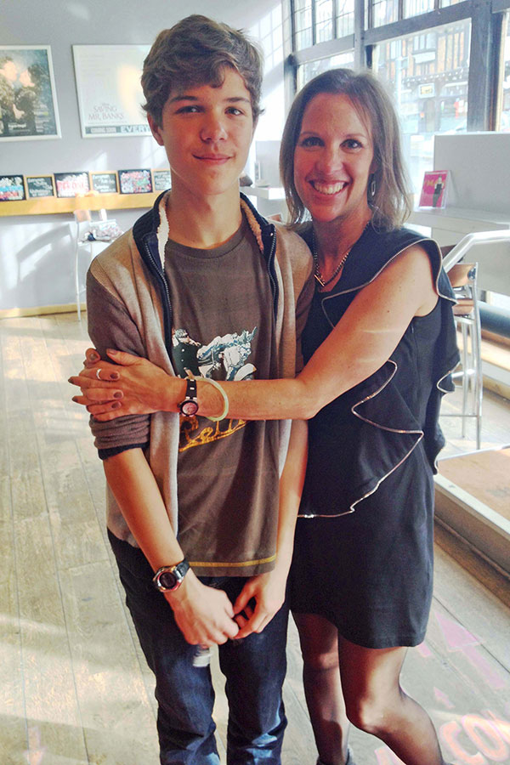
Grooming
It’s not just girls who are at risk of grooming.
14 year old Breck Bednar was groomed by 19 year old Lewis Daynes through online gaming.
After a long period of time, Breck agreed to meet Daynes and was murdered.

Slide 9
Our Pupils

Slide 10
Our Pupils

Slide 11
Our Pupils

Slide 12
Our Pupils

Slide 13
Simple Ways to Keep Children Safe Online
Get to know your child’s online habits.
Stay alert to any sudden changes in mood or appearance, or to any major change in habits or to increased secretiveness.
Keep lines of communication open.
Spend some time surfing the internet yourself.
Install internet filtering software showing a Child Safety Online Kitemark on your computer.

Slide 14
What is sexting?
When people talk about sexting, they usually mean sending or receiving:
Naked pictures or ‘nudes’
Underwear shots
Sexual or ‘dirty pics’
Rude text messages or videos.

Slide 15
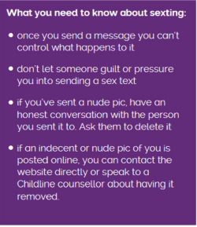
Sexting
The following is a dramatization from CEOP about the impact that sexting can have.
It is estimated that 20% or teens (13-19) have posted or sent a naked or partially naked picture or video – 18% for boys, 22% for girls
https://www.safecic.co.uk/esafety-site/75-esafety-hub/670-video-sexting-2

Slide 16
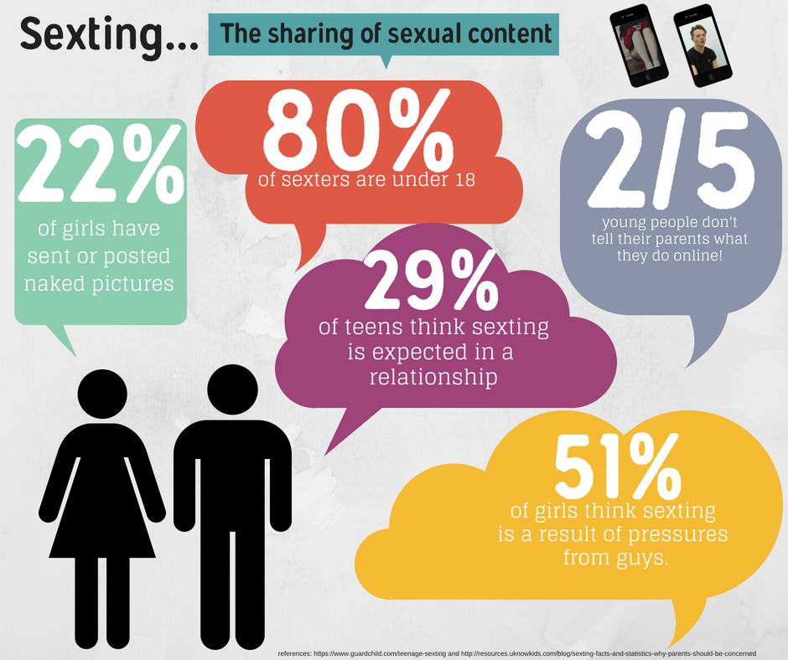

Slide 17
Sexting and the Law

Slide 18
Advice from the ‘thinkuknow’ website
No one has defined ‘indecent’ but basically if it’s naked, a topless girl, contains genitals or sex acts then it will be indecent.
It is illegal to take, possess or share ‘indecent images’ of anyone under 18 – even if you are the person in the picture.
This is not an uncommon issue, but as Mrs Wallace says – If you wouldn’t show it to your gran, you shouldn’t share it online!

Slide 19
Group Chats
Most social media platforms have a group chat function.
There are often a large number of people within these group chats. Commonly our pupils use:
Facebook messenger
Snapchat
Whatsapp
Instagram
Discord

Slide 20
What are the issues with a group chat?
You cannot take something back that you’ve written down.
You cannot delete videos or images that are sent – your only option is to leave the chat.
It is an easier space for unkind or nasty things to be said which would not be said face to face.
There is an evidence trail of inappropriate comments.

Slide 21
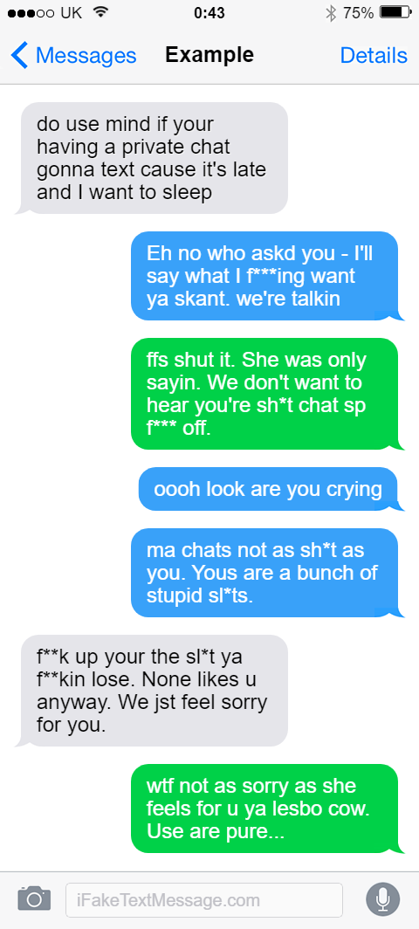

Slide 22
Group Chats
This is an excerpt from a real group chat.
This conversation continued for over an hour.
There were over 100 messages which became increasingly abusive to the point of being criminal.

Slide 23
Group Chats
Group chats are challenging as sometimes people will say things they would not say face-to-face.

Slide 25
Advice to children if something happens on a group chat.
Screen shot any comments that concern you.
Show them to an adult you trust
Remove yourself from the group – don’t stay in a toxic environment.
Do not retaliate in any way. Do not comment back or respond, as you could end up in as much trouble as the first person to comment.
If you need further advice, contact our police officer – PC McFarlane – for information.

Slide 26
S6 – What can happen online.
Exclusion
Inclusion
Targeted comments
Access to inappropriate content online
Interacting with people you don’t know
Photos sent without permission
Fake social media accounts

Slide 27
S6 – How we plan to help.
Wellbeing ambassadors trained
Passing on relevant information to staff
Already had an input into all assemblies for anti-bullying
Process of creating a new anti-bullying poster that will be displayed across the school
Specific input into assemblies about social media awareness from S6 wellbeing ambassadors.

Slide 28
PC McFarlane

Slide 29
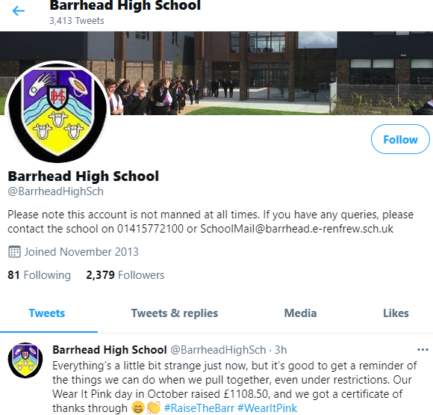
Social Media
Not everything on a mobile is bad – there are some great examples:
School Twitter pages
Lots of excellent apps for school
Can help to teach people about responsibility.

Slide 30
Websites for further advice:

Slide 31
Thank you for your attention

Slide 32
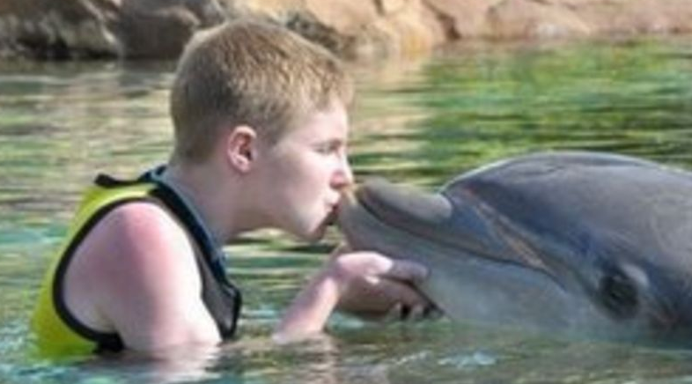
Sexting
Daniel Perry, a 17 year old from Fife, participated in sexting with someone who he thought was a girl his own age.
He was then blackmailed. Told the pictures would be sent to his family and friends unless he paid. He took his own life.

