Slide 1
Antiracism & Allyship
S1 Workshop
Barrhead High School
Nuzhat Uthmani
Nabila Riaz

Slide 2
Aim: To help S1's start developing an understanding of racism & how to combat it.
Focus of the workshop:
1. Why of racism?
2. Real life impact
3. Antiracist allyship

Slide 3
1.Why are we talking about racism?
What is discrimination?
* The unfair treatment of others based on a single or group of protected charactertistics.
Why might someone be treated differently to others? (Brainstorm & share)
What might this look like within school? (Brainstorm & share)

Slide 4
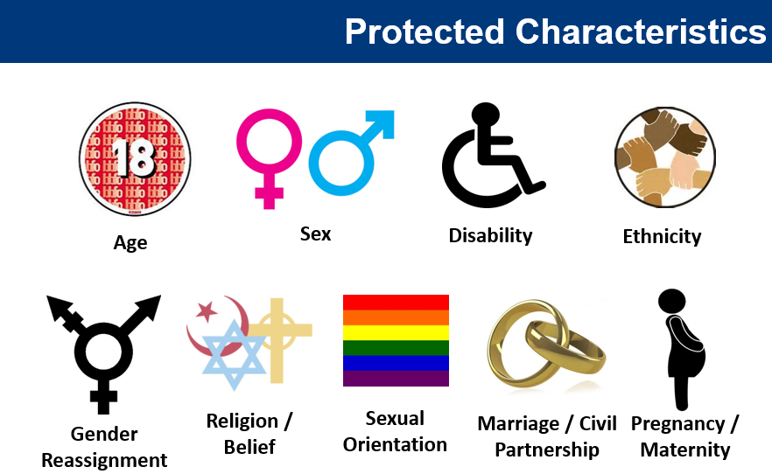
1.Why are we talking about racism?
The Equality Act 2010
Can you pick any of these that you identify with?
Do you only identify with one?
Intersectionality
How would you feel being discriminated against because of one of these?

Slide 5
2. What is racism & its impact?
Definition: "Prejudice, discrimination, or antagonism directed against someone of a different race based on the belief that one’s own race is superior.“ Oxford Dictionary
Colonialism & Decolonising:
Coloniser: A country that sends settlers to a place and establishes political control over it. (Examples?)
Decolonising: Undoing of colonial rule/freeing of minds from colonial ideology – the ingrained idea that to be colonised was to be inferior. Warwick Uni. (Examples?)

Slide 6
2. What is racism & its impact?
What does it look like in modern society? Where do you see it or hear it?

Slide 7
2. What is racism & its impact?
Racist language.
We must tackle the systemic aspect of racism.
What is systemic racism?
https://www.youtube.com/watch?v=H5J7KlxhQK4
Examples of the different forms of racism (next next slide)

Slide 8
2. What is racism & its impact?
Personal | Social | Institutional/Systemic
Racist language: e.g. using the ‘n’ or the ‘p’ word People using negative stereotypes against you because of your ethnicity. Not saying your name properly. | Racist abuse not being recognised or dealt with correctly. Your ethnicity or culture is forced to be hidden from wider society. | People may not be racist, but the organisations they are a part of, often can be. Organisations are set up to suit the needs of the majority (white populations). In school through our curriculum e.g. texts
Notes:
*will say a few words about the harmful nature of these words.
*will also share some of my own lived examples

Slide 9
2. What is racism & its impact?
* 1.8% of teachers BAME
* 0.2% in management
* Less BAME teachers given permanent jobs
Some stats:
Education
Management positions in industry
Stereotyping in interviews
Health inequalities
What do you think of these stats?
Do they surprise you?
What impact do these situations have on positive outcomes for minority ethnic people?
* FTSE 100 ZERO BAME leaders
* 74% more applications
* Muslims suffer highest unemployment rates in the UK
Muslim women discriminated
Black women are 4 x more likely to die during pregnancy and childbirth
Notes:
*https://www.hrmagazine.co.uk/content/news/number-of-black-ftse-100-leaders-drops-to-zero-due-to-vanilla-boys-club-of-senior-leaders
*Annual data report 23% secondary BAME compared to 50% white secondary teachers
*https://www.theguardian.com/commentisfree/2023/apr/20/appalling-statistics-black-maternal-death-healthcare

Slide 10
3. Antiracist allyship
What is anti racism?
Dr Ibram X Kendi speaking to children: https://www.youtube.com/watch?v=W4Pvq1E-UV8 (first 6 mins)
“If you want to change anything, you have to see each other”.
Antiracism is a verb – what do we mean by that? (Examples?)
“WE have the power to change the world, one of the ways we do that is by telling the stories of the people around you.”
How will you do that if you don’t know those stories or those people?

Slide 11
3. Antiracist allyship
What is allyship?
Allyship means to not be a member of a marginalised group but to still want to support and take action to help others in that group.
How do you practise allyship with your friends? (Brainstorm – not specific to racism)
Now think about what actions could you do to show support for a friend, neighbour or class fellow who may be experiencing racism?

Slide 12
Next steps
Being an ally
Call it out!
Make an effort to learn and understand different points of view
Ask for policy changes!
Get comfortable with your discomfort.

Slide 13
Antiracism in the Curriculum
Are there certain subjects we can learn about racism or people around the world? (Examples)
We must learn about racism, social justice, equality by learning more about people from marginalised communities.
Here’s some examples of how and where you can learn about people from marginalised groups.

Slide 14
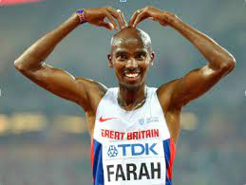
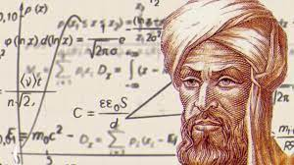
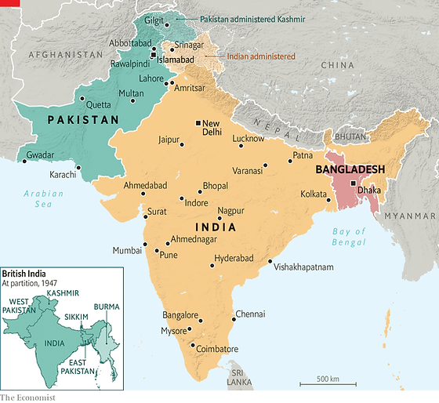
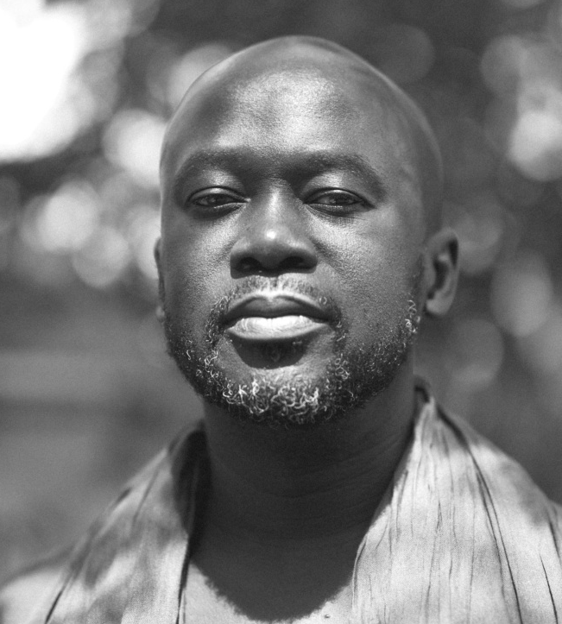
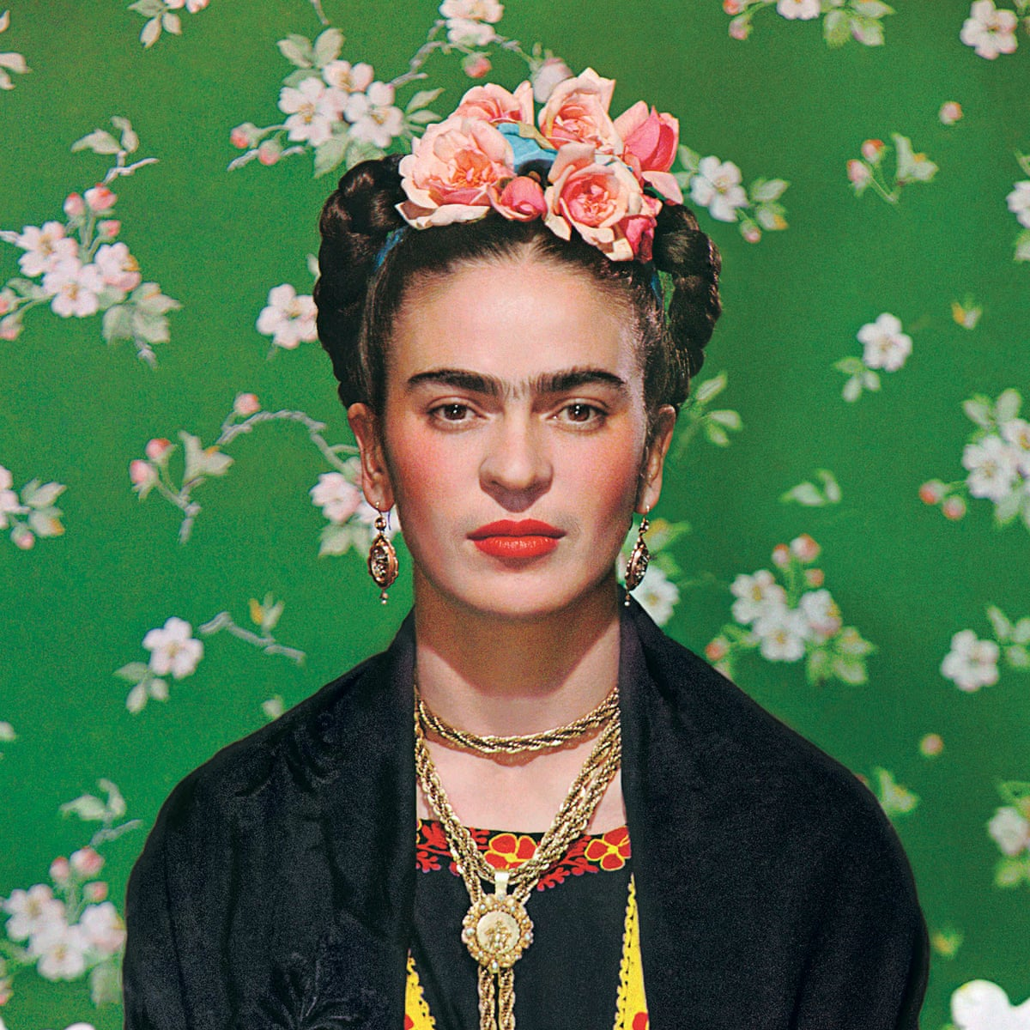
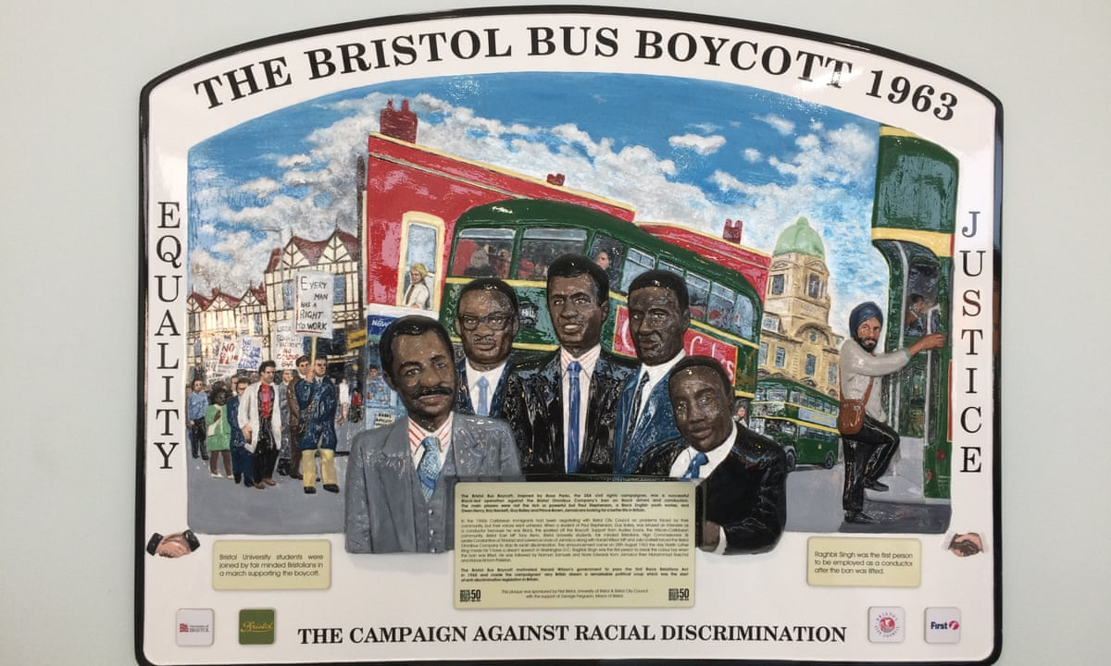
Notes:
*Al-Khwarizmi
*David Adjaye/UK Holocaust Memorial & Learning Centre.
*Mo Farah, Aamir Khan, Raheem Stirling, Marcus Rashford
*Roy Hackett
*Frida Kahlo, Mexican (German and native American, post colonialism art)

Slide 15
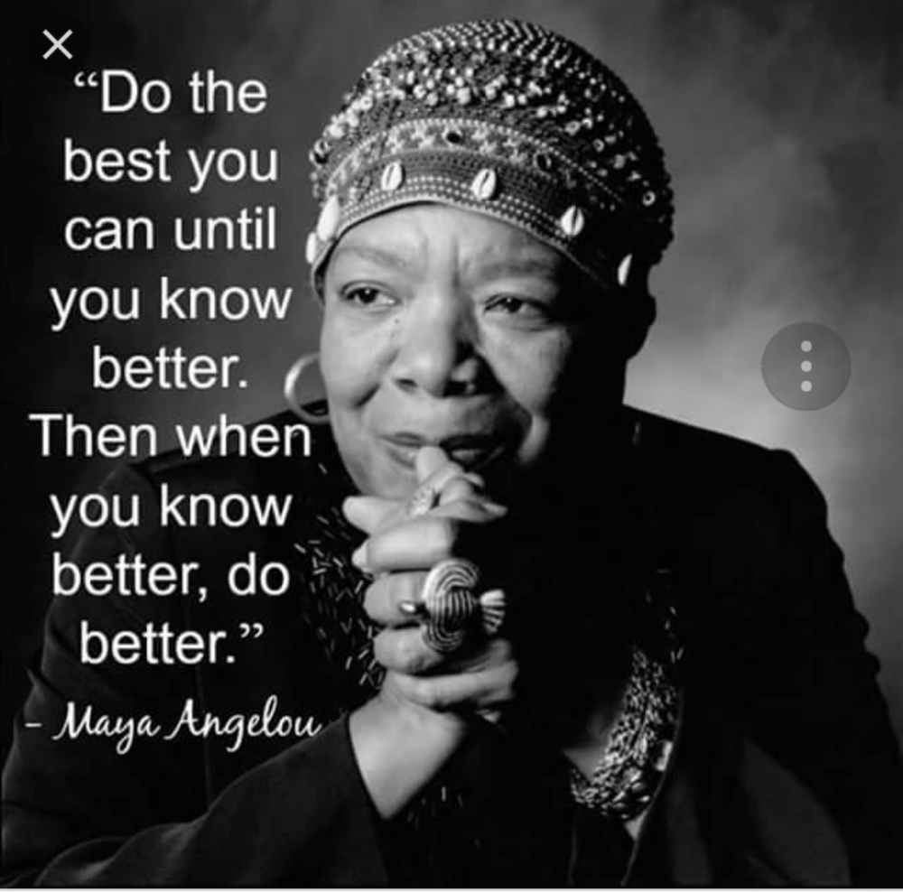
Q&A
Name something you didn’t know but know
now?
What antiracist action do you think you
could take forward?

