Slide 1
Please click on the hyperlinks below to access information on:
Learner Support
Subject Information
myworldofwork.co.uk
Parent/Carer Support
The Options Process
Understanding today’s qualifications
myworldofwork.co.uk
The Learner Journey

Slide 2
Subject Information
Click on the hyperlinks below to find out more information about each of the subjects offered to S3 learners.
LANGUAGES | MATHEMATICS & SCIENCE | SOCIAL SUBJECTS | EXPRESSIVE ARTS | TECHNOLOGIES | HEALTH & WELLBEING | CHOICE SUBJECTS
English | Mathematics | Geography | Art & Design | Administration & IT | Physical Education | Business Management
ESOL | Biology | History | Drama | Computing | Practical Cookery | Personal Development
French | Chemistry | Modern Studies | Music | Graphic Communication
Mandarin | Physics | Travel & Tourism |  | Woodwork
Languages for Life & Work |  |  |  | Fashion & Textile
 |  |  |  | Music Technology

Slide 3
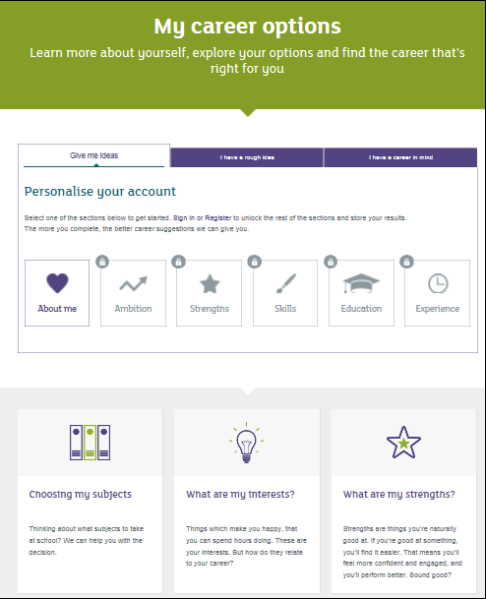
Support for Learners
myworldofwork.co.uk
myworldofwork.co.uk is an interactive web service developed by Skills Development Scotland to help all young people (and young adults) planning their future pathways.
All S2 learners will spend time on the service during pastoral.
This will help prepare them for their pathways interviews.
One of the best features of the site is the subject choice tool:
Option Choices Tool

Slide 4
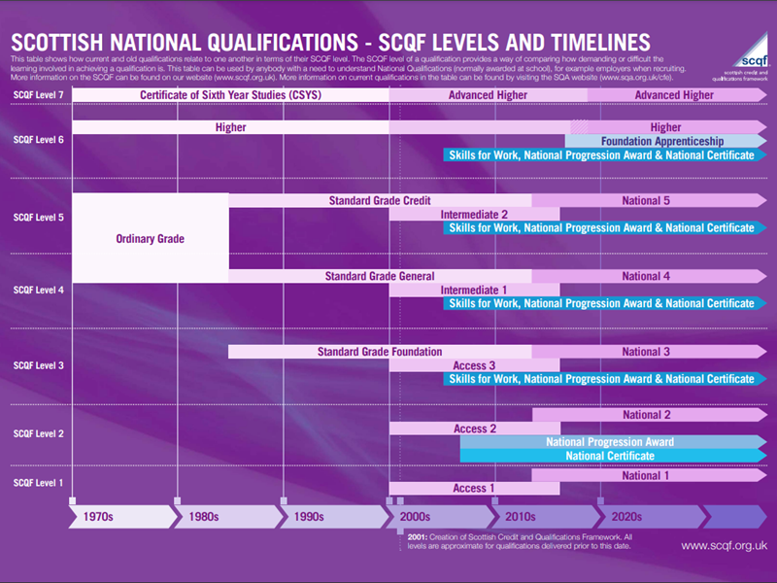
Support for Parents & Carers
Understanding National Qualifications
How do the qualifications and levels my child will work towards compare to the qualifications I did at school?
Here, you can see that a Standard Grade Credit – or Intermediate 2 – is of similar value to a National 5.

Slide 5
Support for Parents & Carers
myworldofwork.co.uk
myworldofwork.co.uk also contains extensive help and support information for parents and carers.
This includes school information about options choices but also wider information about different job sectors and how to support your child as they transition out of school and into the world of work.
Parents & Carers

Slide 6
Support for Parents & Carers
The Learner Journey
The National Parent Forum of Scotland also contains clear and concise information to help you navigate the complex modern educational landscape.
Their ‘In a Nutshell’ series is particularly helpful.
The Learner Journey

Slide 7
Support for Parents & Carers
The Options Process
Date | Event
January & February | S2 learners will discuss their options choices in curricular classes and in Pastoral.
Thursday 26th January | S2 Options Information Evening
Thursday 16th February | S2 Reports Issued (via Parent Portal)
Tuesday 28th February | S2 Parents’ Night
Thursday 2nd March | S2 Options Day All learners will have an interview with their pastoral teacher who will support them with their final options choices.

Slide 8
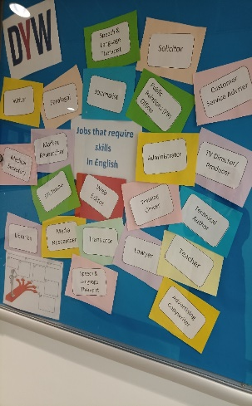
ENGLISH (N3, 4 & 5)
Course Content:
Learners will have one main piece of literature to study - prose, drama, poetry or media. They will develop their understanding and ability to analyse the writer’s techniques. Learners will be asked to demonstrate understanding through critical essay writing (CE).
Learners will also study reading for Understanding, Analysis and Evaluation (RUAE). They will read a range of non-fiction and answer questions showing their understanding and explaining the writer’s techniques.
Learners working towards National 5 will also start the study of a Scottish Set Text (SST). This will be a novel, series of short stories, set of 6 poems or a play. This will be a different genre from their main literature text.
Assessment Overview:
N4 learners will undertake in-class assessments throughout S3 & S4.
N5 learners will submit a writing folio (30% of final mark)
N5 learners will undertake a final exam consisting of 2 papers:
RUAE (30% of mark)
Critical Reading - SST and CE (40% of mark)
Learning and Career Pathways:
Learners passing N4 can progress to study N5
Some learners following a N4 pathway may also be given the opportunity to gain a stand-alone N5 Literacy award.
Learners passing N5 can progress to study Higher
Higher English is a pre-requisite for a majority of University courses. It is particularly relevant for learners wishing to pursue careers in education; law; media and marketing.
Key Skills:
Literacy (Reading, Writing)
Communication (Talking, Listening)

Slide 9
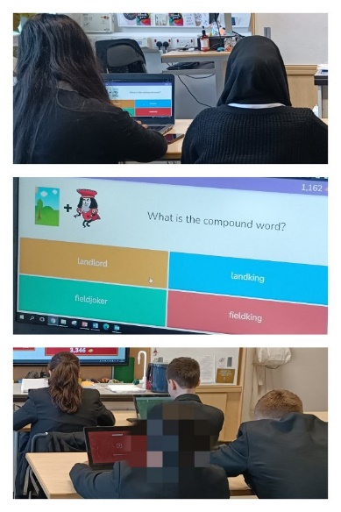
English for speakers of other languages (N3, 4 & 5)
Course Content:
The main purpose of the course is to develop the skills of reading and writing, listening and speaking in order to understand and use English. It is aimed at learners whose first language is not English,
The course will explore three contexts: everyday life, work and study. Within each context, themes and topics are personalised to meet the needs of candidates and learners will develop the four skills of reading, writing, listening, and speaking. Learners can expect to explore topics such as family, hobbies and interests, local community and ambitions.
The ESOL for Everyday Life unit develops the language skills needed for everyday life in familiar personal, social and transactional contexts.
The ESOL in Context unit develops the language skills needed for familiar work and study-related contexts.
Assessment Overview:
N4 learners will undertake in-class assessments throughout S3 & S4 and an Added Value Unit
N5 learners will complete a spoken performance assessment (30% of final grade)
N5 learners will undertake a final exam consisting of 3 papers: Reading, Writing and Listening. (70% of final grade)
Learning and Career Pathways:
Learners passing N4 can progress to study N5
Some universities and colleges will accept an ESOL qualification in place of an English qualification at the same level.
Key Skills:
Literacy (Reading, Writing)
Communication (Talking, Listening)

Slide 10
French (N4 & N5)
Course Content:
The course is made up of two mandatory units - Understanding Language and Using Language - which, taken together, include the four language skills: Reading, Writing, Talking & Listening.
Topic 1 – “Society” – Family & Friends, Leisure, Health & Well-being
Topic 2 – “Learning” – Education systems in Scotland and French speaking countries
Topic 3 – “Employment” – Jobs, Work Experience, Future Plans, Applying for jobs & Job interviews in French
Topic 4 – “Culture” – Is embedded across the whole course
Assessment Overview:
French is assessed across the four language skills with equal weighting of 25% for each skill area.:
Talking is assessed by the class teacher during the Spring Term.
Listening, Reading and Writing are assessed during the final SQA exam diet.
N4 learners will undertake in-class assessments throughout S3 & S4.
Learning and Career Pathways:
Learners passing N5 can progress to study Higher French
A qualification in French is an asset in many career pathways such as tourism & hospitality, international business, law and primary teaching.
Key Skills:
Communication (Talking, Listening)
Literacy (Reading, Writing)

Slide 11
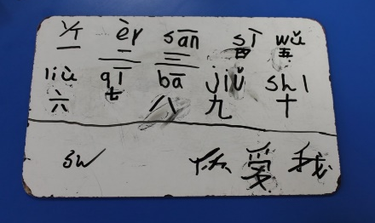
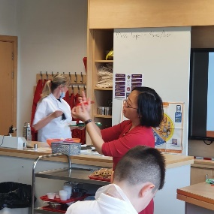
mandarin (N4 & N5)
Course Content:
Learners will study the following four units over S3 and S4:
Society Family and Friends (physical descriptions, personal details and nationalities); Lifestyle (food and health & wellbeing); Language Learning (languages and reasons for learning languages)
Culture (holidays and about special events in China)
Learning (school, further education and future plans)
Employability (job applications and to discuss different areas of employment)
Each topic will make use of all four language skills, listening, reading, speaking and writing, in Mandarin
Assessment Overview:
Mandarin is assessed across the four language skills with equal weighting of 25% for each skill area.:
Talking is assessed by the class teacher during the Spring Term.
Listening, Reading and Writing are assessed during the final SQA exam diet.
N4 learners will undertake in-class assessments throughout S3 & S4.
Learning and Career Pathways:
Learners passing N5 may be able to progress to study Higher Mandarin
The ability to communicate effectively in Mandarin provides an advantage across multiple career areas including business, tourism and travel, sales and marketing, politics and hospitality.
Key Skills:
Communication (Talking, Listening)
Literacy (Reading, Writing)

Slide 12
Modern languages for life & work (N4)
Course Content:
Our ‘Modern Languages for Life and Work Award’ allows learners’ to develop language and employability skills through studying one or two new modern languages in practical and relevant contexts.
Learners gain a greater understanding of their own and other cultures by studying contexts such as society, culture and employability, contributing to their development as global citizens and helping to equip them for life and work in the ever-changing global marketplace.
This qualification covers areas such as communication, self-awareness, confidence and collaborative and independent learning, developing skills that can be applied in life and work.
Assessment Overview:
To achieve the Modern Languages for Life and Work Award, pupils must pass all the required unit outcomes, which are assessed on an ongoing basis throughout S3.
Modern Languages for Life Purposes (Talking & Reading Assessment)
Modern Languages for Work (Talking & Listening Assessment)
Building Your Own Employability Skills (Independent Research & Employability Tasks)
Learning and Career Pathways:
Learners passing N4 will be able to progress to an N4 qualification in French.
The award develops valuable skills for a wide variety of careers including those in travel and tourism, hospitality, culture, sales & marketing and logistics.
Key Skills:
Communication (Talking, Listening)
Literacy (Reading, Writing)

Slide 13
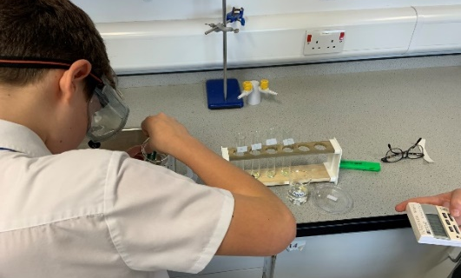
BIOLOGY (N4 & N5)
Course Content:
In Biology, there are 3 units of study: Cell Biology, Multicellular Organisms and Life on Earth. Across these three units, learners will study structure of cells, biological processes, ecosystems, genetics and inheritance
N5 learners will develop their understanding of reproduction; variation and inheritance; plant and animal transport systems; photosynthesis; energy in ecosystems; food production and evolution of species.
Key Skills:
Practical laboratory skills
Numeracy
Problem Solving
Assessment Overview:
N4 learners will undertake in-class assessments throughout S3 & S4.
N5 learners will complete an externally assessed SQA exam at the end of S4.
All learners will undertake regular formative & summative assessments including an S3 exam and S4 prelim.
Learning and Career Pathways:
Learners passing N5 can progress to study Higher Biology.
Some learners may choose to undertake a Foundation Apprenticeship in Scientific Technologies or Social Services & Healthcare.
Biology is used in a variety of careers such as medicine, nursing, healthcare, agriculture, teaching, laboratory technicians, sports science as well as the vast industry of biotechnology.

Slide 14
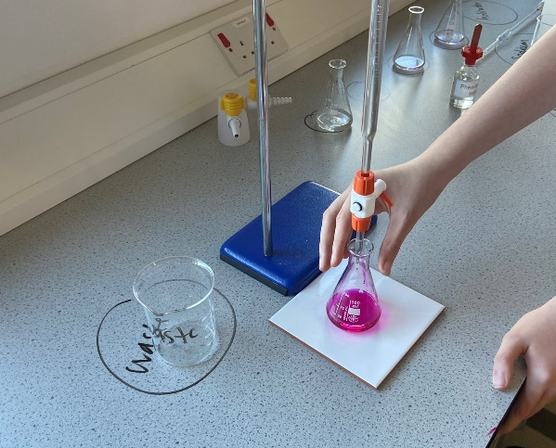
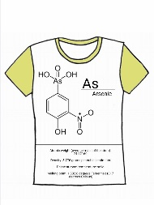
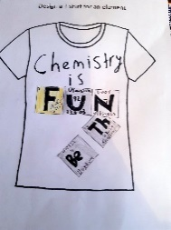
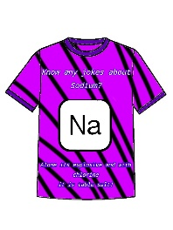
CHEMISTRY (N4 & N5)
Course Content:
Chemistry is studying of the chemical processes, chemical make up and natural interactions between materials that create the products and world around us. Learners will study three units: Chemical Changes, Nature’s Chemistry and Chemistry in Society. Between these units you will study Atomic Structure, Chemical Reactions, Acids and Alkalis, Global Warming and its effects, Metals & Alloys and Nuclear Chemistry
Key Skills:
Practical laboratory skills
Numeracy
Problem Solving
Learning and Career Pathways:
Learners passing N5 can progress to study Higher Chemistry.
Some learners may choose to undertake a Foundation Apprenticeship in Scientific Technologies.
Chemistry is required for many careers including: Medicine, Nursing, Dentistry, Pharmacology, Veterinary Science, Forensic Science, Food Technology, Brewing, Agriculture, Textiles, Environmental Science, Plastics & Engineering.
Assessment Overview:
N4 learners will undertake in-class assessments throughout S3 & S4.
N5 learners will complete an externally assessed SQA exam at the end of S4.
All learners will undertake regular formative & summative assessments including an S3 exam and S4 prelim.

Slide 15
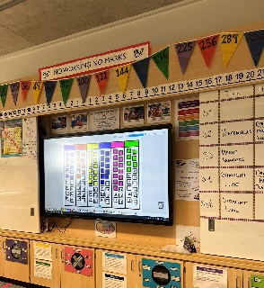
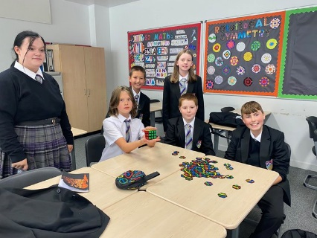
Mathematics (N5)
Course Content:
In Mathematics, learners will work through three units of work; Expressions and Formulae, Relationships and Applications. Between all three units learners will cover aspects of number, algebra, geometry, trigonometry and statistics, with some of this being in real life contexts.
Key Skills:
Numeracy
Problem Solving
Data Analysis
Assessment Overview:
N4 learners will undertake in-class assessments throughout S3 & S4.
Learners following this pathway may also be given the opportunity to gain a National 5 Numeracy stand-alone award.
N5 learners will complete an externally assessed SQA exam at the end of S4.
All learners will undertake regular formative & summative assessments including an S3 exam and S4 prelim.
Learning and Career Pathways:
Learners gaining an A or B award at National 5 Mathematics may be able to progress into Higher Mathematics.
Some learners may choose to undertake a Foundation Apprenticeship in Accountancy, Financial Services, Engineering or Software Development.
The skills and knowledge gained in Mathematics are useful in many scientific, technological, engineering and mathematical (STEM) contexts.

Slide 16
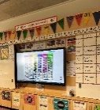
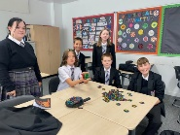
Applications of Mathematics (N4 & N5)
Course Content:
In Applications of Mathematics, learners will work through three units of work: Geometry and Measure; Finance and Statistics and Numeracy. Much of this will be taught with a real life context. As learners tackle real-life problems, they will decide what numeracy skills to use and how to apply those skills to an appropriate level of accuracy. Learners will use their solutions to make and explain decisions.
Learning and Career Pathways:
Learners gaining an aware in N5 Applications of Mathematics may be able to progress to National 5 Maths
Please note that an award in National 5 Applications of Mathematics would not lead directly into Higher Mathematics.
Some learners may choose to undertake a Foundation Apprenticeship in Accountancy, Financial Services, Engineering or Software Development.
The skills and knowledge gained in Mathematics are useful in many scientific, technological, engineering and mathematical (STEM) contexts.
Assessment Overview:
N4 learners will undertake in-class assessments throughout S3 & S4.
Learners following this pathway may also be given the opportunity to gain a National 5 Numeracy stand-alone award.
N5 learners will complete an externally assessed SQA exam at the end of S4.
All learners will undertake regular formative & summative assessments including an S3 exam and S4 prelim.
Key Skills:
Numeracy Problem Solving Data Analysis

Slide 17
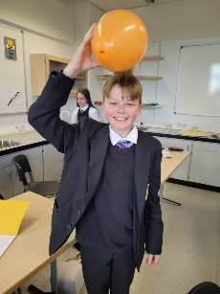
PHYSICs (N4 & N5)
Course Content:
Physics, simply put, is the study of the universe and everything in it. Physics looks at the natural, human made and atomic processes and structures that allow all life to happen.
N4 & N5 learners will study three units: Waves & Radiation, Dynamics & Space and Electricity & Energy. Between these units you will study wave behaviours, nuclear Physics, Forces and space, interstellar travel, simple and complex circuit building and theory and the theory of thermodynamics.
Key Skills:
Practical laboratory skills
Numeracy
Problem Solving
Learning and Career Pathways:
Learners passing N5 can progress to study Higher Physics.
Some learners may choose to undertake a Foundation Apprenticeship in Engineering or Software Development.
Physics is important for many careers in the Health Service such as Physiotherapy, Radiography and Medicine, as well as other careers such as Telecommunication, all types of Engineering - Electronic, Civil, Aeronautical, Software – computer design and many more related careers. All these careers are in high demand.
Assessment Overview:
N4 learners will undertake in-class assessments throughout S3 & S4.
N5 learners will complete an externally assessed SQA exam at the end of S4.
All learners will undertake regular formative & summative assessments including an S3 exam and S4 prelim.

Slide 18
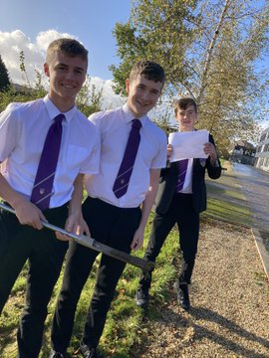
Geography (N4 & n5)
Course Content:
Learners will develop their skills and knowledge about the following areas: map and GIS skills; the changes and challenges facing cities in Scotland and around the world; how and why weather varies across the UK; how to interpret synoptic charts to forecast the weather; the causes and impacts of Climate Change; how glaciation has shaped Scotland’s landscape and how its dramatic coastline was formed; population and global food production.
Learners will also select a second global topic together with their teacher.
Assessment Overview:
There will be regular assessments throughout S3 and S4 to monitor progress.
National 4:
Individual Assignment
In-class assessments
National 5:
Individual Assignment (20% of final mark)
SQA examination
Learning and Career Pathways:
Learners achieving a pass at National 5 can progress to study Higher Geography
Careers that can lead on from studying Geography include, working in the renewable energy, tourism, and environmental sectors. It can also lead to specialised careers such as meteorology, geoscience, and international development.
Key Skills:
Literacy
Numeracy
Problem-Solving & Analysis
Communication & Teamwork

Slide 19
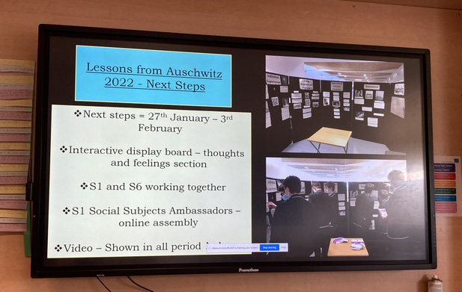
History (N4 & n5)
Course Content:
Free at Last: Civil Rights in the USA
This unit is a study of the development of race relations in the USA from 1918–68. It looks at American immigration and the experience of new immigrants to the USA.; the experience of Black Americans in the southern states and the activities of the Ku Klux Klan.
Changing Britain
This unit explores changes in British society leading up to the First World War whilst offering the opportunity for local history – looking at Barrhead throughout this era. Young people will learn about: health and housing; the changes to industry; the changes in transport methods and the changes to British democracy.
The Scottish Wars of Independence
A study of medieval the society of Kings and Queens and of the English-Scottish wars of the 13th and 14th centuries, illustrating the themes of authority, conflict and identity.
Assessment Overview:
There will be regular assessments throughout S3 and S4 to monitor progress.
National 4:
Individual Assignment
In-class assessments
National 5:
Individual Assignment (20% of final mark)
SQA examination
Key Skills:
Teamwork
Communication
Problem Solving
Learning and Career Pathways:
Learners achieving a pass at National 5 can progress to study Higher History
Careers that can lead on from studying History include, journalism, law, political analyst, business, librarian/archivist, teaching and local heritage worker.

Slide 20
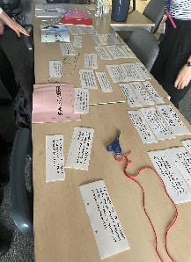
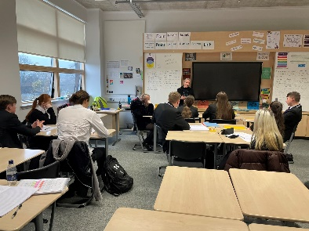
Modern studies (n4 & N5)
Course Content:
Social Issues: using sources of information to make and give straightforward justifications of decisions
Crime and Law within Scotland: the causes of crime, the impact of crime on individuals & society and the role of individuals, the police and the state in tackling crime.
International Issues: a socio-economic and political study of the USA and its political system
Democracy in Scotland and the UK: the institutions and organisations which make up political life.
Assessment Overview:
There will be regular assessments throughout S3 and S4 to monitor progress.
National 4:
Individual Assignment
In-class assessments
National 5:
Individual Assignment (20% of final mark)
SQA examination
Learning and Career Pathways:
Learners achieving a pass a National 5 may be able to progress to study at Higher level
Careers that can lead on from studying Modern Studies include law, police journalism, banking, social work, local government, and civil service.
Key Skills:
Communication
Teamwork
Problem Solving

Slide 21
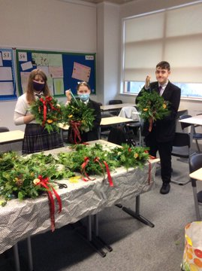
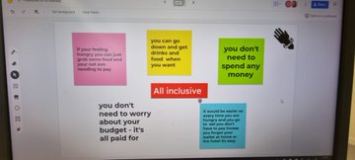
Travel and tourism (N4 & n5)
Course Content:
Learners will develop the skills to deal effectively with all aspects of customer care and customer service in travel and tourism. They will focus on the following topics:
Travel and Tourism in the UK
Customer Service
Travel and Tourism in Scotland
Employability Skills
Key Skills:
Communication
Numeracy
Digital Literacy
Creativity
Enterprise
Assessment Overview:
Pupils will be assessed throughout the course. There will be a combination of project work, role-play and more formal assessments.
Learners will also have the opportunity to gain a People and Society award at N4
Learning and Career Pathways:
Pupils gaining an award at National 4 will be able to progress to National 5.
Pupils gaining an award at National 5 will be able to progress to NC and HNC courses at college.
Careers that can lead on from studying Travel and Tourism include cabin crew, hotel and restaurant management, resort rep, tour guide, and travel agent.

Slide 22
Art & design (N4 & n5)
Course Content:
Expressive
This unit focuses on analysing the factors influencing artists and producing creative ideas for expressive art work. It concentrates on your ideas and imagination, your observational skills and your ability to explore and handle a variety of media (charcoal, inks, pastel, paint, etc).
Design
This unit focuses on analysing the factors influencing designers and design practice and on producing creative design ideas and development work for a design brief. It concentrates on problem solving and experimental ideas and solutions in response to a design brief. This can include computer generated work.
Assessment Overview:
National 4:
Learners must pass 3 Units during in-class assessments
National 5:
Design Folio (40% of final grade)
Expressive Folio (40% of final grade)
SQA examination (20% of final grade)
Learning and Career Pathways:
Learners achieving a pass at National 5 can progress to study Higher Art & Design
Some learners may choose to undertake a vocational design course in S5/6.
Careers that can lead on from studying Art & Design include: graphic design; fashion design, architecture; product design; animation; interior design; make-up
Key Skills:
Creativity
Communication & Teamwork
Digital Literacy

Slide 23
Drama (N4 & n5)
Course Content:
This is a practical course in which learners will develop their drama skills as well as increasing their knowledge and understanding of putting together a theatre production. Learners will work on a variety of devised and scripted pieces of drama and all learners choosing this course will be expected to perform in front of an audience.
Unit 1 – Drama Skills
Learners will respond to stimuli, generate ideas and use a range of drama skills to portray character in a presentation.
Unit 2 – Production Skills
Learners will work with others to develop ideas for performance as an actor or in a production role. Production roles include the following: acting, costume design, hair and make-up design, props design, set design, lighting design and sound design.
Assessment Overview:
There will be regular assessments throughout S3 and S4 to monitor progress.
National 4:
In-class assessments & Added Value Unit
National 5:
Practical Assessment (60% of final grade)
SQA examination (40% of final grade)
Key Skills:
Teamwork Communication
Creativity Resilience
Learning and Career Pathways:
Learners achieving a pass at National 5 can progress to study Higher Drama
Career pathways involving drama skills include: acting; directing script writing; TV/theatre production; costume design; sound engineer; lighting designer; education; radio; drama therapy and more.

Slide 24
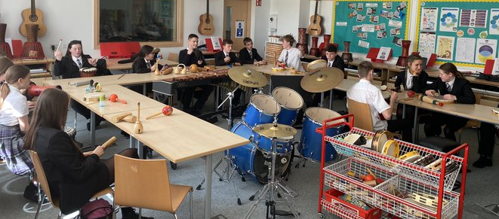
Music (n4 & N5)
Course Content:
Performing Skills
Learners will develop performing skills on two selected instruments, or on one selected instrument and voice.
Composing Skills
Learners will use knowledge of music styles and concepts when creating their own music.
Understanding Music
By listening to a range of music and music styles, learners will develop their understanding of level-specific music concepts. They will develop the ability to distinguish between different music styles and sounds
Assessment Overview:
National 5
Practical Performance (50% of final grade)
Composing Assignment (15% of final grade)
SQA Examination – Listening (35% of final grade)
Learning and Career Pathways:
Learners achieving a pass a National 5 may be able to progress to study at Higher level
Careers that can lead on from studying Music include musician, actor, sound engineer, theatre manager, director, teacher, music therapist and more.
Key Skills:
Communication
Creativity
Resilience

Slide 25
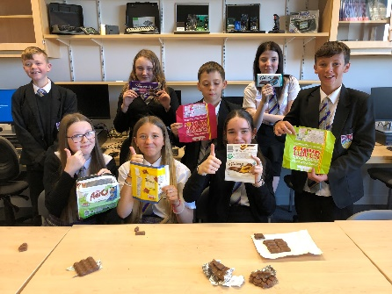
Administration & IT (N4 & n5)
Course Content:
Learners will develop their IT skills using the following packages:
Microsoft Access, Excel, Powerpoint, Outlook & Word
Google Docs, Slides & Sheets
Pupils will also learn about Administration in the workplace and will cover the following theory topics: Customer Care; Health & Safety in the Workplace; File Management; Electronic Communication; Corporate Image and Features of Software.
Assessment Overview:
There will be regular assessments throughout S3 and S4 to monitor progress.
National 4: To achieve the National 4 Administration and IT course, learners must pass all of the required Units, including the Added Value Unit. Learners will undertake these in-class assessments throughout S3 and S4.
National 5: To achieve the National 5 Administration and IT course, learners must complete an assignment in March of S4 and sit a final exam in May of S4.
Key Skills:
Digital Literacy
Using spreadsheets, databases, word-processing & desktop publishing
Using technology for electronic communication and investigation
Problem-solving skills in administrative contexts
Learning and Career Pathways:
Learners achieving a pass at National 5 can progress to study Higher Administration & IT
A qualification in this subject is useful in careers in IT, Office Administration and Management, retail, travel and tourism, leisure industry, public sector work …the list is endless!

Slide 26
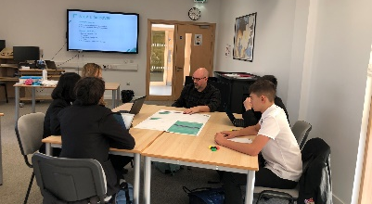
Computing Studies (N4 & n5)
Course Content:
Computer Systems
Learners will develop an understanding of how data and instructions are stored in binary form and basic computer architecture.
Database Design and Development
Learners will apply computational-thinking skills to analyse, design, implement, test and evaluate practical solutions, using SQL code.
Web Design and Development
Learners will apply computational-thinking skills to analyse, design, implement, test and evaluate web pages, using a range of coding languages such as HTML, CSS and Javascript.
Software Design and Development
This unit develops programming and computational-thinking skills by coding practical solutions and explaining how these programs work. They are expected to analyse problems and design, implement, test and evaluate their solutions.
Assessment Overview:
There will be regular assessments throughout S3 and S4 to monitor progress.
National 4: To achieve the National 4 Administration and IT course, learners must pass all of the required Units, including the Added Value Unit. Learners will undertake these in-class assessments throughout S3 and S4.
National 5: To achieve the National 5 Administration and IT course, learners must complete an assignment in March of S4 and sit a final exam in May of S4.
Learning and Career Pathways:
Learners achieving a pass at National 5 can progress to study Higher Computing
There are a huge variety of job prospects for computer scientists including: Test Analyst; Database Developer; ICT Technician; Mobile App Development; Games Designer; 3D Modeller; Software Engineer; Web Design; Graphic Design; Database Administrator
Key Skills:
Digital Literacy
Problem-solving
Creativity

Slide 27
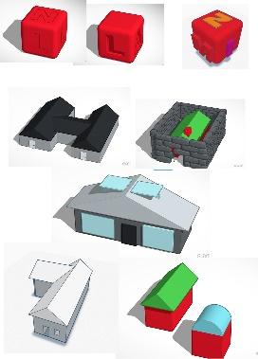
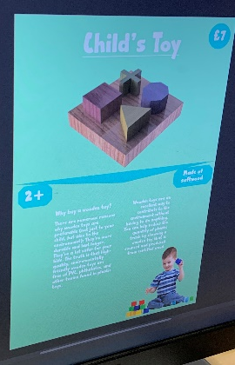
Graphic communication (n4 & N5)
Course Content:
Learners will focus on developing their skills in Computer Aided Design, Desktop Publishing and sketching. This happens naturally by completing a variety of projects designed to create relevant 2D and 3D folio evidence.
Additional topics will include colour theory, design elements & principles and the ability to recognise and justify how they have been used in designs. Learners will use their 3D models to create digital production drawings where they will also learn how to apply British Standards.
Assessment Overview:
National 4
Create evidence and pass 2D unit outcomes and 3D unit outcomes (in-class assessments)
Added value design folio, including preliminary, production and promotional work.
National 5
Learners will complete an 8 hour independent practical assignment/folio – 40 marks
Learners will sit a two hour exam – 80 marks
Key Skills:
Digital Literacy (desktop publishing)
Problem Solving
Creativity (sketching & planning)
Learning and Career Pathways:
Learners achieving a pass a National 5 may be able to progress to study at Higher level
A qualification in this subject is useful in a variety of careers such as Graphic Design, Engineering, Architecture, CAD or Multi-media Technician.

Slide 28
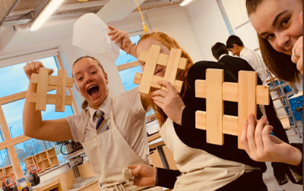
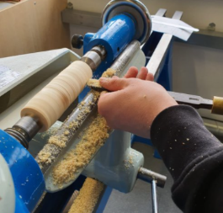
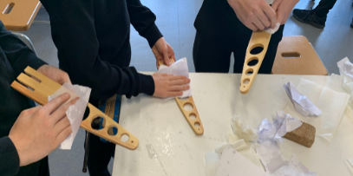
Practical woodworking (N4 & n5)
Course Content:
It is largely workshop-based course, combining elements of theory and practical woodworking techniques.
Learners develop practical psychomotor skills (manual dexterity and control) in a universally popular practical craft.
Learners are introduced to safe working practices and become proactive in matters of health and safety. They learn how to use a range of tools, equipment and materials safely and correctly.
Learners develop skills in reading drawings and diagrams, measuring and marking out, cutting, shaping and finishing materials. They learn how to work effectively alongside others in a shared workshop environment.
Assessment Overview:
There will be regular assessments throughout S3 and S4 to monitor progress.
National 4: To achieve the National 4 Administration and IT course, learners must pass all of the required Units, including the Added Value Unit. Learners will undertake these in-class assessments throughout S3 and S4.
National 5:
Practical Activity – 70 marks (70% of final grade)
SQA Examination – 60 marks (adjusted to 30% of final grade)
Learning and Career Pathways:
Learners achieving a pass at National 5 may choose to progress onto a vocational construction course
This qualification would be useful to learners who wish to pursue a career in engineering, construction or looking for an apprenticeship.
Key Skills:
Creativity
Numeracy

Slide 29
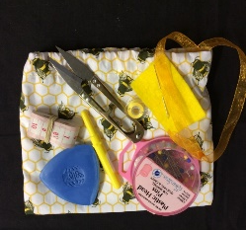
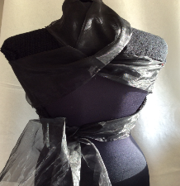
Fashion & Textile technology (N4 & n5)
Course Content:
Textile Technologies
Learners will have the opportunity to make detailed fashion/textile items using a pattern and a range of textile construction techniques.
Fashion/Textile Item Development
Learners will work with a brief to develop solutions for detailed fashion/textile items based on current trends. Learners will plan and make detailed fashion/textile items using quality standards that take into account fashion/textile trends.
Fashion and Textile Choices
Learners will apply knowledge of a range of factors affecting the fashion and textile choices of consumers.
Assessment Overview:
National 4
Learners will be assessed throughout the course on task based learning. Learners must also complete an Added Value Unit.
National 5
Practical Activity – 70% of final grade
SQA examination – 30% of final grade
Learning and Career Pathways:
Learners achieving a pass at National 5 may be able to progress to study at Higher level.
Related careers include: research, development & design; manufacturing; fashion design; buying; sales & marketing; interior design; visual merchandiser and many more.
Key Skills: Creativity; Numeracy; Problem Solving

Slide 30
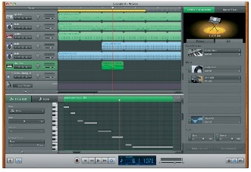
Music technology (N4 & n5)
Course Content:
Music Technology Skills
Practical skills in the use of music technology hardware and software to capture and manipulate audio.
Music Technology in Context
The use of practical skills and musical understanding in at least two different contexts. For example creating music for film or producing a radio show.
Understanding 20th and 21st Century Music
Learners will develop listening skills in the context of 20th and 21st Century Music and how these styles and genres related to music technology.
Assessment Overview:
National 4
To achieve National 4 learners must pass all required units as well as the Added Value Unit. All units will be internally assessed.
National 5
Two Assignment s
SQA examination
Learning and Career Pathways:
Learners may choose to undertake a related music technology course at college
Related career pathways include music production; sound engineering; studio technician; radio presenter/producer; DJ; podcast presenter.
Key Skills: Creativity; Problem-Solving; Digital Literacy

Slide 31
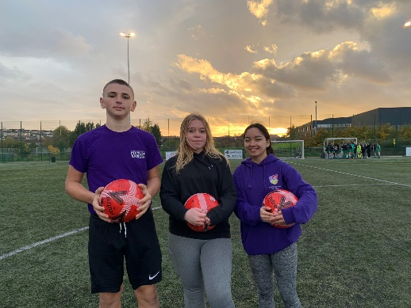
Physical education (N4 & n5)
Course Content:
Learners will work on skill development throughout S3 in a variety of activities including: badminton; basketball; trampolining; gymnastics; athletics; netball; cycling; football; tennis; dance and rugby.
Learners will undertake the following units: Performance Skills and Factors Impacting on Performance.
In S4, learners will work on their Portfolios in theory one period per week. In practical, pupils will complete a PDP (Training programme) which they will write about in their Portfolio.
Assessment Overview:
National 4:
Learners must pass all units during in-class assessments
Learners must complete an Added Value Unit
National 5:
Practical One-off Performance (50% of final grade)
Written Portfolio (50% of final grade)
Learning and Career Pathways:
Learners achieving a pass at National 5 can progress to study Higher Physical Education
Some learners may choose to undertake a vocational design course in Coaching or Fitness in S5/6.
Careers that can lead on from studying PE include: sports coach; fitness intstructor; personal trainer; physiotherapist; sports scientist; nutritionist; teacher and more.
Key Skills:
Communication & Teamwork
Resilience

Slide 32
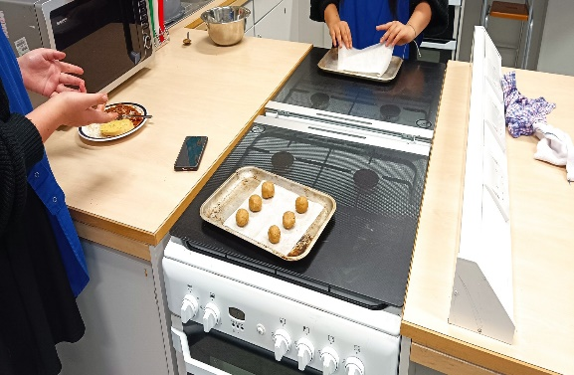
practical cookery (N4 & n5)
Course Content:
Learners will gain an understanding of the importance of food safety and hygiene, using sustainable ingredients and current dietary advice relating to the use of ingredients.
The course includes practical cookery (1 - 2 dishes per week) which will allow learners to develop a range of practical food preparation skills
Cookery Skills, Techniques and Processes:
Learn about cookery skills, food preparation techniques and how to apply these when producing a variety of dishes.
Understanding and Using Ingredients:
You will learn about ingredients from a variety of different sources and of their characteristics. It also addresses the importance of sustainability, the responsible sourcing of ingredients and current dietary advice.
Organisational Skills for Cooking:
Learn about planning, organisational and time management skills.
Assessment Overview:
National 4:
In class assessment and practical assessment (2 course meal)
National 5:
Practical Activity and Assignment (75% of final grade)
SQA examination (25% of final grade)
Key Skills:
Communication
Teamwork
Learning and Career Pathways:
Learners may develop their study of cookery at NC or HNC level at college
A qualification in subject is useful in careers such as: chef or cook; baker; confectioner; bar worker; catering manager; childminder; food counter assistant; food technician; kitchen assistant; restaurant manager; teacher of home economics – secondary.

Slide 33
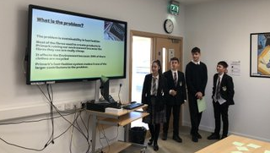
Business management (N4 & n5)
Course Content:
Business Management develops enterprise skills and attributes by providing opportunities to study a range of business and organisational contexts. Pupils learn about the ways which society relies on businesses and other organisations to satisfy its needs and an understanding of how to use business information to interpret and report on overall business performance.
Over the course of S3 and S4, learners will develop their understanding of: Understanding Business; Marketing; Operations; Human Resources; and Finance.
Learners will also complete an assignment which involves choosing a topic from the course as well as a real-world organisation which they will research independently.
Assessment Overview:
National 4
To achieve the National 4 Business award, learners must pass all the required Units, including the Added Value Unit.
National 5
Assignment (25% of final grade)
SQA examination (75% of final grade)
Learning and Career Pathways:
Learners achieving a pass at National 5 may choose to progress on to study Higher Business Management
Some learners may choose to undertake a Foundation Apprenticeship in Business or Financial Services
This qualification would be useful to learners who wish to pursue a career in marketing; human resources; investment banking; teaching and more.
Key Skills:
Numeracy Enterprise
Problem Solving Digital Literacy

Slide 34
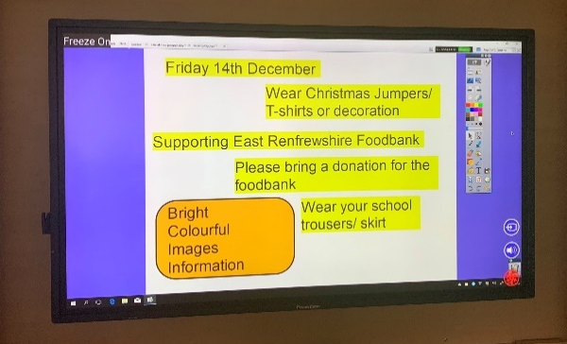
Personal development (SCqf 4 & 5)
Course Content:
The Personal Development course aims to help pupils to become more independent and to develop their potential as contributing members of society.
Learners will work on a range of projects to develop skills including: self-awareness and self-evaluation; interpersonal skills and working with others; task management skills and planning, target setting and reviewing.
Learners will complete the following four units:
Self Awareness
Self and the Community
Self and Work
Practical Abilities
Assessment Overview:
There is no external exam for SCQF Level 4 or SCQF Level 5.
Pupils will be assessed at appropriate points throughout the course. A folio of evidence will be gathered to demonstrate that the pupil has met the required standard. Peer and self-assessment will be included as well as teacher assessment.
Key Skills:
Communication & Teamwork
Problem Solving
Digital Literacy
Learning and Career Pathways:
Learners achieving a pass at Level 4 or 5 may progress on to Level 5 or 6.
This qualification would be useful to learners who wish to pursue a career in marketing; human resources; investment banking; teaching and more.

