Slide 1

The Duke of Edinburgh – Bronze Award
Parents’ & Carers’ Information Evening
19th Sept 2019

Slide 2

The Benefits

Slide 3

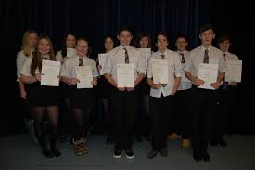
Benefits
New skills and confidence relevant to work
Recognition for things that you do
Valued by employers, colleges and universities (automatic interview for those who have the award with some employers)

Slide 4
The Bronze Award

Slide 5
Bronze Requirements
Skill – 3 months
Volunteering – 3 months
Physical – 3 months
+ an additional 3 months on either one of these.
(You pick which one is undertake for 6 months)
Expeditions – two expeditions (1 Practice – June)
  (1 Assessed – Sept)
  – Both expeditions are for 2 days, 1 overnight.
All three sections (Skills, Volunteering & Physical) must be completed before participants go on expedition.

Slide 6
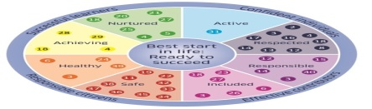
DOFE - 4 sections:
  Skill: Developing practical and social skills and personal interests
  Volunteering: undertaking service to individual or community
  Physical Activity: improving in an area of sport, dance or physical activity
  Expedition: planning, training and completing an adventurous journey
  Top Tip: Try and undertake activities that you are already involved with.

Slide 7
The Skill Section

Slide 8

Skill Section

Slide 9
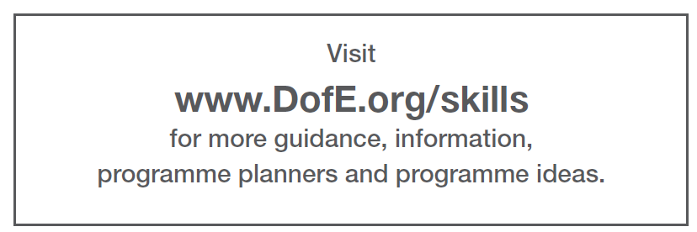
Skill Section

Slide 10
The Volunteering Section

Slide 11
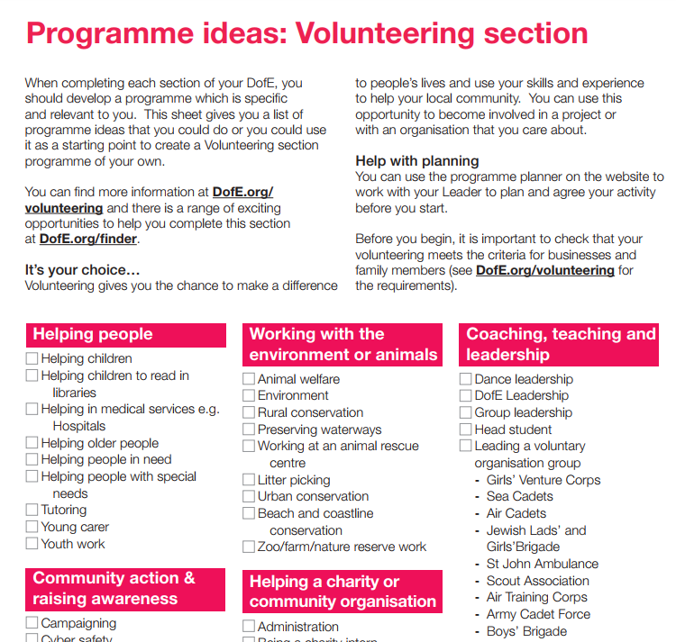
Has to be one of these 5 categories

Slide 12

Volunteering Section
Reminder: You cannot volunteer for a
profit making company.

Slide 13
The Physical Section

Slide 14
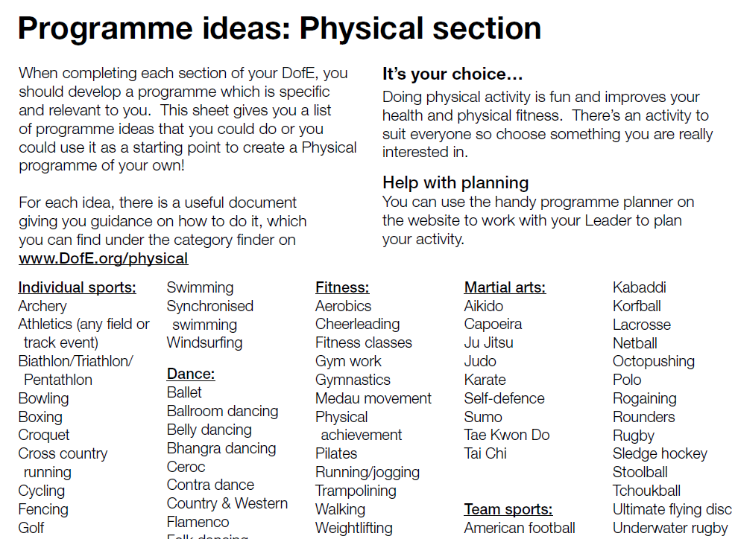
Physical Section

Slide 15

Physical Section

Slide 16
The BEST Section

Slide 17
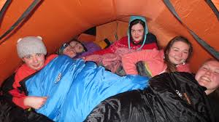
Expeditions
2 expeditions
  Expedition 1 – practice
  Expedition 2 – assessed
Day 1 – Walk approximately 12km using a route card and a map for navigation.
– Camp overnight.
Day 2 – Walk approximately 12km using a route card and a map for navigation.

Slide 18
I want to do DOFE?

Slide 19
I want to do DOFE
Please collect a Registration Form before leaving tonight.
We will be asking for a £22 payment to be made through ParentPay.
  This pays for DOFE registration.
This payment is non-refundable

Slide 20
Registering for DOFE
Please think carefully about signing up for DOFE.
  Don’t sign up just because your friends are!
  Don’t sign up because your parent’s/carer’s tell you to.
  ONLY SIGN UP BECAUSE YOU WANT TO!
Drop out rate – we need to fix this.
(2018-19 – 50% of students that signed up, dropped out)

Slide 21
Completing the Bronze DOFE Award

Slide 22
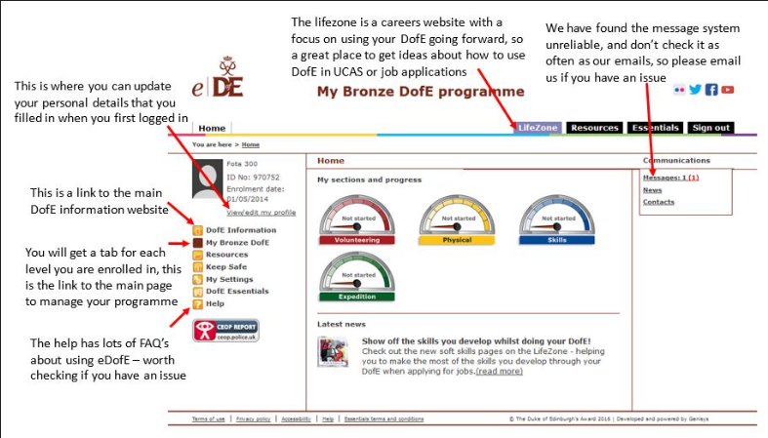
Completing the DOFE Award

Slide 23
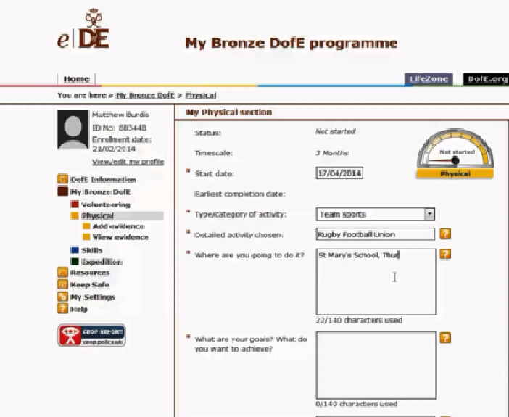
Completing the DOFE Award

Slide 24
Completing the DOFE Award
Each of the three sections (Skill, Physical and Volunteering) require:
An HOUR of activity, per section, per week.
Your evidence has to be uploaded into your eDOFE account.
As a minimum:
a. Students must have a piece of text FOR EACH WEEK OF ACTIVITY. This should explain what you undertook
AND
b. FOUR photographs per section
AND
c. An Assessor’s report per section

Slide 25
Completing the DOFE Award
ONCE YOU ARE REGISTERED AND HAVE ACCESS TO YOUR EDOFE ACCOUNT, students should:
1. Decide what activities you plan to undertake to fulfil each section.
Check that your activity is recognised by DOFE – using the DOFE Programme Ideas PDF
3. Identity an adult who can assess your activity:
a. This maybe a teacher or volunteer in the community
b. An Assessor CANNOT be a family member or family friend.

Slide 26
Completing the DOFE Award
4. Login to your EDOFE account, and enter in the dates, aim and Assessor’s details INCLUDING TELEPHONE NUMBER AND EMAIL ADDRESS
5. You then submit each section for Approval
6. Once approved by me, you can then start gathering your weekly evidence.
7. Target: Be ready to start gathering evidence by the end of October.

Slide 27
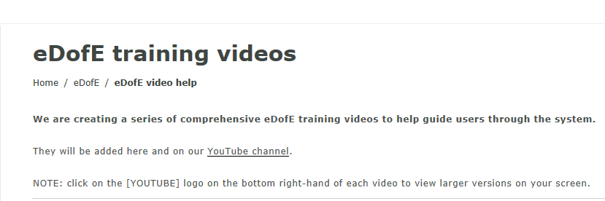
Completing the DOFE Award
https://www.dofe.org/leaders/edofe/edofe-video-help

Slide 28
Gathering Evidence

Slide 29
Gathering Evidence
You can gather evidence in two ways:
Login into https://m.edofe.org/ on your mobile.
This is the quickest way to upload photographs and text as evidence.
Or
2. Login to eDOFE and upload you evidence using a PC.

Slide 30
Nearing the End
(of your DOFE Award, not this presentation!)

Slide 31
Nearing the end of your Award
For each piece of evidence (text or photograph):
I need to authorise/approve it.
Having now completed either 12 weeks or 24 weeks, you now need to ask your assessor for an “Assessor’s Report”

Slide 32
Assessor’s Reports

Slide 33
Assessor’s Report
Your Assessor now needs to confirm that you have met your aim:
You should give your Assessor the following details:
i: Your eDOFE ID Number (e.g. 1645536)
ii: Your Level (e.g. BRONZE)
iii: The section they are assessing (e.g. Skill)
iv: And ask them to enter their report online here:
https://www.edofe.org/assessor

Slide 34
Assessor’s Report
3. The Assessor’s Report does not need to be too lengthy – a paragraph is fine.
Be aware:
Your assessor can be contacted to confirm that you have completed all the work that you are evidencing.
5. You need an Assessor’s Report for each section.
https://www.edofe.org/assessor

Slide 35
What I need from you

Slide 36
Commitment
Participants must:
  Attend the weekly/fortnightly meetings at lunch time or after school.
    We will meet every two/three weeks throughout the winter at lunch time.
    Once the better weather returns we will meet after school, for an hour, to complete all the camp craft activities (putting up tents, trangia stove cooking, navigation, First Aid etc)
  commit to your chosen activities
  log your evidence regularly online

Slide 37
Commitment
By the end of MAY 2020, you should have:
1. Both 12-week sections fully complete..
(i.e. 12 paragraphs, 4 photos and an assessor’s report.)
2. You should also be more than half-way with your 6-month section.
(i.e. 12 paragraphs & 2 photos).

Slide 38
Additional Recognition

Slide 39
Additional Recognition
With the volunteering section, you/we can apply for a Saltire Award if you complete a minimum of 15 hours of volunteering:
More information here:
https://saltireawards.org.uk/

Slide 40
Further Costs

Slide 41
Further Costs
£22 Fee (Registration Fee – already discussed )
Expedition 1 – Practice = Approx £30
Expedition 2 – Assessed = Approx £25
(The expedition costs are:
Hiring minibus and transit vans, diesel, gas for stoves, Assessor’s fee, Assessor’s Expenses, Train Fares, Equipment Rental Fee (£10), Sundries, Supervising Staff Fees & Expenses).

Slide 42
Further Costs
Walking Boots - £25 upwards
Midge Net - £6 - £10
Waterproofs - £20 upwards
First Aid Kit - £6 upwards
8. Total Cost - Approx £122

Slide 43
Hiring Expedition Equipment

Slide 44
Hiring Equipment
Students can borrow:
A Tent, Rucksack, Sleeping Bag, Roll Mat and Stove.
i. All Equipment is collected from The Edge (beside ASDA in The Mearns).
ii. Students must hand over a £50 deposit, which is returned when the kit is returned.

Slide 45
Next Parents’ Meeting

Slide 46
Next Parents’ Meeting
I will have another meeting in March to talk through the procedures for the expeditions.

Slide 47
Communicating with students

Slide 48
Communication
Google Classroom DOFE Group:
BHS Duke of Edinburgh (2019-20)S3 & S4
All information will posted on our DOFE Google Classroom.
To access:
1. Students should download the Google Classroom app from their app store.
2. When logging in, notice the different email address! (Password is the same as GLOW)
gw08boagstuart2@ER.GLOW.SCOT
Alternatively, students could accept the “invite” that is in their Glow Email.
See Mr Boag if you can’t access this by next week.

Slide 49
Student Meetings

Slide 50
Next Student Meeting
Students should meet in Mr Boag’s room (202) every Thursday lunch time from now on:
Meeting 1: Thursday, 3rd Oct @ 12:30pm
Meeting 2: Thursday, 10th Oct @ 12:30pm
Meeting 3: Thursday, 24th Oct @ 12:30pm
Meeting 4: Thursday, 31st Oct @ 12:30pm

Slide 51
Student Meetings
A register is taken at all DOFE meetings.
If a student misses three meetings, then a letter will be sent home to make parents/carers aware that your child is at risk of being removed from the award.
If a student misses a further two meetings after a letter being sent home, then they would be removed from the award.
Students would still have a DOFE account and could join a community DOFE group.

Slide 52
Well Done!
Any Questions?

