Slide 1
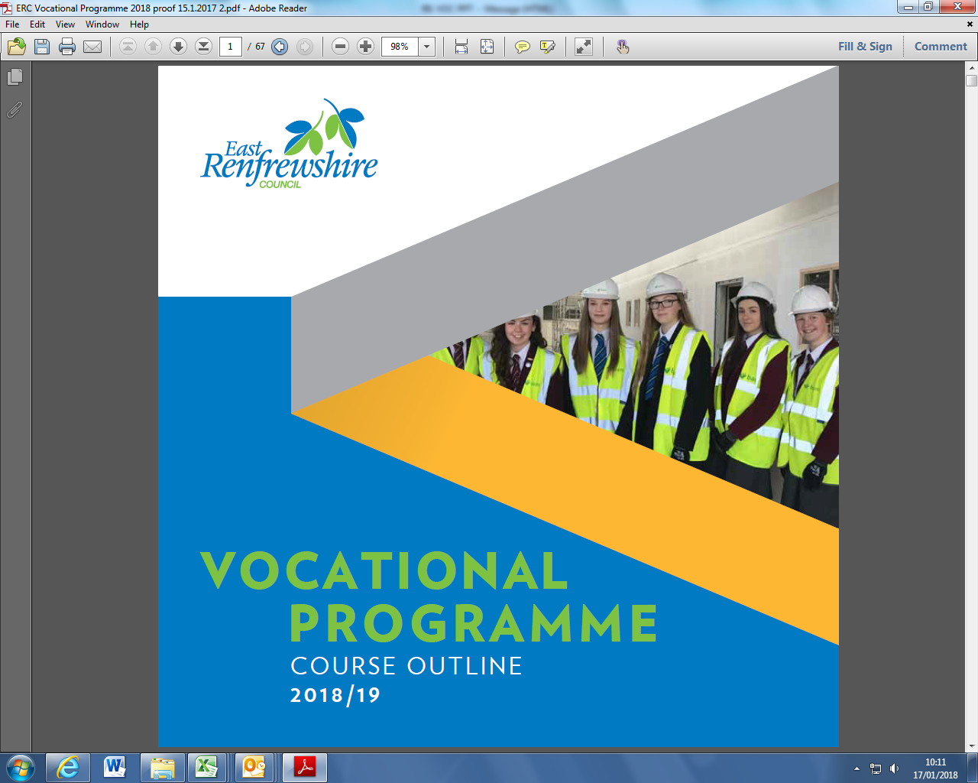
Course Guide 2018/19

Slide 2
Programme Details
2.5 days per week
Monday, Tuesday, Wednesday afternoons, Thursday all day,
2 half days
Tuesday/Thursday afternoons
Friday morning
Periods 1,2,3
Transport provided or travel expenses reimbursed

Slide 3
Programme Details
Opportunity to gain qualifications and practical experience
Most courses run from August to May
Progress reports provided
Attendance/attitude/performance monitored
Courses do not run on school holidays or in-service days.

Slide 4
Benefits of Vocational Courses
Relevant for career / work
Practical
New Environment / opportunity to try college
Treated as an adult (responsibility)
Qualifications – Access, National 4, National 5, National Progression Awards, Higher, National Certificate & University Level 1 & 2

Slide 5
Open to S5 and S6 pupils
some places available to S4

Slide 6
Our Partners
City of Glasgow College
Glasgow Clyde College
Glasgow Kelvin College
West College Scotland
Glasgow Caledonian University
Strathclyde Univeristy
Encroute Catering
Greenhouse Community Café
Neilston Development Trust
U Concept

Slide 7
Courses Available in the following sectors
Access and Continued Learning
Aviation and Travel
Care, Health Life Science & Social Care
Community and Flexing Learning
Construction & Engineering
Creative and Digital Industries & Music
Fashion & Design
Hair and Beauty
Horticulture, Hospitality and Landscaping
Humanities & Social Sciences
Nautical
Personal Development
Sports
Uniformed & Emergency Services
Vehicle Systems

Slide 8
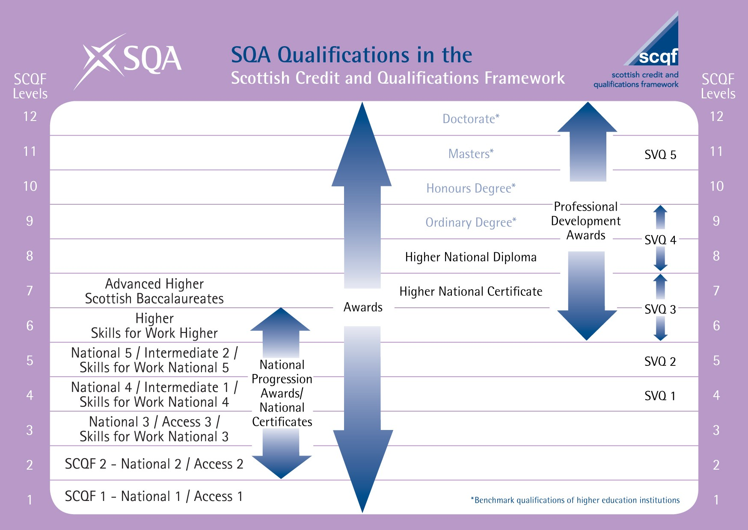

Slide 9
Applying for a course
Register interest with Pupil Support PT
Complete application form, (including parental consent) – see Pupil Support PT
Interview
School report

Slide 10
The Vocational Training Programme booklet can be downloaded from:
http://www.eastrenfrewshire.gov.uk/article/1740/About-our-schools

