Slide 1
Senior Phase Pathways:
Foundation Apprenticeships
Gail Paterson and
Ashleigh Bonnar

Slide 2
What are they?
Same level as Highers
2 year programmes to gain an industry recognised qualification.
Open to pupils starting S5.
Currently 13 frameworks offered by Glasgow and Paisley colleges.
New frameworks being added.
Combine school, college and work placement.

Slide 3
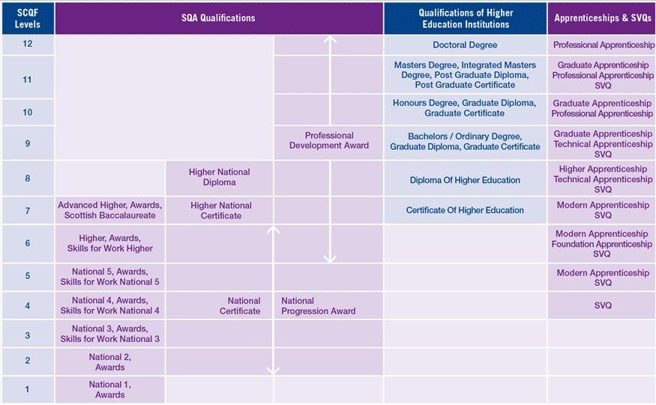
How they compare?

Slide 4
Options Available…

Slide 5
Industry Demand…

Slide 6
How do they work?
Overall
Programme becomes one of your Option choices
Yr. 1: S5
You attend College 2 half days per week
4 days per week in school
Yr. 2: S6
You attend school 3 or 4 days per week
Up to 1 day at college and 1 day per week with an employer

Slide 7
Employer Engagement:

Slide 8
Progression opportunities…
FAST TRACK MODERN APPRENTICESHIP
COLLEGE HNC/HND
EMPLOYMENT
UNIVERSITY
FOUNDATION APPRENTICESHIP

Slide 9
University Recognition:
Inverness
Aberdeen
Dundee
Stirling
Glasgow
Edinburgh
Paisley

Slide 10
Eligibility Criteria?
Students are expected to have an interest in developing greater awareness of the industry with a potential desire to pursue as a career
Students must be capable of working at Level 6 (Higher) over S5 and S6
Some Frameworks require these to include English and Maths
Programme lasts 2 years. No Foundation Apprenticeship qualification or part qualification if participants leave early

Slide 11
Why should I apply?
Industry is telling education that something needs to change
Increasingly jobs require much more than academic qualifications
At the end of S6 you will have gained invaluable industry experience
You will have experienced College Life
You will have gained competitive advantage for routes to employment and/or future learning
You will have an industry designed, led and supported qualification – at Higher Level

