Slide 1
OPTIONS FOR S5/S6 SESSION 2018-2019
Mrs Crawford / Depute Head - Timetabler

Slide 2
STAGE (1) PROCESS
Lessons in Pastoral prior to choices being made
Senior Pupils should be researching independently
Entry requirements – Strathclyde University - Accounts
Minimum grades
Required subjects are indicated following minimum accepted grades.
Highers
1st sitting: AAAA or AAABB (English B, Maths A); 2nd sitting: AAAABBB (English B, Maths A)
Option Sheet issued – progression encouraged
ONE-2-ONE interview with own Pastoral Teacher
Parental signature required on Option Sheet
Initial Process completed by Easter holidays

Slide 3
OPTION SHEET
KAY CRAWFORD – s4 courses | THIS SESSION | NEXT SESSION
ENGLISH | NAT 5 | HIGHER
MATHS | NAT 4 | NAT 5
FRENCH | NAT 5
GEOGRAPHY | NAT 5 | HIGHER
CHEMISTRY | NAT 5
ADMIN & IT | NAT 5 | HIGHER
ART | NAT 5
PHYSICS | NAT 5
PE | NAT 5 | HIGHER
Parental/Carer Signature …………………………………

Slide 4
STAGE (2) PROCESS
Data processed by EMIS Unit
Timetable created during SQA examinations
Pupils/Parents with non-fits interviewed AFTER SQA exams
Consortium Arrangements – studying at another secondary school in ERC – starts August 2018
4 weeks in June – trial time – however important
Interview after SQA results in August – Where??

Slide 5
ADDITIONAL INFORMATION
DOUBLE PERIODS – (5*6=30 ….. 1 PERIOD PASTORAL 2 PERIODS CORE PE = 33)
New S5 - MUST CHOOSE 5 SUBJECTS even if choosing college course
College courses start in August – need something for June
New S6 – MUST CHOOSE 3 OR 4 subjects
Work placements – will be looked at August for S6 pupils

Slide 6
Entry requirements - Business
Minimum grades
Required subjects are indicated following minimum accepted grades.
Highers
1st sitting: AAAB or AABBB; 2nd sitting: AAABBB (English B, Maths National 5B/Intermediate 2; Higher Maths B for combinations with Finance

Slide 7
Entry requirements – primary teaching
Minimum grades
Required subjects are indicated following minimum accepted grades.
Highers
1st sitting: AAAB
2nd sitting: AAABB
Required subjects
Higher English B, plus one from the list below.
Maths National 5 C
Higher Subjects
Art
Drama
Economics
Geography
German
History
Italian
Modern Studies
Music
Philosophy
Politics
Psychology
Religious Moral and Philosophical Studies
Sociology
Spanish

Slide 8
Minimum Entry Requirements – law at Caledonian University
All entry requirements listed here should be used as a guide and represent the minimum required to be considered for entry. Applicants who are made a conditional offer of a place may be asked to achieve more than is stated.
Year 1
SQA Higher: AAABB including English PLUS Nat 5 Maths at C A level: BBB including English/Law PLUS GCSE Maths at C/4 ILC Higher: H1, H1, H2, H3, H3, including English at H2 or above PLUS Maths at O1 IB Diploma: 28 points must include Maths BTEC: Level 3 Extended Diploma in a relevant subject at DDM PLUS A Level English/Law at B PLUS Maths at C/4

Slide 9
NC IN CREATIVE INDUSTRIES
What qualifications do I need?
There's no formal entry requirement. For a place on the course you'll need to attend an informal interview and show that you're interested in the creative industries
HNC IN CREATIVE INDUSTRIES
What qualifications do I need?
You'll need a related NC or similar qualification at SCQF level 6
HND IN CREATIVE INDUSTRIES
What qualifications do I need?
You'll need to have successfully completed HNC Creative Industries: Media and Communication (12 credits) as well as three additional relevant credits

Slide 10
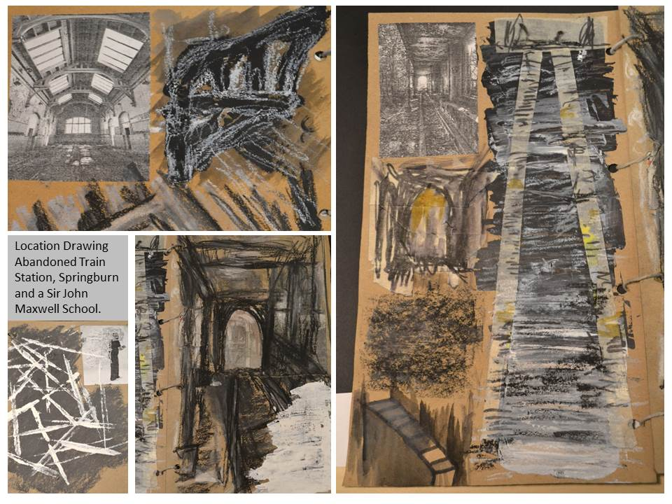
RACHEL BELL
ADVANCE HIGHER ART – WILLIAMWOOD HIGH SCHOOL

