Slide 1
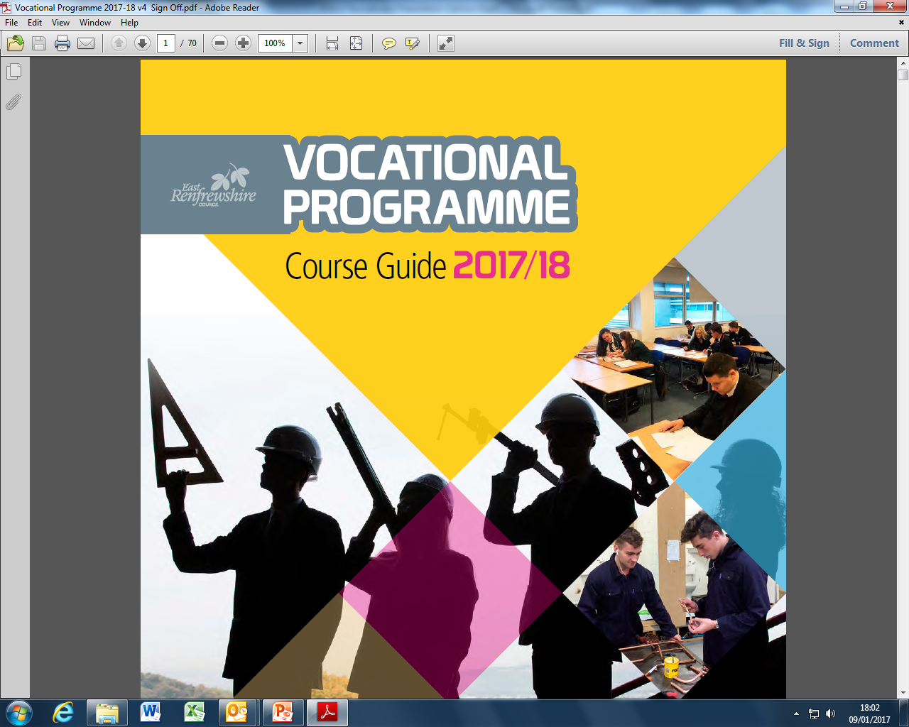

Slide 2
Programme Details
2.5 days per week
Monday, Tuesday, Wednesday afternoons, Thursday all day,
2 half days
Tuesday/Thursday afternoons
Friday morning
Periods 1,2,3
Transport provided or travel expenses reimbursed

Slide 3
Programme Details
Opportunity to gain qualifications and practical experience
Most courses run from August to May
Progress reports provided
Attendance/attitude/performance monitored
Courses do not run on school holidays or in-service days.

Slide 4
Benefits of Vocational Courses
Relevant for career / work
Practical
New Environment / opportunity to try college
Treated as an adult (responsibility)
Qualifications – Access, National 4, National 5, National Progression Awards, Higher, National Certificate & University Level 1 & 2.

Slide 5
Open to S5 and S6 pupils
some places available to S4

Slide 6
Our Partners
Glasgow Clyde College
Glasgow Kelvin College
West College Scotland
Glasgow Caledonian University
Encroute Catering
Neilston Development Trust
Riverside Studios
U Concept

Slide 7
Courses Available:
Access and Continued Learning
ESOL
Animal Care
Animal Care
Aviation & Travel
Airport Operations
Up in the air and on the ground

Slide 8
Courses Available - Cont:
Business & Finance
Accounting
Business Skills
Financial Services
Human Resources and Law

Slide 9
Courses Available - Cont:
Care, Health, Life Sciences & Social Care
Applied Anatomy
Early Education and Childcare
First Aid
Forensic Science
Health and Social Care
Human Body Structure and Function
Introduction to Nursing
Pharmacy Services
Playwork and Childcare
Psychology
Social Services and Healthcare (Adult Services)
Social Services Children and Young people

Slide 10
Courses Available - Cont:
Community and Flexible Learning
Youth Work
Construction & Engineering
Building Services Engineering
Building Services Engineering
Building Services Engineering
Civil Engineering
Construction Crafts
Construction Crafts
Construction Industry Crafts
Construction Management
Construction Skills Certificate Scheme (CSCS)
Engineering Systems

Slide 11
Courses Available - Cont:
Creative, Digital Industries & Music
Computer Games Development
ICT Hardware Systems Support
ICT Software
Photography
Professional Theatre Preparation
Sound Production
Television Production
Urban Music

Slide 12
Courses Available - Cont:
Fashion & Design
Fashion Brand Retailing
Hair & Beauty
Barbering
Hair, Beauty and Make-Up
Hairdressing
Fantasy Make Up
Make-Up Artistry and Beauty Therapy

Slide 13
Courses Available - Cont:
Horticulture, Hospitality & Landscaping
Craft Bakery
Grow Cook and Eat
Introduction to Food Service Skills
Professional Cookery
Shoestring Cookery

Slide 14
Courses Available - Cont:
Nautical
Maritime Skills
Personal Development
Comedy through Confidence
Transitions Programme
Retail
Retailing
Sports
Sport and Recreation: Outdoor Sports

Slide 15
Courses Available - Cont:
Unformed and Emergency Services
Unformed and Emergency Services
Vehicle Systems
Automotive Skills
Cycle Maintenance (Bicycle)
Vehicle Maintenance

Slide 16
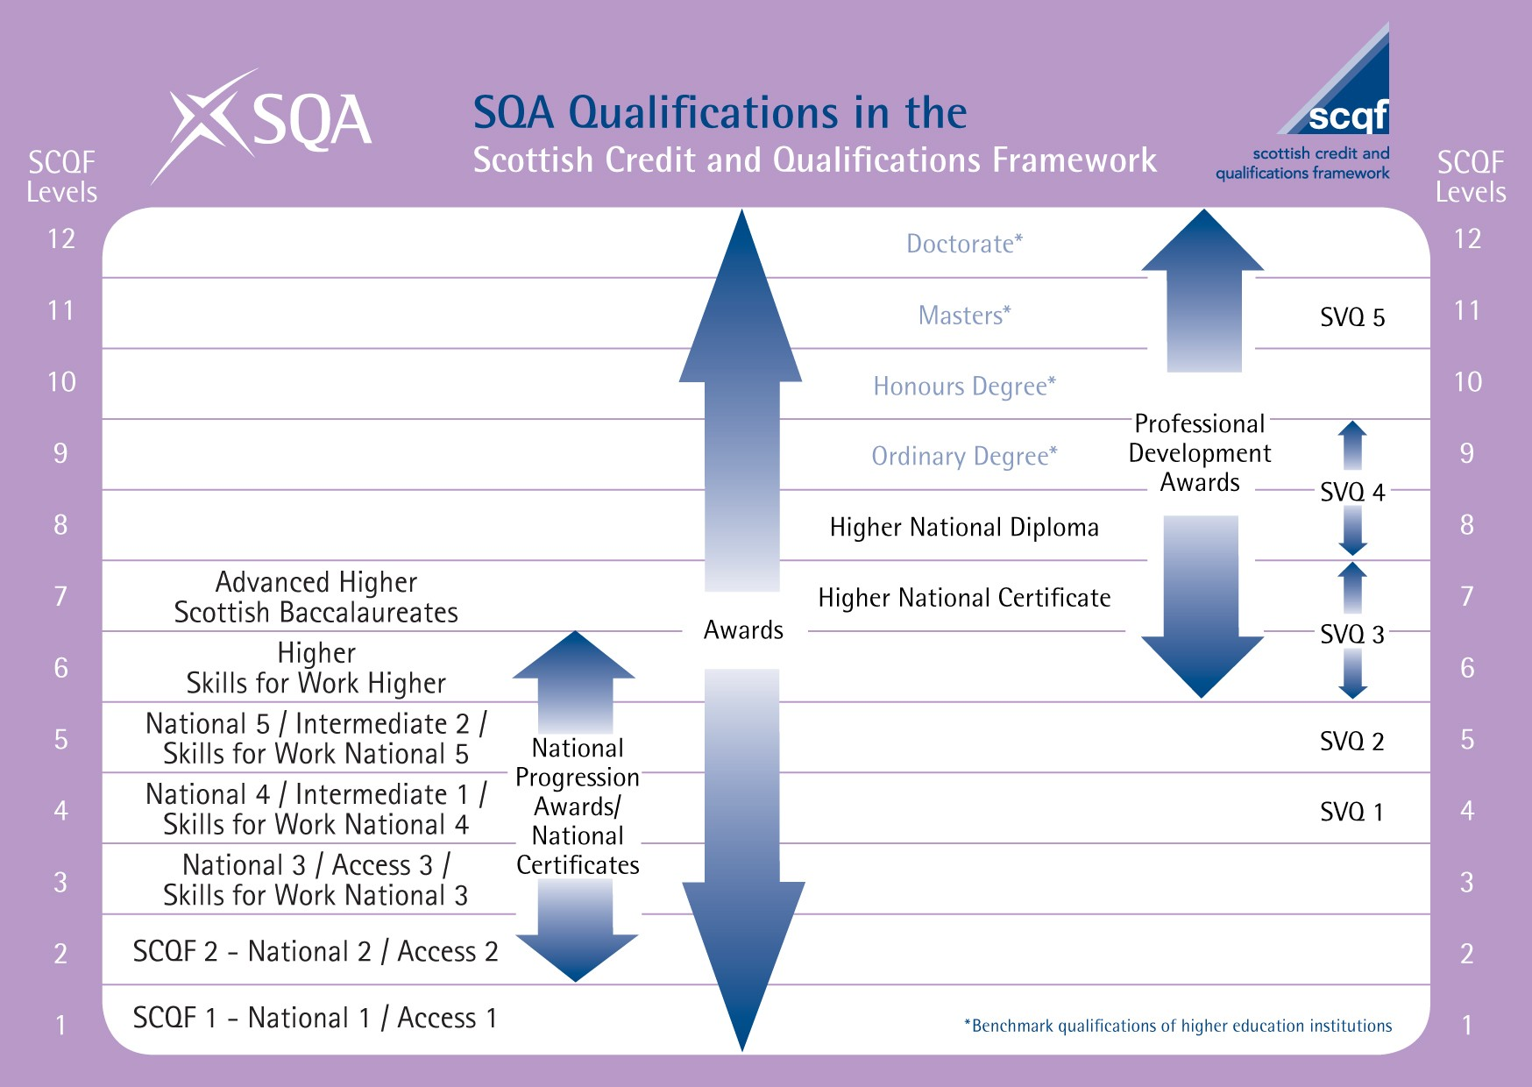

Slide 17
Applying for a course
Register interest with Pupil Support PT
Complete application form, (including parental consent) – see Pupil Support PT
Interview
School report

Slide 18
The Vocational Training Programme booklet can be downloaded from:
http://www.eastrenfrewshire.gov.uk/article/1740/About-our-schools

