Slide 1
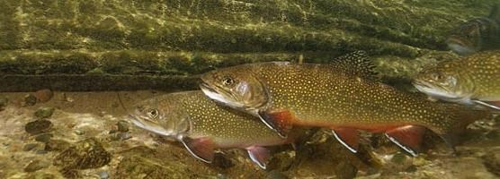
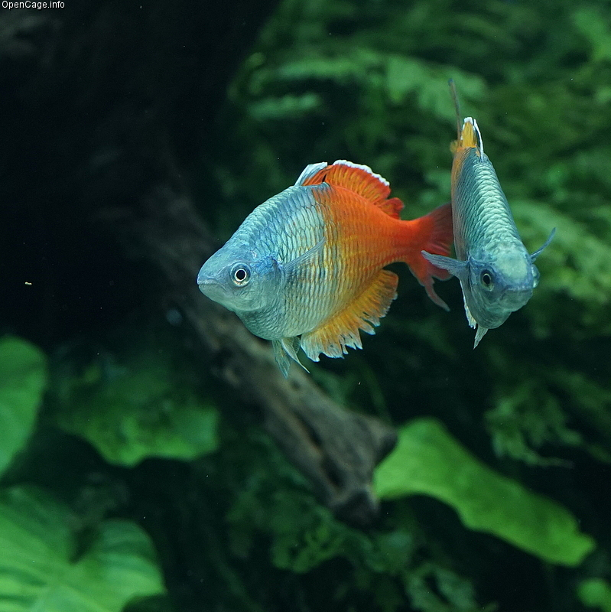
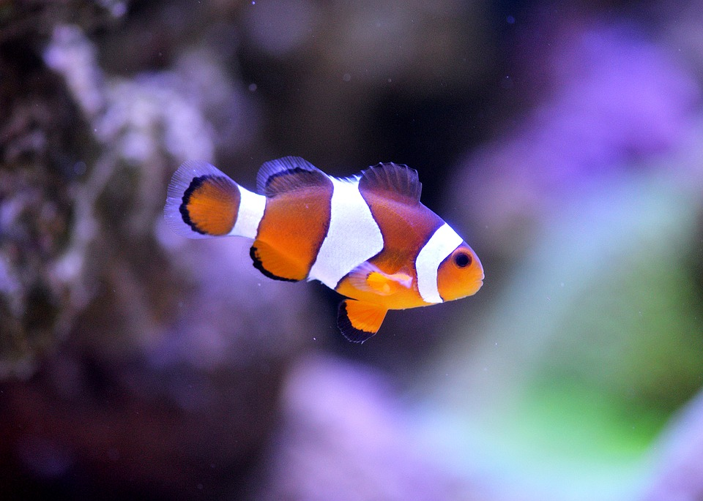
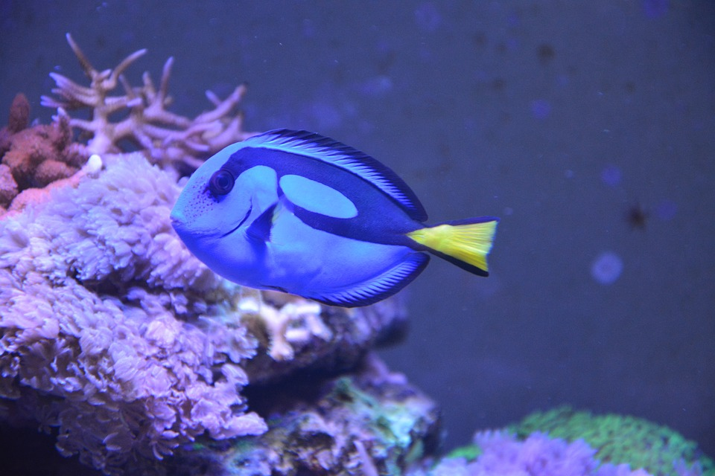
Welcome to our slideshow about our brown trout and how they go through their life !
We hope you enjoy it !
By Ava,Nathan J and Callum

Slide 2
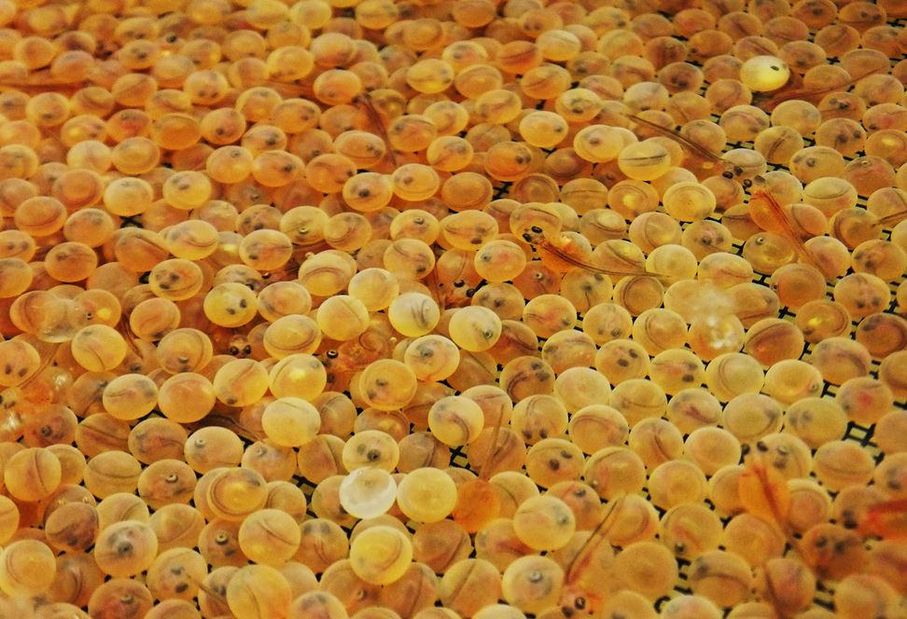
Hatchery
We got the hatchery on Monday the 18th of january. We got the hatchery before the eggs so we could practice getting the temperature correct. The hatchery is a blue fish tank that can transfer water from one tank to the other. The hatchery is split into two parts. One of the tanks is for frozen water, the other is for the eggs and rocks !

Slide 3
Looking after the eggs
We have to check the temperature 3 times a day and if it is higher than 10 degrees, we send someone to get frozen water bottles out a freezer.

Slide 4
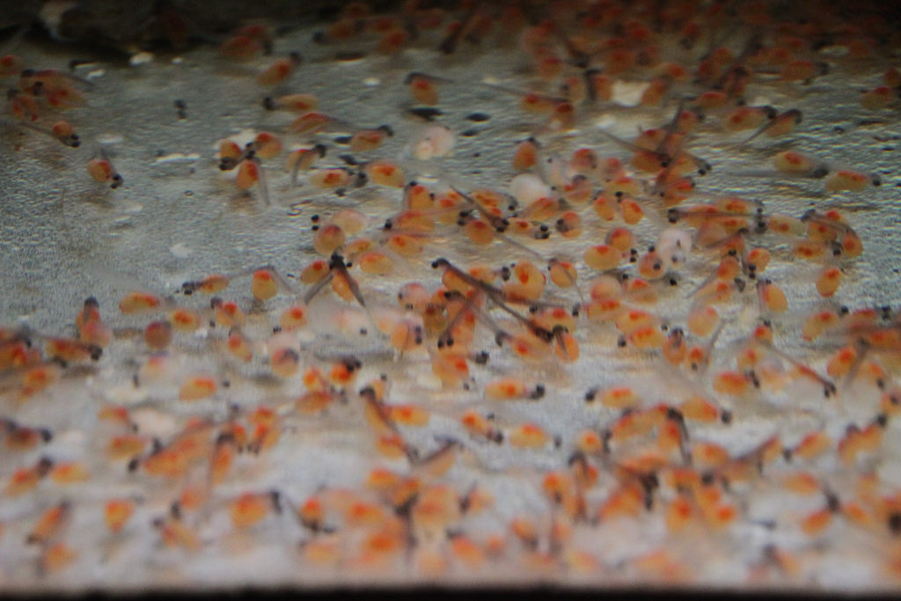
When the eggs came they were tiny and the colour orange with a little black dot in the middle (we got 2 hundred eggs in total). We got them on 31st of January.

Slide 5
In the brown trout life-Cycle they have a lot of different trout to turn into.When you first get them they are eggs then they hatch into Alevin,Fry,Parr,Adult and then Spawning.

Slide 6
Temperature
Every day we needed to check the temperature 3 times a day. If the temperature was 1-7 degrees it would take a long time to hatch. If it is 8-15 degrees it is fine. But if it 16-20 degrees they will die.
It's Time For a QUIZ !!!

Slide 7
QUIZ Time?
HOW MANY TIMES DO WE CHECK THE TEMPRUTURE A DAY?
A.4 TIMES
B. 3 Times
C. 1 Time

Slide 8
Question 2
What colour were the eggs when they came?
A.Yellow
B.White
C. Orange

Slide 9
Question 3
When did we get the hatchery ?
A. Monday 21st January 2019
B. Wednesday 26th October 2018
C. Friday 3rd February 2019

Slide 10
Last question
Where did we go for our trip?
A. Rouken Glen park
B. Aquarium
C. Science Centre

