Slide 1
Use Objects
Problem Solving Strategies

Slide 2
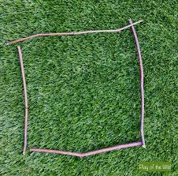
Square
How many sticks
do you need?
You try…

Slide 3
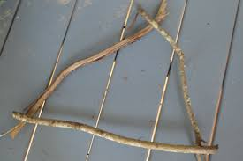
Triangle
How many sticks do you need?
You try...

Slide 4
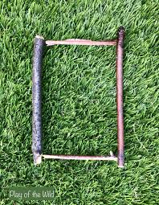
Rectangle
How many sticks do you need
to make a rectangle?
You try…

Slide 5
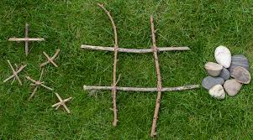
Game
Use 4 sticks and make a
Knots and Crosses grid.
Use stones and pines cones or anything you can find, play Knots and Crosses with someone in your family
The winner is the first person to get three in a row!

