Slide 1

MEARNS CASTLE HIGH SCHOOL ENGLISH DEPARTMENT
National 5 / Higher English
Advice on SQA folio submission

Slide 2
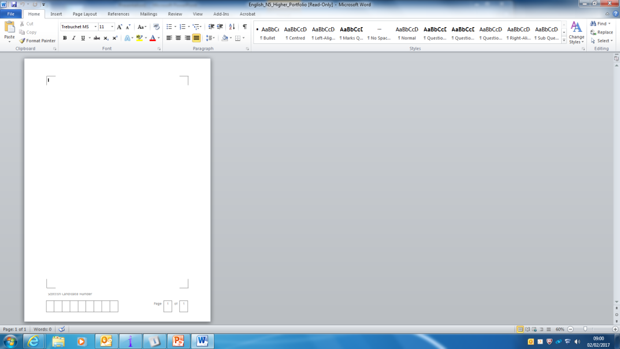
MEARNS CASTLE HIGH SCHOOL ENGLISH DEPARTMENT
SQA FOLIO SUBMISSION - ADVICE
All candidates must submit their folio using the template provided by the SQA
The template can be found as a word document at http://www.sqa.org.uk/sqa/47904.html under the ‘Submitting Coursework’ tab

Slide 3
MEARNS CASTLE HIGH SCHOOL ENGLISH DEPARTMENT
SQA FOLIO SUBMISSION - ADVICE
Candidates can enter their writing onto their folio template in three different ways:
  Typing directly onto the template
  Copying and pasting from a word document
  Printing a blank copy of the template and handwriting their essays (NOT recommended!)
  (The template is set up to allow candidates to enter text in the Trebuchet MS font at 11 point size. It is best to stick with this – if making a change, keep to 11 or 12 point font in an easy-to-read font such as Arial.)

Slide 4
MEARNS CASTLE HIGH SCHOOL ENGLISH DEPARTMENT
SQA FOLIO SUBMISSION - ADVICE
Candidates can either have both essays contained within one template or have essays on separate templates.
Irrespective of which option is chosen, the following is very important:
The start of each folio piece must be clear. (It is best to take a new page for the second essay.)
Pages should be consecutive and noted in the box at the foot of the template. E.g. 1 of 8….8 of 8. The second folio piece should NOT start at 1 again! (IF THIS PROVES VERY PROBLEMATIC, CANDIDATES COULD ENTER PAGE NUMBERS BY HAND.)
The pieces must follow the order of the flyleaf, i.e. broadly creative followed by broadly discursive.
The candidate’s SCN (Scottish Candidate Number must be added to the foot of every page in the template, using the box provided.

Slide 5
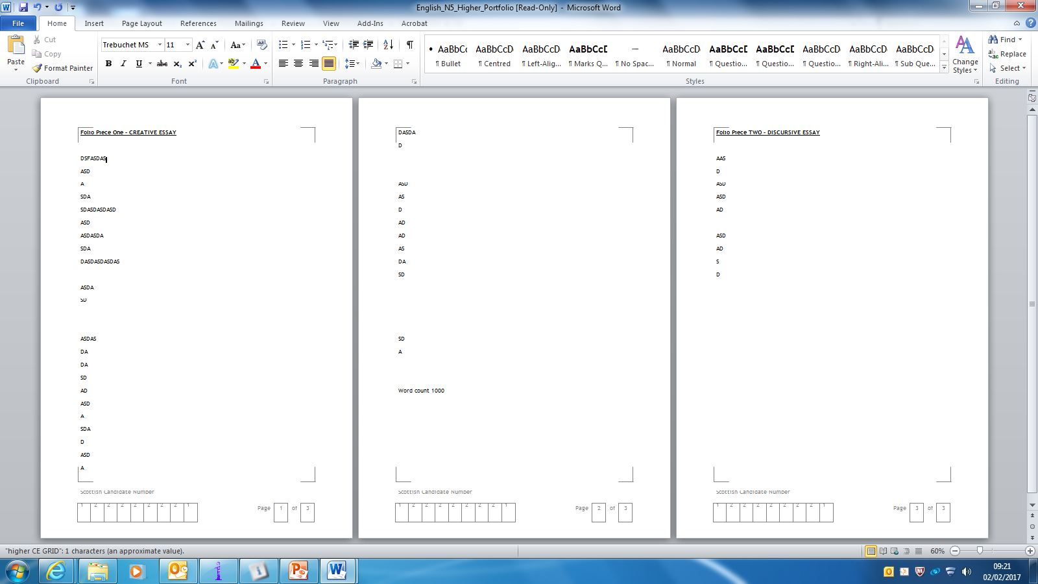
MEARNS CASTLE HIGH SCHOOL ENGLISH DEPARTMENT
SQA FOLIO SUBMISSION - ADVICE
EXEMPLAR
Page #
CANDIDATE NUMBER

Slide 6
MEARNS CASTLE HIGH SCHOOL ENGLISH DEPARTMENT
SQA FOLIO SUBMISSION - ADVICE
SOME FINAL POINTS:
It is recommended that folio pieces are printed double sided where possible.
Staples should not be used – essays should be placed within the flyleaf ‘loose leaf’.
FULL INFORMATION / ADVICE CAN BE ACCESSED AT: http://www.sqa.org.uk/sqa/files_ccc/Candidate_Portfolio_Submission_Instructions.pdf

