Slide 1
Health and Wellbeing Understanding Behaviour and Calming Ideas
Lucy Adair
March 2019

Slide 2
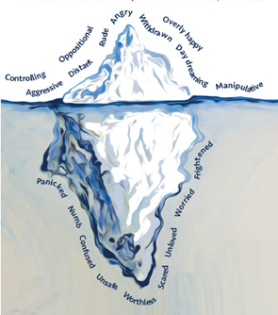
The tip of the iceberg
What is driving the behaviour?
Notes:
The behaviour that we see is the observable part. It is only the tip of the iceberg.
We need to consider what is going on underneath. – this is the significant part (the needs and feelings that are making a child behaviour this way).

Slide 3
Function of Behaviour
Nurture Principle - All behaviour is communication
How an individual is feeling and thinking (Boredom, Angry, Upset etc).
Need for attention (Insecure attachment, low self-esteem, few friends.)
Need for comfort/human contact
Physiological state e.g pain, discomfort
Notes:
Feelings
Inadequate – may be finding the work difficult and going off task as a way of avoiding the work
Need to feel in control – attachment difficulties. Feel no sense of control in life at home. Clutch at ways to control life in other ways.
Challenging behaviour usually has a message- I am bored, I am sad, you hurt my feelings, I need some attention
Children often use challenging behaviour when they don’t have the social or communication skills they need to engage in appropriate interactions.

Slide 4
Active Strategies and De-escalation
Redirection
Choices
Planned Ignoring
If… then
First…then
Clear positive commands
Count down
Reminders

Slide 5
Self regulation is the ability to monitor and control our own behaviour, emotions, or thoughts, altering them in accordance with the demands of the situation. (Cook & Cook, 2009)
Four psychological components.
need to be aware of their behaviour to gauge it against societal norms.
need to understand how others are reacting to their behaviour so as to predict how others will respond to them.
This necessitates a third mechanism, which detects threat, especially in complex social situations.
Finally, there needs to be a mechanism for resolving discrepancies between self-knowledge and social expectations or norms, thereby motivating behaviour to resolve any conflict that exists

Slide 6
Self Regulation
Self-regulation is not simply self-control. It is the ability to manage our energy states, emotions, behaviour and attention: the ability to return to a balanced, calm and constant state of being.
Self-regulation is vital for children to manage life’s normal ups-and-downs: for concentration, social relationships and learning. It is a major task for a young child to regulate their feelings and behaviour consistently.

Slide 7
Development through Co-regulation
All children learn to regulate their emotions through watching adults.
Co-regulation is ‘a form of coordinated action between participants that involves a continuous mutual adjustment of actions and intentions’
Links back to attachment theory – sensitive and comforting care from warm, supportive and trusted adults.
The development of self-regulation, in part, requires the development of higher level thinking. It is, for example, the ability to recognize that when something or someone triggers us, we need to take a moment to breathe or otherwise bring down our level of arousal before we respond. It requires a level of awareness and ability to reflect.
Notes:
Parents and carers are therefore important models for their children in their day to day life. When children see parents and carers effectively regulate their own emotions and actions, it helps them to learn how to manage their own feelings and behaviours.
That is, co-regulation can often bring down our level of arousal
more rapidly than self-regulation because the latter requires us, on some level, to think
it through (top down processing). “Being with”, on the other hand, can help co-regulate
the other more quickly because it bypasses our thinking brain (bottom-up processing).

Slide 8
Sequence of Engagement
Regulate
Help to regulate/calm their fight/flight response.
Relate
Sensitively connect with the child.
Reason
Support the child to reflect, learn, remember, articulate and become self-assured.
Notes:
A lot of us think that we should “Relate” with children before we attempt to regulate difficult emotions. There are also times where we try to “Reason” with them creating a battle of wills where we may yell, command or punish. However, research has indicated that children who are stressed and anxious struggle to use the parts of their brain that allow for strong relationships and rational reasoning.
The order here is critical! Until a child is regulated (i.e., feeling physically and emotionally settled), he is unlikely to be able to relate to you (i.e., feel connected and comfortable). And until a child is related, he is unlikely to have the mental capacity to fully engage with you in the higher level cognitive processes that are critical for problem-solving, like perspective taking, predicting the future, and considering multiple solutions.

Slide 9
Emotion Coaching Name it to Tame It
Did that make you feel…when…
Were you feeling …when …
It sounds/looks like that made you feel …
That would make me feel ... too
I feel … when …happens too
It looks like you are very happy/sad
I can see you are angry
Are you feeling sad?
It sounds/looks like you were very scared?
I wonder if you are feeling sad?
I bet that made you angry?
Notes:
Improved emotional regulation
Better problem solving skills
Higher self esteem
Better academic outcomes
Positive peer relations

Slide 10
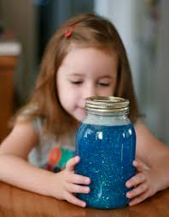
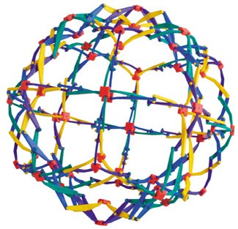
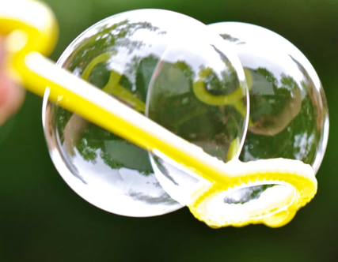
Calming Strategies

Slide 11
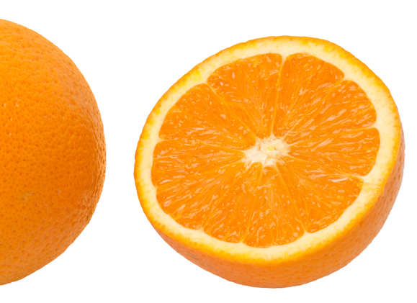
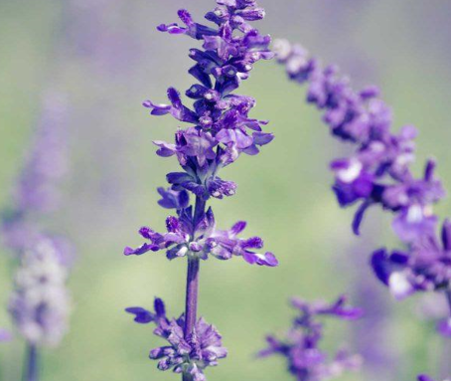
Calming Strategies

Slide 12
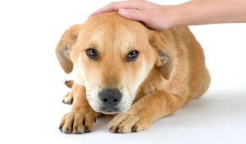
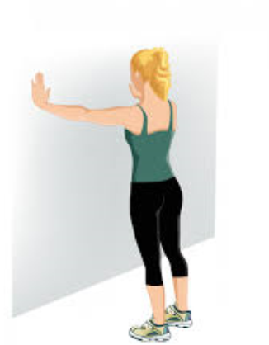
Calming Strategies

Slide 13
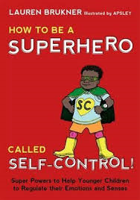
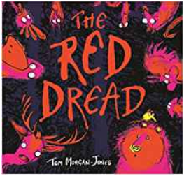
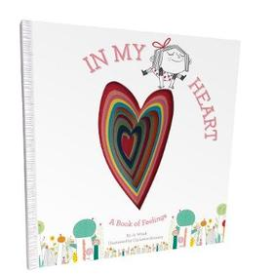
Use of Books

Slide 14
The Adult
Breath
Think before reacting
Powerful thinking e.g.
‘I managed this before, I can do it again.’
‘I know it’s not personal.’
Ask for support

