Slide 1
While the cats away!
Braidbar Nursery Class June 2017

Slide 2
While everyone was a way at the school sports day…..
Our boys and girls had fun checking out the school!

Slide 3
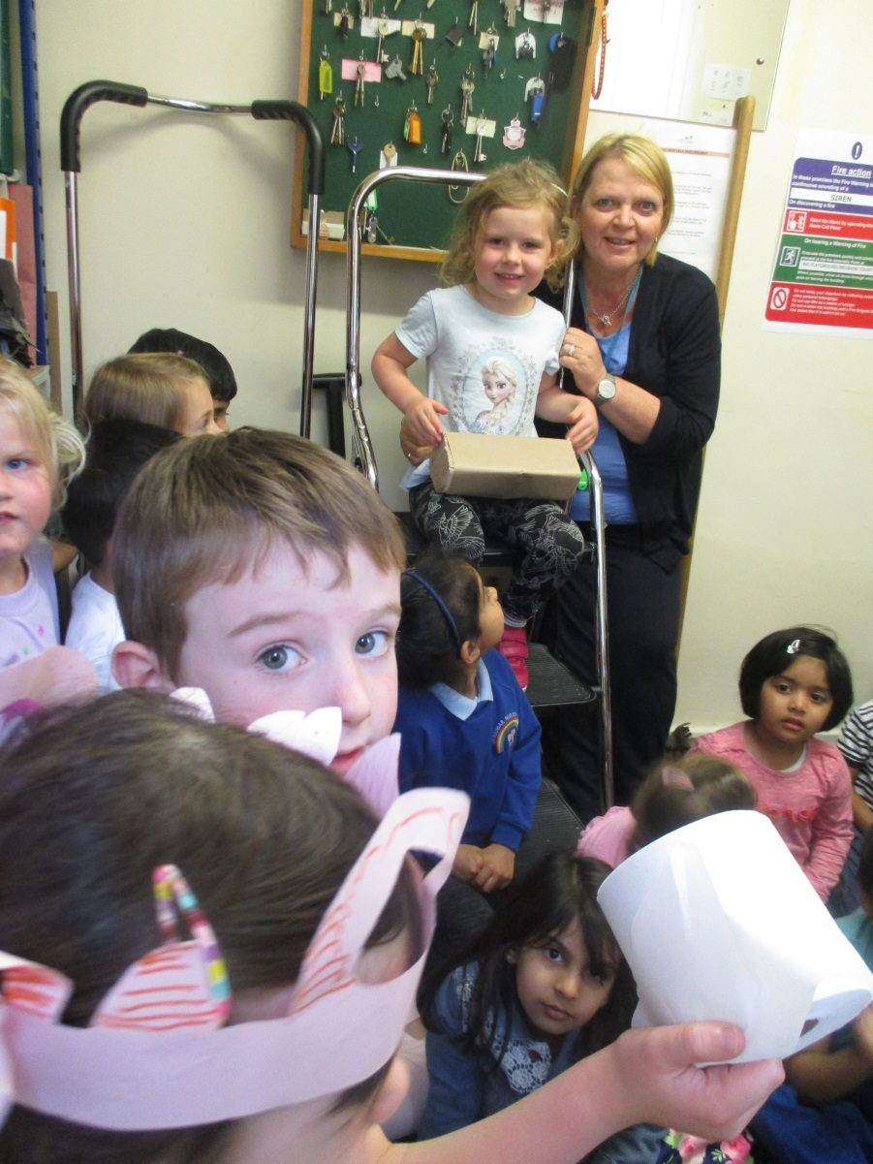
We went to the Janitors office.

Slide 4
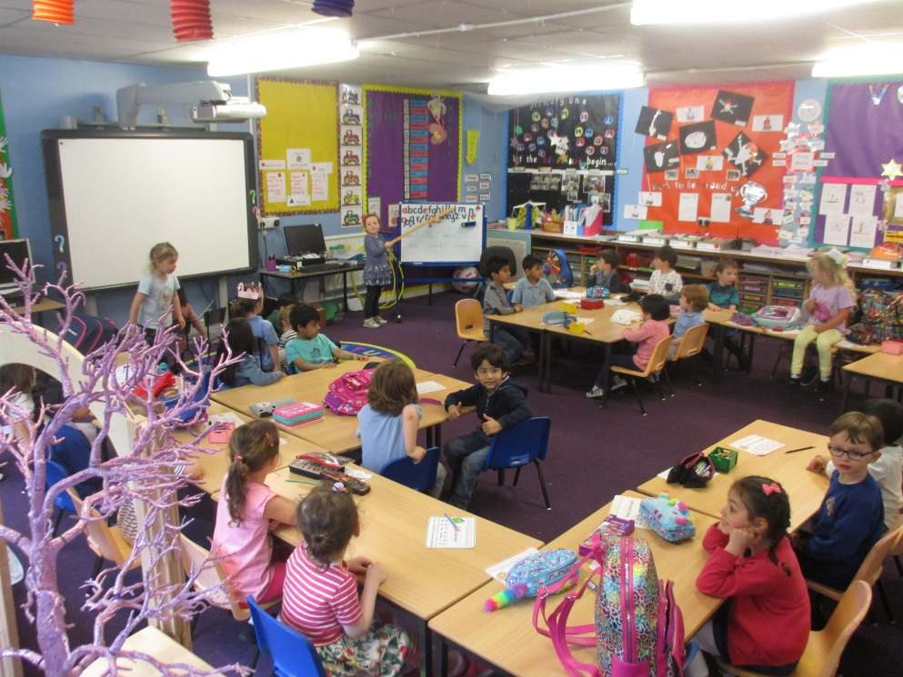
WE had fun in Primary 1!

Slide 5
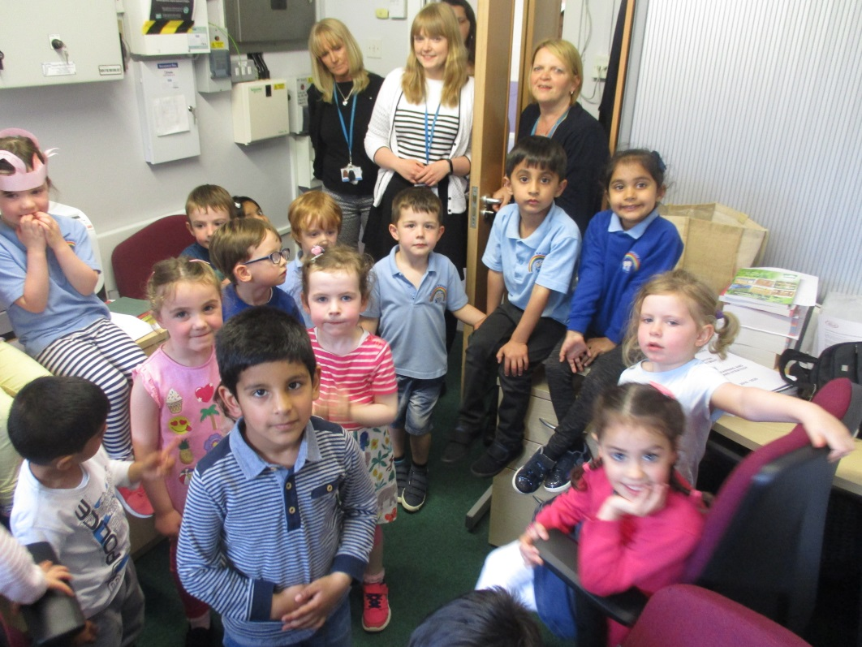
Mrs Carroll is a very busy lady!

Slide 6
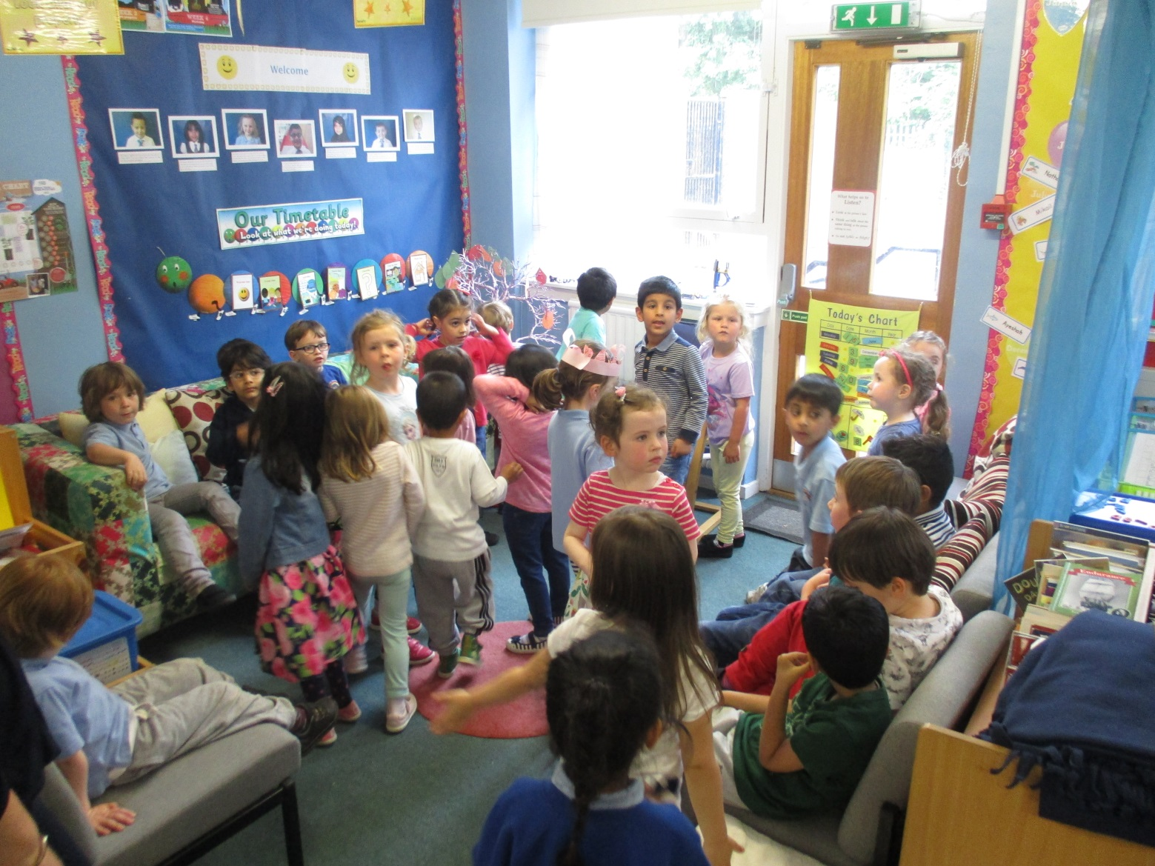
Mrs Young’s room is interesting too!

Slide 7
We like the butterfly room!

Slide 8
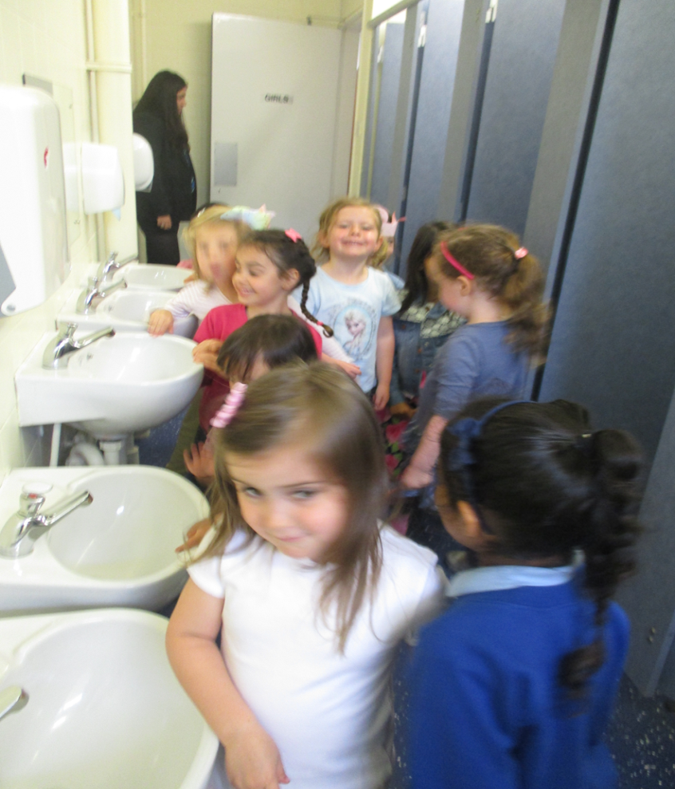
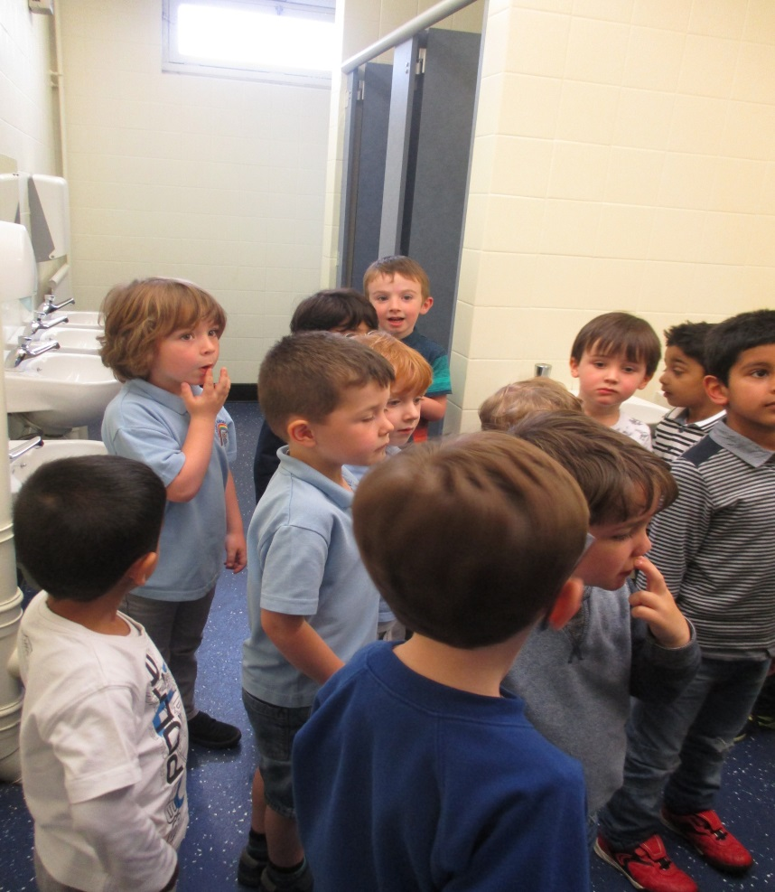
It’s always fun to see New toilets!

Slide 9
These desks are so big!

Slide 10
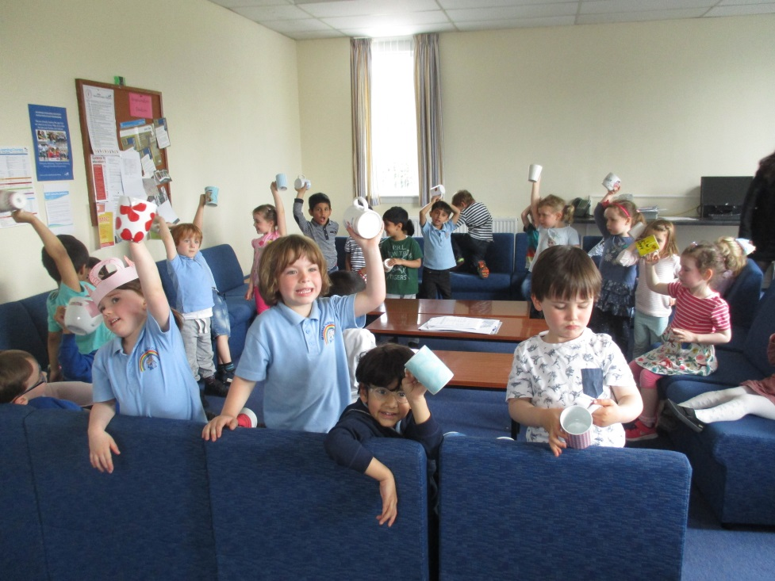
So this is what happens in the staffroom!

Slide 11
We can’t wait to go to School!

