Slide 1

www.DofE.org
Staff
Stuart Boag - D of E Coordinator
Nikki Walker – D of E Supervisor
Kirsten Kirkpatrick – D of E Supervisor
Raymond Weir – D of E Assistant
Pauline Taylor – D of E Assistant
Mike Russell – D of E Assistant

Slide 2
DofE - Parents’ Evening Agenda
Aim of the Award
Student Training
Expedition Dates & Routes
Cost
Emergency Procedures
Kit Guide
Food Guide
Supervision
Parental Assistance

Slide 3
Aim of the Award
“To provide an enjoyable, challenging and rewarding programme of personal development for young people, which is of the highest quality and the widest reach.”

Slide 4
Bronze Requirements
Volunteering involves working with young people, elderly, environment, charity or animals.
Skills creative, performance, care of animals, music, foreign language, life skills.
Physical Recreation team, individual, water, racquet, dance, fitness
From the three categories above two are for 3 months duration, one is for 6 months.
Expedition - Two days/one overnight camp.

Slide 5
Updating Profile
It is essential that students keep their eDofE profile up-to-date.
For a Bronze award students require a minimum of FOUR photographs (2 of which should contain the student), and twelve written entries for each section.
Students, while out on expedition, should gather evidence to demonstrate they have met their expedition aim and to complete a presentation on return.

Slide 6
Student Training

Slide 7
Student Training
- Map reading skills
- Campcraft including cooking on a trangia
- Navigation and route planning
    - First Aid Training
- Equipment and hygiene
- Expedition Prep
- Country code, plus revise all above
- Packing rucksacks, revise all above

Slide 8
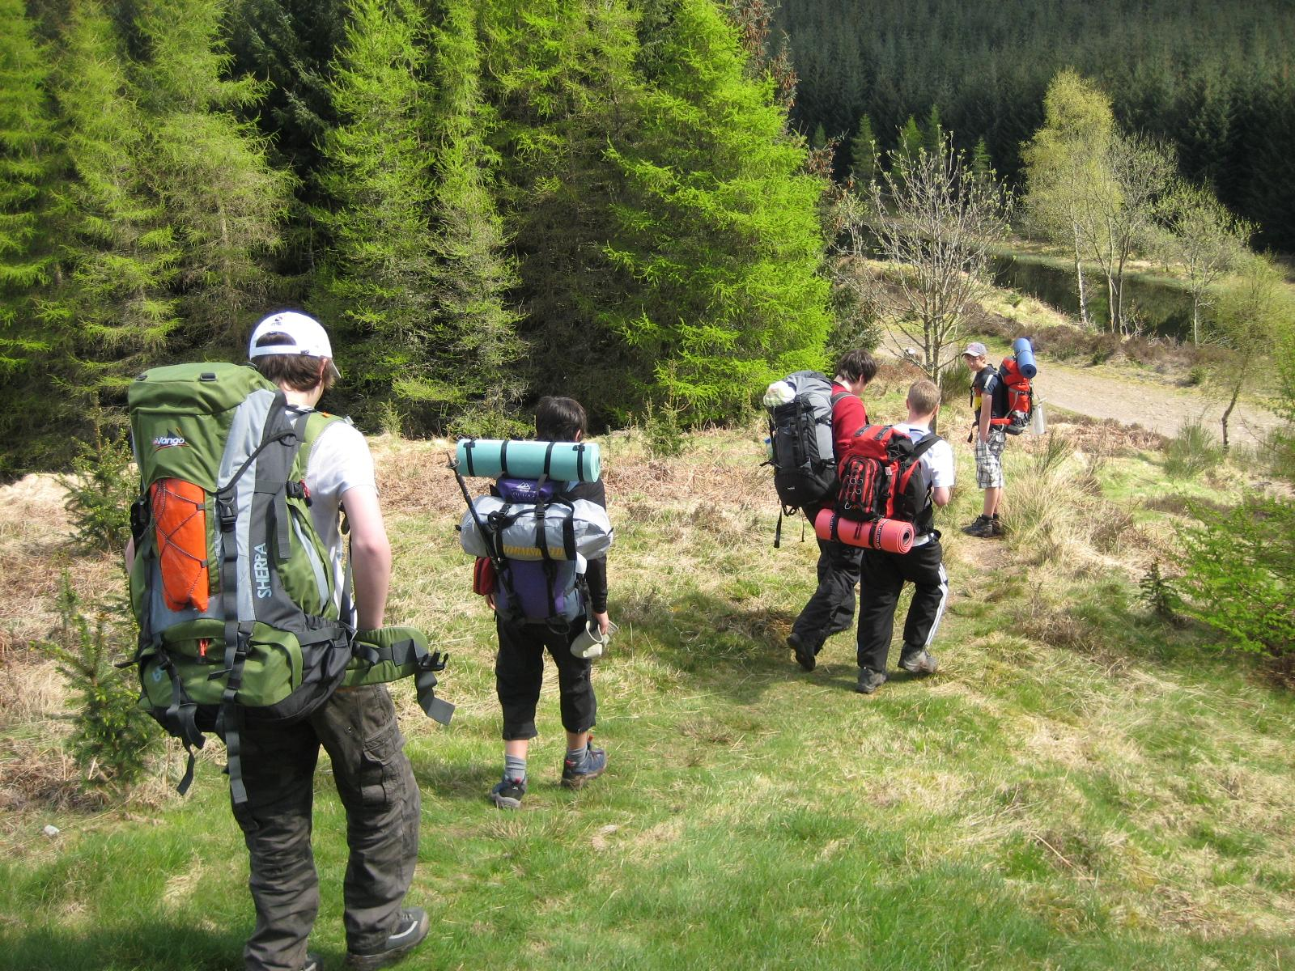
Focus on Expeditions

Slide 9
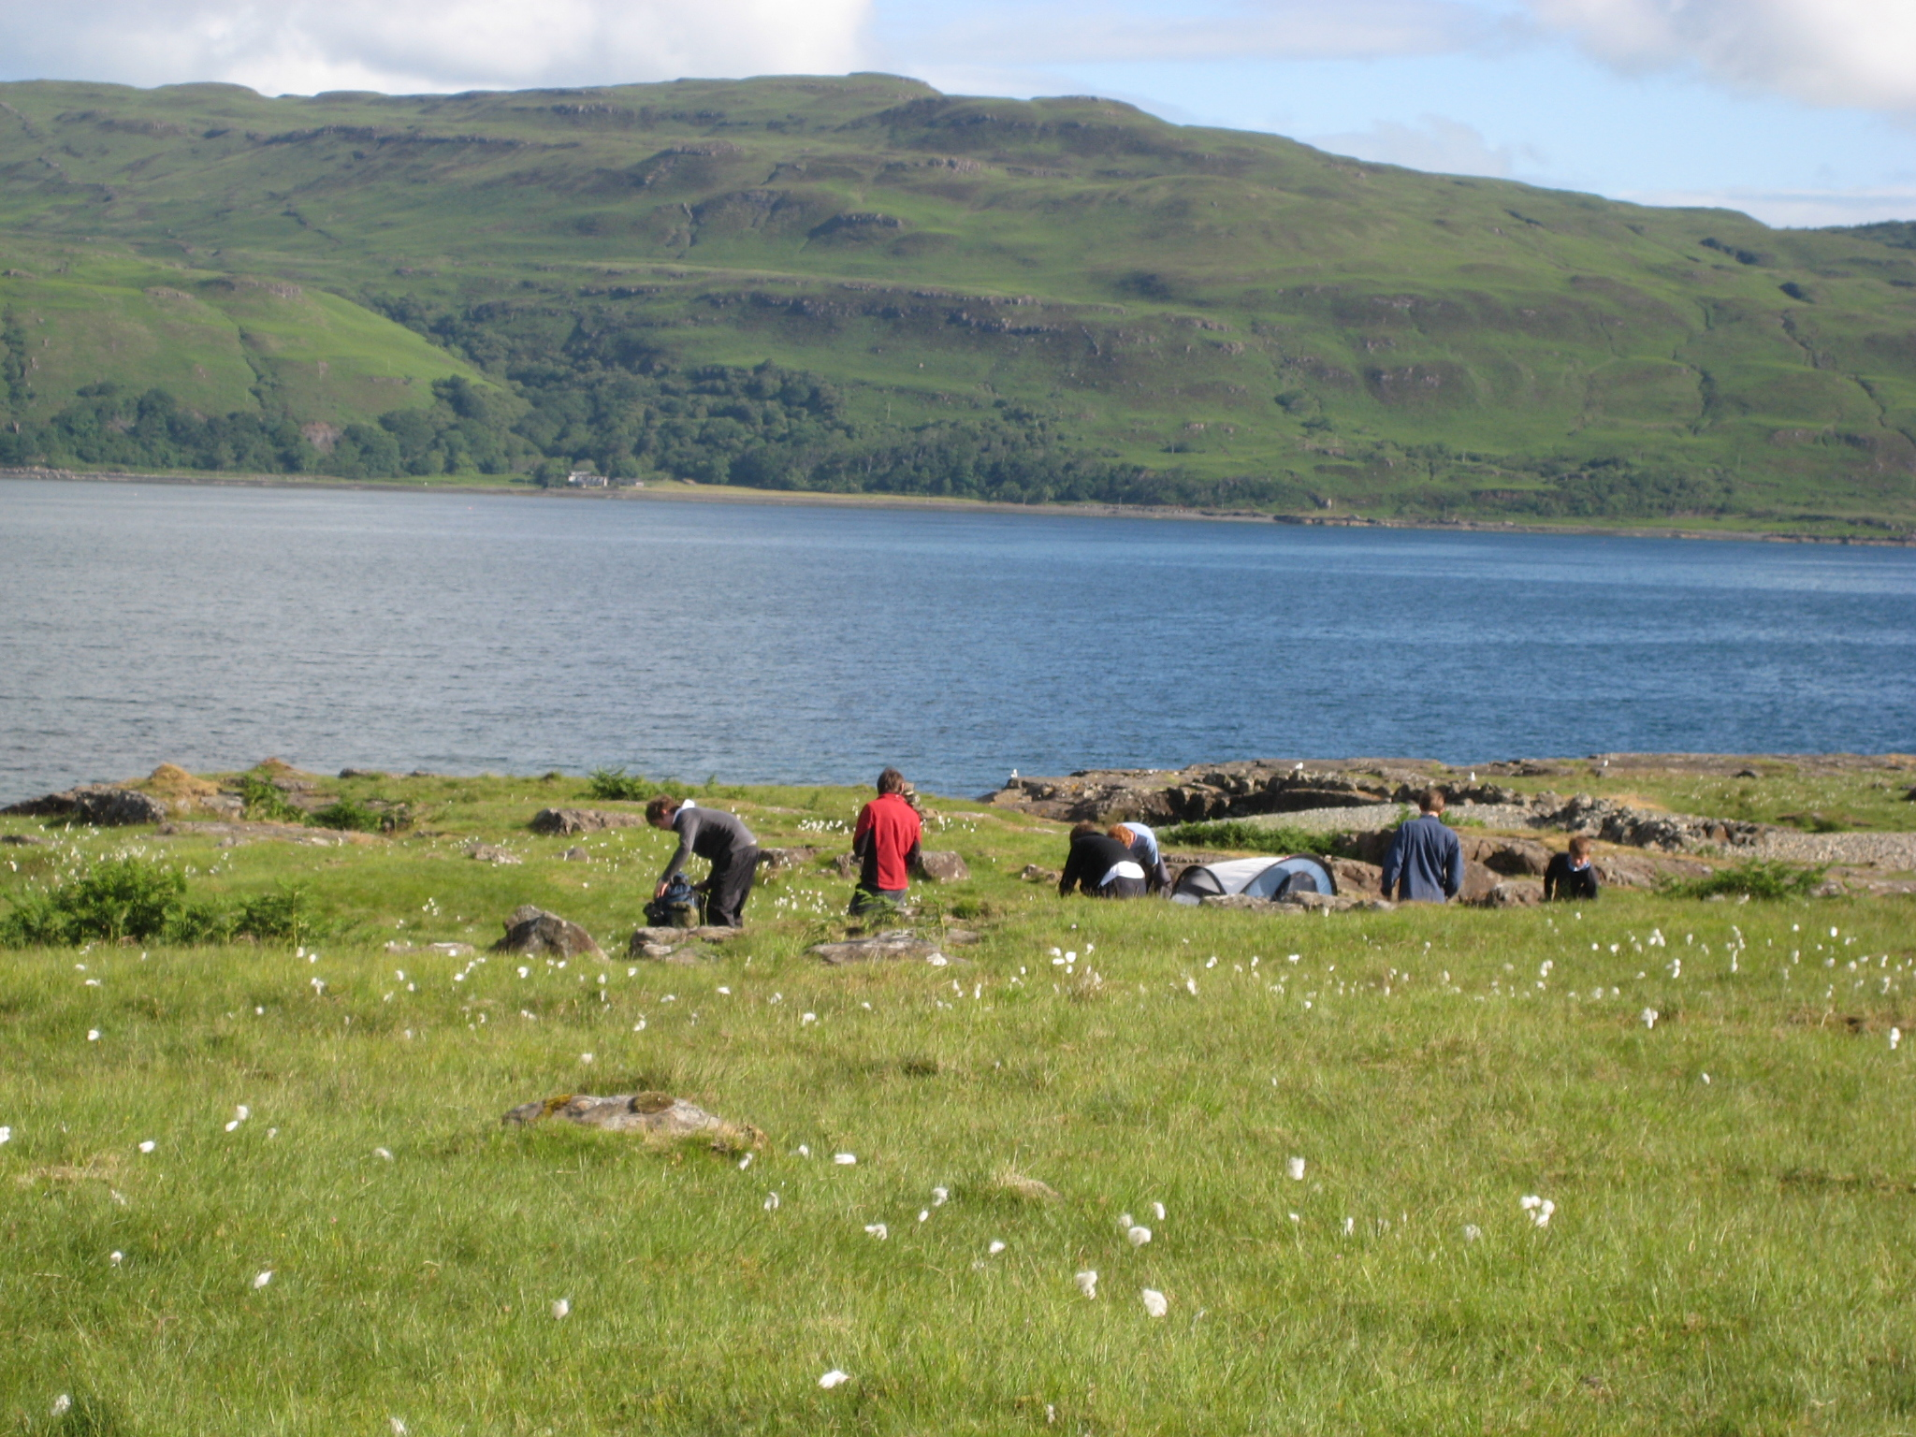
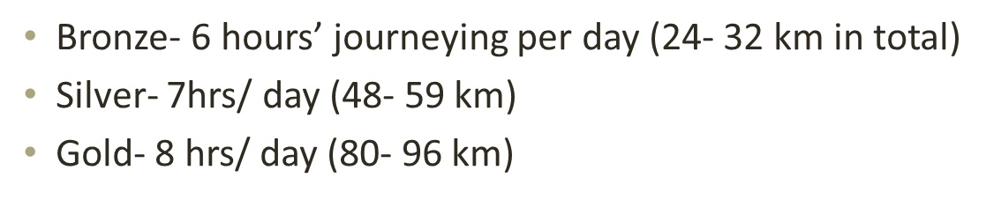
Staffing

Slide 10
Practice Expedition
Day 1
From Tuesday, 5th June – Wednesday 6th June
Students arrive in Strathaven at 10am .
POSTCODE: ML10 6DU
55 LETHAME ROAD
Walking into the Whitelees Windfarm

Slide 11
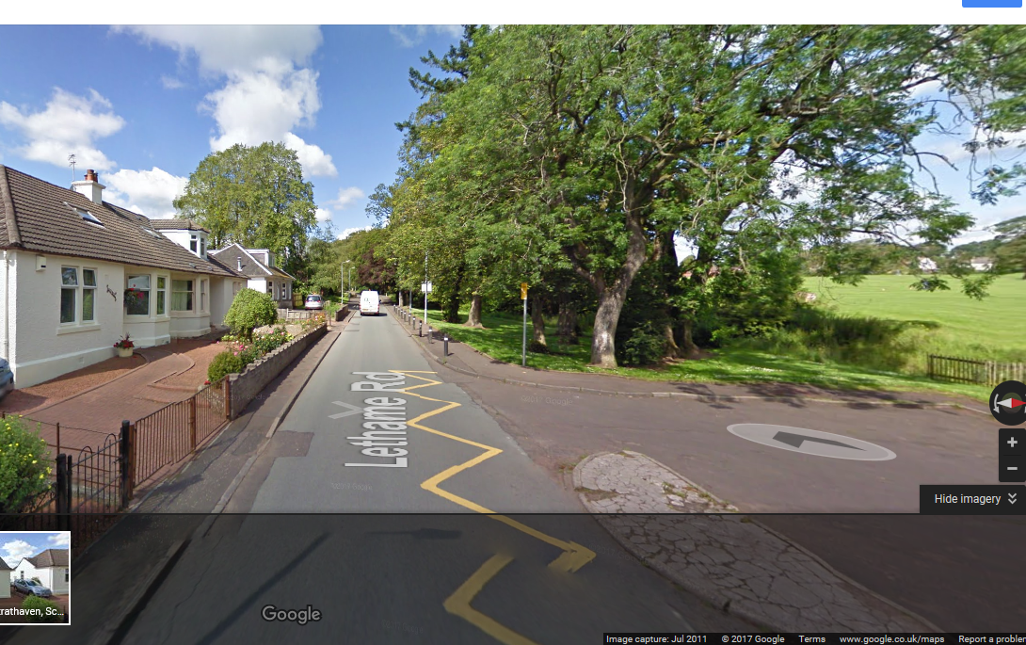
Day 1
From Monday, 5th June – Tuesday 6th June
Parents to drop students in Strathaven at 10am.
POSTCODE: ML10 6DU
55 LETHAME ROAD
Walking into the Whitelees Windfarm

Slide 12
Practice Expedition - Bronze
Day 2
Walk out of Whitelees Windfarm and down to Williamwood High school.
Parents to collect students from 2pm onwards on Wednesday, 6th June at Williamwood High School.

Slide 13
Assessed Expedition - Bronze
The date:
From Thursday, 13th Sept – Friday, 14th Sept
Greenock Cut for our Bronze expedition.
Students meet at Barrhead High School for 9am.
Students walk to the train station and get the train to Drumfrochar (approx £5 each way).

Slide 14
Costs

Slide 15
Costs of each expedition
We keep costs to an absolute minimum
The practice expedition will cost £20 – paid through ParentPay (don’t do this yet!)
The assessed expedition is usually cheaper as students travel by train.
The expenses incurred are usually:
Minibus & transit van hire, diesel, sundries, occasionally we have to pay for additional DOFE staffing.
On the assessed expedition we sometimes pay for the assessor and their costs.

Slide 16
Emergency Procedures

Slide 17
Emergency Procedures
Practice Expedition
Students will be issued with a mobile number to call if they need emergency help.
Groups will be issued with a walkie-talkie as well.
Assessed Expedition
Students will be issued with a mobile number to call if they need emergency help – the vast majority of their time will be spent walking in their groups, remotely supervised, and will be required to use their training if an emergency occurs.
They will also have a walkie-talkie

Slide 18
Kit Guide

Slide 19
Kit Guide
Participants can borrow:
Participants can borrow a tent, rucksack, roll mat, sleeping bag, stove, compass and map.
Participants must have:
1. Their own boots (worn in).
2. Waterproofs jacket & trousers
3. A first aid kit
4. A midge net
5. A head torch
Please do not wear/bring jeans
Please see kit list for further advice

Slide 20
Kit Guide
Equipment issued:
  From: The Edge
  (Behind Fairweather Hall Barrhead Road, Newton Mearns G77 6BB)
  When: Monday, 4th June at 6pm
  Please: car-share where possible.

Slide 21
Kit Guide
  New Procedures
When collecting kit, a £50 cash or cheque deposit is required. (cheques made payable to East Renfrewshire Council)
Please secure cash/cheque in an envelope with your child’s name and school on the front.
Mr Sinclair is aware of these procedures and does not wish this to be a barrier to ANY young person completing their DOFE Award.
If you have concerns, please contact Mr Sinclair in confidence.

Slide 22
Kit Guide
  Returning kit
  ALL EQUIPMENT MUST BE RETURNED TO THE EDGE.
  This means you need to:
  Hang your tent in a garage/over a door to ensure they are completely dry – even if it hasn’t rained.
  Scrubbing, with a brillo, all of the trangia stove until it is spotless
  Washing and drying any borrowed sleeping bags

Slide 23
Kit Guide
S3 Students
  I will get a date for when you will return your clean/dry kit to THE EDGE
If your kit is not returned clean and dry, and at the designated time – you risk losing all or part of your deposit.

Slide 24
Rucksacks

Slide 25

Packing your rucksack
Students should place heavier items to the bottom of the rucksack.
ALL CLOTHES SHOULD BE PLACED in one or more RUBBLE bags. (Please don’t use bin bags they are generally too thin).

Slide 26
Adjusting your rucksacks
To save time on the morning of the expeditions, it would be helpful if students had adjusted their rucksacks to fit.
I have posted the following instructions on the student Yammer site, and on the school website.
http://bit.ly/1GoxRcm

Slide 27
Food Guide

Slide 28
Food Guide
Students must bring enough food to last for two days – i.e. breakfast, lunch and dinner.
Students will sleep three to a tent and it is expected that students will coordinate their meals – particularly where cooking is required - such that everyone in the tent eats the same meal.
Students must prepare a substantial meal each evening – pot noodles and super noodles do not count!!
No tins please.
Fresh pasta is preferred to dry pasta – it cooks quicker.

Slide 29
Food Guide
Please pre-cook food before the expedition i.e. pre-cook any pieces of chicken, sausage or bacon.
Water – preferably stored in a camelbak rather than sports bottles – students can walk and drink at the same time.
Students will replenish their camelbaks each day from our water supplies.. although local streams can be used if checked properly!!

Slide 30
Supervision

Slide 31
“Remote supervision”
Practice Expedition
Students will spend the majority of their time being trained and supervised by the staff on the trip.
Students will be given the opportunity to practice the skills being taught – this may require them to navigate to certain areas unsupervised – Teachers will be observing from a distance.
Assessed Expedition
Students will spend the majority of their time walking in their groups - unsupervised.
Teachers will observe at times from a distance, but students must be able to navigate and deal with emergencies – initially on their own - until staff are notified and arrive.

Slide 32
Lyme Disease & Ticks

Slide 33
Lyme Disease
Both the practice expedition and the assessed expedition have students walking through farmland/woodland.
Students will be made aware of Lyme Disease and Ticks prior to the first expedition.
Students should keep there arms and legs covered when walking through long grass or bracken. They should also check themselves over when they arrive at camp and when they return home.
I have posted a Lyme Disease & Ticks leaflet on the school website if you require more information.

Slide 34
Parental Assistance

Slide 35
Parent Assistance
Encourage your son/daughter to organise as much of their DOFE expedition themselves.
Let them decide how many (old) clothes they wish to bring.
Let them buy and prepare the food they will need.
Encourage them to think about unexpected events – bad weather or really warm weather..
Let them pack their own rucksack – that way they know where everything is, and if they forget something they only have themselves to blame!
Can you help transport kids to Strathaven on Tuesday, 5th June – 2 parents (with cars) is all I need!

Slide 36
Any Questions?

