Slide 1
S3 Cad Modelling Solutions
Questions 1 – 3

Slide 2
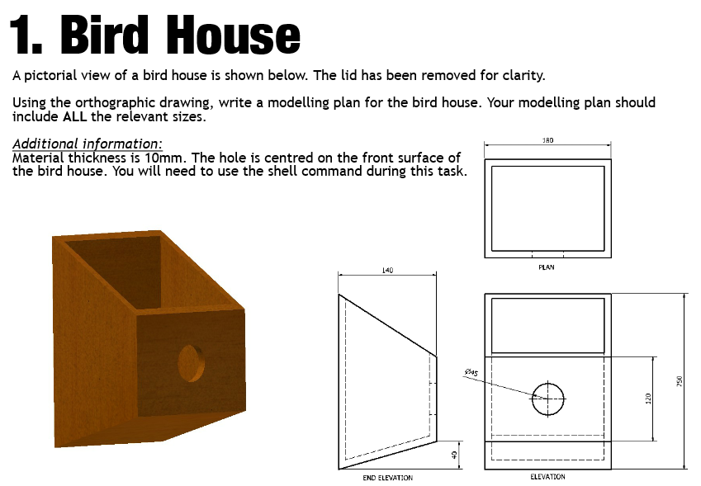

Slide 3
Question 1
Let’s watch this being modelled in the video on the next slide.
Sketch the shape shown using the line tool. (1 mark – ALL sizes must be shown to gain mark)
Extrude (addition) (1 mark) 180mm (1 mark)
Shell the shape removing the top surface (1 mark) thickness of 10mm (1 mark)
Sketch a circle Ø45 centred on the front surface (1 mark)
Extrude the circle (subtract) (1 mark) 10mm (1 mark)

Slide 6
Question 2
Note that the two circles can be drawn and extruded in the opposite order to how it is described here – it doesn’t matter in this case i.e. the 8mm circle can be drawn first. You will see this in the video on the next slide.
Sketch a circle Ø65. (1 mark)
Extrude (addition) (1 mark) 22mm (1 mark)
On one side, sketch a circle Ø16 (1 mark)
Extrude (subtraction) (1 mark) 10mm (1 mark)
On the opposite side, sketch a circle Ø8 (1 mark)
Extrude (subtraction) (1 mark) through all material / 22mm (1 mark)
Fillet the outer edges of the wheel 8mm (1 mark)

Slide 9
Question 3
Let’s watch this being modelled in the video on the next slide.
Sketch the shape shown using the line tool. (1 mark – ALL sizes must be shown to gain mark)
Extrude (addition) (1 mark) 50mm (1 mark)
Sketch a circle Ø30 (1 mark) in the position shown (sketch must show dimensions of the position of the circle 1 mark)
Extrude (subtraction) (1 mark) through all material / 100mm (1 mark)
Fillet the short vertical edges (1 mark) 25mm (1 mark)

