Slide 1
CIRCLES
2019
Turnbull High School

Slide 2
Learning Intentions:
By the end of this unit, you should:
know the different parts of the circle.
understand how they relate to each other.
be able to draw a circle to a given size.
Success Criteria: You will know if you have been successful when:
you can identify the circumference, radius and diameter of a circle.
you can explain the relationship between these parts
you can use a compass to draw a circle to a given radius or diameter.

Slide 3
For each of the three circles:
cut a piece of string the same length as the red line.
cut a piece of string the same length as the green line.
cut a piece of string the same length as the black outline.
Keep your three pieces of string for each circle together. You will be comparing them for Activity 2.

Slide 4
Lay your pieces of string next to each other for each of the three circles.
In your group or with the person next to you, use your string to discuss:
what you notice about the length of the red line compared to the green line.
what you notice about the length of the green line compared to the length of the black outline.
Note your thoughts down on your worksheet.

Slide 5
FEEDBACK TIME!
What did you notice about the length of the red line compared to the green line?
You should have noticed that the red line was half the length of the green line.

Slide 6
FEEDBACK TIME!
What did you notice about the length of the green line compared to the black outline?
You should have noticed that the black outline was approximately 3 times the length of the green line.

Slide 7
Let’s look at the different parts of the circle:
CIRCUMFERENCE
The green line is called the DIAMETER.
This is the distance between two points on the circumference through the centre point of the circle.
The black outline is called the CIRCUMFERENCE.
This is the length of the outside of the circle.
RADIUS
DIAMETER
The red line is called the RADIUS. This is the distance from the centre of the circle to any point on the circumference.
The DIAMETER is always twice the length of the RADIUS.

Slide 8
The drawing opposite is used to mark out the S1 bear keyring that pupils make in Technical.
Both a circle and a curve appear on the drawing.
When a full circle is shown, we show the diameter of the circle using this symbol: Ø
When only part of a circle is shown i.e. a curve, we show the radius using this symbol: R
All sizes are always in MILLIMETRES.
O 3.5mm
18
12
0
1
R
2
0
0
1
0
5
2
1
15
10
15
15
60

Slide 9
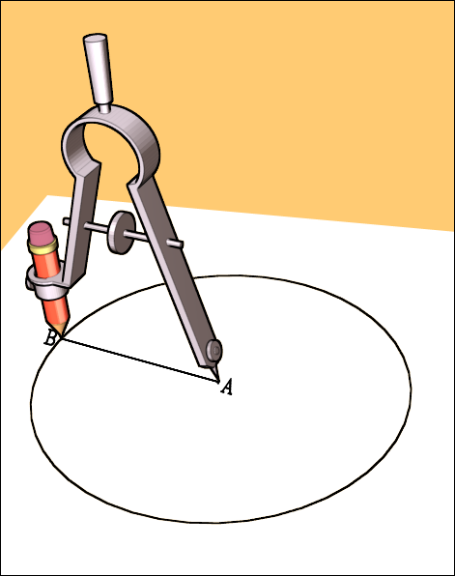
When we draw circles, we use a compass. One leg of the compass has a point and the other has a pencil.
1. The point of the compass goes on the centre point.
2. The pencil is then set to the correct distance from the point.
Look at the image opposite. What part of the circle is shown as line A-B?
When we draw circles, we set the compass to the size of the radius of the circle. The compass is spun round the centre point to give us the circle.
THE RADIUS

Slide 10
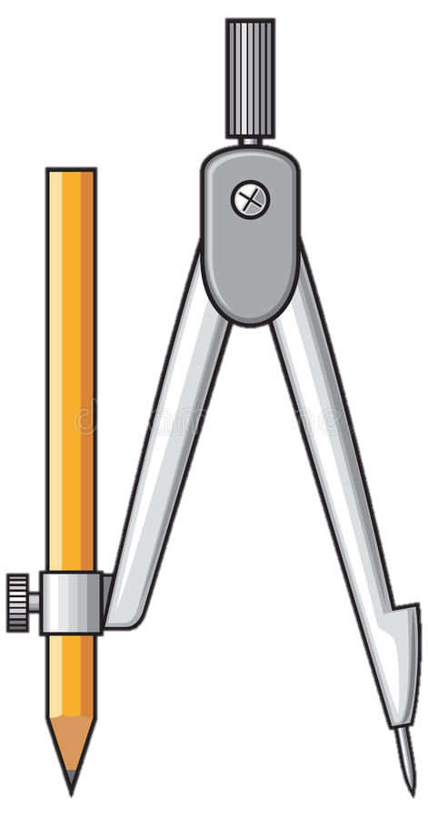
DRAWING CIRCLES
1. To set your compass, place the point on the zero on the scale on your ruler.
Move the pencil along the scale until is reaches the size you want (remember this should be in millimetres).
Once set, place the point of the compass on the centre point. Spin the compass around this point to draw the circle.
*Handy Tip* You may find it easier to draw the circle by keeping the point still and spinning the paper instead of the compass. Try it both ways and see what works best for you.

Slide 11
COMPLETE ACTIVITY 4 ON YOUR WORKSHEETS
ASK THE PERSON NEXT TO YOU TO DOUBLE CHECK YOUR SIZES ONCE YOU’VE DRAWN YOUR CIRCLES.

Slide 12
DRAWING CIRCLES
We already know that to draw a circle with a compass, we need to know the RADIUS.
What would we do if we were given the diameter instead?
HALF THE SIZE
Complete ACTIVITY 5 on your worksheets.
Remember to half the diameter size to draw the circle. If you don’t half it, your circle will end up twice the size it should be!

Slide 13
What is the name of the red line?
What is the name of the green line?
What is the name of the black outline?
What size should the compass be set to when drawing a circle?
What does this symbol mean? Ø
What does this symbol mean? R
What size should the compass be set to if you are asked to draw a circle Ø40.
RADIUS
DIAMETER
CIRCUMFERENCE
THE RADIUS
DIAMETER
RADIUS
20 mm

