Slide 1
Aluminium Sand Casting

Slide 2
Aluminium sand casting is the only metal casting process that is commonly available in schools. This is because the material is cheap and the temperature required for casting 750ºC is not hard to achieve.
The process involves 6 distinct stages:
Making the pattern
Encasing the pattern in moulding sand
Removing the pattern leaving the sand mould
Pouring the molten metal into the mould
Removing the sand from around the solidified work piece.
Cleaning up the work piece.

Slide 3
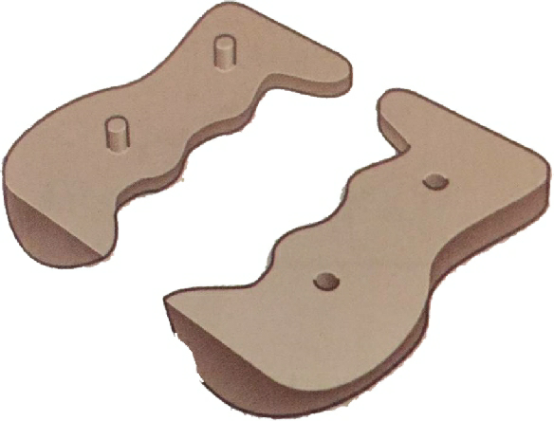
Pattern Making
The quality of the casting depends on the quality of the pattern. The requirements are:
Radiused corners
Drafted sides (tapered)
Good surface finish.
Most moulds are made from wood and they may be flat backed for simple forms or split as in the image below (note that the two halves are pegged together for location).

Slide 4
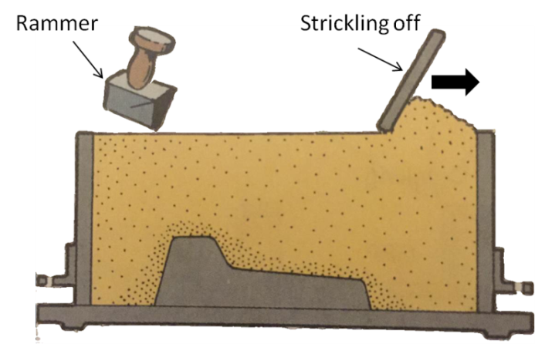
Mould making
The moulding must be sieved to get rid of lumps and any foreign matter, and damp enough to hold its shape. The mould box to contain the sand is a two-part construction with pins to locate the halves together.
The mould is built up in stages:
Stage 1
The lower half, the drag, is placed on a flat board around the lower half of the pattern (inverted). Parting powder is dusted onto the pattern (to prevent sticking) and the mould is then filled with sand.

Slide 5
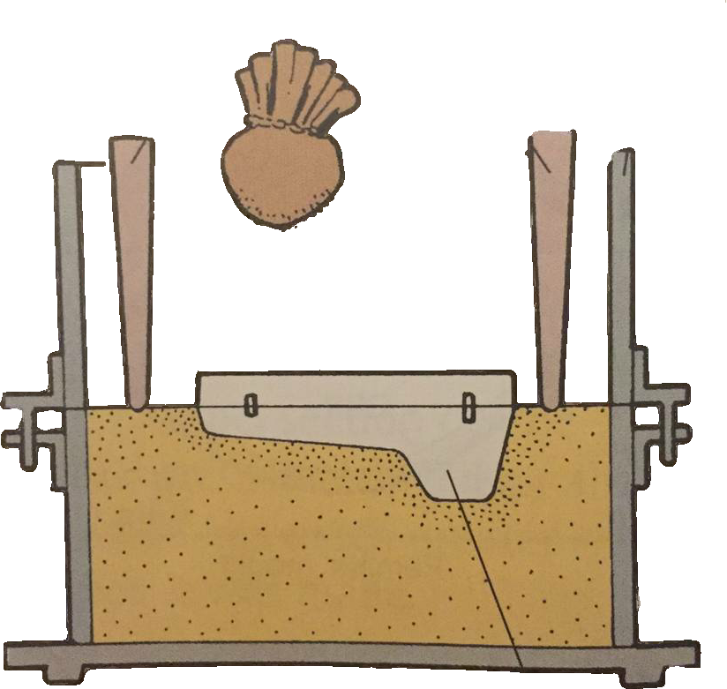
Stage 2
The drag is turned over and the cope and top half of the pattern are put in place. The sprue pins and then added and the mould box filled with sand.
Sprue Pins
Cope
Parting powder
2nd Part of split pattern added

Slide 6
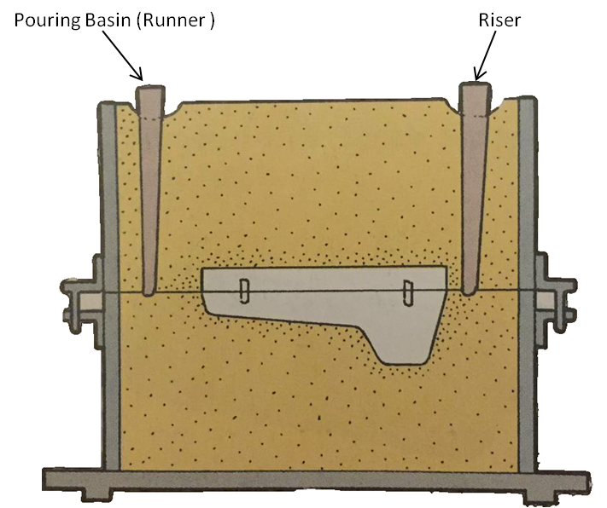
Stage 3
Pouring basins are made in the sand and the sprue pins are carefully removed to create the runner and the riser. Vents are made in the sand to allow the steam to escape.

Slide 7
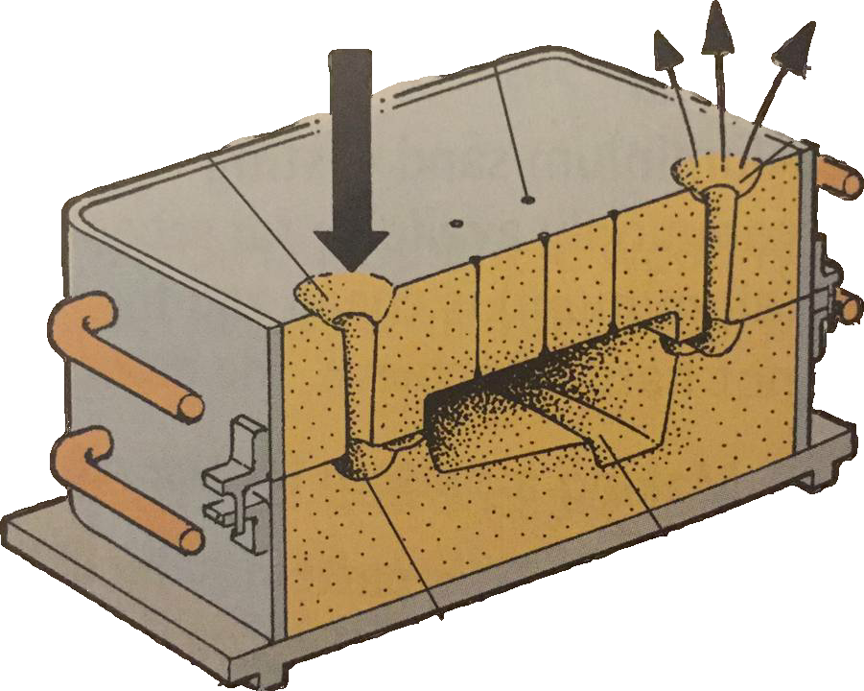
Stage 4
The mould box is opened, the pattern is removed, and gates are made in the sand to allow the molten metal to flow into the cavity. The mould is re-assembled ready for pouring.
Vents
Pouring Basin
Riser
Mould Cavity
Gate

Slide 8
Pouring
Aluminium melts at 600ºC but needs to be at 750ºC for pouring. Pouring should be slow and continuous into the pouring basins until a pool forms at the top of the riser. Great care is needed, the safety issues are important:
Wear protective clothing: gloves, apron, full face mask.
Ensure that there is fume extraction and good ventilation.

Slide 9
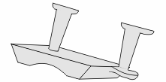
Fettling
Fettling is the term used to describe the process of finishing off the work by removing the runners and risers with a hacksaw and file, and cleaning up the casting.

Slide 10
Lost pattern casting
Patterns for casting can be made from expanded polystyrene (the sort used for packaging). This can be embedded in the sand and when the molten aluminium is poured in, the pattern is totally burned away. The main advantage is that the pattern can be as complex as required as it doesn’t have to be removed from the sand but it does mean that it can only be used once. The disadvantage is that when the polystyrene burns, it gives off toxic fumes therefore should only be carried out where there is proper ventilation.

