Slide 1
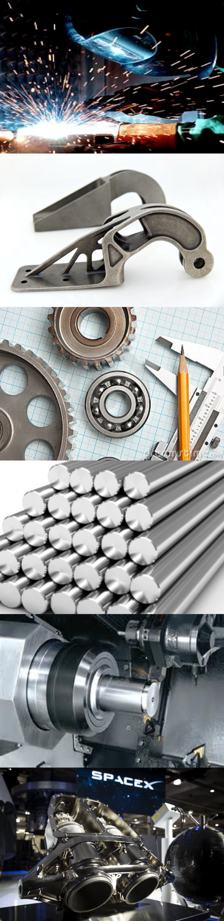

National 5
Practical Metalworking
During the Practical Metalworking course you will develop skills, knowledge and understanding of:
Safe working practices in workshop environments
Metalworking Techniques
Measuring and marking out metal sections and sheet materials
Practical creativity and problem-solving skills
Sustainability issues in a practical metalworking context
Areas of study: Bench Skills / Machine Processes / Fabrication & Thermal Joining
Notes:
A short word on the course structure and areas of study.
Point out key knowledge and understanding A3 sheets on wall.

Slide 2
Practical Metalworking
National 5
Unit 3: Thermal Joining & Fabrication
Spot Welding
Safety Rating: (Med - High)

Slide 3
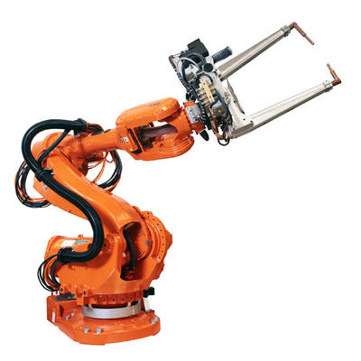
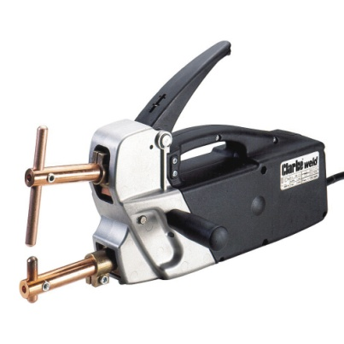
Thermal Joining & Fabrication
Spot Welding
Spot welding is principally used as a method of joining sheet steel. The process is used extensively in the Automobile industry where the spot welding process can be automated with the aid of large robots. However, spot welding can be undertaken in the school workshop on a much smaller scale.

Slide 4

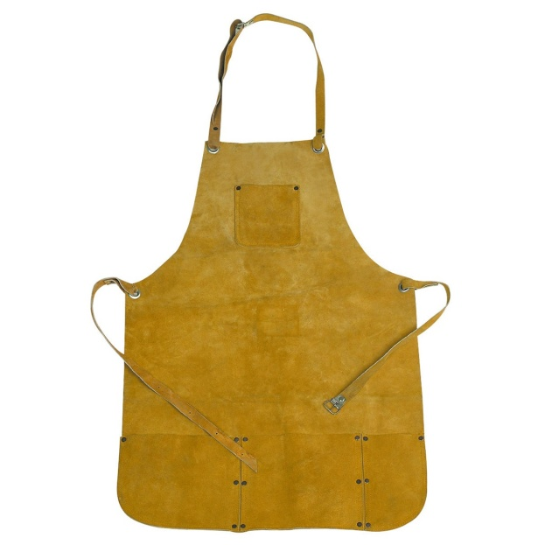
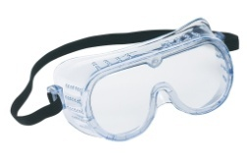
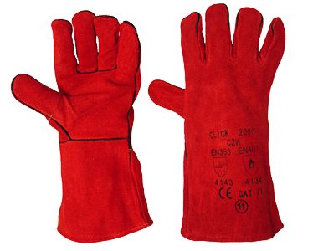
Thermal Joining & Fabrication
Spot Welding
The spot welder we will use in the workshop is smaller in size when compared to its industrial robotic counterparts but it can be just as dangerous if not used correctly. Before use you must always wear the correct PPE.
All thermal joining & fabrication work will require the use of a leather apron and leather gauntlets.
Goggles
Leather Apron
Gauntlets

Slide 5
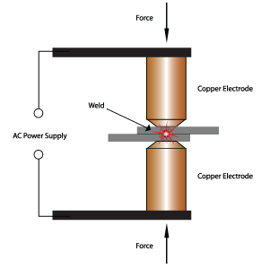
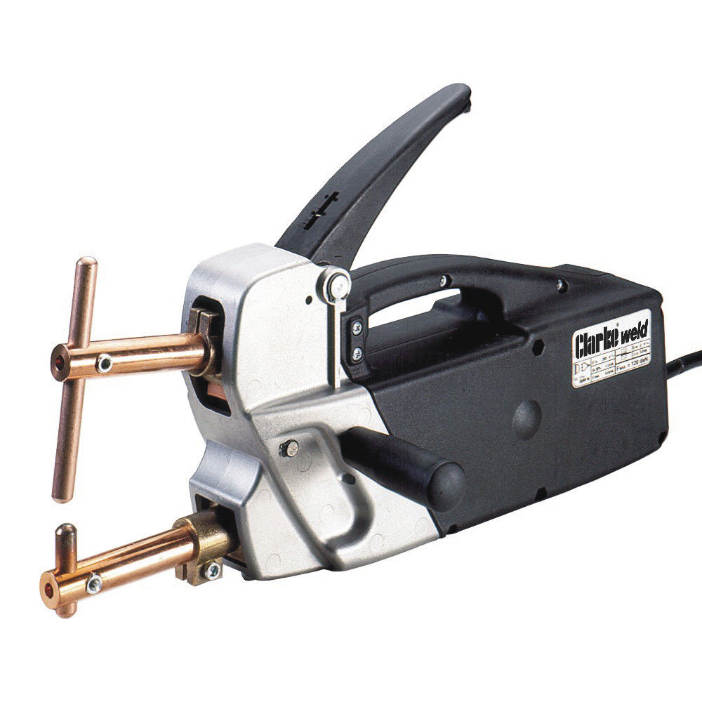
Thermal Joining & Fabrication
Spot Welding
It is very important to know all parts of the spot welder and their function before use. The lever is pushed down to bring the copper electrodes together to create the weld. The weld timer can be set to ensure the weld time is correct for the thickness of material.
LEVER / HANDLE
WELD TIMING
DIAL
POWER CABLE
COPPER
ELECTRODES
ON/OFF
SWITCH

Slide 6
Thermal Joining & Fabrication
Spot Welding
Step 1: The two pieces of metal to be joined must be cleaned thoroughly, rust, paint, grease etc must be removed. Use a piece of emery cloth to clean the metal.
Step2: Set the weld timer on the spot welder to suit the material thickness you are using. The thicker the sheet the longer it will take.
Step 3: Clamp the material between the copper electrodes by pushing down the handle. Hold the handle down until the weld cycle is finished. Repeat the process if required.
Step 4: Remove the metal and allow to cool.
ALWAYS REMEMBER TO WEAR HEATPROOF GLOVES WHEN HANDLING THE METAL DURING AND AFTER WELDING!

Slide 7
Quiz Questions 12
Record answers in your notes jotter
Spot welding is mostly used to join what metal?
2. What metal are the electrodes made from?
3. What PPE should be worn when operating the spot welder?
What industry commonly uses spot welding?
5. What must we do to the metal before spot welding?
Why would we need to adjust the weld timer dial?

Slide 8
Quiz Questions 12
Record answers in your notes jotter
Spot welding is mostly used to join what metal?
Steel
2. What metal are the electrodes made from?
Copper
What PPE should be worn when operating the spot welder?
Goggles, heat proof gloves, leather apron
What industry commonly uses spot welding?
Automotive Industry
What must we do to the metal before spot welding?
Ensure metal is clean from paint, grease etc
Why would we need to adjust the weld timer dial?
Adjust to suit thickness of metal

