Slide 1
National 5
Practical Metalworking
During the Practical Metalworking course you will develop skills, knowledge and understanding of:
Safe working practices in workshop environments
Metalworking Techniques
Measuring and marking out metal sections and sheet materials
Practical creativity and problem-solving skills
Sustainability issues in a practical metalworking context
Areas of study: Bench Skills / Machine Processes / Fabrication & Thermal Joining
Notes:
A short word on the course structure and areas of study.
Point out key knowledge and understanding A3 sheets on wall.

Slide 2
Practical Metalworking
National 5
Unit 2: Machine Processes
Pillar Drill
Safety Rating: (Med - High)

Slide 3
Machine Processes: Drilling
The Pillar Drill
The ‘Pillar Drill’, named after the pillar it stands on, is a very important piece of machinery in the metal workshop. Pillar Drills are used to accurately and precisely drill holes through
a variety of materials in the workshop.
Things you MUST remember when using the Pillar Drill:
Make sure you tie back long hair and secure any loose clothing.
Always wear eye protection.
Always secure material in machine vice or jig. Never by hand!
Only one person should use the drill at any one time.
Never distract the person operating the drill.

Slide 4
Machine Processes: Drilling
The working TABLE on the drill can be adjusted to different depths to accommodate many different material types and sizes. There is also a DEPTH STOP that, once set, allows the operator to repeat the cut depth.
The material to be drilled must always be clamped down to the working table. Your work piece can be secured to the work table using a machine vice or a specific jig.
There is also a TELESCOPIC GUARD in place, guarding from the moving DRILL BIT and CHUCK as it is lowered by the operator using the rotating lever.
EMERGENCY
STOP
DEPTH STOP
LEVER
TELESCOPIC
GUARD
CHUCK
TABLE
TABLE
ADJUSTMENT

Slide 5
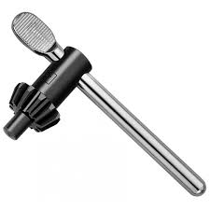
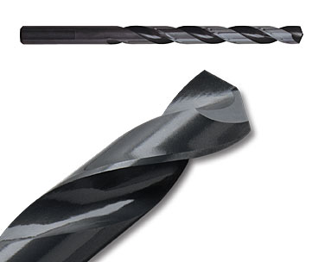
Machine Processes: Drilling
The ‘Drill Bits’ used in the metal workshop are known as High-Speed Steel (HSS) TWIST DRILL BITS and are characterised by their black colour. More expensive, durable bits may contain cobalt or be titanium coated.
We can also use a COUNTERSINK BIT in the pillar drill to countersink drilled holes or remove sharp burr after drilling. These are secured in the CHUCK using a CHUCK KEY.
CHUCK KEY
CHUCK
(HSS) TWIST DRILL BIT
COUNTERSINK BIT

Slide 6
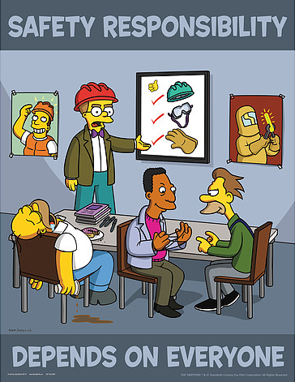
Machine Processes: Drilling
Remember! Stay Alert when using the drill. The machine does not have a brain, you must use yours.

Slide 7
Quiz Questions 8.0
Record answers in your notes jotter
1. What piece of equipment could I use to secure my metal when using the Pillar Drill.?
2. What protects the moving chuck on the Pillar Drill?
What can I set to repeat cut depths?
4. What is the full name of the Drill Bits we use in the metal workshop?
5. What part of the drill holds the Drill Bit in place?
6. What ‘C’ can we use to remove a sharp burr?
7. Name four things you MUST remember when using the Pillar Drill.

Slide 8
Quiz Questions 8.0
Record answers in your notes jotter
1. What piece of equipment could I use to secure my metal when using the Pillar Drill.?
Machine Vive or Jig
2. What protects the moving chuck on the Pillar Drill?
Telescopic Guard
What can I set to repeat cut depths?
Depth Stop
4. What is the full name of the Drill Bits we use in the metal workshop?
HSS Twist Drill Bits
5. What part of the drill holds the Drill Bit in place?
The Chuck
6. What ‘C’ can we use to remove a sharp burr?
Countersink Bit
7. Name four things you MUST remember when using the Pillar Drill.
Any of the following: Make sure you tie back long hair and secure any loose clothing. Always wear eye protection. Always secure material in machine vice or jig. Never by hand! Only one person should use the drill at any one time. Never distract the person operating the drill.

