Slide 1
National 5
Practical Metalworking
During the Practical Metalworking course you will develop skills, knowledge and understanding of:
Safe working practices in workshop environments
Metalworking Techniques
Measuring and marking out metal sections and sheet materials
Practical creativity and problem-solving skills
Sustainability issues in a practical metalworking context
Areas of study: Bench Skills / Machine Processes / Fabrication & Thermal Joining
Notes:
A short word on the course structure and areas of study.
Point out key knowledge and understanding A3 sheets on wall.

Slide 2
Practical Metalworking
National 5
Unit 1: Bench Skills
- Cutting Metals
Safety Rating: (High)
The Hacksaw
The Junior Hacksaw
The Guillotine / Bench Shears
Gabro Guillotine / Notcher

Slide 3
Bench Skills: Cutting
The Hacksaw
The ‘Hacksaw’ is the most commonly used method of cutting metal in the school workshop. The main points to note when choosing a Hacksaw are :
Make sure it has a good blade. No blunt or missing teeth
Choose an appropriate blade. Fine teeth for hard metals Coarse teeth for softer metals
Make sure the blade is fitted correctly. Teeth should point forward
Make sure the blade is tight.

Slide 4
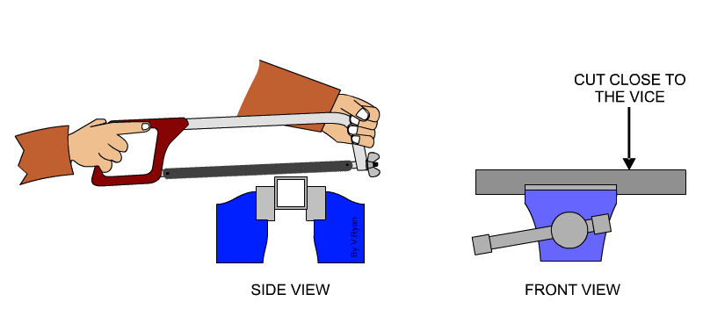
Bench Skills: Cutting
The Hacksaw
The main points to remember when setting up and using the hacksaw are:
Make sure the material is secure in the vice.
Grip your hacksaw as illustrated below.
Always saw with an even downward force/motion.
Cut as close to the jaws of the vice as you can.
Depending of the type and size of metal section it may heat up. Alleviate this with some oil.
The ‘Hacksaw’ is limited to a certain depth of cut unless the blade is adjusted. Do this by turning the angle of the blade using the pins and wing nut

Slide 5
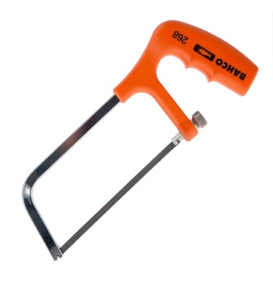
Bench Skills: Cutting
The Junior Hacksaw
The ‘Junior Hacksaw’ is used to cut smaller sections and is designed for use with one hand. The main points to note when choosing a junior hacksaw are :
Make sure it has a good blade. No blunt or missing teeth
Make sure the blade is fitted correctly. Teeth should point forward
Make sure the blade is tight.

Slide 6
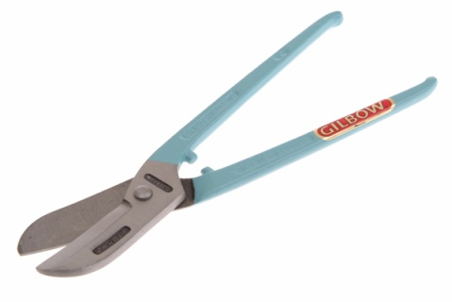
Bench Skills: Cutting
Tin Snips
‘Tin Snips’ are used to cut sheet metals. There are many types used for various jobs. The main types are ‘straight cut’ and ‘curved cut’. These come left and right handed. They can be used in your hand “like scissors” but it is easier to use them fixed in the vice.
Sheet metal edges can be razor sharp so when we are cutting and handling sheet materials we will be wearing safety gloves provided by your teacher.

Slide 7
Bench Skills: Cutting
The Guillotine / Bench Shears
The ‘Guillotine’ or ‘Bench Shear’ is primarily designed for cutting sheet metal (up to 4.8mm thick). However it can also be used to cut round or square/flat bar (up to 12.7mm diameter).
Being bench mounted and using a compound mechanism for increased mechanical advantage, means these are an effective way to cut metal in the workshop. However, they are not suited to delicate work.
HANDLE
LOCKING PIN
BLADE

Slide 8
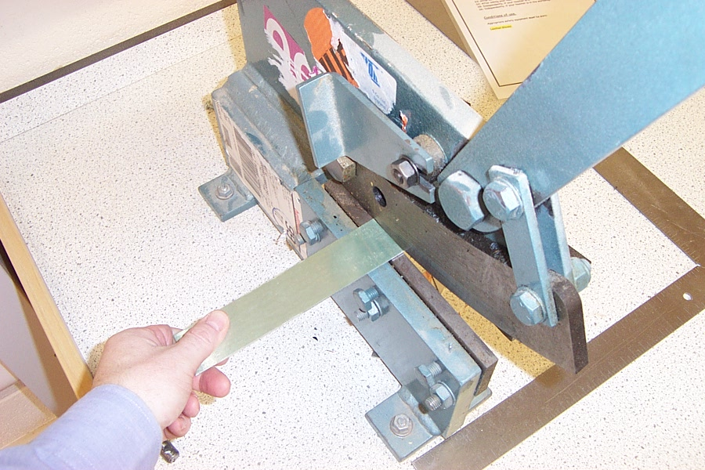
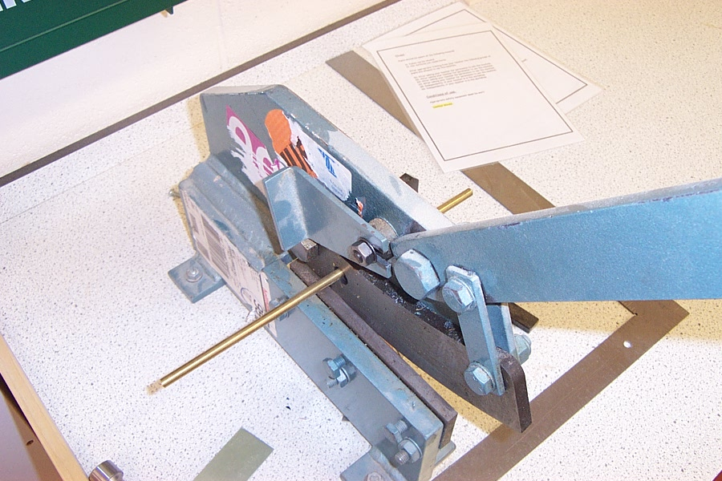
Bench Skills: Cutting
The Guillotine / Bench Shears
The Guillotine will cut metal sheet metal and bar.
Remember to keep your fingers well away from the blade when cutting metal!
The Guillotine can also be used to cut round bar. This is done by feeding the bar through the ‘Shear Hole’. This is the only way to cut bar using the Guillotine. If you try to cut with the normal shearing surface you will damage the Guillotine.

Slide 9
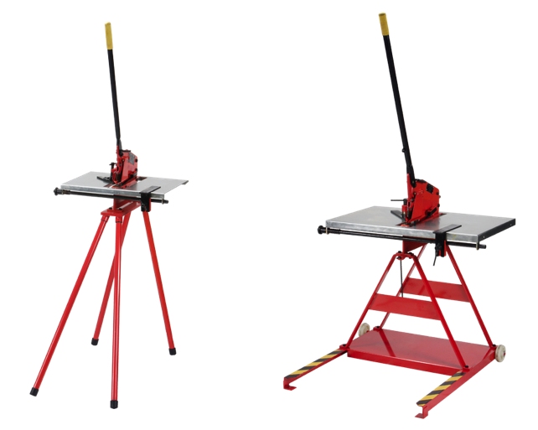
Bench Skills: Cutting
Gabro Guillotine / Notcher
The ‘Gabro’ guillotine also known as a ‘Notcher’ is another type of guillotine used to cut sheet metal. Conventional guillotines have a scissor action which distorts at least one of the cut edges, but the Gabro designed guillotines cut out a thin strip of metal leaving both edges undistorted and free from sharp burrs.
HANDLE
FENCE
GUARD

Slide 10
Bench Skills: Cutting
Gabro Guillotine / Notcher
Pupils should be aware of the following Hazards:
Closing movement between shearing surface and other parts can result in trapping and serious injury.
Sharp edges on cut material can cause cuts. (When carrying large sheets of metal wear gloves)
Lack of space around the guillotine can lead to the operator being pushed by passers by.
Slippery floor surface or loose items around the machine can cause slips that result in contact with moving parts.
Manual handling of sheet metal can present a hazard.
Conditions of use
Only one person is allowed to use this equipment at a time.

Slide 11
Quiz Questions 4.0
Record answers in your notes jotter
1. Name two things you should consider when selecting a hacksaw?
2. What should you do if the metal is heating up when cutting?
3. How should I saw when cutting with a hacksaw?
4. What are the two common types of tin snip?
What should you wear when handling sheet metal?
Name the two types of guillotine used in the metal workshop?
How do we cut round metal bar?
What is another name for a Gabro designed guillotine?

Slide 12
Quiz Questions 4.0
Record answers in your notes jotter
1. Name two things you should consider when selecting a hacksaw?
Blade damage, Type of teeth
2. What should you do if the metal is heating up when cutting?
Lubricate with oil
3. How should I saw when cutting with a hacksaw?
Even downward force
4. What are the two common types of tin snip?
Straight, Curved
What should you wear when handling sheet metal?
Gloves
6. Name the two types of guillotine used in the metal workshop?
Bench Shears and Gabro Guillotine
7. How do we cut round metal bar?
Use Shear Hole on Guillotine
8. What is another name for a Gabro designed guillotine?
Notcher

