Slide 1
National 5
Practical Metalworking
During the Practical Metalworking course you will develop skills, knowledge and understanding of:
Safe working practices in workshop environments
Metalworking Techniques
Measuring and marking out metal sections and sheet materials
Practical creativity and problem-solving skills
Sustainability issues in a practical metalworking context
Areas of study: Bench Skills / Machine Processes / Fabrication & Thermal Joining
Notes:
A short word on the course structure and areas of study.
Point out key knowledge and understanding A3 sheets on wall.

Slide 2
Practical Metalworking
National 5
Unit 1: Bench Skills
- Bench Tools

Slide 3
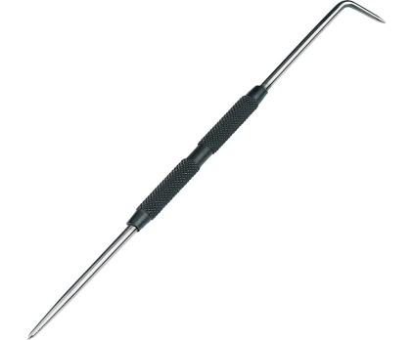
Bench Tools: Marking
It is vital to be very accurate when marking out metal in preparation for cutting, bending or forming metal. Engineers will work to strict tolerances, therefore many tools and techniques are used to ensure accuracy of work.
Scriber
The ‘Scriber’ is used to mark your metal.
‘Engineers Blue’ can be used to help make marks more visible when working. This is simply a heavily pigmented ink wash. A simple dry wipe marker will do for now!

Slide 4
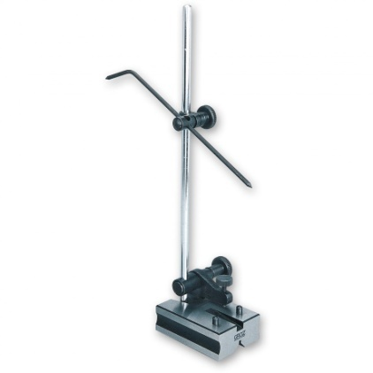
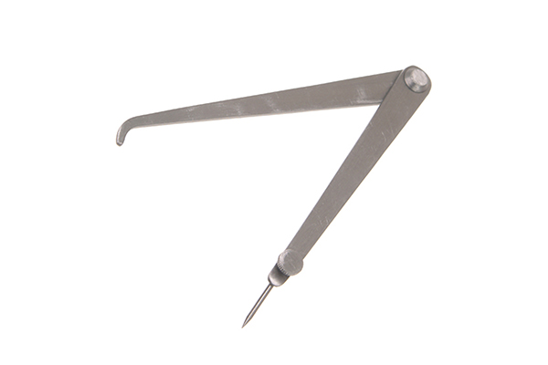
Bench Tools: Marking
Scribing Block
The ‘Scribing Block’ is used to help accuracy of marking. Especially useful when repeatedly marking the same size.
Odd Leg Calipers
The ‘Odd Leg Calipers’ are used to accurately mark lines parallel to an edge

Slide 5
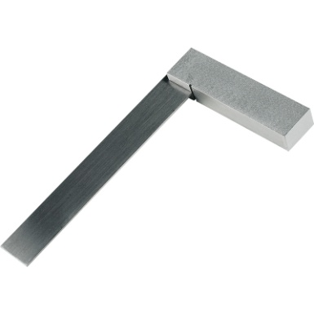
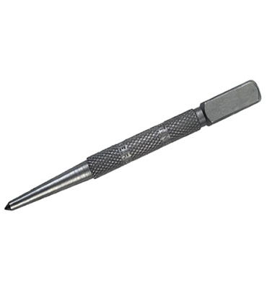
Bench Tools: Marking
Engineers Square
The ‘Engineers Square’ is the metalwork equivalent of the try-square. It has a steel blade inserted into a steel body at 90. A small notch or ‘relief’ is made in the corner of the square to prevent small particles from accumulating and affecting the reading.
o
Centre Punch
Made from High Carbon Steel, The ‘Centre Punch’ is used to mark centres of holes before drilling. It can also be used carefully for witness marking.

Slide 6
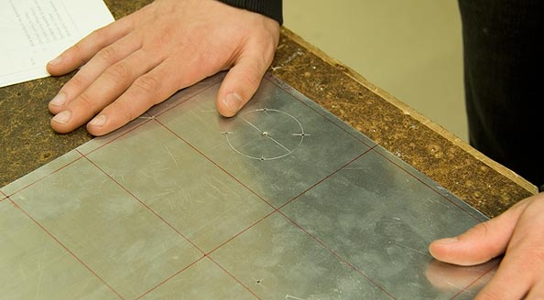
Bench Tools: Marking
Witness Marks
When lines have been scribed, they tend to fade due to exposure. This fading can be overcome by putting ‘witness marks’ along scribed lines. These traditionally are made with
dot punches (thinner version of a centre punch) but can also be done with a centre punch, so long as you vary the force applied. Just a tap!

Slide 7
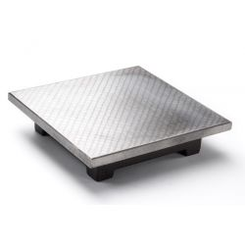
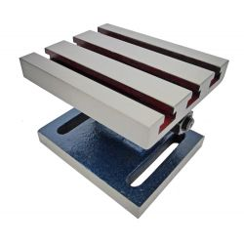
Bench Tools: Marking
Surface Table or Plate
A ’Surface Table’ or ‘Plate’ is a solid, flat surface used as the main horizontal reference plane for precision marking and inspection. The surface plate is often used as the baseline for all measurements to a work piece. Plates are typically square or rectangular. One current British Standard includes specifications for plates from 160 mm × 100 mm to 2500 mm × 1600 mm.

Slide 8
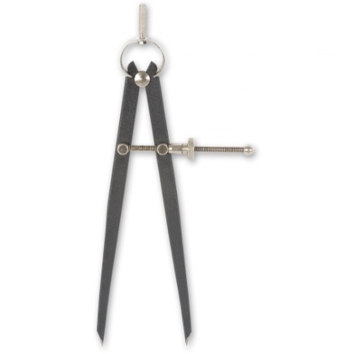
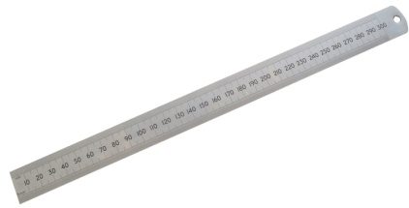
Bench Tools: Measuring
Spring Dividers
The ‘Spring Divider’ is used much like a compass would be on paper, it will mark a
radius on your material. It is good practice to use a centre punch before use.
Steel Rule
The 300mm (metric) ‘Steel Rule’ is used to accurately measure your material. We only measure in metric/mm but often a rule will
give imperial/inches.

Slide 9
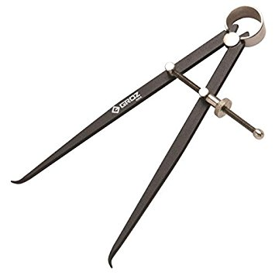
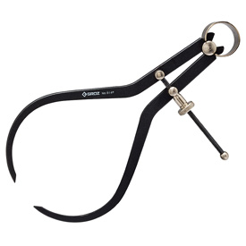
Bench Tools: Measuring
Inside Calipers
The ‘Inside Caliper’ measures inside diameters
of holes or pipe sections.
Outside Calipers
The ‘Outside Caliper’ measures the outside diameter of bar sections.
In both cases the ‘Vernier Gauge’ is far more accurate.

Slide 10
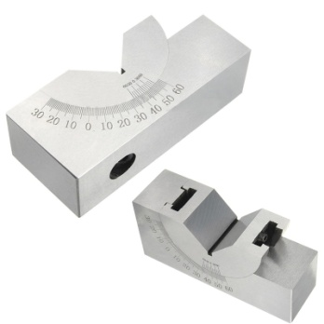
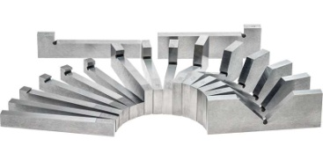
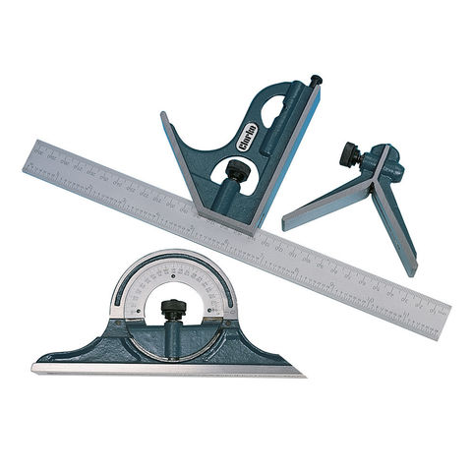
Bench Tools: Measuring
Set and Adjustable Angle Blocks
The ‘Angle Block’ is useful for drilling, milling and set up jobs where a particular angle to a reference face is required. Adjustable Angle Blocks allow the job to be held at any angle
0-60° for angular machining jobs.
Combination Set
The ‘Combination Set’ has multiple uses across metalworking, woodworking and stonemasonry.
It is composed of a ruled blade and several interchangeable heads (usually three) that may be affixed to it.

Slide 11
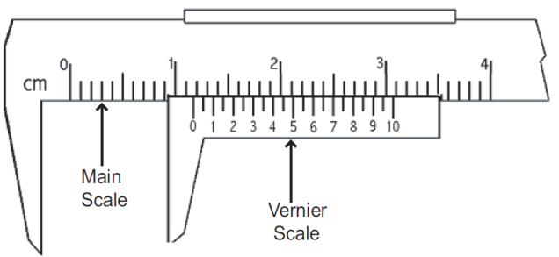
Bench Tools: Measuring
Vernier Gauge
The ‘Vernier Gauge’ is a very accurate tool as it uses the Vernier scale to read between the main scale increments. It can measure inside and outside diameters as well as hole depth.

Slide 12
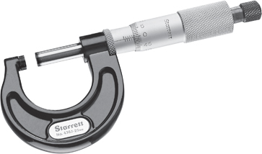
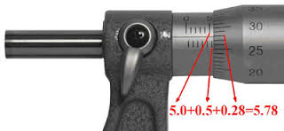
Bench Tools: Measuring
Micrometer
The ‘Micrometer’ is an extremely precise instrument that uses a finely calibrated screw to measure outside diameters.

Slide 13
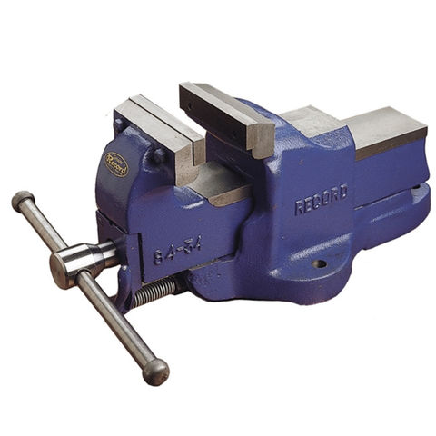
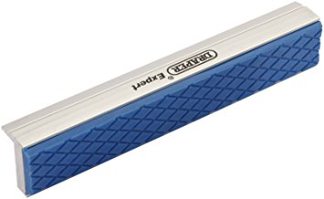
Bench Tools: Clamping
Engineer’s Vice
The ‘Engineer’s Vice’ is used to firmly secure
material when working. Remember, when not
in use the handle should not be tightened! This means it will not budge if you walk into it!
Soft Jaws
‘Soft Jaws’ can be used to protect material from surface scratches. These can occur due to the hard, grooved fixed jaws on the vice. Soft jaws will usually be made from nylon or soft metal
like Aluminium.

Slide 14
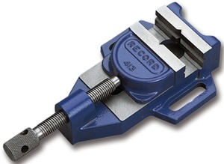
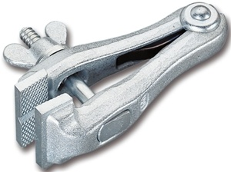
Bench Tools: Clamping
Machine Vice
The ‘Machine Vice’ is used to secure material when machining. This is mainly used at the
Pillar Drill and can be fixed to the bed/table of the drill.
Hand Vice
The ‘Hand Vice’ is used to secure small sections of material when working.

Slide 15
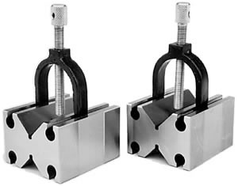
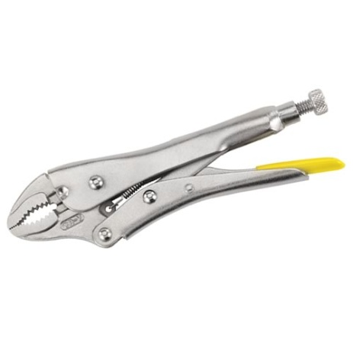
Bench Tools: Clamping
V - Block
The ‘V - Block’ is used to secure metal section when cutting, drilling or milling.
Mole Grips
‘Mole Grips’ are versatile and can be used to secure material during a number of different workshop operations.

Slide 16
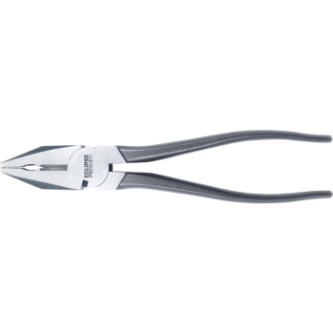
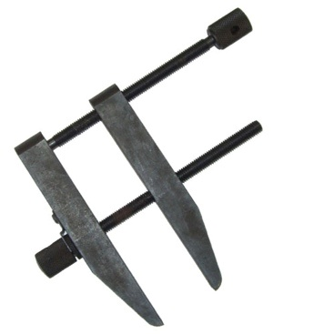
Bench Tools: Clamping
Engineers Pliers
‘Engineers pliers’ are Multi purpose pliers used for gripping small objects and cutting fine wire.
Toolmakers Clamp
The ‘Toolmakers clamp’ can be used to hold small pieces of work while working on them.

Slide 17
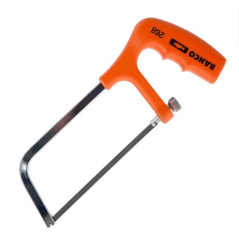
Bench Tools: Cutting
Hacksaw
The ‘Hacksaw’ is used to cut material of
various thicknesses.
Junior Hacksaw
The ‘Junior Hacksaw’ is used to cut smaller
sections of material.

Slide 18
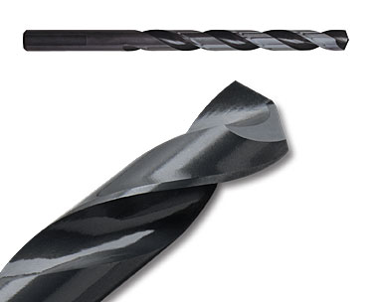
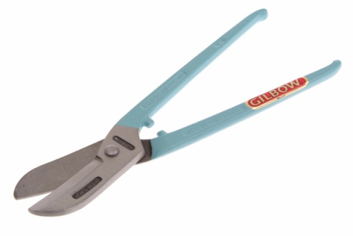
Bench Tools: Cutting
Drill Bits
The twist ‘Drill Bit’ used in the metal workshop is known as a high-speed steel (HSS) Twist Drill Bit and is characterised by it’s black colour. More expensive, durable bits may contain cobalt or be titanium coated.
Tin Snips
The ‘Tin Snips’ are used to cut sheet metals.
There are many types used for various jobs.
The main types are ‘straight cut’ and ‘curved cut’. These come left and right handed. For finer work a slimmer version called ‘jewellery snips’ can also be used.

Slide 19
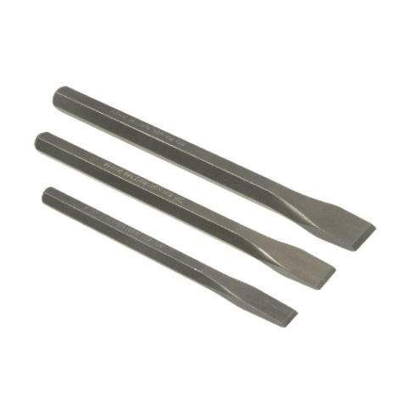
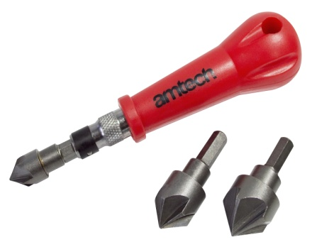
Bench Tools: Cutting
Cold Chisel
The ‘Cold Chisel’ is normally made from High Carbon Steel and is made in a variety of sizes.
These are used to cut metal but can be used
for brick and concrete.
Hand Countersink
The ‘Countersink’ can be used to remove the sharp burr from drilled holes.

Slide 20
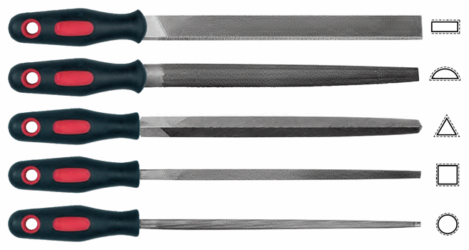
Bench Tools: Cutting
Files
The ‘File’ is used to cut, shape and finish metal.
The file comes in various shapes and cuts to suit different jobs.
The files ‘tang’ secures the file to the handle. Never use a file with a damaged or missing handle!
End Cutters
The ‘End cutters’ are used to cut rivets to
the desired length.

Slide 21
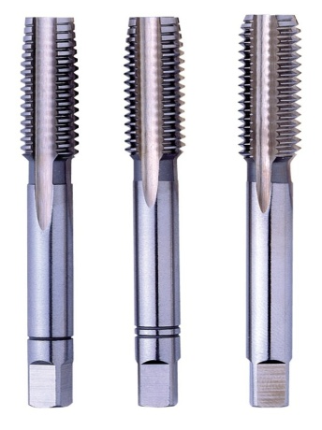
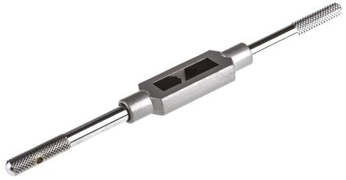
Bench Tools: Cutting
Taps
The ‘Tap’ is used when ‘Tapping’ a hole. This is the process of cutting a thread inside a hole so that a cap screw or bolt can be threaded into the hole. Taps are made from (HSS) and usually come in sets of three; Taper, Intermediate or Second and Plug Tap. These are used for different types of holes
The choice of Tap and the preparation of the hole is vital for the successful cutting of an internal thread. We will look at this in detail later.
Tap Wrench
The ‘Tap Wrench’ is used to secure and turn the Tap square to the work piece, ensuring proper alignment and an even thread. The clamp is opened to insert the tool and then tightened down against the tool to secure it.

Slide 22
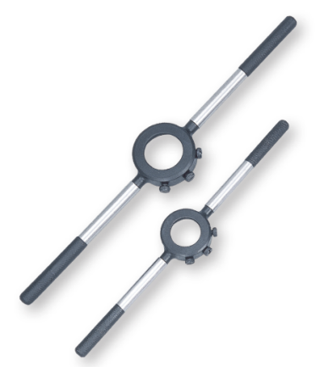
Bench Tools: Cutting
Dies
The ‘Die’ is used when ‘threading’ a bar. This is the process of cutting external screw threads, also known as male screw threads (e.g., a bolt). The Die can be round, hex, split or solid. The most commonly used, and the one we will use, is the round split die.
Both the Die and the Tap can be used to clean out existing threads, this is a process called ‘Chasing’.
Die Stock
The ‘Die Stock’ is used to secure and turn round and hex dies, ensuring proper alignment and a uniform thread. The Die is secured in the stock using three screws, two ‘locking’ screws on the outside and the ‘expanding’ screw in the middle.
We will look at the adjustment of the Die Stock in detail later on in the course.

Slide 23
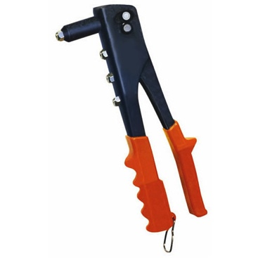
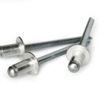
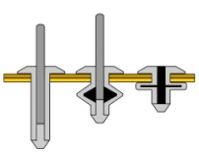
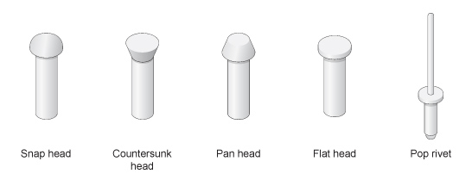
Bench Tools: Joining
Pop Rivet Pliers
Pop riveting is a technique that is used to join thin pieces of metal. The rivet has two parts; the pin and the rivet. The ‘Pop Rivet Pliers are used to pull the pin through the rivet and as this happens the rivet is deformed slightly so that it joins the metal.
Rivets
The ‘Rivet’ is a metal pin used to permanently join together two plates of metal, its headless end is beaten out or pressed down when in place. A rivet consists of a cylindrical shaft with a head on one end and the opposite end is called the tail.

Slide 24
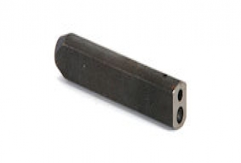
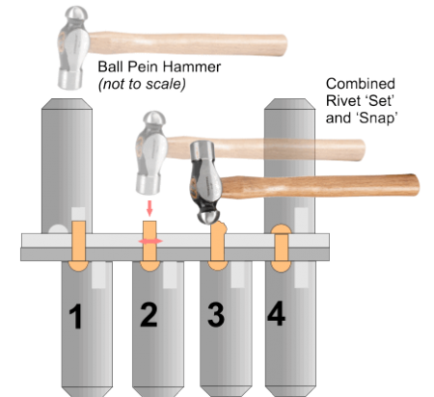
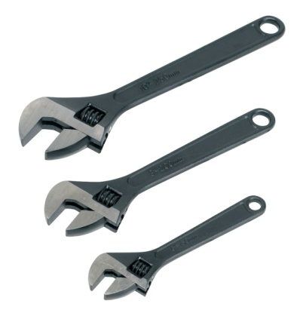
Bench Tools: Joining
Rivet Set & Snap
The ‘Rivet Set & Snap’ can be used when setting the rivet in place with the ‘set’ end.
The ‘snap’ end is used when forming the
head on the solid rivet.
Adjustable Spanner
The ‘Adjustable spanner’ will fit any nut/bolt up to 34mm in size. While an adjustable spanner
is a useful tool to have, it is preferable to use a normal spanner as it is less likely to round the corners of a nut/bolt.

Slide 25
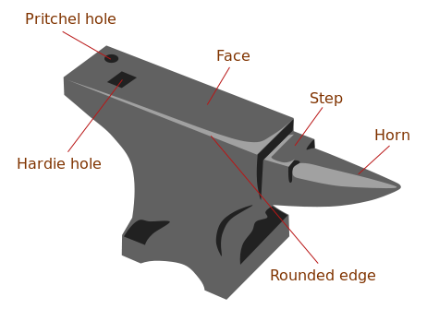
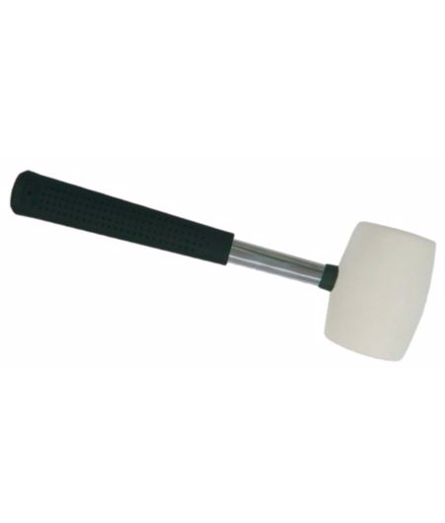
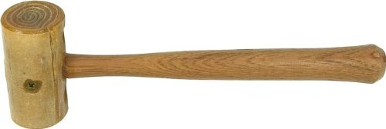
Bench Tools: Forming
Anvil
The ‘Anvil’ is a block of cast or forged steel. The very hard surfaces are used in many ways to strike and form metals. The better the quality of anvil the more efficiently it will cause the energy of the striking tool to be transferred to the work piece.
Rawhide or Rubber Mallet
The ‘Rawhide’ or the ‘Rubber’ mallet is a must in the metal workshop as it can be used to form and shape metal without leaving hammer marks.

Slide 26
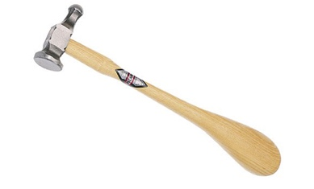
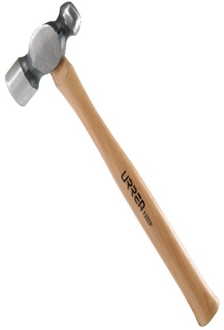
Bench Tools: Forming
Repousse Hammer
This ‘Repousse hammer’ (sometimes called a chasing hammer) is a great tool for forming and raising shapes from sheet metal. The word 'repousse' comes from the French verb meaning 'to push back' and it is one of the oldest metalsmithing techniques in the world.
Ball-Pein Hammer
The ‘Ball-Pein’ hammer, also known as the machinists hammer, was mainly used for ‘peening’ (the act of surface hardening by impact). Nowadays it is used for many tasks such as striking punches or and chisels. It is also used for rounding of edges and fasteners such as rivets.

Slide 27
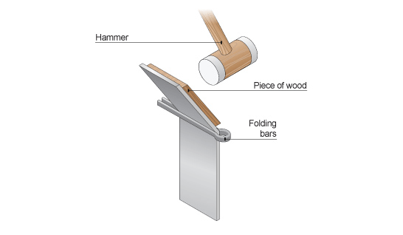
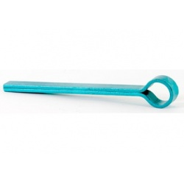
Bench Tools: Forming
Folding Bars
The ‘Folding Bars’ are used in conjunction with the vice to insure an accurate bend when working with sheet metal or thin plate. A rawhide mallet and a piece of wood should be used to protect the material from damage when working.

Slide 28
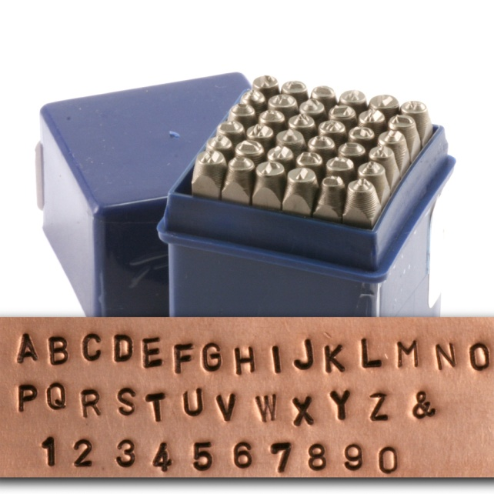
Bench Tools
Number & Letter Punches
The number & letter punches can be used to mark soft metals.
When using the letter stamps make sure that..
You are working on a hard surface (an anvil).
2. The lettering on the stamp is facing you.
3. Like with a centre punch, you strike the stamp with one firm blow.

Slide 29
Bench Tools
The Bench Grinder
The ‘Bench Grinder’ is a benchtop type of grinding machine used to drive abrasive wheels. These types of grinders are commonly used to hand grind various cutting tools and perform other rough grinding. Depending on the grade of grinding wheel, it may be used for sharpening cutting tools such as tools, drill bits, chisels, and gouges. Alternatively, it may be used to roughly shape metal prior to welding or fitting.
Also, a wire brush wheel or buffing wheel can be interchanged with the grinding wheel in order to clean or polish work pieces. Stiff buffing wheels can also be used when deburring.
Bench grinders are standard equipment in metal fabrication shops and machine shops, as are handheld grinders (such as angle grinders).

Slide 30
Quiz Questions 2.0
Record answers in your notes jotter
1. What can we use to help us see scribed lines?
2. What tool should I use before marking with the ‘Spring dividers’?
What is a characteristic of the drill bits used in the metal workshop?
4. What do we use the countersink bit for?
Name the tool I can use to mark a line parallel to an edge?
6. What is the name given to the handle insert on a file?
7. What sizes can I measure with the ‘Vernier gauge’?
8. Name four types of rivet.
What type of clamp should I use to secure long sections of bar when drilling?
10. What tool(s) should be used to form the head on a solid rivet?

Slide 31
Quiz Questions 2.0
Record answers in your notes jotter
1. What can we use to help us see scribed lines?
Engineers Blue
2. What tool should I use before marking with the ‘Spring dividers’?
Centre Punch
What is a characteristic of the drill bits used in the metal workshop?
Black in colour
4. What do we use the countersink bit for?
Remove Burr
Name the tool I can use to mark a line parallel to an edge?
Odd Leg Caliper
6. What is the name given to the handle insert on a file?
Tang
7. What sizes can I measure with the ‘Vernier gauge’?
Outside, inside diameters & Depth
8. Name four types of rivet.
Snap, Countersunk, Flat, Pop
What type of clamp should I use to secure long sections of bar when drilling?
V-Block
10. What tool(s) should be used to form the head on a solid rivet?
Set & Snap, Ball Pien Hammer

