Slide 1
National 5
Practical Metalworking
During the Practical Metalworking course you will develop skills, knowledge and understanding of:
Safe working practices in workshop environments
Metalworking Techniques
Measuring and marking out metal sections and sheet materials
Practical creativity and problem-solving skills
Sustainability issues in a practical metalworking context
Areas of study: Bench Skills / Machine Processes / Fabrication & Thermal Joining
Notes:
A short word on the course structure and areas of study.
Point out key knowledge and understanding A3 sheets on wall.

Slide 2
Practical Metalworking
National 5
Health & Safety In The Workshop

Slide 3
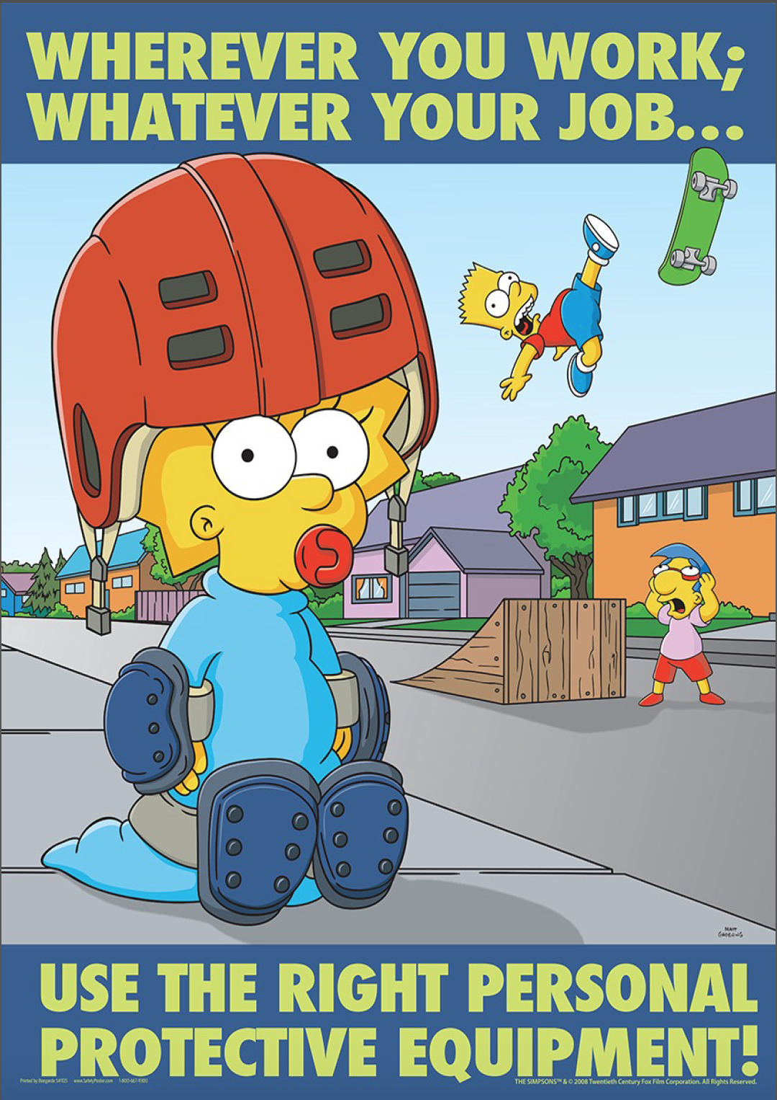
Workshop Rules and Precautions
The Practical Metalwork course requires pupils to consider, record and participate in good, safe working practices during all activities. Any miss-behaviour of any kind puts you and your class-mates in harms way. Therefore, such incidents will be taken very seriously and dealt with accordingly.
Pupils will always wear personal protective equipment (PPE) during various workshop activities. Apron, leather apron, safety specs, goggles, gloves, gauntlets visors and welding masks.
Pupils must wear safety specs and aprons AT ALL TIMES when in the workshop.
Always report if you feel unwell. It is important to be alert in the workshop.
Tie back hair and any loose clothing.
Aprons must always be tied at the back.
Absolutely no jewellery worn in the workshop.
No running in the workshop.
No food or drink in the workshop.
Report any oil and grease on floor immediately.
Always leave vice handle slack when not in use.
Always double check that material is secure when working.
Do not move around the workshop with sharp tools.
Wear suitable footwear when in workshop.
Ask teacher for help before lifting any heavy objects.
Always check tools/machinery before using them.
Report any damaged or broken tools/machinery immediately.
Always check appropriate guards are in place.
Always use the correct tool for the job.
Never leave the chuck key in the lathe.
Always keep a tidy work station.
If unsure, ask!
Notes:
Remind pupils that goggles must still be worn instead of or over specs when drilling etc
Vice should be slack when not in use so it will move if someone bumps into it

Slide 4
Workshop Rules and Precautions
Notes:
Remind pupils that goggles must still be worn instead of or over specs when drilling etc
Vice should be slack when not in use so it will move if someone bumps into it

Slide 5
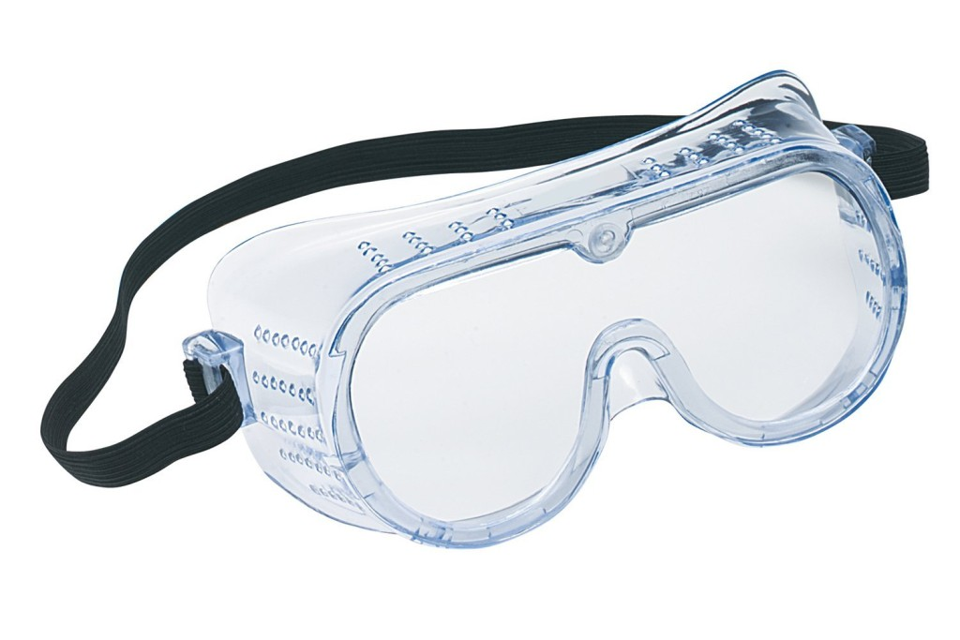
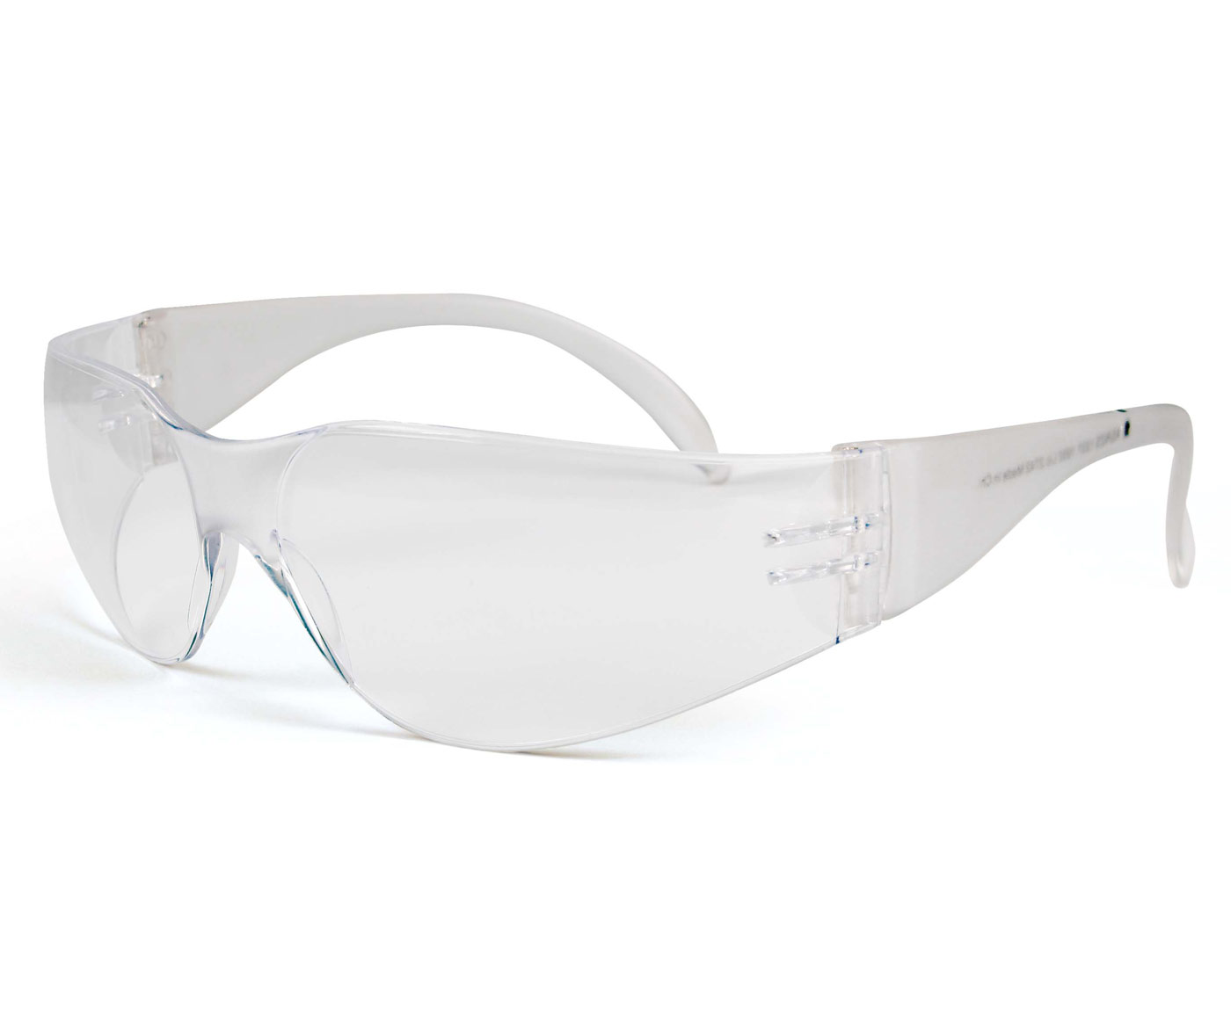
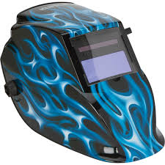
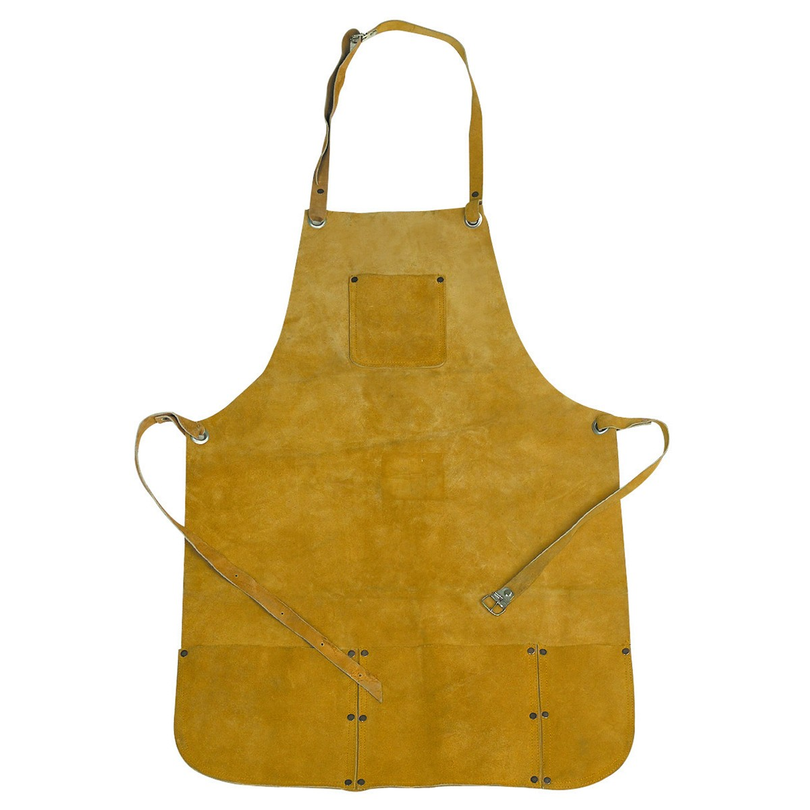
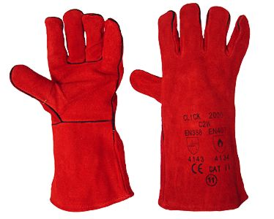
Workshop Rules and Precautions
Safety Specs & Goggles
PPE
Welding Mask
Standard Apron &
Leather Apron
Gauntlets
Notes:
Remind pupils that goggles must still be worn instead of or over specs when drilling etc
Vice should be slack when not in use so it will move if someone bumps into it

Slide 6
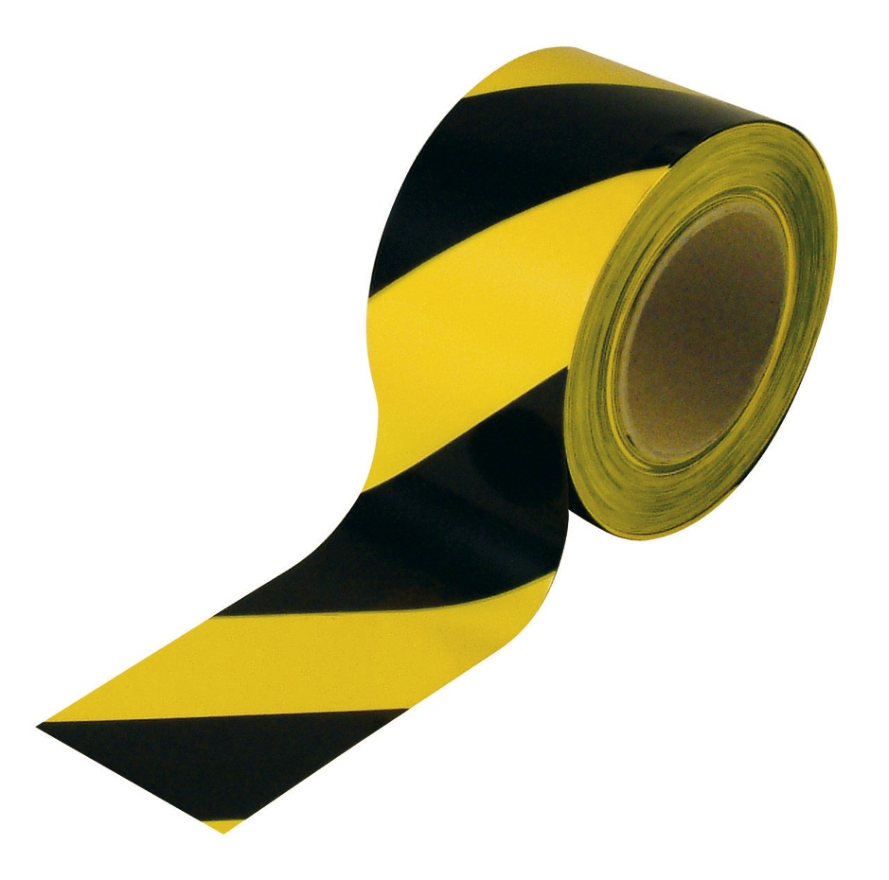
Workshop Rules and Precautions
When in the workshop remember to watch out for areas or items marked with black and yellow ‘DANGER’ tape. This is used to cordon off areas where machinery is used or anywhere there is a potential hazard.
Notes:
Remind pupils that goggles must still be worn instead of or over specs when drilling etc
Vice should be slack when not in use so it will move if someone bumps into it

Slide 7
Now your teacher will go over the Design Technology departments Health and Safety Contract. This MUST be signed by all pupils before any practical work can be undertaken.

