Slide 1
Manufacturing
processes

Slide 2

CNC Machining
CNC = Computer Numerically Controlled.
A computer converts the design produced by Computer Aided Design software (CAD), into numbers.
The numbers can be considered to be the coordinates of a graph and they control the movement of the cutter.
In this way the computer controls the cutting and shaping of the material.

Slide 3
Advantages
Much faster than human operators
Much more accurate than human operators
Can run 24 hours a day without a break – increased productivity
Thousands of identical items can be produced – no waste due to error
Less skilled/ trained people can operate CNC machines compared to manual lathes which need skilled engineers
One person can supervise multiple machines as they are normally left to run once they are programmed

Slide 4
Disadvantages
Initial set up costs of software and machinery
Cost of maintenance and software updates
Fewer operators needed – potential loss of employment
Loss of manual engineering skills

Slide 5

Laser Cutting
  Laser cutting is a technology that uses a laser to cut materials, and is typically used for industrial manufacturing applications.
  Laser cutting works by directing the output of a high-power laser most commonly through optics.
  The laser optics and CNC are used to direct the material or the laser beam generated.
  The focused laser beam is directed at the material, which then either melts, burns, vaporizes away, or is blown away by a jet of gas, leaving an edge with a high-quality surface finish.
  Industrial laser cutters are used to cut flat-sheet material as well as structural and piping materials.

Slide 6
Plasma Cutting
What is plasma?
In its simplest terms, plasma is the fourth state of matter. We commonly think of matter having three states: a solid, a liquid, and a gas. Matter changes from one state to the other through the introduction of energy, such as heat.
Example:
Water will change from a solid (ice) to a liquid when a it is heated. More heat causes it to change to a gas (steam). Now, if the heat levels increase again, the gases that make up the steam will become ionized and electrically conductive, becoming plasma.

Slide 7

  Plasma cutter uses this electrically conductive gas to transfer energy from a power supply to any conductive material, resulting in a cleaner, faster cutting process.
  The plasma arc formation begins when a gas such as oxygen, nitrogen, argon, or even shop air is forced through a small nozzle inside the torch.
  An electric arc generated from the external power supply is then introduced to this high pressured gas flow, resulting in what is commonly referred to as a “plasma jet”. The plasma jet immediately reaches temperatures up to 40,000° F, quickly piercing through the work piece and blowing away the molten material.

Slide 8
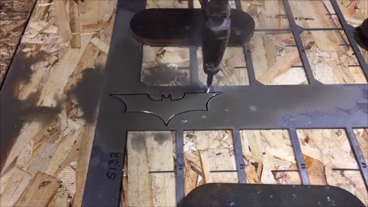
Water-jet Cutting
  Process involves using a jet of highly pressurised water (60,000 pounds per square inch – PSI)
  Water is mixed with an abrasive which enables materials to be cut cleanly to close tolerances, squarely and with a good edge finish.
  Capable of cutting many industrial materials including stainless steel, titanium, aluminium, tool steel, ceramics, granite, and armor plate.
  Generates significant noise.

