Slide 1
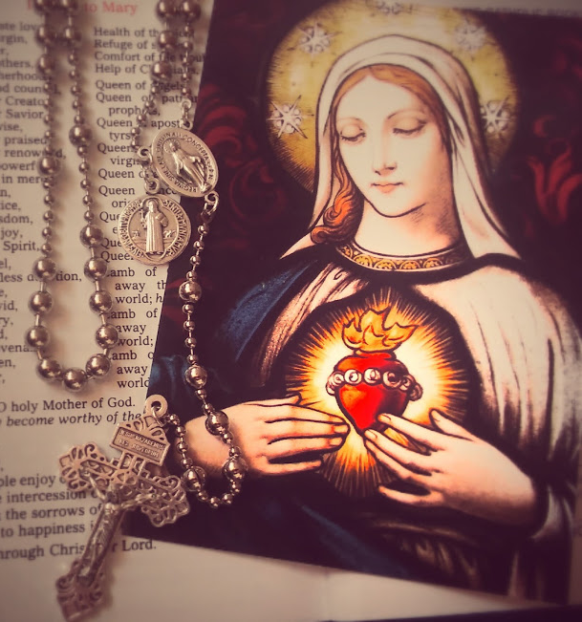
The Holy Rosary
Turnbull High School

Slide 2
The Most Holy Rosary of the Blessed Virgin Mary is a method of prayer that was given to the Church by Our Lady herself and that has been reinforced by her in every approved apparition. Although comprised of the vocal prayers, Our Father, Hail Mary and Glory Be, the Rosary is primarily a means to meditate on the mysteries and events of the life of Jesus and Mary. Whilst praying the vocal prayers we enter into mental prayer as we focus on each scene from the life of Christ.
Introduction
Notes:
Pope Leo XIII named October as the Month of the Holy Rosary. Every time we renew our school consecration, one of the things we promise is to be more devoted to praying the rosary.

Slide 3
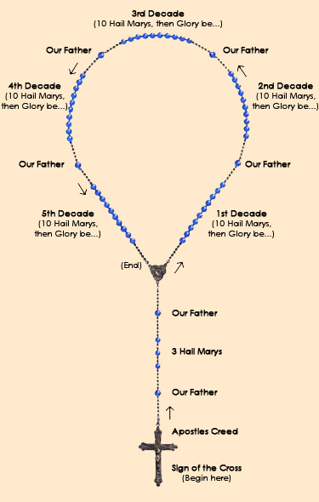
Rosary beads are used to help us focus and keep our place.
See the picture to understand the geography of the beads and the prayers associated with each one. The initial three ‘Hail Mary’ beads are for an increase in the virtues of Faith, Hope and Charity.

Slide 4
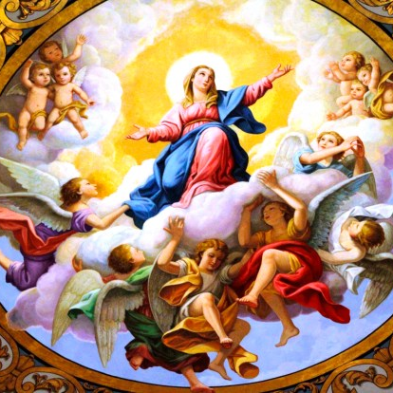
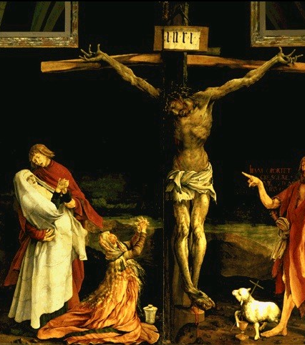
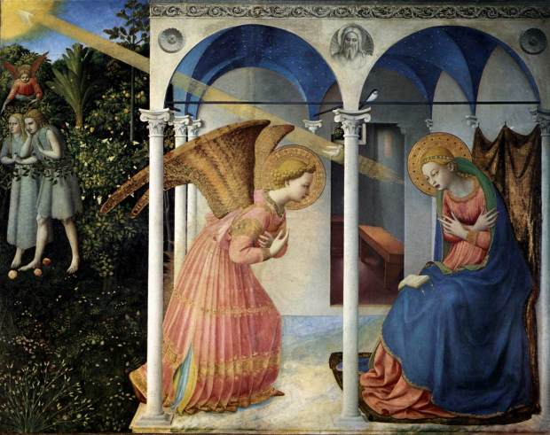
Sorrowful Mysteries
Joyful
Mysteries
Glorious Mysteries
Notes:
This resource focuses on the Three set of Mysteries that Our Lady gave to St Dominic. She called the Rosary 'Her Paslter' because for the 150 psalms for the Old Testament which prefigured the Messiah, She gives 150 Hail Marys which meditate on the New Testament.

Slide 5
1. The Annunciation
Things to meditate on:
Mary said Yes to God. How can I say Yes to God.
Jesus was present in Mary's womb. Jesus is present in my heart when I receive Him in Holy Communion
Notes:
Luke 1:26-31
26 And in the sixth month, the angel Gabriel was sent from God into a city of Galilee, called Nazareth,27 To a virgin espoused to a man whose name was Joseph, of the house of David; and the virgin’s name was Mary.28 And the angel being come in, said unto her: Hail, full of grace, the Lord is with thee: blessed art thou among women.29 Who having heard, was troubled at his saying, and thought with herself what manner of salutation this should be.30 And the angel said to her: Fear not, Mary, for thou hast found grace with God.31 Behold thou shalt conceive in thy womb, and shalt bring forth a son; and thou shalt call his name Jesus.32 He shall be great, and shall be called the Son of the most High; and the Lord God shall give unto him the throne of David his father; and he shall reign in the house of Jacob for ever.33 And of his kingdom there shall be no end.

Slide 6
2. The Visitation
Things to meditate on:
St John leapt for joy when he recognised the presence of Jesus. Do we recognise Jesus' presence?
Mary sang a song of thanksgiving. What do I want to thank Him for?
Notes:
Luke 1:39-45
39 And Mary rising up in those days, went into the hill country with haste into a city of Juda.40 And she entered into the house of Zachary, and saluted Elizabeth.41 And it came to pass, that when Elizabeth heard the salutation of Mary, the infant leaped in her womb. And Elizabeth was filled with the Holy Ghost:42 And she cried out with a loud voice, and said: Blessed art thou among women, and blessed is the fruit of thy womb.43 And whence is this to me, that the mother of my Lord should come to me?44 For behold as soon as the voice of thy salutation sounded in my ears, the infant in my womb leaped for joy.45 And blessed art thou that hast believed, because those things shall be accomplished that were spoken to thee by the Lord.

Slide 7
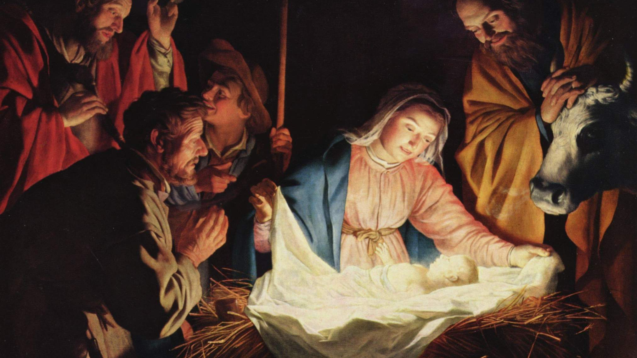
3. The Nativity
Things to meditate on:
Jesus left the glory of Heaven to enter our humanity.
Jesus came as a helpless baby. God can do amazing things through us even though we are weak.
Notes:
Luke 2:6-7
6 And it came to pass, that when they were there, her days were accomplished, that she should be delivered.7 And she brought forth her firstborn son, and wrapped him up in swaddling clothes, and laid him in a manger; because there was no room for them in the inn.

Slide 8
4. The Presentation of Jesus in the Temple
Things to meditate on:
Mary and Joseph were quick to take Jesus to the Temple to give thanks.
Am I always ready to show my love of God by going to Church and receiving the Sacraments?
Notes:
Luke 2:22-24
And after the days of her purification, according to the law of Moses, were accomplished, they carried him to Jerusalem, to present him to the Lord:23 As it is written in the law of the Lord: Every male opening the womb shall be called holy to the Lord:24 And to offer a sacrifice, according as it is written in the law of the Lord, a pair of turtledoves, or two young pigeons:

Slide 9
5. The Finding of Jesus in the Temple
Things to meditate on:
Jesus was found in His Father's House. Can we be found doing God's work?
We can pray that all people find Jesus in the Temple of the Church
Notes:
Luke 2:46-49
46 And it came to pass, that, after three days, they found him in the temple, sitting in the midst of the doctors, hearing them, and asking them questions.47 And all that heard him were astonished at his wisdom and his answers.48 And seeing him, they wondered. And his mother said to him: Son, why hast thou done so to us? behold thy father and I have sought thee sorrowing.49 And he said to them: How is it that you sought me? did you not know, that I must be about my father’s business?

Slide 10
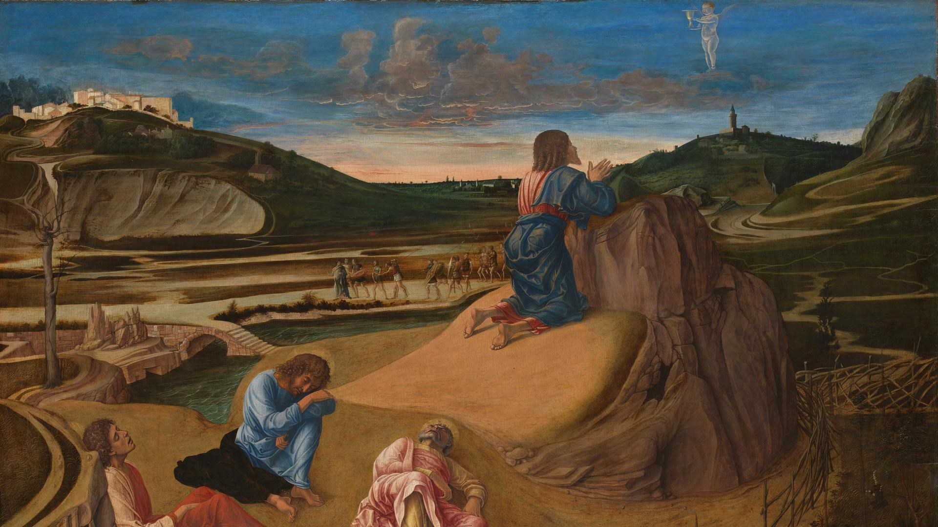
1. The Agony in the Garden
Things to meditate on:
Jesus could turn away from his difficult calling but He is brave and seeks to do God's will.
How can I do this?
Notes:
Matthew 26:36-39
36 Then Jesus came with them into a country place which is called Gethsemani; and he said to his disciples: Sit you here, till I go yonder and pray.37 And taking with him Peter and the two sons of Zebedee, he began to grow sorrowful and to be sad.38 Then he saith to them: My soul is sorrowful even unto death: stay you here, and watch with me.39 And going a little further, he fell upon his face, praying, and saying: My Father, if it be possible, let this chalice pass from me. Nevertheless not as I will, but as thou wilt.

Slide 11
2. The Scourging at the Pillar
Things to meditate on:
We sometimes suffer in different ways. Jesus understands because He suffered for us.
How should we live if Jesus suffered for us?
Notes:
Matthew 27:25-26
25 And the whole people answering, said: His blood be upon us and our children.26 Then he released to them Barabbas, and having scourged Jesus, delivered him unto them to be crucified.
Matthew 27:25-26
25 And the whole people answering, said: His blood be upon us and our children.26 Then he released to them Barabbas, and having scourged Jesus, delivered him unto them to be crucified.

Slide 12
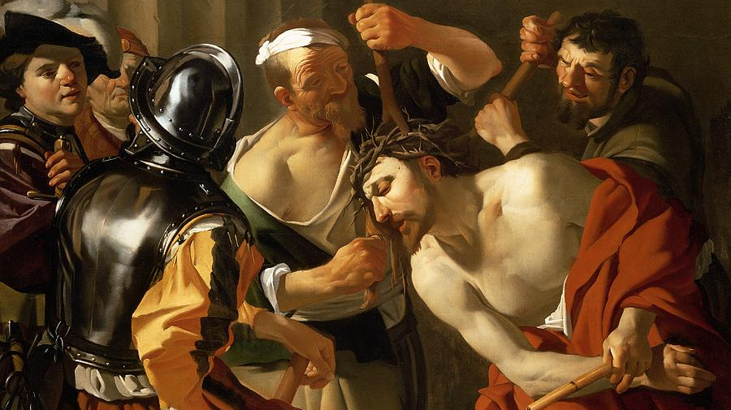
3. The Crowning with Thorns
Things to meditate on:
Jesus was mocked. Where He once wore a crown of glory, He was forced to wear a crown of thorns.
Sometimes we might be mocked for our faith. We should be brave because Jesus is with us.
Notes:
Matthew 27:28-29
28 And stripping him, they put a scarlet cloak about him.29 And platting a crown of thorns, they put it upon his head, and a reed in his right hand. And bowing the knee before him, they mocked him, saying: Hail, king of the Jews.

Slide 13
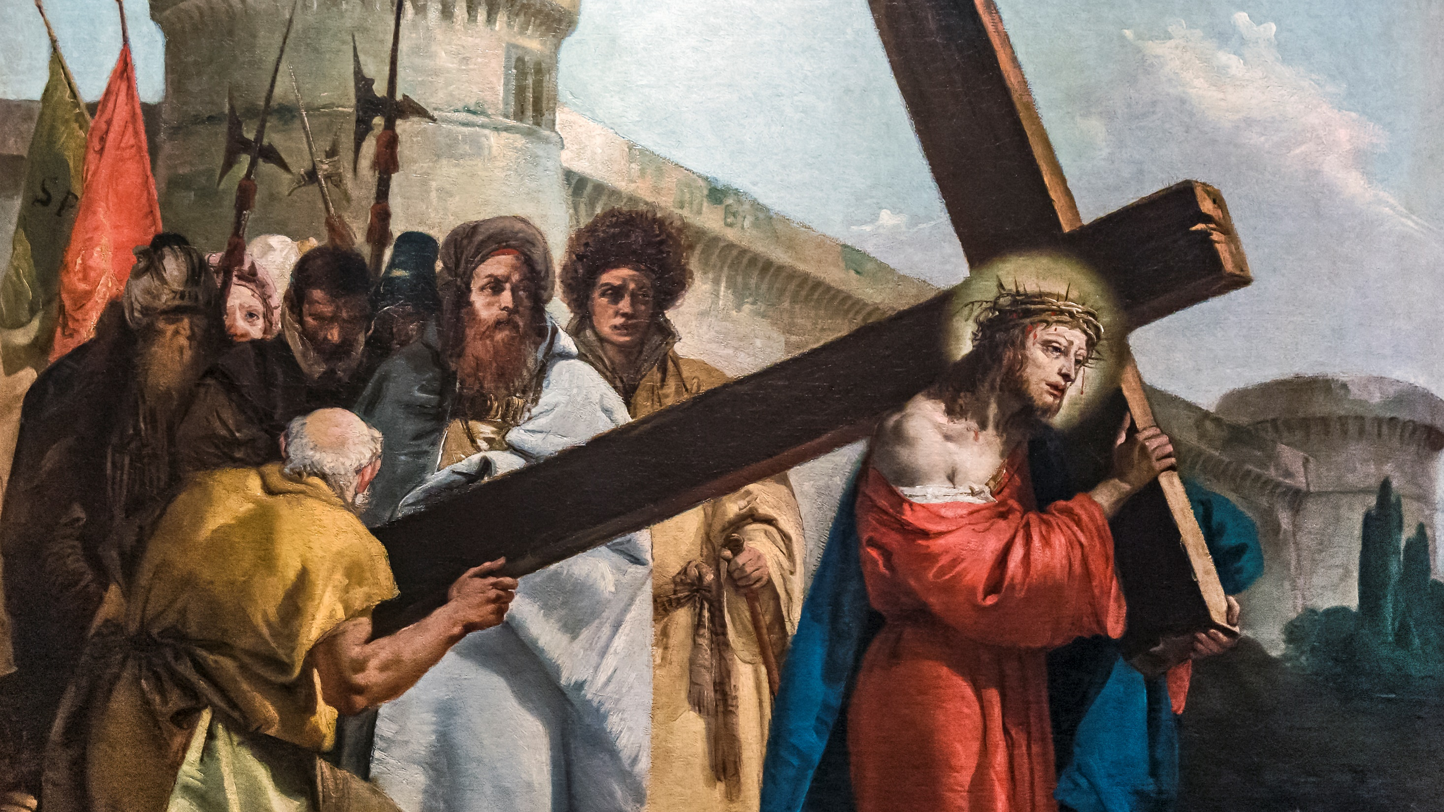
4. Jesus Carries the Cross
Things to meditate on:
Jesus had to carry the cross out of the city. Jesus said that we would have crosses to carry too.
What are my crosses? How can I carry them with Jesus?
Notes:
John 19:12-18
12 And from henceforth Pilate sought to release him. But the Jews cried out, saying: If thou release this man, thou art not Caesar’s friend. For whosoever maketh himself a king, speaketh against Caesar.13 Now when Pilate had heard these words, he brought Jesus forth, and sat down in the judgment seat, in the place that is called Lithostrotos, and in Hebrew Gabbatha.14 And it was the parasceve of the pasch, about the sixth hour, and he saith to the Jews: Behold your king.15 But they cried out: Away with him; away with him; crucify him. Pilate saith to them: Shall I crucify your king? The chief priests answered: We have no king but Caesar.16 Then therefore he delivered him to them to be crucified. And they took Jesus, and led him forth.17 And bearing his own cross, he went forth to that place which is called Calvary, but in Hebrew Golgotha.18 Where they crucified him, and with him two others, one on each side, and Jesus in the midst.

Slide 14
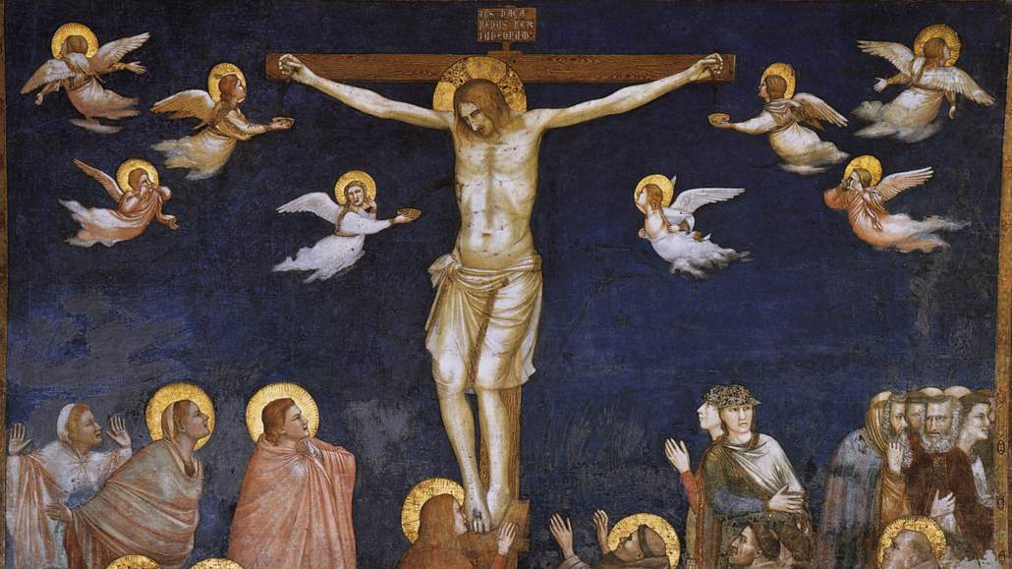
5. The Crucifixion and Death of Jesus
Things to meditate on:
On the cross, Jesus shows just how much He loves us. He was willing to sacrifice Himself to bring us back to God.
Let's ask Jesus for forgiveness of our sins
Notes:
Luke 23:45-46
45 And the sun was darkened, and the veil of the temple was rent in the midst.46 And Jesus crying out with a loud voice, said: Father, into thy hands I commend my spirit. And saying this, he gave up the ghost.

Slide 15
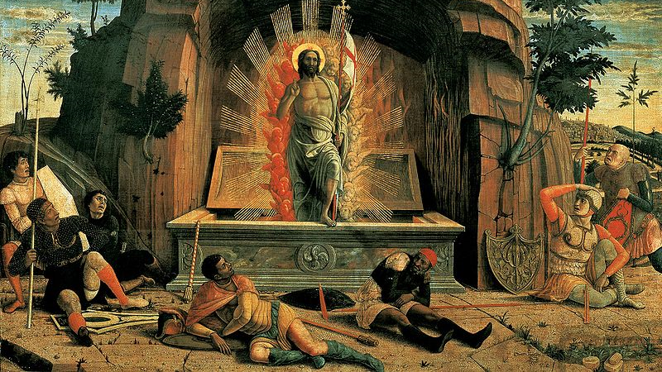
1. The Resurrection
Things to meditate on:
Jesus did not only die for us but He defeated death and opened the way for those who follow Him to have eternal life.
Notes:
Mat 28:5-6
5 And the angel answering, said to the women: Fear not you; for I know that you seek Jesus who was crucified.6 He is not here, for he is risen, as he said. Come, and see the place where the Lord was laid.

Slide 16
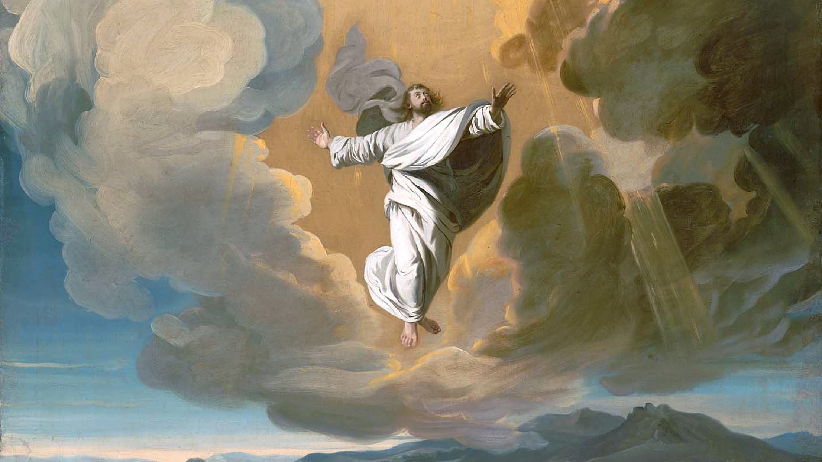
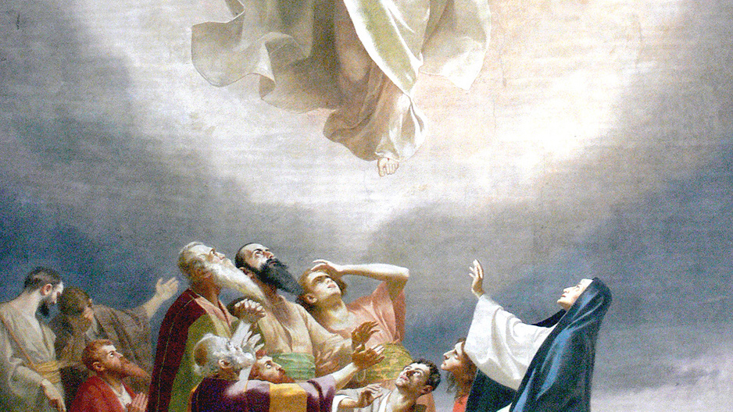
2. The Ascension of Jesus into Heaven
Things to meditate on:
Before He ascended into Heaven, Jesus said to His Apostles 'I will be with you until the end of time.'
Jesus is with us in everything we do. We should serve Him with courage.
Notes:
Luke 24:50-51
50 And he led them out as far as Bethania: and lifting up his hands, he blessed them.51 And it came to pass, whilst he blessed them, he departed from them, and was carried up to heaven.

Slide 17
3. The Descent of the Holy Spirit at Pentecost
Things to meditate on:
Jesus promised the Holy Spirit who came at Pentecost.
Do we use the gifts of the Holy Spirit that were given to us at confirmation?
Notes:
Acts 2:1-4
2 And when the days of the Pentecost were accomplished, they were all together in one place:2 And suddenly there came a sound from heaven, as of a mighty wind coming, and it filled the whole house where they were sitting.3 And there appeared to them parted tongues as it were of fire, and it sat upon every one of them:4 And they were all filled with the Holy Ghost,

Slide 18
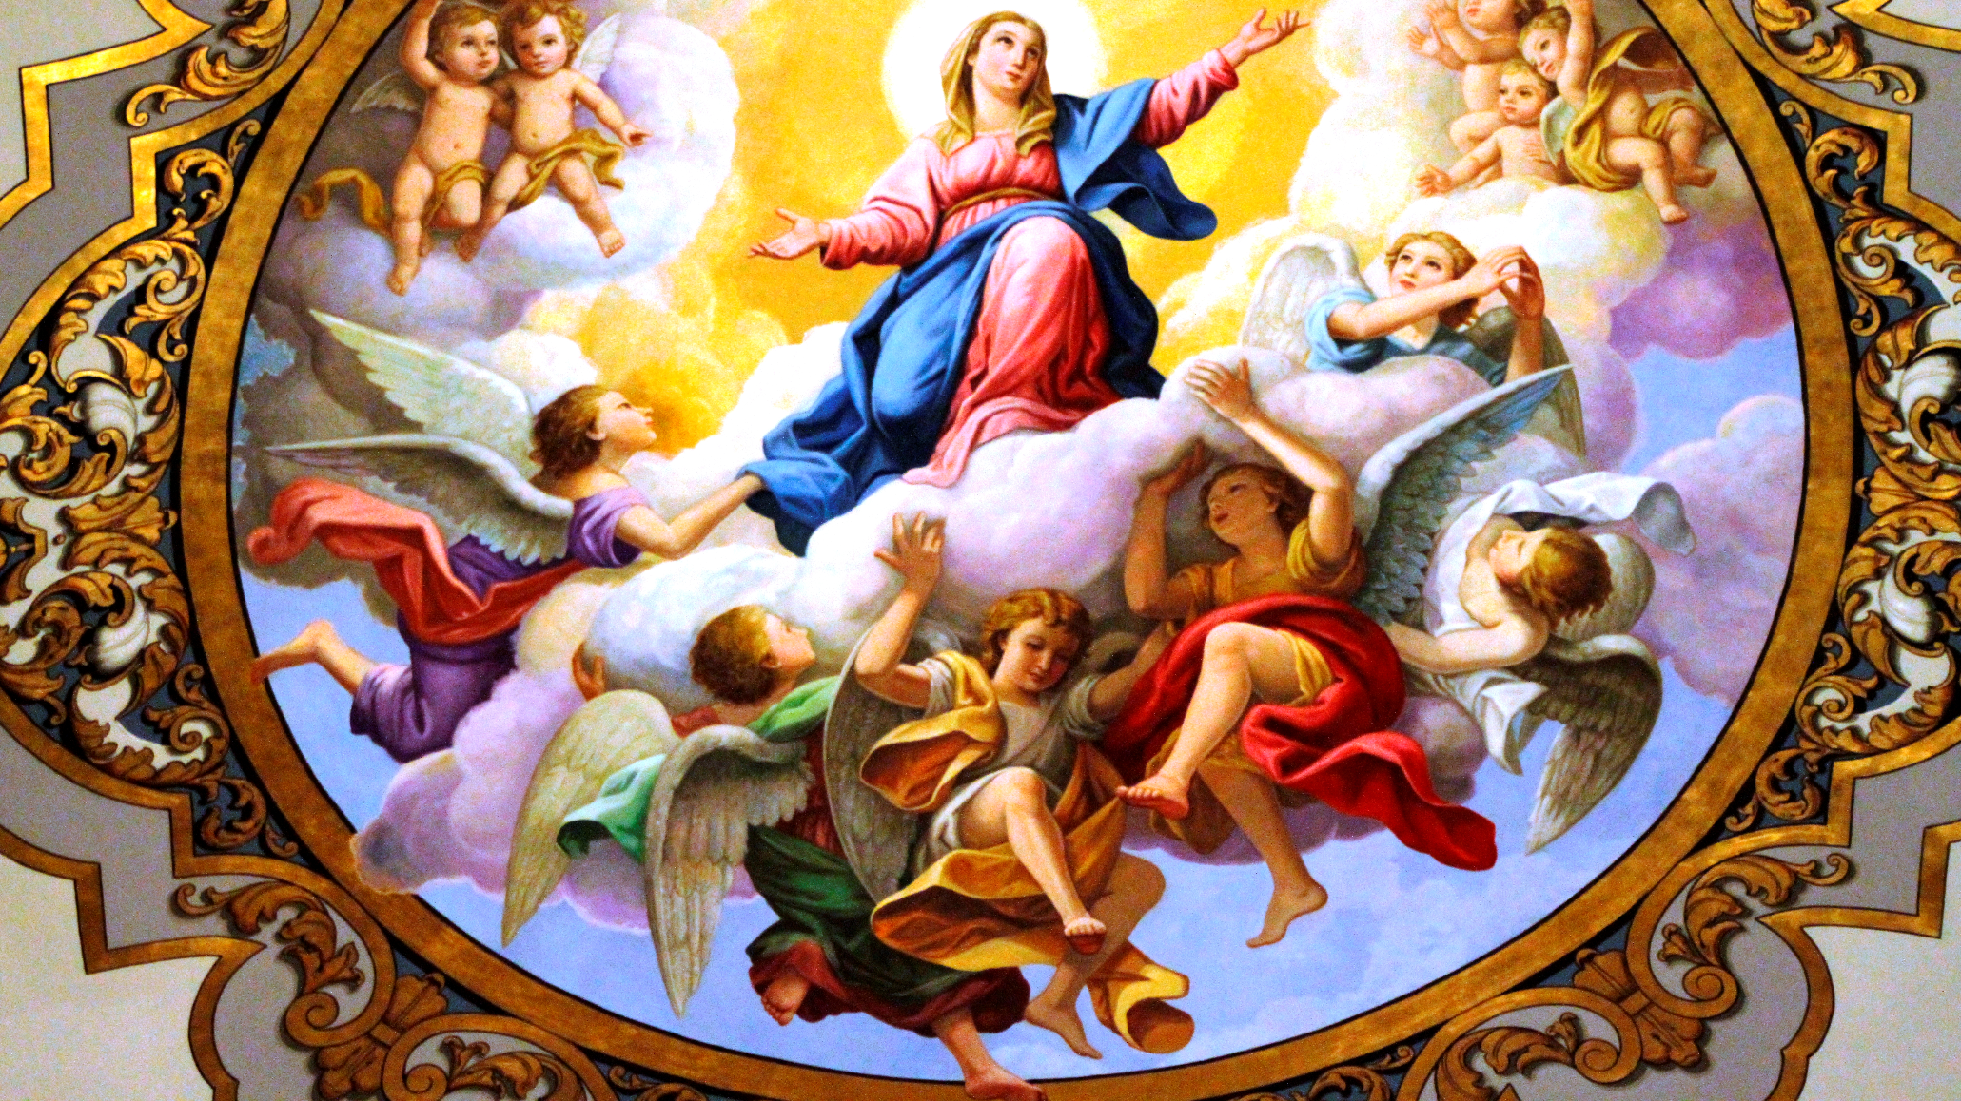
4. The Assumption of Our Lady into Heaven
Things to meditate on:
Jesus promised eternal life to those who follow Him. Our Lady is proof.
How can we follow Her example and join Her in haven one day?
Notes:
1 Kings 2:19
…and a throne was set for the king’s mother, and she sat on his right hand.

Slide 19
5. The Coronation of the Blessed Virgin
Things to meditate on:
Our Lady was crowned as Queen of Heaven and intercedes for us there.
Let's entrust ourselves to Her as we follow Jesus.
Notes:
Apocalypse 11:19-12:1
19 And the temple of God was opened in heaven: and the ark of his testament was seen in his temple, and there were lightnings, and voices, and an earthquake, and great hail.12 And a great sign appeared in heaven: A woman clothed with the sun, and the moon under her feet, and on her head a crown of twelve stars:

